Slide 1
Predicting Sales for ABC {
BMAN73701
Table
“using ‘Python’”:
{ by: “Bansi Kamani” }
}
Date: 6th December, 2023

Slide 2

if Higher Prediction:
Introduction
Objective
ABC, a leading South American retailer, seeks to enhance sales predictions for optimal inventory management and improved customer satisfaction.
Challenge:
not able to strike the right balance at ABC store as :
“Overstock of perishable goods”
elif Lower Prediction:
“Lost revenue share
Dissatisfied customers”
Picture reference: https://medium.com/@benjaminmckean/how-ai-is-changing-grocery-shopping-forever-2a531828960dog6qx8PGCAxV5ticCHQxLCL0Qr4kDegQIARBX
1
Notes:
The problem statement was to enhance the sales prediction for South American retailer ABC to improve inventory management, and the challenge the company faced was that they were not able to strike the right balance between supply and demand using predictions. If the value predicted is on the higher side, then the company end up with an overstock of goods, and if the predicted value is on the lower side, then it will lead to a loss of revenue and dissatisfaction in customers as they were not able to buy their desired products.

Slide 3
Goal;
Introduction
Objective
< “Predict sales for each product type in each store from July 31st 2017 to August 15th 2017” >
2

Slide 4
ABC's current approach: Subjective forecasting and limited data
Background
Data description
Case of ABC grocery retailers in South America:
Lack of automation in execution
Minimal data support
New Approach: Precise methodology using ML
3
Notes:
The particular case with ABC is that there is a lack of automation and execution and minimal data to support decisions. The current approach is more inclined towards subjective forecasting, which leads to inefficient predictions. Counter to this, we are using precise Machine Learning methodologies to give objective predictions.

Slide 5
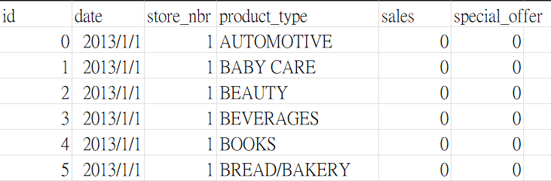
Data Description
Background
Data description
# date: the date of this dataset
# store_nbr: the indicator number of stores, with 54 distinct store numbers
# product_type: the type of the product for sale, covered 33 product types
# sales: the total sales for a specific product type
# special_offer: the strength of the promotion
4

Slide 6
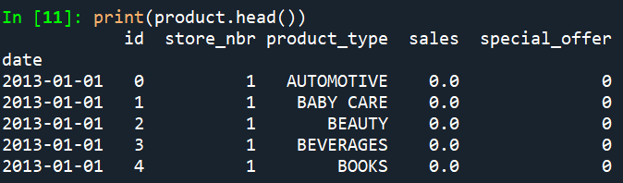
Data Pre-Processing
Data description
Data Pre-Processing
Handling Missing Values
Check the missing values using 'isnull().sum()' to count missing values in each column ​
Data Transformation
Converted the 'date' column to datetime format using 'pd.to_datetime()'
Check for Updated Processing
Data Saving: Saved the processed data into a CSV file
5
Notes:
First, we check if there is any missing value in the dataset.
Then we transform the ’date’ column to datetime and put it in the index column.
This the head of our processed data, you can see that the index column is the date and follow by id, store num…
The last step of pre-processing is to save the data in a CSV file

Slide 7
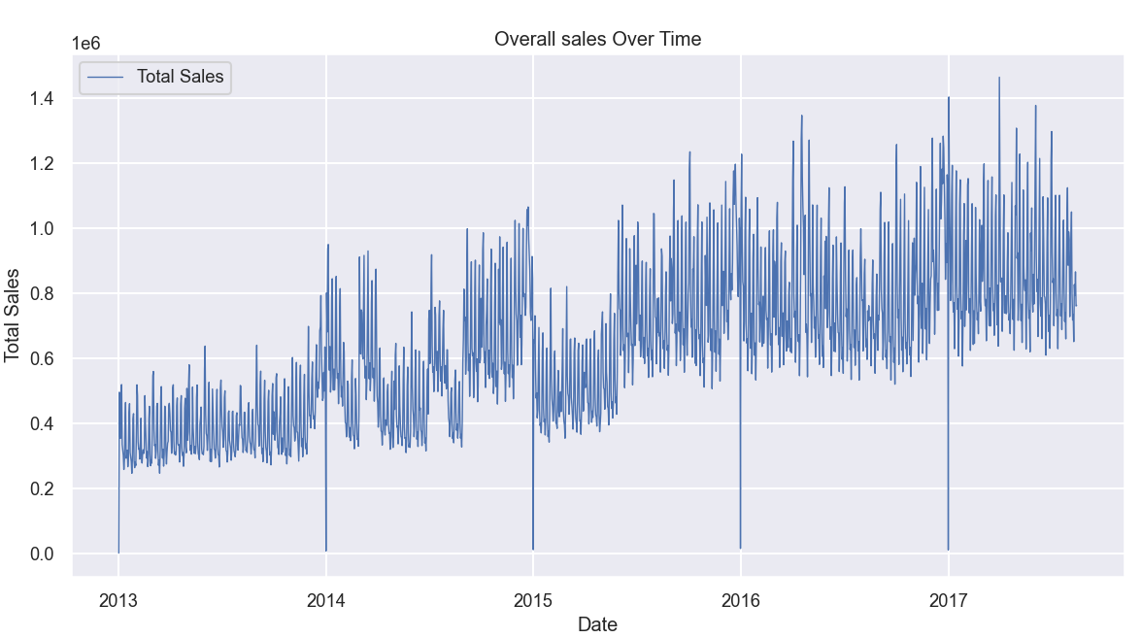
Extensive Exploratory Data Analysis
EDA
Workflow
Sales Trends Analysis
6
Notes:
Now we move on to EDA part.
We plotted the overall sales versus time to observe the sales trend all over the years, and we observed an increasing trend.

Slide 8
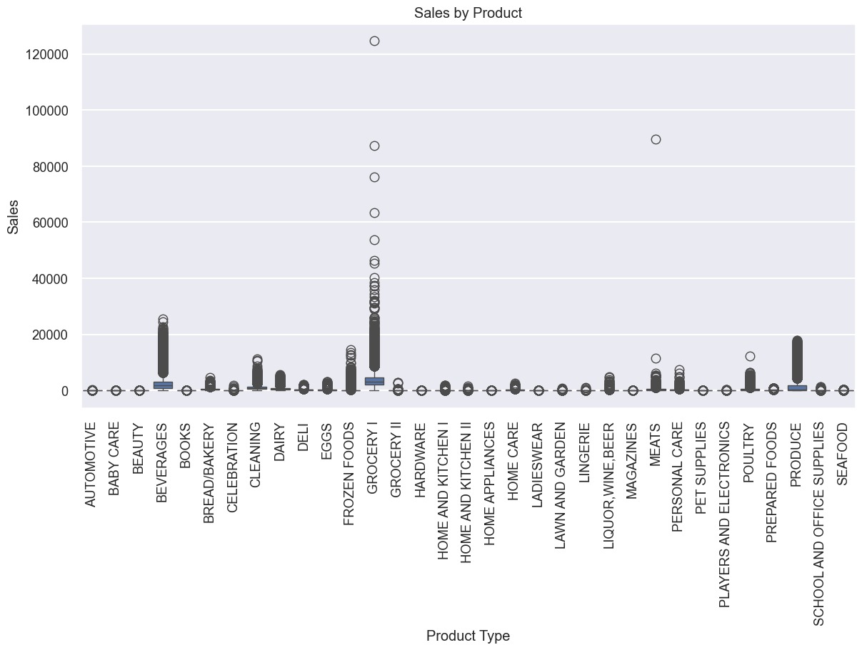
Extensive Exploratory Data Analysis
EDA
Workflow
7
Notes:
After this, we wanted to observe sales for each product for all stores, so we plot a sales vs product graph.
In which we can see that several products have almost zero sales overall.
And there are also some products like beverage, grocery1 and produce have relatively high sales overall compare to all the other products.

Slide 9
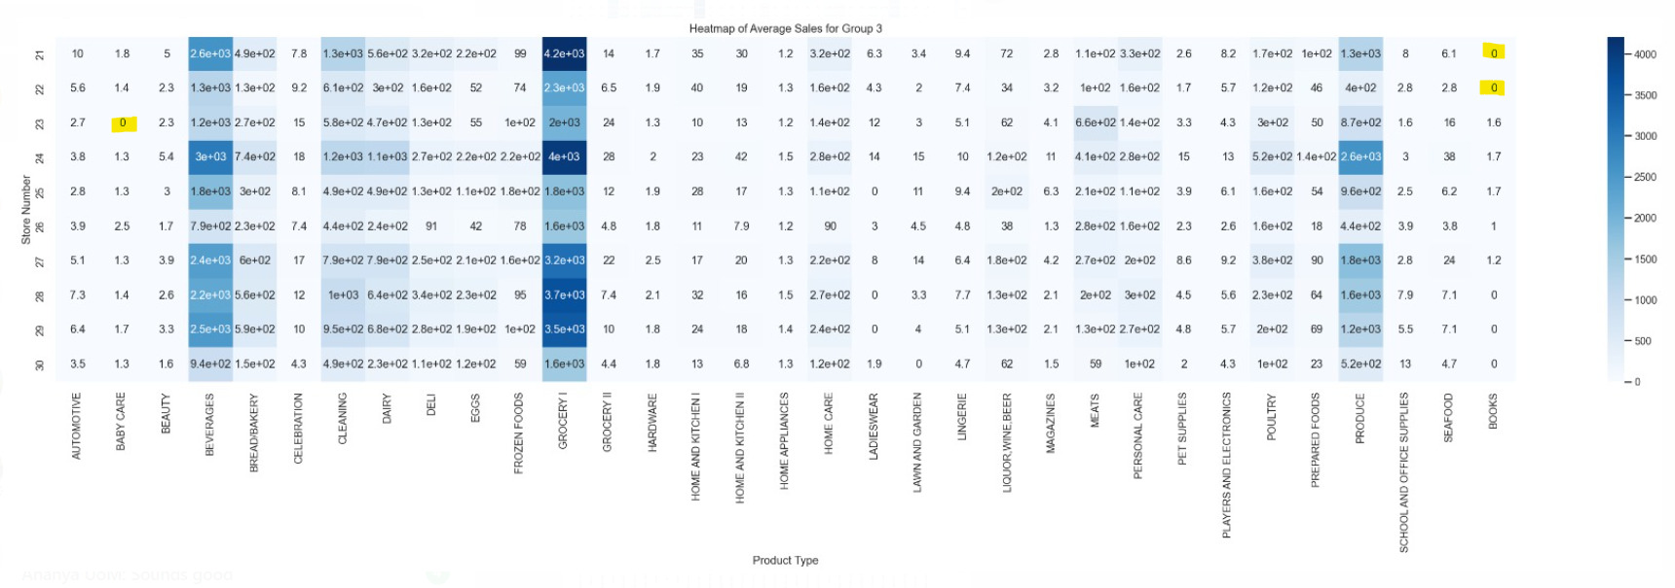
Extensive Exploratory Data Analysis
EDA
Workflow
8
Notes:
Looking at the heat map, we can see that the mean sales across each combination have a considerably wide range.
So we decided that, each combination should have their own suitable models for forecasting.

Slide 10
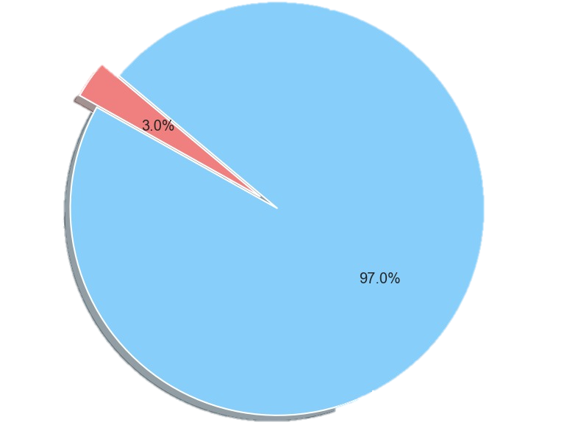
Extensive Exploratory Data Analysis
EDA
Workflow
Proportion of Zero and Non-Zero Sales Combinations
Zero sales
Non-Zero sales
9
Notes:
According to the heat map, we discover that there r some combinations contains 0 sales
To ensure that we process the data correctly, we have to separate the data that has zero sales thought out the time
And focus on Non-Zero sales
Next, We have Vedant to present our workflow

Slide 11
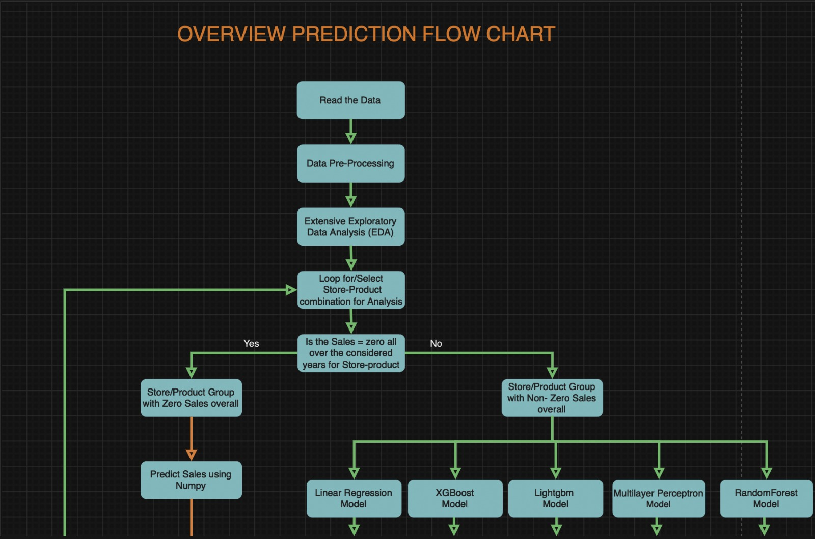
EDA
Workflow
10
Notes:
Firstly, we kick off by reading and importing our data, setting the foundation for our analysis. Following this, we engage in data preprocessing to ensure our dataset is clean, consistent, and ready for analysis.Moving forward, we conduct Exploratory Data Analysis (EDA) to glean insights into our dataset. Post EDA, we take a strategic step in selecting specific store-product combinations, narrowing our focus for targeted predictions.Now, the predictive journey diverges. For instances where sales are zero, we employ NumPy methods for accurate predictions. Conversely, for non-zero sales, we leverage the power of five distinct models: Random Forest, Linear Regression, MLP, XGBoost, and LightGBM.Feature selection comes next, streamlining our dataset for optimal model performance. Following this, we split our data into training and testing sets, laying the groundwork for model evaluation.To enhance our models, we engage in hyperparameter tuning, fine-tuning the parameters for each model to maximize predictive accuracy. The culmination of this process involves calculating Mean Absolute Error (MAE) for each model.in the final stretch, we compare the MAE values of all models, identifying the model with the minimum MAE. This optimal model is then stored in a results table, capturing the essence of our predictive prowess.As we seamlessly loop through these steps for each store, this iterative process ensures a comprehensive analysis for our entire dataset

Slide 12
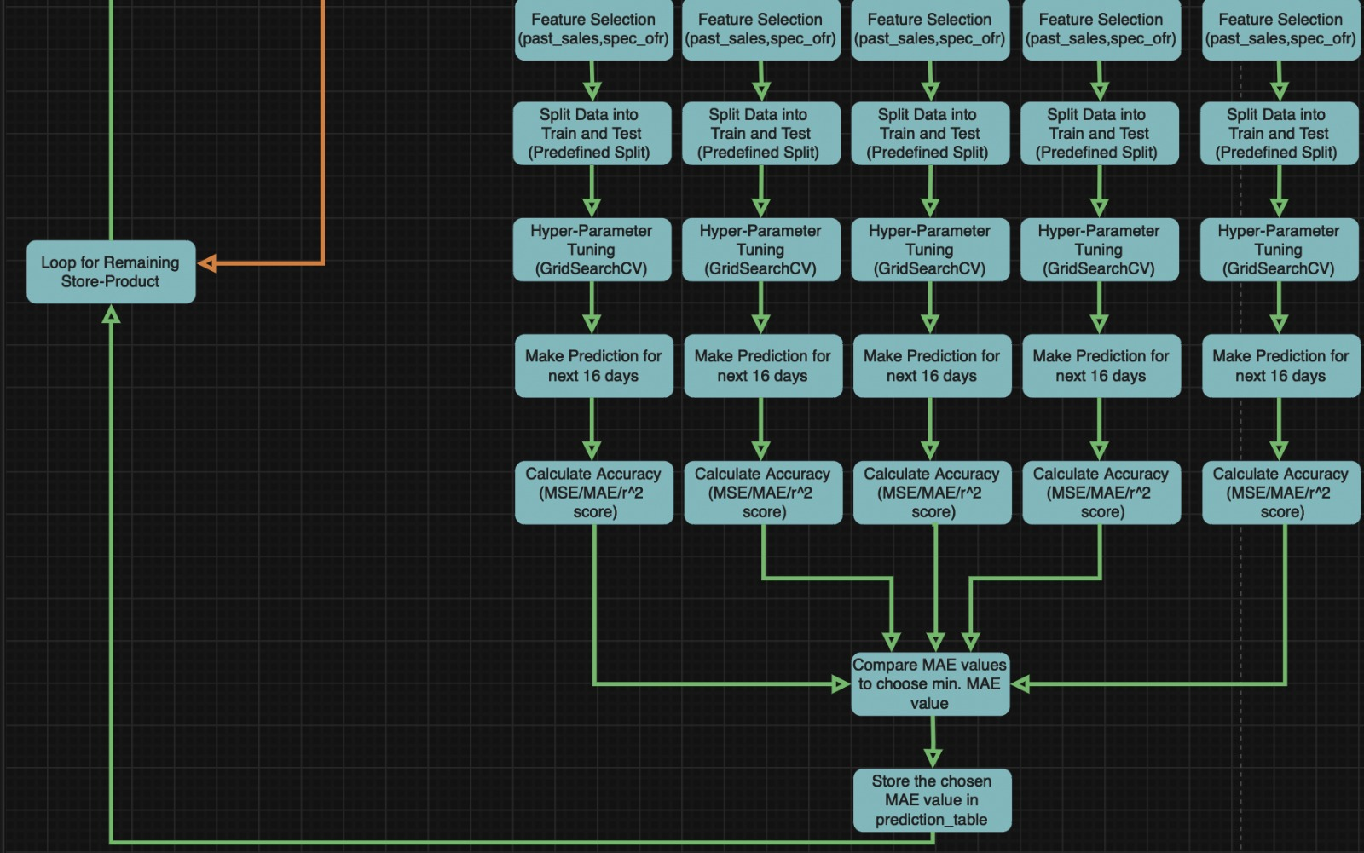
11

Slide 13
Segmentation
Feature Engineering
Segmentation
# Groupby both Store and Product
Provides explicit insights into sales patterns
Businesses can develop localised marketing and inventory strategies,
catering to customers' unique demands
# Zero and Non-Zero
Zero – Predicted using simple NumPy methods
Non-Zero - Distinct regression and machine learning models
12
Notes:
Segmentation. Firstly, we employ a strategic groupby operation, combining both Store and Product dimensions. This approach provides explicit insights into sales patterns, enabling us to discern nuanced trends within specific store-product combinations. For instances where sales are zero, we employ straightforward NumPy methods for accurate predictions. This streamlined approach ensures efficiency in predicting instances where no sales are recorded.Conversely, for non-zero sales, we venture into the realm of distinct regression and machine learning models. This sophisticated approach, including models such as Random Forest, Linear Regression, MLP, XGBoost, and LightGBM, allows us to capture the complexity of sales patterns where transactions have occurred. The flexibility of this methodology enables us to adapt to the diverse nature of non-zero sales scenarios.In the final stretch, we compare the MAE values of all models, identifying the model with the minimum MAE. This optimal model is then stored in a results table, capturing the essence of our predictive prowess.As we seamlessly loop through these steps for each store, this iterative process ensures a comprehensive analysis for our entire dataset. At this juncture, I hand over the baton to the next phase of our analysis. Thank you for your attention, and I invite any questions or discussions on our predictive journey.

Slide 14
Segmentation
Feature Engineering
Feature Engineering
# External features
'Id' and 'Store_nbr’ - impractical for inclusion due to limited impact on sales
# Historic sales data
Solely relying on previous sales data yielded suboptimal performance
for prediction
# Historic sales data & Special offers
Promising outcome observed
13
Notes:
we didn't use certain features like 'Id' and 'Store_nbr' because they didn't really impact sales. Initially, relying only on past sales data didn't give us great predictions. However, when we combined information about special offers with the historical sales data, things started looking more promising.

Slide 15
Data Split &
Hyperparameter Optimisation
Model Selection
# Data Split
Training dataset – 80%
Validation dataset - ​20%
Test dataset – 31st July , 2017 to 15th August , 2017
Used 'Predefined Split' function instead of K-fold cross-validation to ensure
training and validation data are sequential in the stage of fine-tuning.
# Hyperparameter Optimisation
GridSearchCV for all models
14
Notes:
we trained models with 80% of our data, fine-tuned them with 20%, and then evaluated their final performance on a specific set of dates. To make sure our fine-tuning is realistic, we used a 'Predefined Split' method. Additionally, we optimized the models by trying out different settings with GridSearchCV to find the best ones.

Slide 16
Models Selection {
Data Split &
Hyperparameter Optimisation
Model Selection
< Linear Regression
Random Forest
Multi-layer Perceptron
XGBoost
LightGBM
>
}
15

Slide 17
Models Selection
Data Split &
Hyperparameter Optimisation
Model Selection
Linear Regression Insights
Initial Attempt: Commenced with Linear Regression as a baseline model.​
Observation: Not all store-product combinations were accommodated effectively.​
Performance Assessment: Suboptimal results for many combinations.​
Diversified Approach with Ensemble​
Challenges Addressed: To tackle complex data and varied combinations.​
Ensemble Models Chosen:​
Random Forest: XGBoost:LightGBM: MLP (Multi-Layer Perceptron)
Advantages of Ensemble Models
Robust Handling: Accommodates diverse store-product dynamics.​
Enhanced Performance: Overcomes limitations observed with Linear Regression.​
Specialized Strengths: Each model selected for specific strengths and adaptability.
16
Notes:
Simply put, we started with basic Linear Regression but noticed it didn't work well for all store-product combos. So, we switched to a mix of advanced models (Ensemble) like Random Forest, XGBoost, LightGBM, and MLP. These models are better at handling diverse store-product scenarios, perform well, and each brings its own unique strengths to the table.

Slide 18
Predictions
Model Selection
Prediction
# Process
Implemented linear regression, XGBoost, LightGBM, Random Forest
and MLP models
Applied these models for all the store product combinations
Calculated MAE value for each model
Selected model with the least MAE values for each combination
and stored it in a data frame for representation.
17

Slide 19
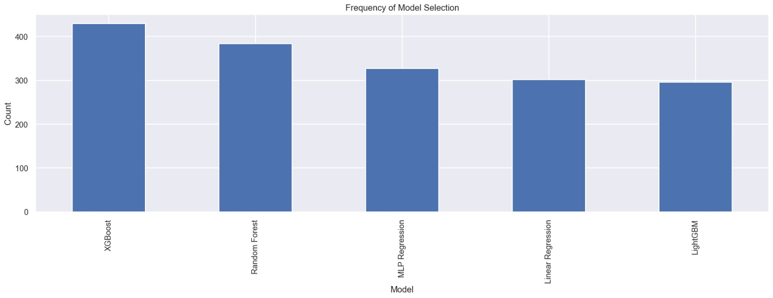
Results
References
Number of Model selection
18

Slide 20
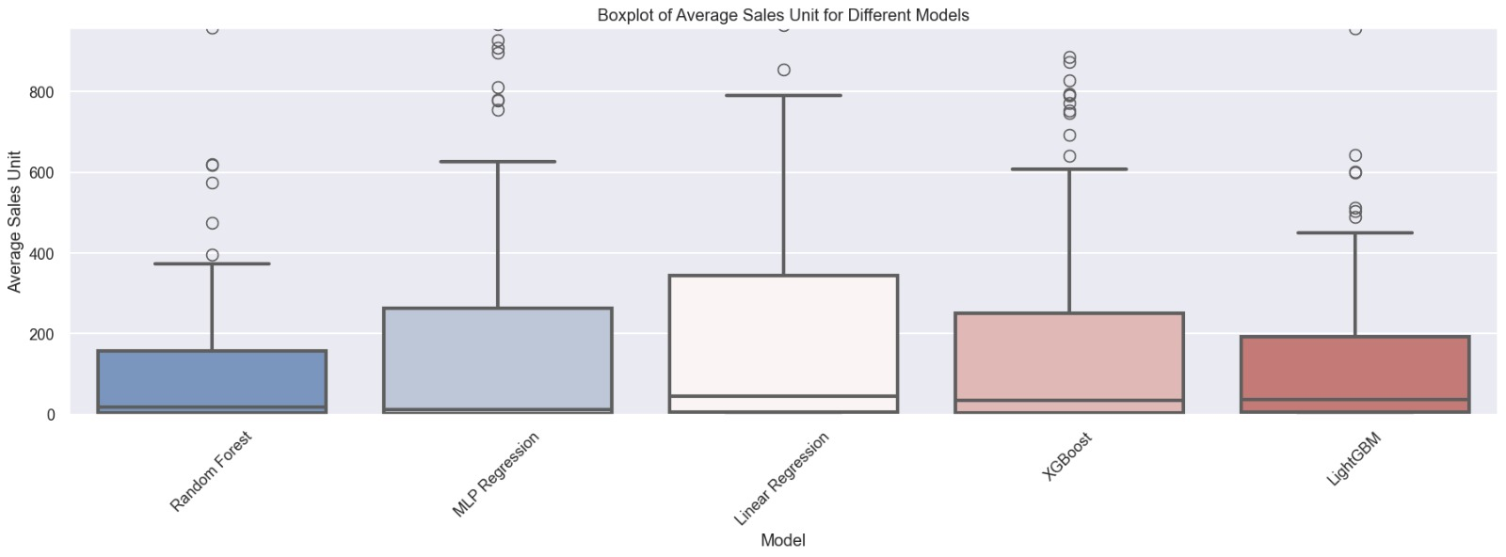
Results
References
Boxplot of Average Sales Unit for Different Models
19
Notes:
Linear can cover widest range of the average sales, and randomforest cover the narrowest range of average sales unit -> this means that if the averages of the sales unit is quite wide, then it could possibly be filter to linear

Slide 21
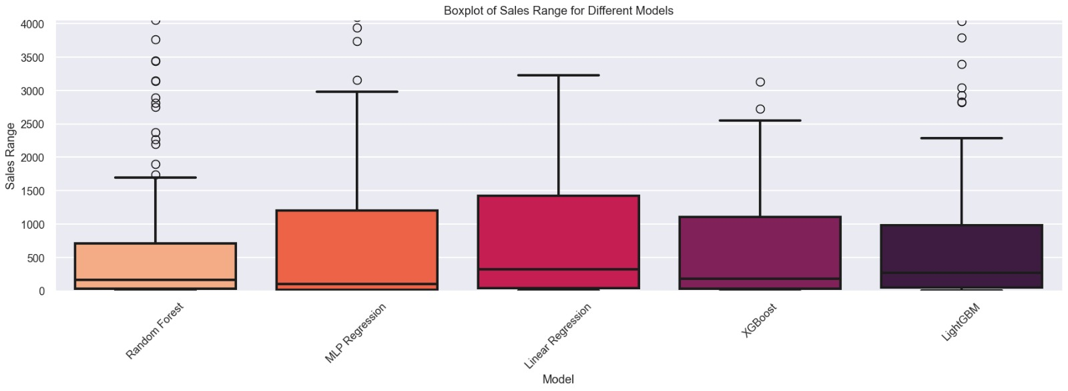
Results
References
Boxplot of Sales Range for Different Models
20
Notes:
Same as the sales range, this result indicates that linear regression can cover the most significant range of the combinations, the random forest did not -> this means that if the range of the sales unit is quite wide, then it could possibly be filter to linear

Slide 22
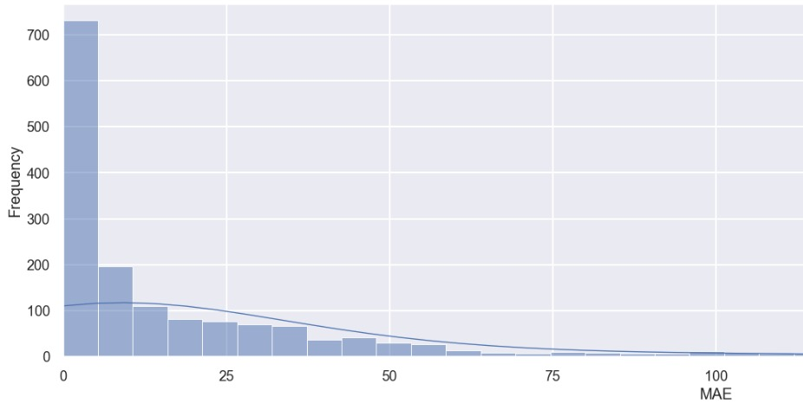
Results
References
Distribution of MAE
21

Slide 23
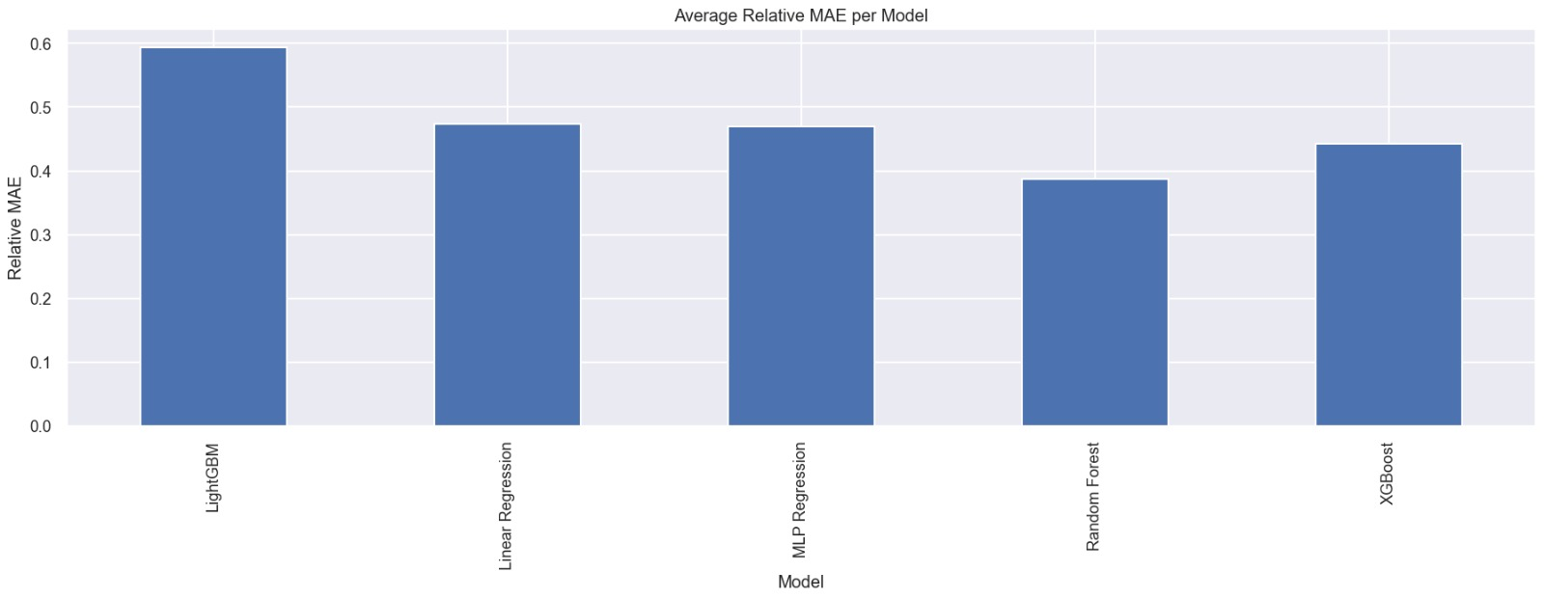
Results
References
Average Relative MAE per Model
22

Slide 24
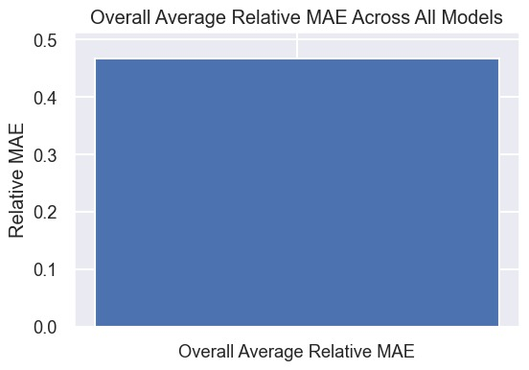
Results
References
Average Relative MAE per Model
23

Slide 25
References
Thank you!
Pophali, P. (2023) 'Grocery Sales Prediction Using Time Series Forecasting ML Model'
Odegua, R. (2020). “Applied Machine Learning for Supermarket Sales Prediction”
Chavali, S. D. A., Bellamkonda, L., Chinta, D. P., Devarapalli, A., Bathula, S. N., and B. Sai Jyothi. (2023). “Supermarket Sales Prediction Using Machine Learning”
Kigo, S.N., Omondi, E.O. and Omolo, B.O. (2023) “Assessing predictive performance of supervised machine learning algorithms for a diamond pricing model”

Slide 26
Thank { You;
Thank you!
}

