Slide 1

Online Rails Bookstore Application
By
Banta Bernard P15/29697/2009
Supervisor: Mr. Elisha Opiyo

Slide 2
Abstract
This project deals with developing an e-commerce website for Online bookstore. It provides the user with a catalog of different books organized into categories available for purchase in the store. In order to facilitate online purchase a shopping cart is provided to the user. The payment mode of this system is through M-pesa where a customer receives an invoice through SMS and then pays using M-pesa. After the order has been processed the customer is notified through SMS and when the books will be delivered.
Since the customers will not always be shopping for the books the project will also deal with the development of a module within which the system will allow users to upload and share non copy written materials for free.
.

Slide 3
Problem Definition
As much as 70% of the purchases are made by cash. Books are picked by the customers from the shelves. All other tasks including order processing are done manually. Other problems that were found out are:
Duplication of data
Lack of security of the data stored
Manually storing the records, which consume a lot of space and as a result cause slow record lookup process
There is too much paper wastage
Lack of accuracy i.e., common errors do occur, etc

Slide 4
Project Objectives
The main aim of this project is to provide a suitable solution to the problem. The following are the objectives that this project seeks to meet:
Improving better management performance by reducing paper base system and instead uses an online database.
Improving customer services by introducing a web-base system and search engine.
Making a better selection by using the online bookstore.
Using IT for purchasing and selecting items.
Using M-pesa as the main mode of payment in this system.

Slide 5
Literature Review
Electronic Commerce (e-commerce) applications support the interaction between different parties participating in a commerce transaction via the network, as well as the management of the data involved in the process [2].
The increasing importance of e-commerce is apparent in the study conducted by researchers at the GVU (Graphics, Visualization, and Usability) Center at Georgia Institute of Technology. In the summary of their findings from the eighth survey, the researchers report that “e-commerce is taking off both in terms of the number of users shopping as well as the total amount people are spending via internet based transactions”.
Although the issue of security remains the primary reason why more people do not purchase items online, the GVA survey also indicates that faith in the security of e-commerce is increasing. As more people gain confidence in current encryption technologies, more and more users can be expected to frequently purchase items online [11].

Slide 6
Scrum Methodology
Scrum allows rapidly and repeated inspection of actual working product (at least once a month or twice) hence provides ability for the project to adapt to rapidly changing market and other complex external factors. The focus of the scrum methodology is to deliver the highest business value of the project in the shortest possible time.

Slide 7
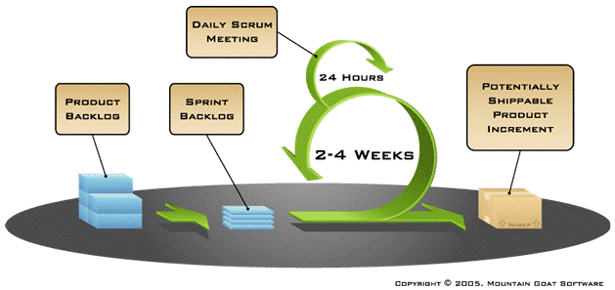
Cont. Scrum Methodology

Slide 8
Cont. Scrum Methodology
Characteristics of Scrum
Working teams are self organizing in Scrum
Do a little of everything all the time rather than doing all of one thing at a time.
Scrum are a series of two- to four-week “sprints”
“Product backlog” is used to capture the requirements in Scrum
No changes during the sprint are allowed

Slide 9
Cont. Scrum Methodology
Justification
Due to short sprints and constant feedback, it becomes easier to cope with changes.
Regular meetings make it possible to measure individual productivity. This leads to the improvement in the productivity of each of the team members.
The overhead cost in terms of process and management is minimal thus leading to a quicker, cheaper result.
It is easier to deliver a quality product in a scheduled time.
Another reason that Scrum methodology was because Ruby on Rails is agile in nature
Agile scrum saves time and money.
It is a lightly controlled method which insists on frequent updating of the progress in work through regular meetings. Thus there is clear visibility of the project development.

Slide 10
Analysis and Design
Use Case Diagram
Use case is a description of a set of sequence of actions that a system performs that yields an observable result of value to a particular thing in a model. Graphically, Use Case is rendered as an ellipse with lines, usually including only its name as show below.

Slide 11
Cont. Analysis and Design
Use case diagram for the system

Slide 12
Cont. Analysis and Design
Data model for the system

Slide 13
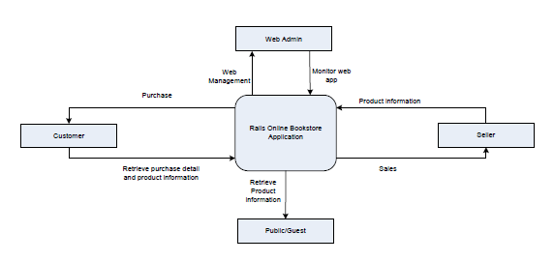
Cont. Analysis and Design
Context diagram for the system

Slide 14

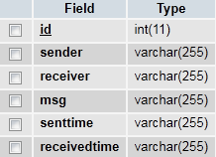
Payment Processing
BLO3TF9292N Confirmed. You have received Ksh2,600 from Pxxx Gxxxxx 254703371113 on 11/6/11 at 3:01 PM New M-PESA balance is Ksh50,000
Extract amount and compare
Extract name & no. and compare
Messageins Table
Check the date of the message.
Must be > Today - 3
If every thing above is satisfied then
order is processed successfully
Else
order is canceled

Slide 15
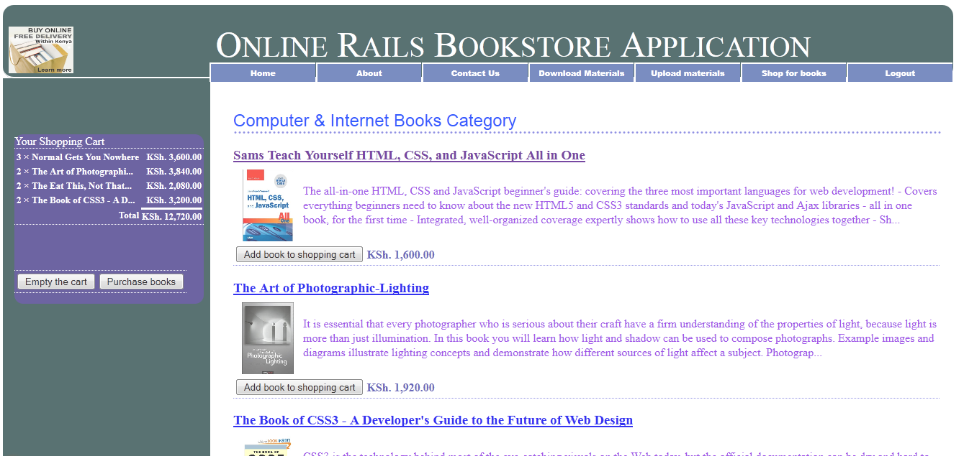
Screen Shots
Shopping cart for the user

Slide 16
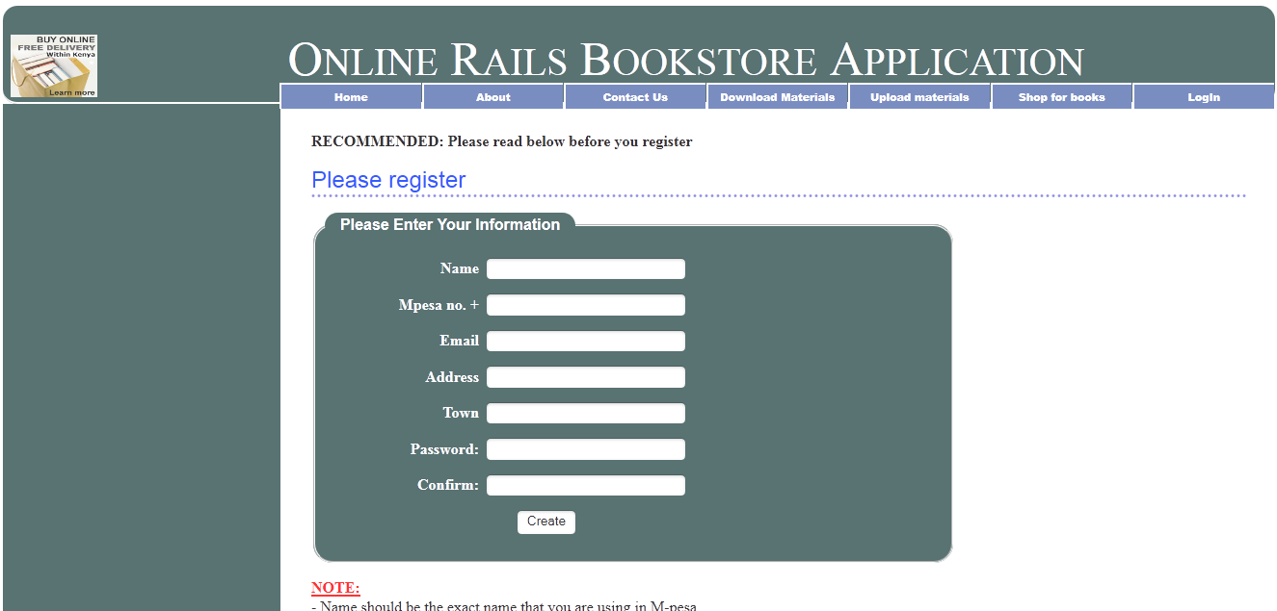
Cont.Screen Shots
Registration of the new user
Registration of the new user
Registration of the new user

Slide 17
Conclusion
Shopping at an online bookstore provides customers the ultimate individual experience. Anyone can buy books tailored to his unique interests while relaxing in sweatpants on the couch. These businesses are changing the way authors and readers come together and will impact the publishing and retail industries in the future.
Future improvements
Addition of explicit social layer on the system e.g forums
Integration with Amazon and other websites
A fully compliant mobile web version of the system
Communication companies API in Kenya for SMS handling
Mobile money till number
Bookshop module

Slide 18
Thank you!!
Questions

