Slide 1
VR Photo Album
Nikhil Verma
Mychal Lipson
Arjun Dhuliya
Xiaoxuan Zhang

Slide 2
Till Midterm
Premade Lobby Scene
Art Gallery Prototype
Planetarium Prototype and works

Slide 3
Updates
Procedurally Generated Lobby
Procedurally Generated Art Gallery
Planetarium transparency / fade effect
Music
On User focus Photo Details (Separate scene)
Xbox Controller integration (different for mac/windows)

Slide 4
Demo

Slide 5
Art Gallery

Slide 6
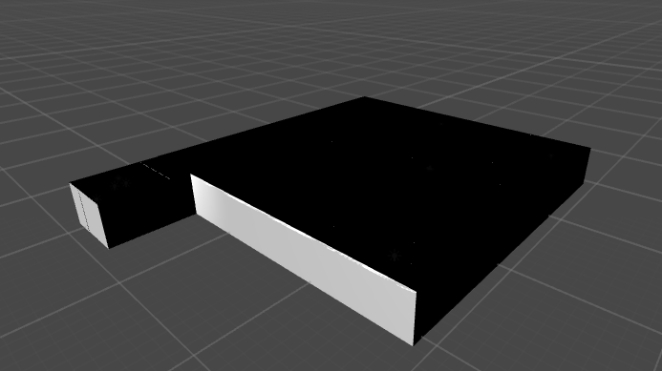

Slide 7
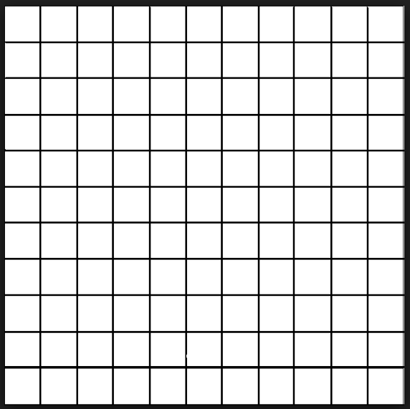
Tilemaps

Slide 8
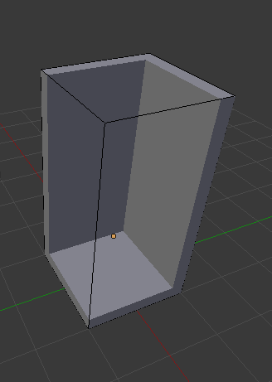
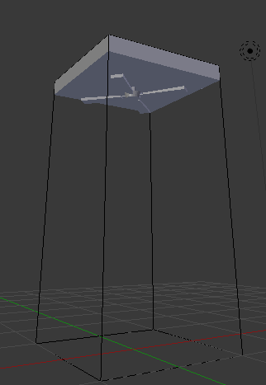
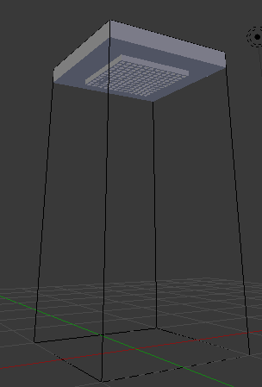
3D model individual tiles

Slide 9
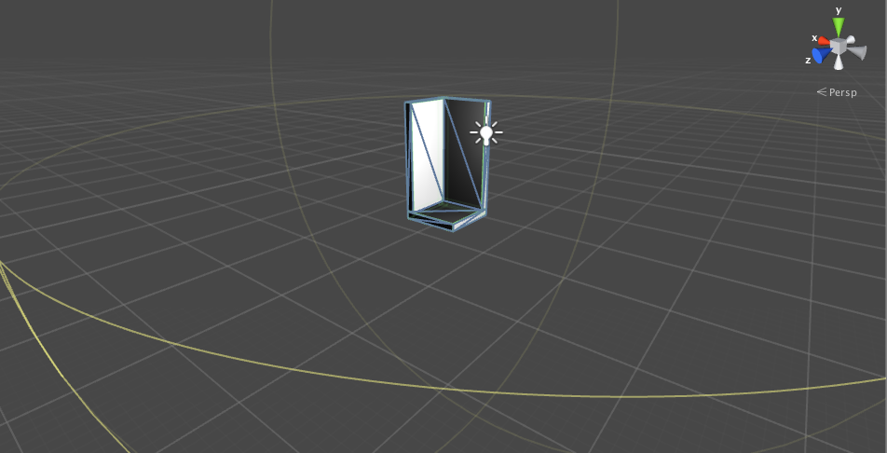
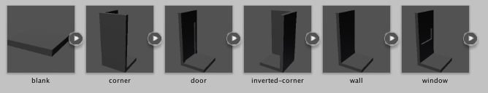
Prefab for each type of Tile

Slide 10
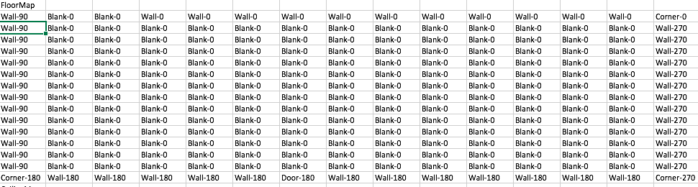
Previously tilemap layout generated from CSV

Slide 12
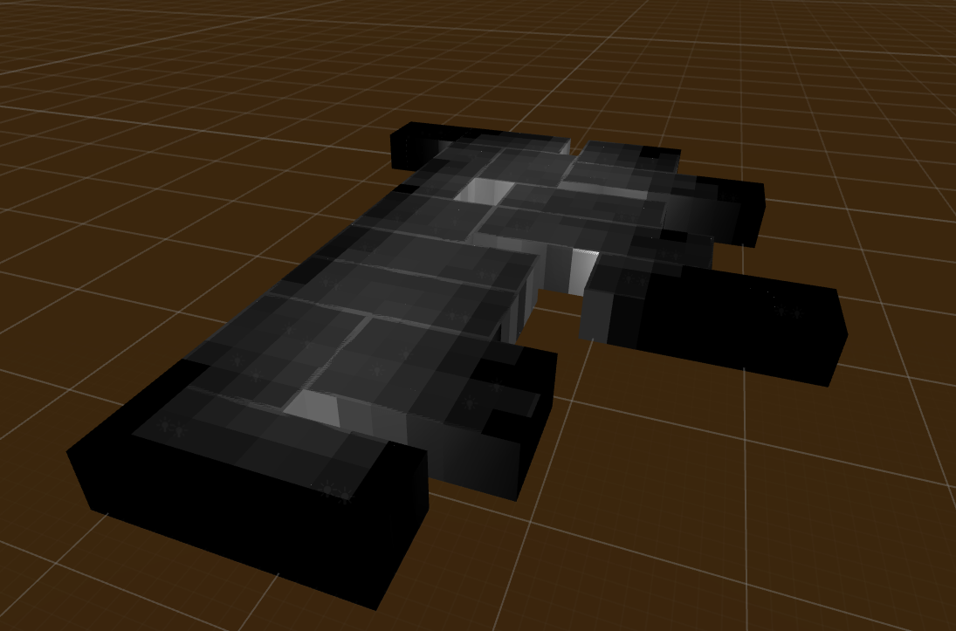
Now layout is generated procedurally

Slide 13
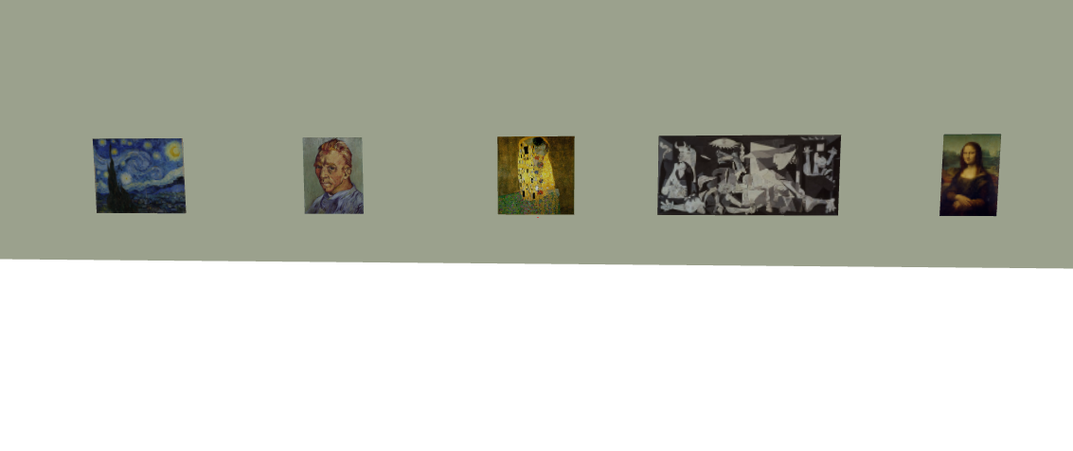
Based on the number of photos in the album

Slide 14
Dimensions are based on requirements of the contained images
Room
Contained Images

Slide 15
Generate rectangular rooms

Slide 16
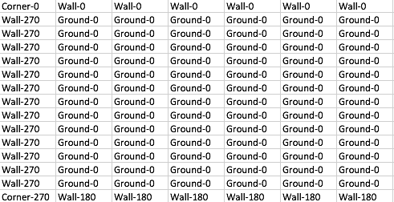
Individually create tilemaps for each room
........

Slide 17
Layout
Algorithm

Slide 18
Merge to create one tilemap

Slide 19
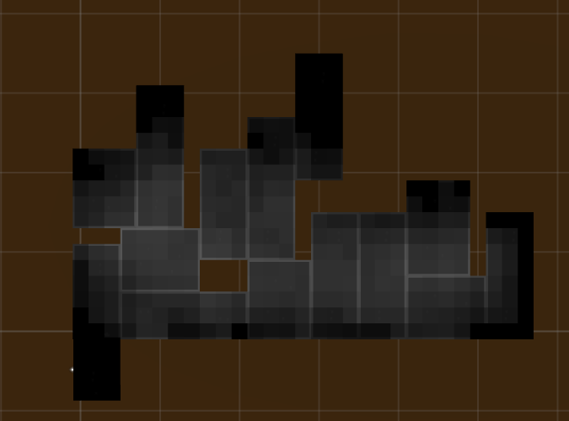

Slide 20
Future goals
Polishing and bug fixing
Image placement in art gallery
Openings to adjacent rooms in art gallery
Decorations in the art gallery
Texturing
Revolving Celestial bodies in the art gallery

Slide 21
Thank you
Q/A

