Slide 1
Project Title: Keylogger- Capturing Key-Strokes

Slide 2
AGENDA
Introduction
A brief overview of the presentation.
Keylogger Types
Different methods and classifications of keyloggers.
Pros and Cons
The advantages and disadvantages of using keyloggers.
Data Collection & Analysis
How to collect and analyze the captured keylogger data.

Slide 3
Introduction to Keylogger
Keyloggers are software applications that capture every keystroke input by a user on a computer or mobile device. They can be used for legitimate purposes, such as monitoring employee productivity, or for nefarious activities like stealing personal information.
Types of Keyloggers
Hardware Keyloggers
Physical devices that can be inserted between a keyboard and a computer to intercept keystrokes.
Software Keyloggers
Applications that can be installed on a computer or device to capture keystrokes.

Slide 4
Advantages and Disadvantages of Using a Keylogger
Advantages
Provide a way to monitor employee productivity and internet usage, provide evidence in case of a data breach, and keep track of children's online activities.
Disadvantages
Easily abused for illegal or unethical purposes and can lead to a violation of data privacy laws.

Slide 5
Collecting and Analyzing Keylogger Data
The key to effectively using a keylogger is collecting accurate and relevant data and then analyzing it meaningfully. It requires research, knowledge of data processing techniques, and credibility in decision making.
Here are some points you need to follow to make the keylogger effective:-
Define Your Purpose
Determine what information you want to capture and why you need it.
Choose the Right Keylogger
Select a keylogger that offers the features you need for your end goals.
Ensure Appropriate Logging
Choose the correct file types, ensure the program is running correctly and that details are properly logged.

Slide 6
PROJECT OVERVIEW
Keyloggers are software applications that capture every keystroke input by a user on a computer or mobile device
Mainly key-loggers are used to steal password or confidential details such as bank information etc.
The use of keyloggers is both a powerful tool and a potential risk.

Slide 7

End Users
End users of keyloggers include organizations and Individuals in various
industries such as finance, education, and healthcare.
Keyloggers may be used for research, productivity monitoring, intrusion detection,
or auditing.
Keylogger can be also used by Cyber Criminals to steals your confidential information such as you passwords, bank information, emails and everything you type through your keyboard.
This Photo by Unknown Author is licensed under CC BY-SA

Slide 8
MODELLING
For the creation of the keylogger I used the Python library named as “pynput”
The library can detect and record keystrokes made by the users.
The package pynput.keyboard contains classes for controlling and monitoring the keyboard.
For the GUI based creation of the Keylogger I used the framework called as “Tkinter”.
The framework provides tools and widgets to design windows, buttons, test boxes, and other GUI elements.

Slide 9
Results
The results of a keylogger vary depending on its purpose and the intentions of the user or attacker deploying it. Here are some potential results that can arise from the use of a keylogger:
a.) Captured Keystrokes
b.) Stolen Credentials
c.) Sensitive Information Theft
d.) Unauthorized Access
e.) Surveillance and Monitoring
The data obtained from the keystrokes were sent to a file which the deployer of the keylogger creates at the time of the creation of Keylogger

Slide 10
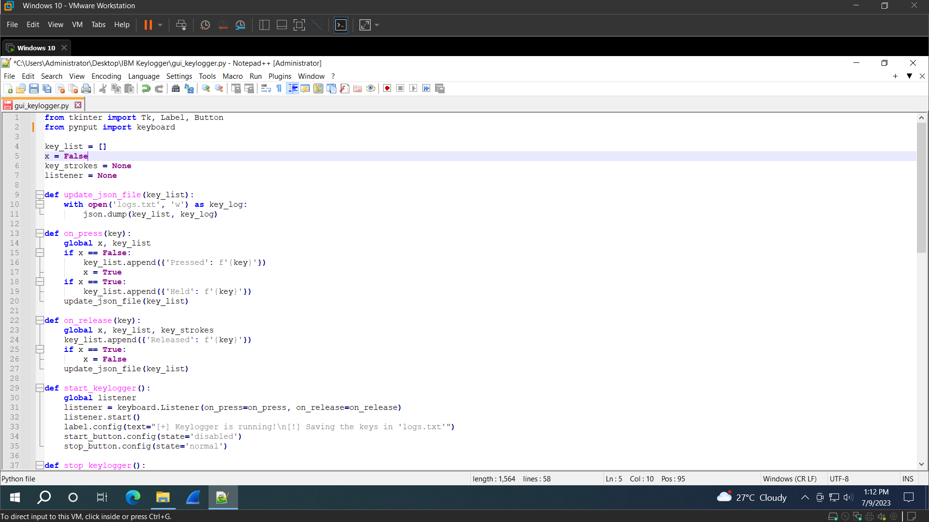
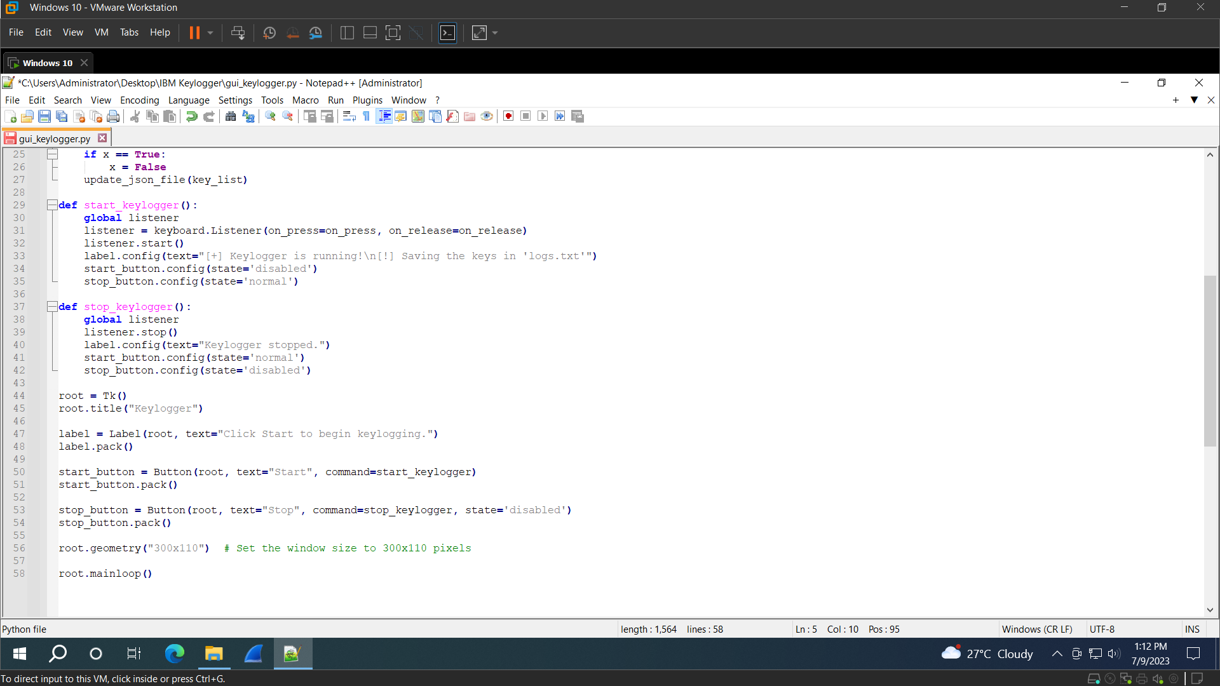
Below are some screenshots presenting the result of the keylogger
These are the codes of the keylogger Program

Slide 11
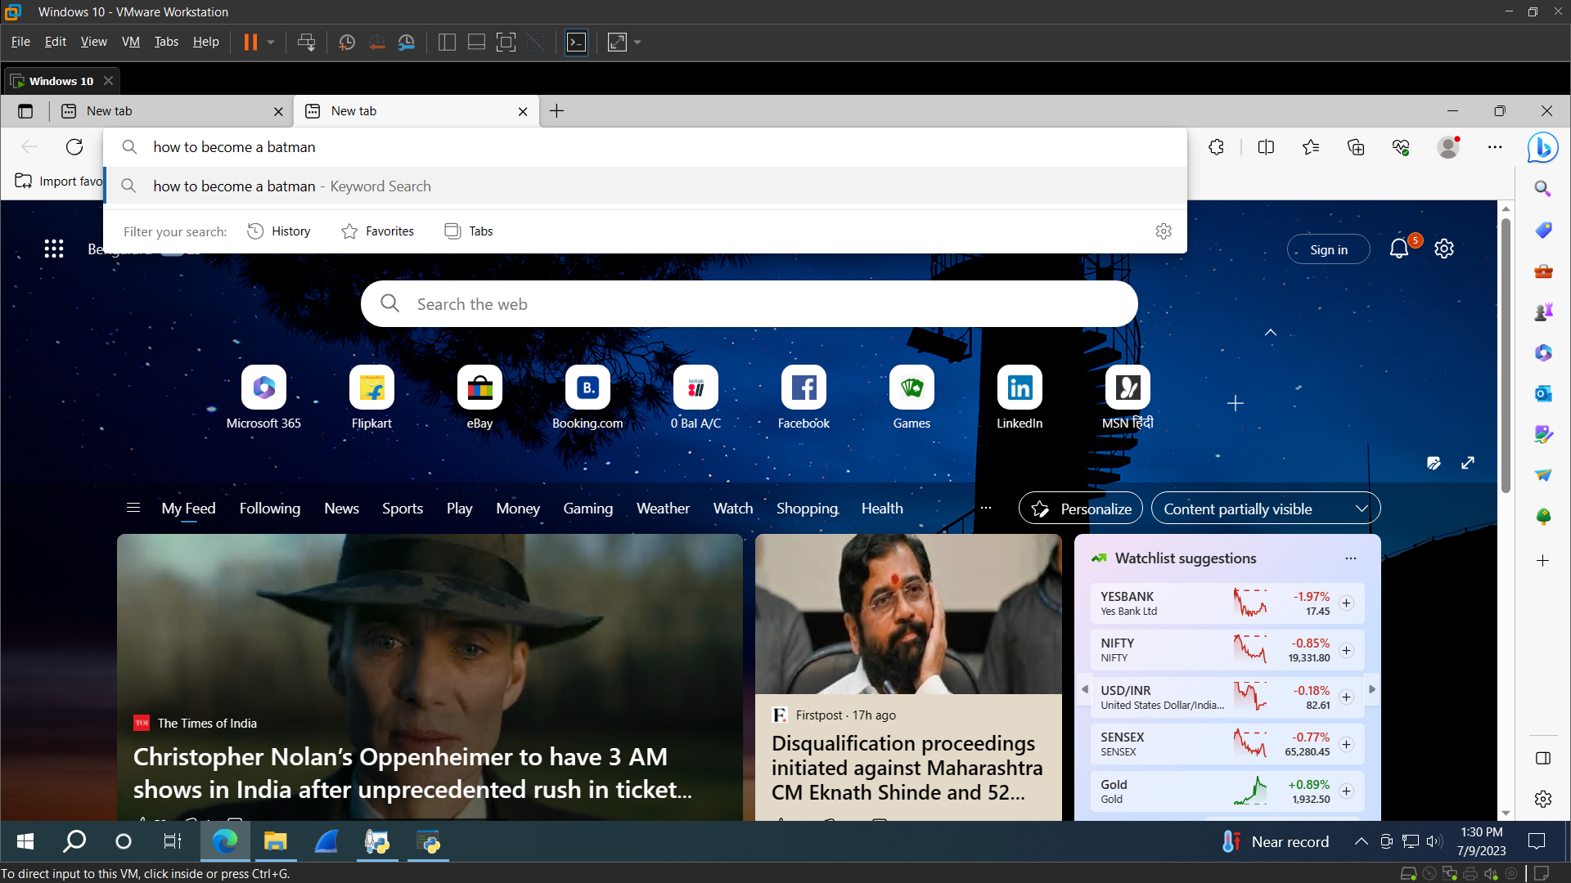
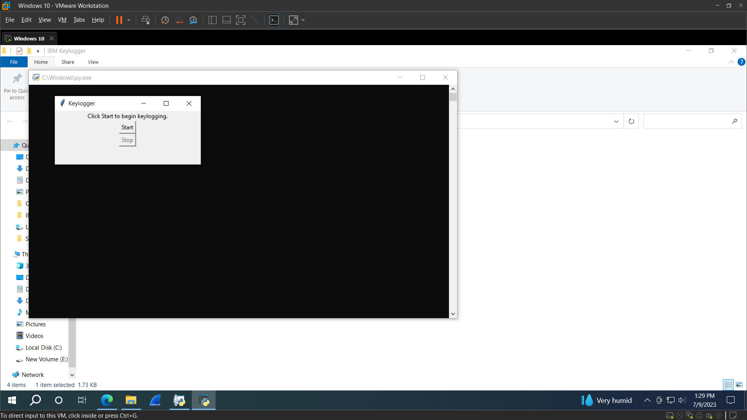


GUI to Start and Stop Keylogger
Some search queries

Slide 12
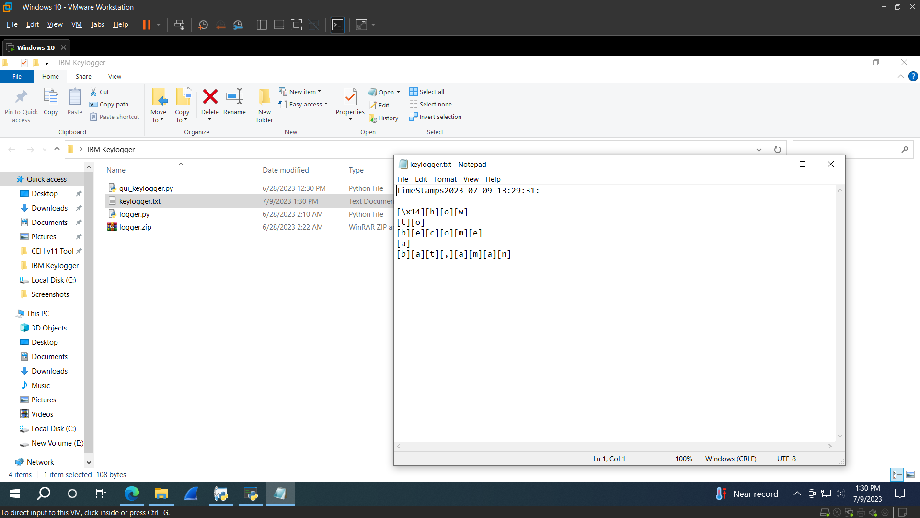


Result of the previous query
Text File Created after executing the keylogger files

Slide 13
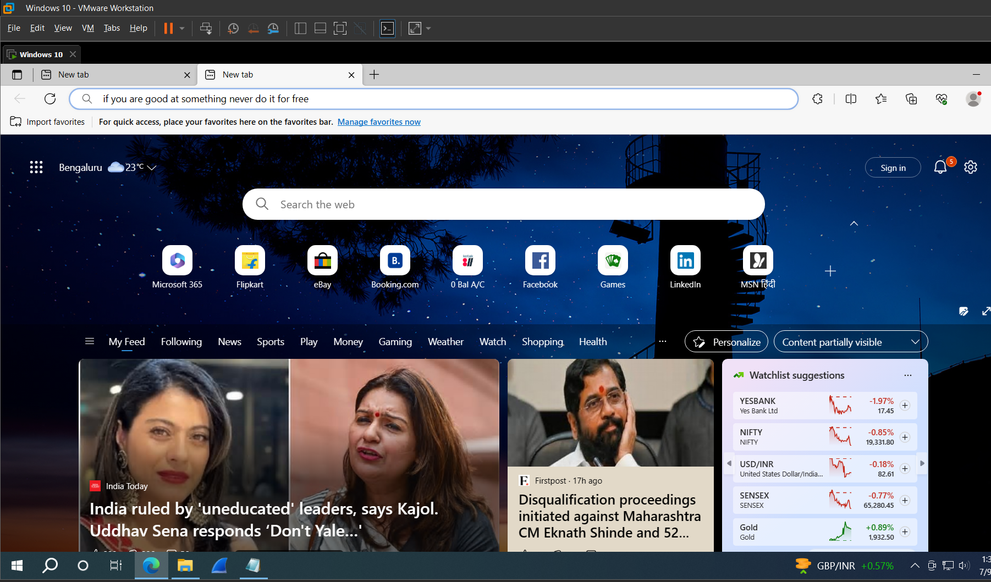
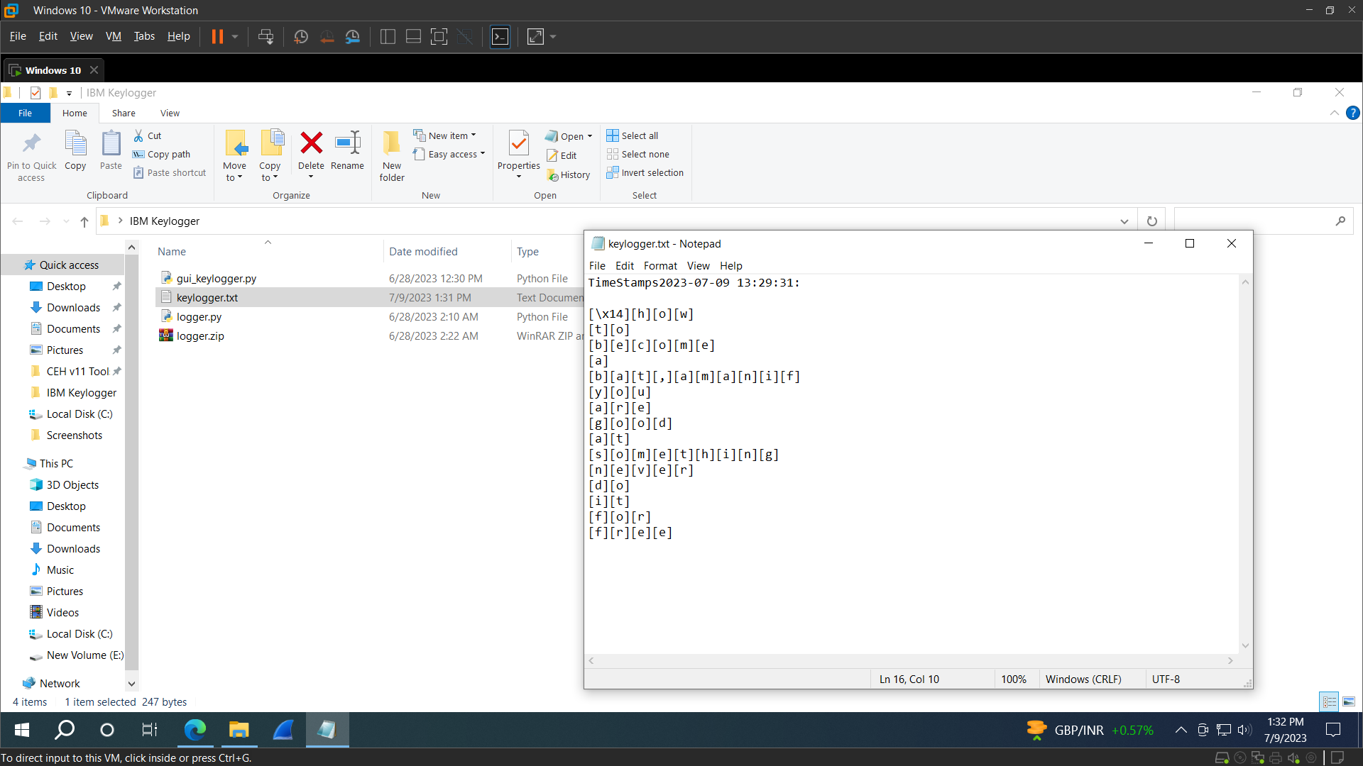




Slide 14
links
Reference taken from the YouTube Video
Google Drive Link:>>
GitHub Profile

Slide 15
THANK YOU…

