Slide 1
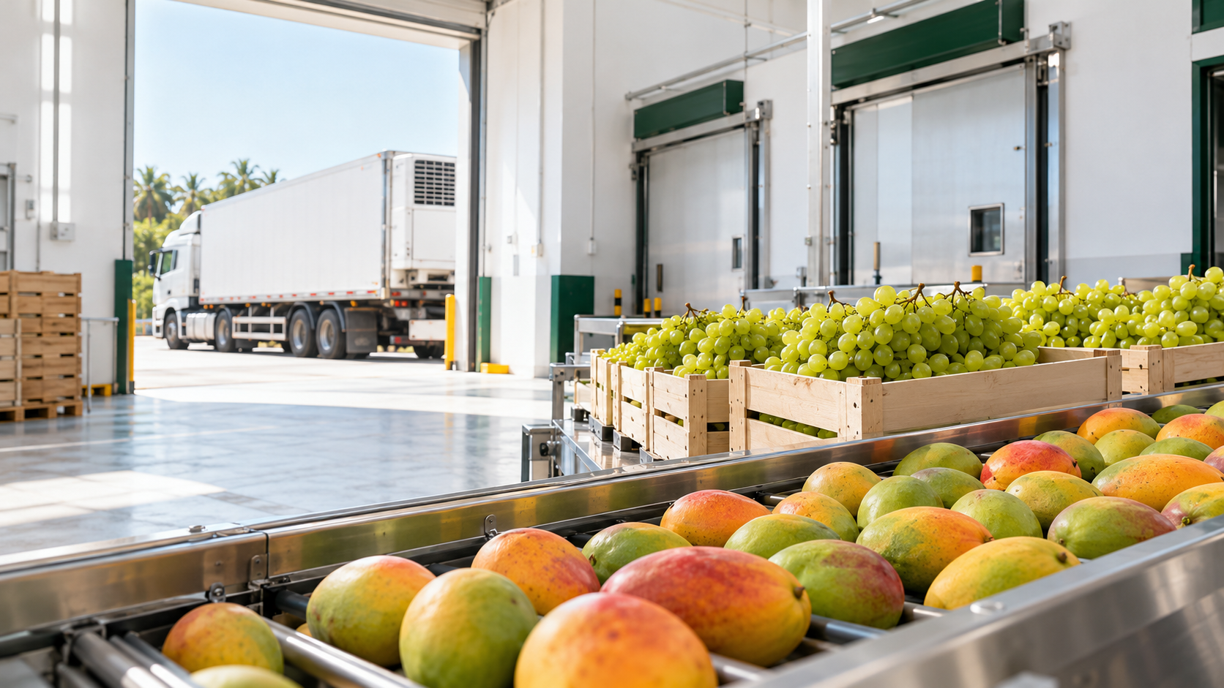

APEDA
Bharat Krishi
Niryat Yojana
Financial Assistance Guidelines
2026–27 to 2030–31
Export infrastructure and support for registered exporters
Notes:
Source: supplied guidelines pp. 1–4. Krishika logo from supplied UP presentation. Cover and facility photographs are AI-generated illustrative assets, not records of an actual funded project. Native text and policy diagrams remain editable.

Slide 2

02
Eligibility and support areas
APEDA scheduled products and NPOP-certified organic products
Export infrastructure
Quality development
Market development
Packhouses, cold chain and facilities that close processing gaps
Certification, packaging, testing, laboratories and technology
New markets, overseas brands, retail access and GI promotion
APEDA RCMC exporters
Manufacturers, producers and eligible merchant exporters
Who can apply
Other eligible applicants
NPOP operators, FPOs / PACS, listed labs and institutions
Bharat Krishi Niryat Yojana | Financial Assistance Guidelines 2026–27 to 2030–31
Notes:
Source: supplied FAS_Guidelines_06102026.pdf, pp. 4–8,16–19,29–31,35–36. Standard applicant route is the presentation's primary focus. Percentages are assistance up to the stated rate, subject to eligible cost, component ceilings, approval and funds.
Component-specific eligibility matters. FPO/PACS, SC/ST, women and startups may qualify for higher rates, briefly mentioned on slide 3. SC/ST entity conditions: proprietor or ≥51% qualifying ownership, entity/holding history ≥1 year. Women category: woman proprietor, or all partners/directors/promoters women, wholly owned/managed for ≥1 year. Startup: RCMC + DPIIT certificate, 2–5 years, annual turnover ≤₹500 lakh. Organic applicants require NPOP certification/registration. APEDA-implemented ecosystem activities include standards/NRL, technology development, fairs/BSMs, market intelligence, protocols, internationalisation and grant administration.

Slide 3
03
40% assistance for export infrastructure
Standard route for projects in other states and ordinary beneficiary categories
₹250 lakh
New integrated packhouse / facility
₹300 lakh combined assistance limit for 1(a)–1(d) per beneficiary over the plan period
40%
₹200 lakh
Upgrade or expansion of 1(a)
₹200 lakh
Processing gaps in an existing line
of eligible cost
₹200 lakh
Reefer / insulated / mobile pre-cooling
Balance financing
from own / bank funds
75% for eligible special categories / North-East, Ladakh, J&K and islands. Public common facilities use a separate route.
Bharat Krishi Niryat Yojana | Financial Assistance Guidelines 2026–27 to 2030–31
Notes:
Source: supplied FAS_Guidelines_06102026.pdf, pp. 7–11,35. Standard applicant route is the presentation's primary focus. Percentages are assistance up to the stated rate, subject to eligible cost, component ceilings, approval and funds.
Specified regions: North-Eastern States, Ladakh, J&K, Andaman & Nicobar and Lakshadweep. Higher rates also apply to eligible FPO/PACS, SC/ST, women and startups across India unless a different component rate is specified. Monetary ceilings remain unchanged. The standard 40% share illustration is before ceilings and fee deductions; it does not imply an automatic entitlement. Public common-facility assistance under 1(e)/(f): up to 90%, caps ₹600 lakh new and ₹200 lakh upgrade, restricted regions, government/public institutions; detailed MoU, 40/40/20 instalments and 50% BG requirements are secondary to the standard exporter route.

Slide 4
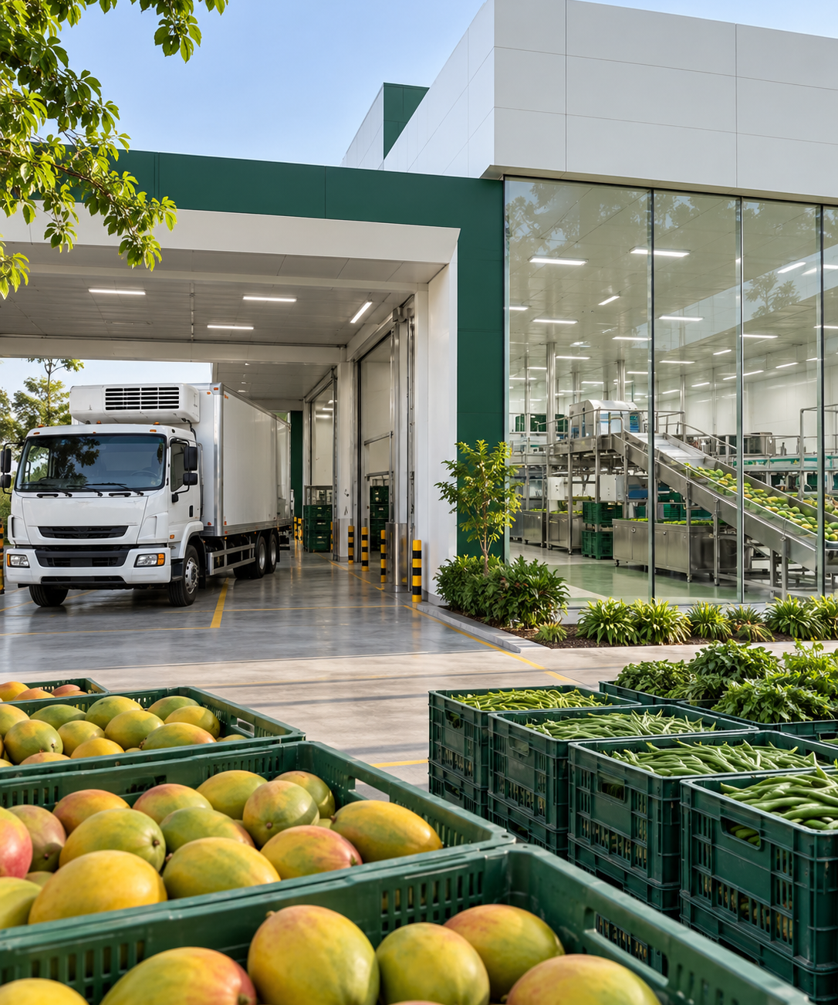
04
New packhouses and facility upgrades
Two investment routes, both at the standard 40% assistance rate
40%
New facility
Collection, washing, grading, pre-cooling, packing and cold storage. New projects only.
Up to ₹250 lakh
40%
Upgrade / expansion
Machinery upgrades / automation of an existing facility under 1(a).
Up to ₹200 lakh
Technical civil work
Maximum 25% of eligible assistance. Land / lease and packhouse norms apply.
Bharat Krishi Niryat Yojana | Financial Assistance Guidelines 2026–27 to 2030–31
Notes:
Source: supplied FAS_Guidelines_06102026.pdf, pp. 9–10,36. Standard applicant route is the presentation's primary focus. Percentages are assistance up to the stated rate, subject to eligible cost, component ceilings, approval and funds.
Cleaning/washing/grading assistance is limited to fresh fruits and vegetables, floriculture and fruit/vegetable seeds. Land in applicant’s name or registered lease valid for 15 years at application. CLU and landowner NOC where applicable. Packhouses follow NCCD/MIDH minimum cold-chain standards and importing-country requirements. Technical civil BOQ certified by engineer/architect. Photograph is conceptual illustrative artwork.

Slide 5
05
Support along the export supply chain
Infrastructure support at 40%, followed by separate market-development support
Packing and cold storage
Processing gaps
Reefer logistics
Trial export shipment
1(a) / 1(b)
1(d)
1(c)
15(b)
Integrated handling and storage facilities
Sortex, IQF, X-ray and metal detection for quality / efficiency
Refrigerated / insulated transport and mobile pre-cooling
New market / product trials. Advisor and SOP required
40% assistance
40% assistance
40% assistance
50% assistance
₹250 lakh new
₹200 lakh upgrade
Up to ₹200 lakh
Up to ₹200 lakh
Up to ₹10 lakh
Bharat Krishi Niryat Yojana | Financial Assistance Guidelines 2026–27 to 2030–31
Notes:
Source: supplied FAS_Guidelines_06102026.pdf, pp. 7–11,30,33. Standard applicant route is the presentation's primary focus. Percentages are assistance up to the stated rate, subject to eligible cost, component ceilings, approval and funds.
Cold storage is part of integrated facilities, not an additional independent cap. Combined ceiling ₹300 lakh for 1(a)–1(d). Merchant exporter vehicle limit 2 per plan, manufacturer 5. Missing-gap line already established (manual facilities needing mechanisation can qualify), HACCP/ISO 22000 in place, quality/productivity equipment not an integral line item. Trial shipment base 50%, cap ₹10 lakh; higher rate in overview for special categories differs from detailed clause and should be clarified.

Slide 6
06
What counts for the infrastructure grant
Only eligible assets and eligible timing enter the assistance calculation
Eligible investment
Timing and procurement
Technical civil work for the project
3 quotations
OEM / authorised suppliers.
Assistance uses the lowest quoted rate, even if another supplier receives the order.
New plant and machinery
Online filing
IPA
Technical civil assistance cannot exceed 25% of total eligible assistance. Submit a certified BOQ and equipment specifications.
Costs before online filing are ineligible.
Filing-to-IPA expenditure needs APEDA’s acceptance.
15-year registered lease
or eligible land title
Existing line + FSMS
for processing gaps
Vehicles per plan
2 merchant / 5 manufacturer
Bharat Krishi Niryat Yojana | Financial Assistance Guidelines 2026–27 to 2030–31
Notes:
Source: supplied FAS_Guidelines_06102026.pdf, pp. 9–11,35–36. Standard applicant route is the presentation's primary focus. Percentages are assistance up to the stated rate, subject to eligible cost, component ceilings, approval and funds.
Exceptions to three quotes: sole manufacturer, imports or government procurement rules need declaration; 1(e)/(f) excluded. Quotes identify supplier address/GSTN/TIN/PAN, specifications, validity and itemised costs. No duplicate funding for same project/components, disclose other grant applications/support. CLU and landowner NOC as applicable. Existing HACCP/ISO 22000 must have prescribed accreditation. FSSAI and other regulatory permissions apply.

Slide 7
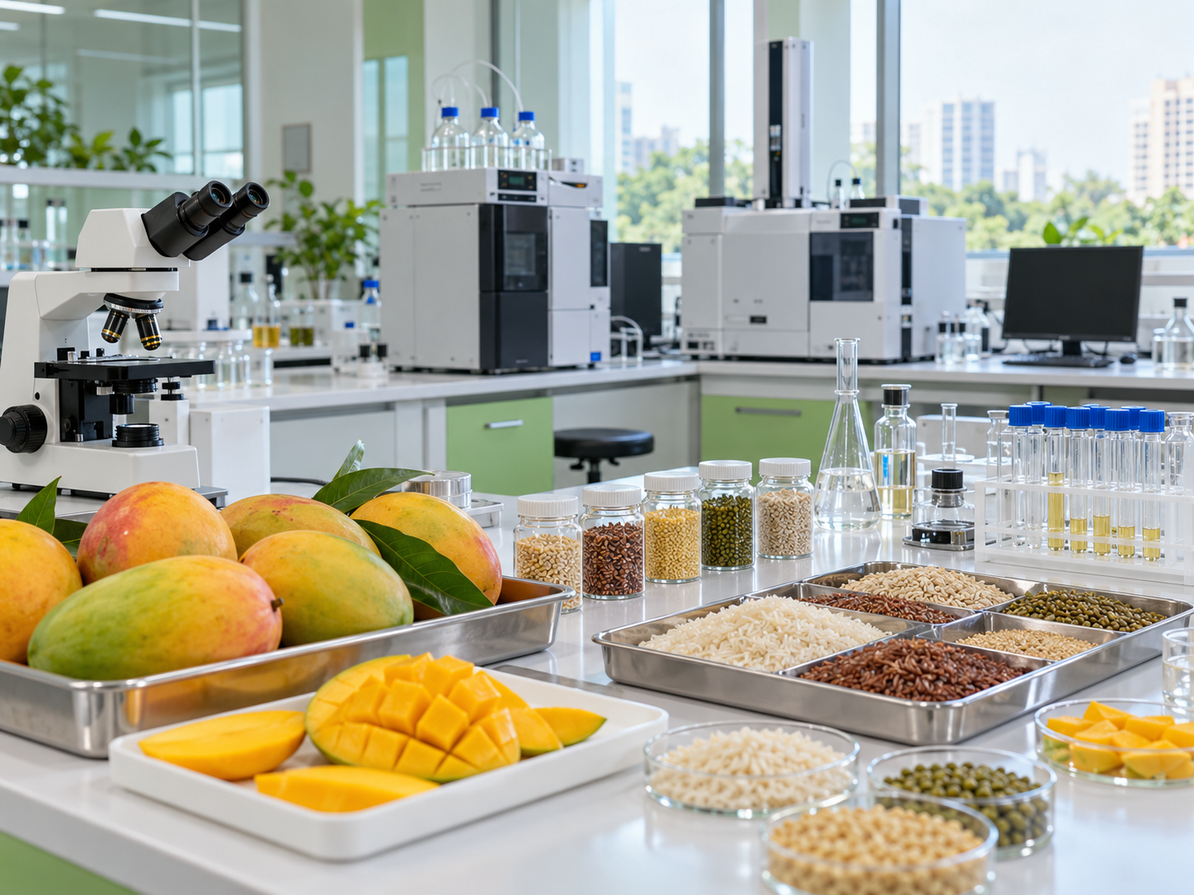

07
Quality, testing and laboratory assistance
Standard rates for certification, shelf life and export-quality verification
Certification
Quality packaging
Mandatory testing
50%
40%
50%
₹5 lakh
₹10 lakh
₹5,000
Per certification, including renewals
Equipment that improves quality / shelf life
Per sample, ₹20 lakh plan cap
Laboratory equipment
₹200 lakh listed labs
50% support
₹100 lakh in-house labs
Packaging: line + FSMS. Testing: no IPA. Lab consumables, civil works, furniture and office equipment excluded.
Bharat Krishi Niryat Yojana | Financial Assistance Guidelines 2026–27 to 2030–31
Notes:
Source: supplied FAS_Guidelines_06102026.pdf, pp. 16–18,20–25. Standard applicant route is the presentation's primary focus. Percentages are assistance up to the stated rate, subject to eligible cost, component ceilings, approval and funds.
Certification FSMS for own manufacturing, sustainability for manufacturing/production, ISO 9001 also merchant. Recognised/IAF-accredited bodies as applicable, separate application per certification, Annexure III fees. Packaging CAP/MAP/active, HACCP/ISO 22000 required. Lab testing is mandatory importing-country or notified APEDA traceability/monitoring. RCMC manufacturers/producers and NPOP operators. NPOP high-risk exports need Transaction Certificate on Trace.Net. NPOP 2% sampling reimbursable, CB-funded 5% sampling excluded. Recognised lab upgrades: APEDA recognition + NABL ISO 17025, equipment/eligible CRM. In-house lab eligible RCMC/NPOP. Higher special-category rates not the main route here. Photo is illustrative artwork.

Slide 8
08
Innovation, startups and export capability
Targeted assistance beyond the standard infrastructure routes
Innovation and startups
Innovative ideas
BHARATI startups
Up to ₹100 lakh
50%, up to ₹100 lakh
Novel solution and proof of concept
BHARATI registration + 3-year export projections
SPS activities
Startup traceability
50%, up to ₹25 lakh
50%, up to ₹20 lakh
SPS evidence, target market and measurable outcome
Eligible farm traceability hardware / software
New varieties
Training / study tours
Workshops and ToT
60%, up to ₹50 lakh
Per product / plan, exporters
50%, ₹3 lakh / person / year
One participant / organisation
₹5 lakh / event / beneficiary
ToT: 50%, ₹5 lakh / year
Bharat Krishi Niryat Yojana | Financial Assistance Guidelines 2026–27 to 2030–31
Notes:
Source: supplied FAS_Guidelines_06102026.pdf, pp. 18–19,21–22,24–28,35. Standard applicant route is the presentation's primary focus. Percentages are assistance up to the stated rate, subject to eligible cost, component ceilings, approval and funds.
Startup definition: RCMC + DPIIT, 2–5 years existence, turnover ≤₹500 lakh. BHARATI cohort indicative 10–20 per plan, export linkage/scalability and performance monitoring. ToT restricted to Central/State government institutions with competence and IPA. Workshop specific conditions exclude merchant exporters. Courses up to 1 month; training table includes travel+fee but detailed conditions only course/participation fee. ToT higher rate differs between table and detailed conditions. Imported material institutions rate up to90%; exporter60%, ₹50 lakh/product/plan, applicant handles import/royalty. Confirm differences with APEDA.

Slide 9
09
Market access and overseas promotion
Base assistance is 50% for the five routes below
₹100 lakh
₹50 lakh
₹10 lakh
₹10 lakh
₹8 lakh
Feasibility study
Trial shipment
Brand / IPR abroad
Retail shelf / listing
GI brand promotion
50%
50%
50%
50%
50%
Per study / beneficiary
New markets / products
Multimodal transport
Per beneficiary / plan
Per beneficiary / year
Per beneficiary
Bharat Krishi Niryat Yojana | Financial Assistance Guidelines 2026–27 to 2030–31
Notes:
Source: supplied FAS_Guidelines_06102026.pdf, pp. 30–34. Standard applicant route is the presentation's primary focus. Percentages are assistance up to the stated rate, subject to eligible cost, component ceilings, approval and funds.
Retail support restricted to FPOs, women-led enterprises, SC/ST exporters and startups. Special75% rates appear in component tables for studies/trials/IPR/GI while detailed trial/IPR/GI clauses list50%; confirm applicable approved rate. Study higher-category list also institutions/Indian missions/trade associations/organic. APEDA-led fairs/BSMs/ODOP/GI/organic promotion separate APEDA-implemented activity with preference new participants.

Slide 10
10
Market proposals: eligibility and evidence
The proposal must establish the target market and the activity-specific case
New market / product
Overseas brand and retail
Feasibility study
Brand / IPR
Consultant with 5 years’ experience, scope, quotation and justification. No repetition of a previous study.
Advance IPA, foreign country / justification, product / brand and overseas fee estimate
Trial shipment
Retail listing
Advance IPA, technical advisor and SOP. Validation report after shipment.
FPOs, women, SC/ST and startups. Foreign chain agreement / intent and fees. Pay chain / authorised entity
GI promotion
APEDA GI product from designated area. International promotion + activity budget. Domestic promotion excluded
Bharat Krishi Niryat Yojana | Financial Assistance Guidelines 2026–27 to 2030–31
Notes:
Source: supplied FAS_Guidelines_06102026.pdf, pp. 33–34,36. Standard applicant route is the presentation's primary focus. Percentages are assistance up to the stated rate, subject to eligible cost, component ceilings, approval and funds.
Retail fees are one-time initial onboarding / shelf-placement fees. Chain must operate in at least one foreign country. GI proposal includes market rationale, competitors, export projections and activity-wise budget. Routine business costs and domestic promotion excluded. Trial advisor may be ICAR, research institution/university or qualified expert; proposal follows APEDA priorities.

Slide 11
11
Application, approval and reimbursement
APEDA website: Schemes menu, “Submit BKNY Application”
Online filing
1
2
3
4
Application call
Complete proposal
Application fee
Tracking number
Priority groups / products. Window closes at twice available funds
Online form and prescribed supporting documents
Pay prescribed non-refundable submission fee
Scheme system generates the application reference
Evaluation and release
APEDA scrutiny
Technical Committee
IPA / Authority
Final claim
Technical / financial
Evaluation
Cost >₹250 lakh: Authority
Verification and payment
Bharat Krishi Niryat Yojana | Financial Assistance Guidelines 2026–27 to 2030–31
Notes:
Source: supplied FAS_Guidelines_06102026.pdf, pp. 35–41. Standard applicant route is the presentation's primary focus. Percentages are assistance up to the stated rate, subject to eligible cost, component ceilings, approval and funds.
Oversight Committee receives TC recommended applications for information. Technical/financial viability, designated applicant categories and pre-inspection may affect acceptance. Authority threshold is project cost over₹250 lakh, not grant. IPA required all components except lab testing5. Amendments within IPA validity; extension case-by-case. Claims and verification before disbursement, budget dependent.

Slide 12
12
Documents supporting the application
Six groups cover the core file. Each sub-component adds its prescribed formats
01
02
03
Land and approvals
Project proposal / DPR
Finance and appraisal
Title / 15-year lease, CLU, NOC and approvals
Profile, process flow, costs and export-market benefits
Appraisal / loan or relevant financial evidence
04
05
06
Quotations and cost
Civil works / layout
Eligibility and declarations
Minimum 3 equipment quotes, specifications and eligible costs
Engineer-certified BOQ and project drawing / layout
RCMC / NPOP / category, entity and other-assistance declarations
Bharat Krishi Niryat Yojana | Financial Assistance Guidelines 2026–27 to 2030–31
Notes:
Source: supplied FAS_Guidelines_06102026.pdf, pp. 9–14,25–27,33–36,38,42–65. Standard applicant route is the presentation's primary focus. Percentages are assistance up to the stated rate, subject to eligible cost, component ceilings, approval and funds.
Annexure I DPR and engineer forms, III certification fees, VIII training, IV testing linkage, VI CA claim, VII asset bond, IX ToT CA certificate and X NPOP2% procedures. Claim additions: invoices, highlighted bank debits, CA/UDIN/registration, ₹100 notarised indemnity bond, installation certificate, import Bill of Entry, prescribed APEDA asset marking, certificates/reports and Aadhaar as applicable. Public facilities require2 years audited statements and prescribed project appraisal, separate bank account, MoU conditions.

Slide 13
13
Release of assistance and continuing obligations
Standard exporter assistance reimburses approved eligible cost after completion and verification
Implementation
Final claim
Verification and payment
Approved eligible assets / activity within IPA validity
CA / UDIN, invoices, bank payments and completion evidence
APEDA scrutiny / inspection. Processing fee: 5% + GST
Claims before IPA expiry. For activities exempt from IPA, submit within 3 months of completion. Assistance depends on available funds.
25% BG
Quarterly
5 years
3 years or until performance, whichever is later
Online performance return, even when exports are nil
Retain assets. No sale / transfer. Recovery for breach
Bharat Krishi Niryat Yojana | Financial Assistance Guidelines 2026–27 to 2030–31
Notes:
Source: supplied FAS_Guidelines_06102026.pdf, pp. 35–41,59–63,66–80. Standard applicant route is the presentation's primary focus. Percentages are assistance up to the stated rate, subject to eligible cost, component ceilings, approval and funds.
25% infrastructure BG renewed annually; release after request, GST returns and performance verification. Special-category annual undertakings3 years, ownership/control plan or3 years post-disbursement whichever longer. FSSAI/regulatory requirements and RCMC ownership/location updates apply. Paint original APEDA logo plus Assisted by APEDA; stickers excluded. NPOP2% grower sampling claim through CB: recognised organic lab, payment/sampling/test evidence, counter samples retained≥6 months. CB-funded5% testing excluded. AnnexureVII5-year asset bond specifies12% recovery interest while general clauses use GFR norms. No right to carry claims beyond plan, subject scheme continuation/funds. Public1e/f40/40/20 releases and50% BG are a separate route, briefly mentioned on slide3.

Slide 14
Thank You
Mr. Sandeep Bohra
FCA, MBA, CAIIB
Founder & Chief Executive Officer
+91 99710 57298
sandeep@krishikaadvisory.com
krishikaadvisory.com
Block B, 818 & 817, 8th Floor, West Bank
Opp. Gold Cinema, Ashram Road
Ahmedabad – 380009
Notes:
Krishika brand and contact details from supplied UP presentation, retained as authorised by the user.

