Slide 1

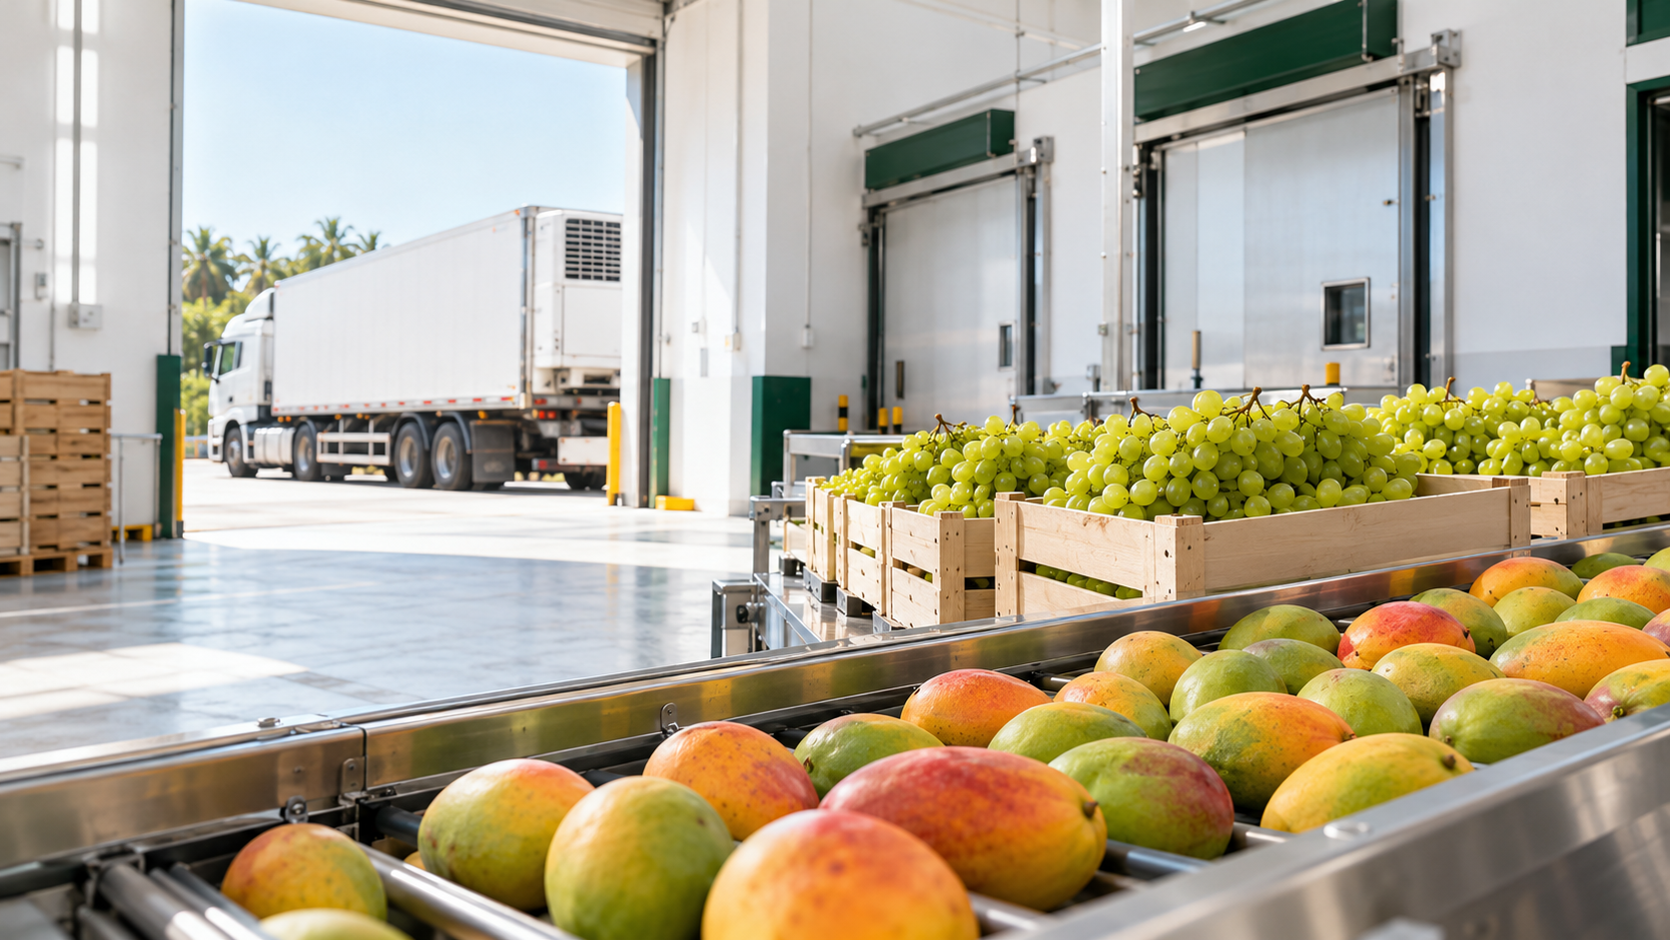
Bharat Krishi
Niryat Yojana
2026–27 to 2030–31
Financial Assistance Guidelines
Agricultural and Processed Food Products Export Development Authority (APEDA)
Export infrastructure and support for registered exporters
Notes:
Source: supplied guidelines pp. 1–4. Krishika logo from supplied UP presentation. Cover and facility photographs are AI-generated illustrative assets, not records of an actual funded project. Native text and policy diagrams remain editable.

Slide 2
Contents
01
Eligibility and support areas
08
Market access and overseas promotion
02
40% assistance for export infrastructure
09
Market proposals: eligibility and evidence
03
New packhouses and facility upgrades
10
Application, approval and reimbursement
04
Support along the export supply chain
11
Documents supporting the application
05
What counts for the infrastructure grant
12
Release of assistance and continuing obligations
06
Quality, testing and laboratory assistance
13
Common infrastructure for public institutions
07
Innovation, startups and export capability

Slide 3

Eligibility and support areas
01
Export infrastructure
Quality development
Market development
Packhouses, cold chain and facilities that close processing gaps
Certification, packaging, testing, laboratories and technology
New markets, overseas brands, retail access and GI promotion
APEDA RCMC exporters
Manufacturers, producers and eligible merchant exporters, including FPOs / PACS
Who can apply
Other eligible applicants
NPOP-certified organic operators, APEDA-listed labs and Central / State government institutions

Slide 4
40% assistance for export infrastructure
02
₹250 lakh
New integrated packhouse / facility
₹300 lakh combined limit across the four items above, per beneficiary over the plan period
40%
₹200 lakh
Upgrade or expansion of packhouse / facility
₹200 lakh
Processing gaps in an existing line
of eligible cost (maximum)
₹200 lakh
Reefer / insulated / mobile pre-cooling
75% instead of 40%, with the same ceilings, for exporters in North-East, Ladakh, J&K, Andaman & Nicobar or Lakshadweep, and for FPO, PACS, SC/ST, women and startups anywhere in India; they file an annual eligibility undertaking for 3 years.
Public common facilities use a separate route (13).

Slide 5
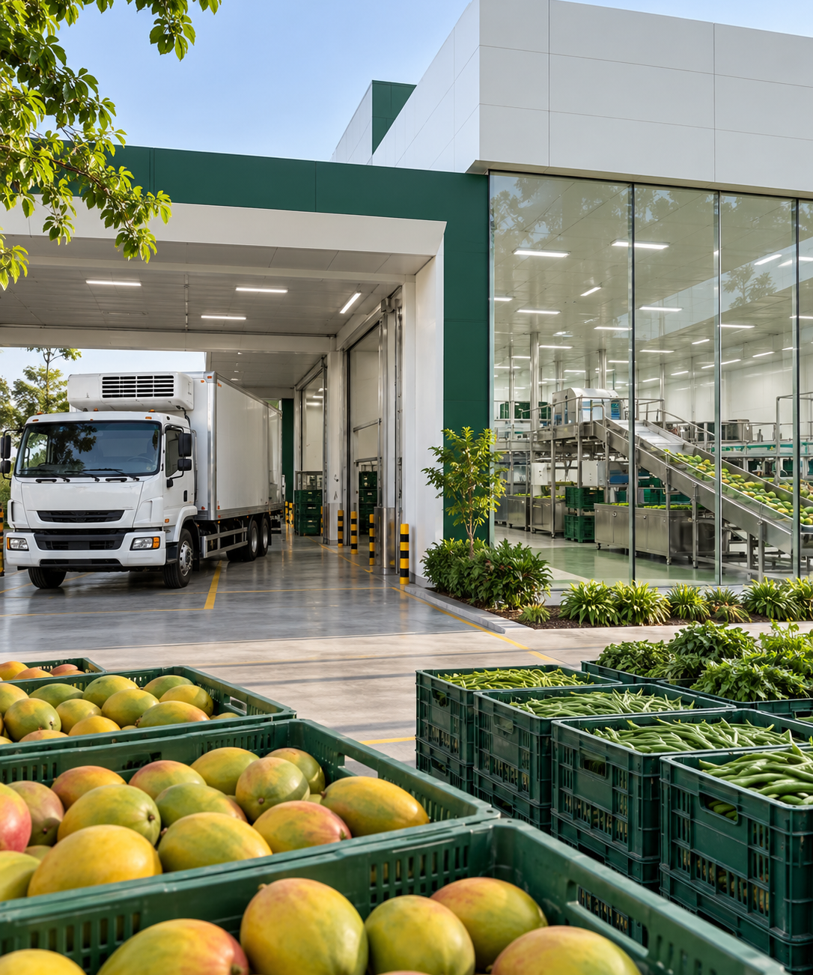
New packhouses and facility upgrades
03
40%
Collection, washing, grading, pre-cooling, packing and cold storage. New projects only. Washing / grading only for fresh fruit & vegetables, flowers and F&V seeds.
New facility
Up to ₹250 lakh
75% for special categories
40%
Upgrade / expansion
Machinery upgrades / automation of an existing packhouse or facility.
Up to ₹200 lakh
75% for special categories
Technical civil work
Maximum 25% of eligible assistance. Land in own name, a 15-year registered lease, or a partner's / director's land with their NOC; packhouses must meet NCCD / MIDH cold-chain norms.

Slide 6
Support along the export supply chain
04
Packing and cold storage
Processing gaps
Reefer logistics
Trial export shipment
Integrated handling and storage facilities
Sortex, IQF, X-ray and metal detection for quality / efficiency
Refrigerated / insulated transport and mobile pre-cooling
New market / product trials. Advisor and SOP required
40% · 75%* assistance
40% · 75%* assistance
40% · 75%* assistance
50% · 75%* assistance
₹250 lakh new
₹200 lakh upgrade
Up to ₹200 lakh
Up to ₹200 lakh
Up to ₹10 lakh
*75% for exporters in North-East, Ladakh, J&K and the islands, and for FPO, PACS, SC/ST, women and startups; same ceilings.

Slide 7
What counts for the infrastructure grant
05
No double funding: a component already funded by another government agency is not eligible; other applications for the same project must be declared.
Eligible investment
Timing and procurement
Technical civil work for the project
Quotations
Quote 1
Quote 2
lowest
Quote 3
Assistance calculated
on lowest quote
New plant and machinery
Get 3 quotes from OEMs / authorised dealers; you may buy from any of them.
Exceptions: sole manufacturer or imported equipment (declaration required).
Online filing
IPA
Technical civil assistance cannot exceed 25% of total eligible assistance. Submit a certified BOQ and equipment specifications.
Costs before online filing are ineligible.
Costs between filing and IPA count only if APEDA accepts them.
Own land or 15-year lease
or a partner's / director's land with NOC
Processing-gap support:
existing line + HACCP / ISO 22000
Reefer vehicles per plan:
2 merchant / 5 manufacturer exporters

Slide 8
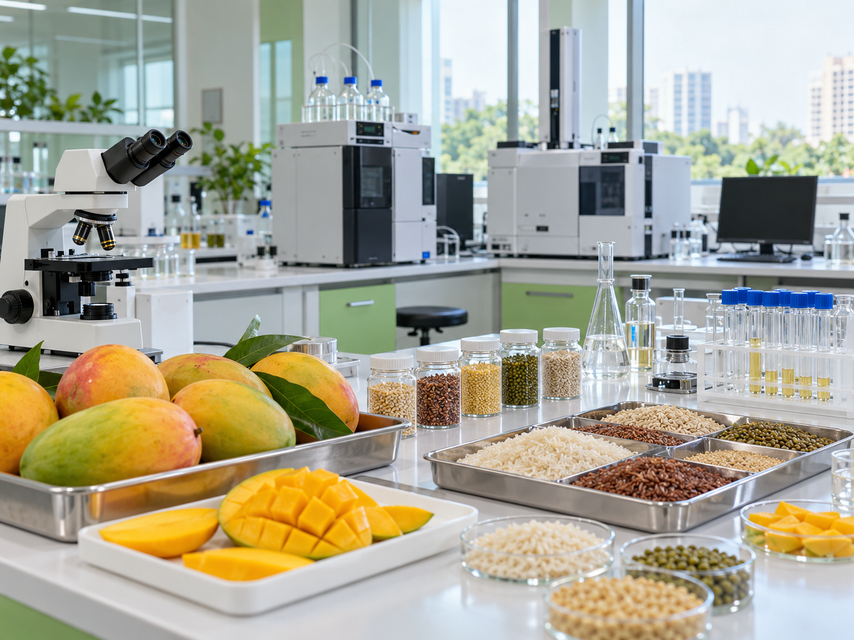

Quality, testing and laboratory assistance
06
Certification
Quality packaging
Mandatory testing
50%
40%
50%
₹5 lakh
₹10 lakh
₹5,000
Per certification, incl. renewals. FSMS: own manufacturing unit
Equipment that improves quality / shelf life
Per sample where the importing country / APEDA requires testing; ₹20 lakh plan cap
Laboratory equipment
₹200 lakh listed labs
50% support
₹100 lakh in-house labs
Listed-lab upgrades need APEDA recognition + NABL ISO 17025. Special categories get 75% on all items here, same ceilings.
Packaging support needs an existing line and food-safety certification. Testing claims need no prior approval (IPA). Lab equipment excludes consumables, glassware, computers, fridges / ACs, furniture and civil works.

Slide 9
Innovation, startups and export capability
07
Innovation and startups
Innovative ideas
BHARATI startups
Up to ₹100 lakh
50%, up to ₹100 lakh
Novel solution and proof of concept
Registered under APEDA's BHARATI startup programme; 3-year export plan
SPS activities
Startup traceability
50%, up to ₹25 lakh
50%, up to ₹20 lakh
Fix an importing country's food / plant-safety (SPS) issue; show target market and outcome
Eligible farm traceability hardware / software
Startup = APEDA RCMC holder with DPIIT certificate, 2–5 years old, turnover up to ₹500 lakh
New varieties
Training / study tours
Workshops and ToT
60%, up to ₹50 lakh
Per product / plan, manufacturer / producer exporters
50%, ₹3 lakh / person / year
One participant / organisation
₹5 lakh / event / beneficiary (not merchant exporters)
ToT (govt institutions): 50%, ₹5 lakh / year

Slide 10
Market access and overseas promotion
08
₹100 lakh
₹50 lakh
₹10 lakh
₹10 lakh
₹8 lakh
Feasibility study
Trial shipment
Brand / IPR abroad
Retail shelf / listing
GI brand promotion
50%
50%
50%
50%
50%
Per study / beneficiary
New markets / products
Multimodal transport
Per beneficiary / plan
FPOs, women, SC/ST, startups; per year
Per beneficiary
*75% for special categories (North-East, Ladakh, J&K, islands; FPO, PACS, SC/ST, women, startups); for studies also trade bodies, Indian missions, govt agencies and organic exporters.
Trade fairs, buyer-seller meets and GI / ODOP / organic promotion are run directly by APEDA, with preference to new participants.

Slide 11
Market proposals: eligibility and evidence
09
New market / product
Overseas brand and retail
Feasibility study
Brand / IPR
Consultant with 5 years’ experience, scope, quotation and justification. No repetition of a previous study.
Advance IPA, foreign country / justification, product / brand and overseas fee estimate
Trial shipment
Retail listing
Advance IPA, technical advisor and SOP. Validation report after shipment.
FPOs, women, SC/ST and startups. Foreign chain agreement / intent and fees. Fee paid directly to the retail chain or its authorised agent
GI promotion
APEDA GI product from designated area. International promotion + activity budget. Domestic promotion excluded
Bharat Krishi Niryat Yojana | Financial Assistance Guidelines 2026–27 to 2030–31

Slide 12
Application, approval and reimbursement
10
Rejected outright if the application is incomplete, the pre-inspection is unsatisfactory, or more than one application is filed for the same sub-component.
Online filing
1
2
3
4
Application call
Complete proposal
Application fee
Tracking number
Priority groups / products. Window closes once requests reach twice the funds available
Online form and prescribed supporting documents
Pay prescribed non-refundable submission fee
Scheme system generates the application reference
Evaluation and release
APEDA scrutiny
Technical Committee
Approval (IPA)
Final claim
Technical / financial
Evaluation
Over ₹250 lakh: APEDA Authority approval
Verification and payment

Slide 13
Documents supporting the application
11
01
02
03
Land and approvals
Project proposal / DPR
Finance and appraisal
Title / 15-year lease, CLU, NOC and approvals
Profile, process flow, costs and export-market benefits
Loan sanction and appraisal note; mandatory for public common facilities
04
05
06
Quotations and cost
Civil works / layout
Eligibility and declarations
Minimum 3 equipment quotes, specifications and eligible costs
BOQ certified by Chartered Engineer / Civil Architect; layout drawing for public common facilities
RCMC / NPOP / category, entity and other-assistance declarations

Slide 14
Release of assistance and continuing obligations
12
You fund the full project first. APEDA reimburses the approved assistance in one payment after completion and verification; there is no advance or instalment.
Implementation
Final claim
Verification and payment
Approved eligible assets / activity within IPA validity
CA certificate, invoices, bank payments; APEDA logo painted on assets (no stickers)
APEDA scrutiny / inspection. Processing fee: 5% + GST
Claims before IPA expiry. For activities exempt from IPA, submit within 3 months of completion. Assistance depends on available funds.
No claims can be carried beyond the plan period (2026–27 to 2030–31); assistance also depends on the scheme continuing.
25% BG
Quarterly
5 years
25% of the grant, held 3 years from payment, or longer until the declared export performance is met
Online performance return, even when exports are nil
Keep assisted assets for 5 years; selling or transferring them means refund with interest

Slide 15
Common infrastructure for public institutions
13
90%
New common facility
Grant released in three instalments
Up to ₹600 lakh
40%
40%
20%
Integrated pack houses, processing units, laboratories etc. set up by Central / State government institutions
1st 40%
After a bank guarantee of 50% of the assistance, valid for the project period plus 12 months
90%
Upgrade of existing common facilities
Up to ₹200 lakh
2nd 40%
After proof of expenditure including own share, utilisation and CA certificates, and APEDA inspection
Up-gradation and modernisation of existing common facilities
Final 20%
On commissioning and an O&M contract with end users (labs: NABL ISO 17025)
Only in these regions
North-East
Ladakh
J&K
Andaman & Nicobar
Lakshadweep
If not implemented as approved: refund with interest; bank guarantee forfeited.
DPR + CE certificate
Annexure I format
Appraisal note
bank, or own if no loan
Land title / 15-yr lease
encumbrance-free, with CLU
Separate bank account
for the grant released

Slide 16
Thank You
Mr. Sandeep Bohra
FCA, MBA, CAIIB
Founder & Chief Executive Officer
Contact: +91 99710 57298
Email: sandeep@krishikaadvisory.com
Website: krishikaadvisory.com
Address: Block B, 818 & 817, 8th Floor, West Bank
Opp. Gold Cinema, Ashram Road
Ahmedabad – 380009
Notes:
Krishika brand and contact details from supplied UP presentation, retained as authorised by the user.

