Slide 1


Handwriting Text Recognition
Group members:
Kushagr Garg IIT2018107
Hitesh Kumar IIT2018160
Aditya IIT2018161
Akshit Agarwal IIT2018166
Sushant Singh IIT2018171
Month
20XX

Slide 2
Introduction
There are many things we humans have in common. But there are other things that are very unique to every individual - DNA, fingerprints, etc. Handwriting is one other such thing that is unique to every individual.
As computerization is becoming more prominent these days, Handwriting Recognition is gaining importance in various fields eg. Authentication of signatures in banks, recognizing ZIP codes addresses on letters, forensic evidence, etc.
In Handwritten manuscript there is no restriction on the writing technique. Handwritten alphabets are complicated to recognize because of miscellaneous human handwriting technique, difference in size and shape of letters, angle.
Handwriting recognition has been one of the most fascinating and challenging research areas in the field of image processing and pattern recognition. Handwriting recognition is the task of transforming a language re-presented in its own spatial form of graphical marks into a symbolic representation.
A number of techniques are available for feature extraction and training of CR systems in the literature, each with its own superiorities and weaknesses.
Notes:
final kb tq complete krna h project

Slide 3
Problem Statement
It is easy for the human to perform a task accurately by practicing it repeatedly and memorizing it for the next time. Human brain can process and analyse images easily. Also, recognize the different elements present in the images.
In this competition, the goal is to correctly identify images from a dataset of thousands of handwritten images and experiment with algorithms to learn first-hand what works well and how techniques compare.
Notes:
han

Slide 4

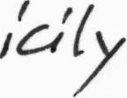

Dataset
IAM Handwriting Dataset is a collection of handwritten passages by several writers.
The dataset is freely available at fki site.[1] The database contains forms of unconstrained handwritten text, which were scanned at a resolution of 300dpi and saved as PNG images.
It includes contributions from 657 writers making a total of 1,539 handwritten pages comprising 115,320 words and is categorized as part of modern collection.
The figure below provides samples of a complete form, a text line and some extracted words.

Slide 5
Literature Survey
TITLE | OBJECTIVE | METHODOLOGY | CONCLUSION
Handwritten word recognition based on structural characteristics and lexical support. (2003) | The main objective in this paper is recognize handwritten word based on structural characteristics, histograms and profiles. (NIST Dataset) The well-known horizontal and vertical histograms are used, in combination with the newly introduced radial histogram, out-in radial and in-out radial profiles for representing 32 × 32 matrices of characters, as 280-dimension vectors. | The recognition process has been supported by a lexical component based on dynamic acyclic FSAs (Finite-State-Automata). The horizontal histogram, the vertical histogram, the radial histogram, the out-in profile and the in-out radial profile are further calculated in this methodology. | The described approach has been tested on two different databases with recognition accuracy varying from 72.8% to 94.8% depending on the difficulty of the database and the character category.

Slide 6
Literature Survey
TITLE | OBJECTIVE | METHODOLOGY | CONCLUSION
Handwritten Word Recognition with Character and Inter-Character Neural Networks (2012) | The main objective is to describe an off-line handwritten word recognition system. (NIST Database) The images of handwritten words are further matched to lexicons of candidate strings. | The segmentation process initially detects connected components. Some simple grouping and noise removal is performed. The methodology described here builds the confidence modification due to spatial relationships into the dynamic programming. | A word recognition algorithm employing dynamic programming, neural- network- based character recognition, and neural-network based inter-character compatibility scores shows that the inter-character information can lead to a significant improvement in performance.

Slide 7
Literature Survey
TITLE | OBJECTIVE | METHODOLOGY | CONCLUSION
HandWritten Character Recognition using Artificial Neural Network (2014) | The objective of this project is to identify handwritten characters with the use of neural networks by constructing a suitable neural network and training it properly. (No Benchmark Dataset used.) | The input is fed through the network which traverses through each neuron as it compares the input image with each neuron and gives the value in terms of a percentage of similarity between the input image and the neurons. | Classification of characters and learning of image processing techniques is done in this project. The result which was got was correct up to more than 90% of the cases, but it would be improved at the end.

Slide 8
Methodology
In this proposed approach, we intend to use Neural Networks(NN) for image text recognition purposes. Our desired NN consists of three parts namely,
CNN Layers
RNN Layers
Connectionist Temporal Classification Layer(CTC) Layer
This methodology joins the over three layers and plans to accomplish best in class precision/results.
Image Pre-Processing :
We have built a separate module for the task of image pre-processing.
It will take an image, one at a time and apply image augmentation, which in our case is varying the width of image by a random factor. Because, transformations operations like rotation and noise addition will cause severe loss of data, rendering image of no further use.
In the next step, we apply contrast stretching on the on the image obtained after step above.

Slide 9
Methodology
We then apply the morphological operation of erosion, it will make the text written on image sharp. It will thus increase probability of correct decoding by our model, thus in turn increasing model accuracy.
Image is the further resized to dimensions of 64X800.
The obtained image is then returned for further processing.
A Formal Approach :
Firstly Use Convolutional Recurrent Neural Network to extricate the significant highlights from the transcribed line text Image.
The yield before the CNN FC layer (512x100) is passed to the BLSTM which is for arrangement reliance and time-succession tasks. The yield of BLSTM is 100x80 i.e 100 timesteps and 80 characters including clear.
At that point CTC LOSS is utilized to prepare the RNN which kills the Alignment issue in Handwritten since manually written have an alternate arrangement of each author.
We just gave them what is written in the picture (Ground Truth Text) and BLSTM yield, at that point it ascertains misfortune basically as log("gtText"); expect to limit the negative greatest probability way.

Slide 10
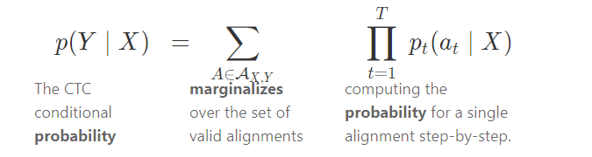
Methodology
At that point, CTC discovers the potential ways from the given marks. Misfortune is given by for (X, Y) pair is:
Finally, For decoding the output we used CTC decode, during Prediction.
Basically, 3 steps are involved :
Multi-scale feature Extraction --> Convolutional Neural Network 7 Layers
Sequence Labeling (BLSTM-CTC) --> Recurrent Neural Network (2 layers of LSTM) with CTC
Transcription --> Decoding the output of the RNN (CTC decode)

Slide 11
Methodology
CNN Layers:
The input image is fed into the CNN layers.
These layers are trained to extract relevant features from the image.
The proposed part consists of:
Convolutional Layers
RELU Activation Layer
Max-Pooling Layer
RNN Layers:
The output of CNN Layers is fed to RNN layers as input.
Most probably we may use LSTM implementation of RNN. If time allows we may also focus on implementing 2D-LSTM for better results.
Connectionist Temporal Classification Layer(CTC) Layer:
While training CTC Layer is fed with output generated by RNN Layers as input.
It will also be provided with ground truth text to calculate loss.
While inferring, the CTC is only given the matrix and it decodes it into the final text.
Notes:
ok

Slide 12
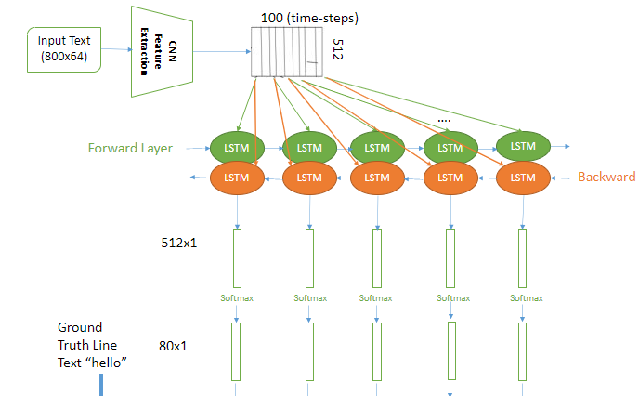
Overview of NN Architecture

Slide 13
Activity Schedule
.
Till 14 Feb
15-18 Feb
19-27 Feb
2 -10 March
12-30 March
1-20 April
Understanding the need of the project
Finding Appropriate Dataset
Finalized the complete methodology with its flow diagram to be followed up.
Will be Implementing all the decided modules
Will be Training and Testing the Model
Will be Comparing the accuracy with some other model and Finalizing the Model.
Notes:
star bhai

Slide 14
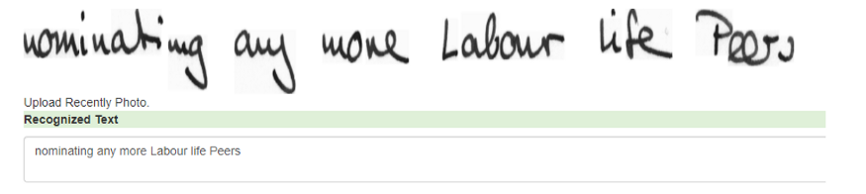
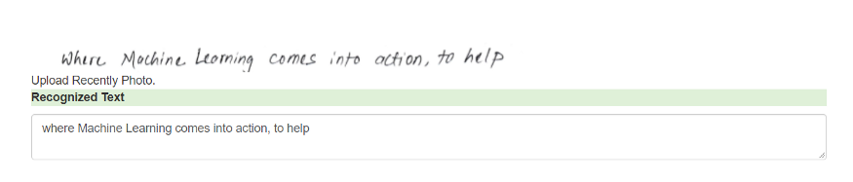
Results

Slide 15
Conclusion
In this project, we have tried to recognize many address blocks written in capital/small letters. The strength of algorithms that we have used is that it is even able to recognize blocks/sentences in which the letters are slightly joined.
We have talked about how CRNN (CNN + LSTM) can perceive text in pictures with its itemized design. The model comprises of 7 CNN and 2 LSTM layers and yields a character-likelihood grid. We have used Convolutional Recurrent Neural Network to recognize the Handwritten line text image without pre-segmentation into words or characters. Then use CTC loss Function is used to train.
The model has yielded an accuracy of 88% on training, on testing the received accuracy is 81%. We have used Levenshtein Distance as a metric to determine the accuracy of the model.

Slide 16
References
https://fki.tic.heia-fr.ch/databases/iam-handwriting-database
E. Kavallieratou, K. Sgarbas, N. Fakotakis and G. Kokkinakis, “Handwritten Word Recognition based on Structural Characteristics and Lexical Support”, by Wire Communications Lab, University of Patras, 26500 Patras, 2003.
Paul D. Gader, Magdi Mohamed, and Jung-Hsien Chiang, “Handwritten Word Recognition with Character and Inter-Character Neural Networks”, 2012.
Tapan K Bhowmik Swapan K Parui Ujjwal Bhattacharya Bikash Shaw, “An HMM Based Recognition Scheme for Handwritten Oriya Numerals”, 2014.

Slide 17
Thank You!

