Slide 1

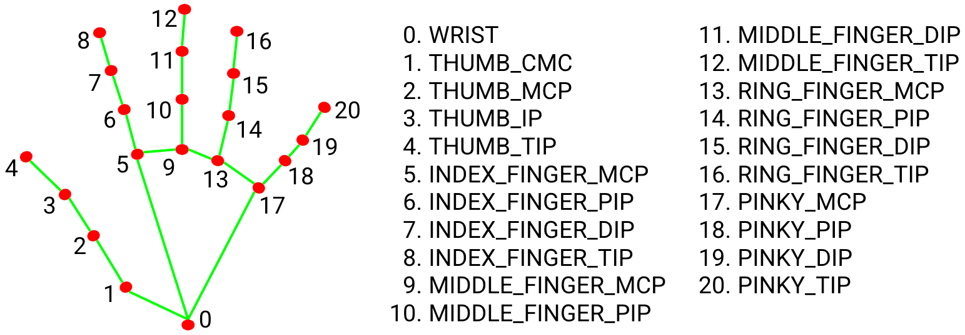
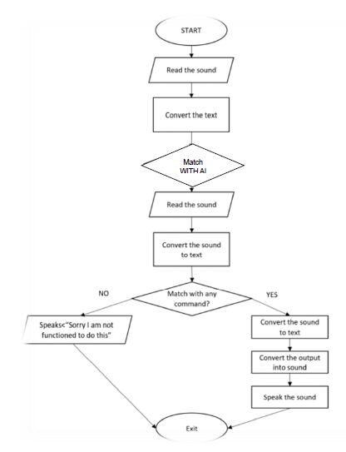
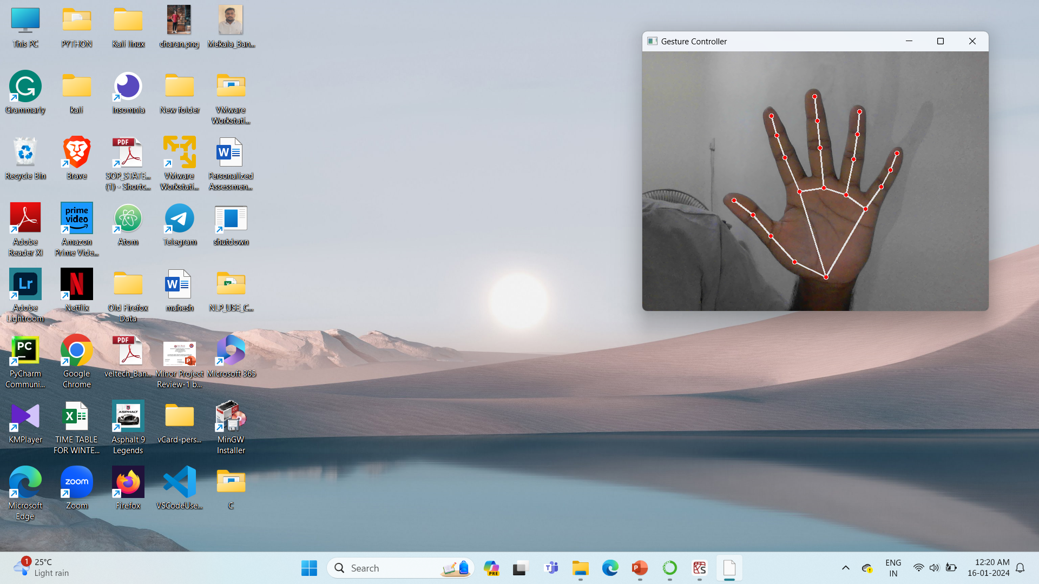
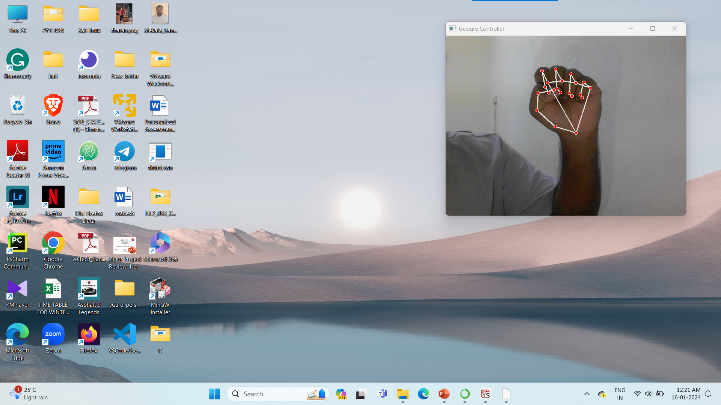
GMAI - Augmented Mouse Using Hand Gesture Recognition by Artificial Intelligence
Department of Computer Science & Engineering
School of Computing
1156CS701 – MAJOR PROJECT
WINTER SEMESTER 2023-2024
ABSTRACT
INTRODUCTION
STANDARDS AND POLICIES
RESULTS
In this project, a virtual mouse system that makes use of hand recognition technologies is being developed. The device does away with the requirement for a physical mouse by allowing users to control their computer cursor with hand movements. The hand identification system precisely detects and tracks hand movements using computer vision techniques, providing accurate cursor control. The virtual mouse technology provides an intuitive approach to communicate with computers, a user-friendly interface, and easy accessibility.
One of the most significant developments in Human-PC Interaction (HCI) is the mouse. Currently, a remote mouse or a Bluetooth mouse really uses technology because they require a battery for electricity and a dongle to connect to a computer. This restriction can be overcome in the proposed AI virtual mouse architecture by using a webcam or an additional camera to capture hand motions and the location of the hand tip using computer vision. Without using a real mouse, the Computer can be effectively operated by using gestures to execute clicking, looking-over functions, and PC cursor activities.
Through the use of hand movements, users can control the computer cursor with a virtual mouse utilising hand recognition software, doing away with the necessity for a hardware mouse.
The user's hand movements are detected and tracked by this technology, which subsequently translates these into cursor movements on the computer screen.
In comparison to conventional mouse systems, the hand recognition-based virtual mouse has a number of advantages, including better accessibility for people with disabilities or mobility issues, increased comfort and lessened physical strain for users, and the potential for more engaging and intuitive user interfaces in a variety of contexts, including gaming and virtual reality.
The Potential uses for the creation of a virtual mouse based on hand identification include the medical, educational, and entertainment industries.
In healthcare, education, and entertainment, it might allow touchless control of medical equipment, more engaging learning opportunities, and immersive gaming experiences.
The usefulness and accessibility of technology could be considerably increased for a larger range of people if this study is successful.
Privacy policies: Virtual mouse technology often involves the use of cameras and other sensors to track hand gestures and movements. Companies that develop and use this technology should have clear privacy policies that explain how user data is collected, used, and protected. They should also obtain user consent before collecting or using any personal data.
Security standards: Virtual mouse technology can be vulnerable to security threats such as hacking, malware, and unauthorized access. Companies should follow security standards and best practices to ensure that user data and devices are protected from these threats.
Accessibility: Virtual mouse using hand gesture recognition can provide a more natural and intuitive interface for people with disabilities who cannot use a traditional mouse. It can enable people with limited mobility, hand tremors, or amputations to interact with computers and other devices more easily.
Mobility: Virtual mouse using hand gesture recognition can also provide a hands-free interface for people who need to control a computer or other devices while moving around or performing other tasks. For example, surgeons in the operating room can use hand gestures to control medical devices without touching them directly.
Gaming and entertainment: Virtual mouse using hand gesture recognition can provide a more immersive and interactive experience for gaming and entertainment. Users can make hand gestures to control the characters or objects in the game, making the experience more engaging and realistic.
Virtual and augmented reality: Virtual mouse using hand gesture recognition can also be used in virtual and augmented reality applications, where users need to interact with virtual objects in a natural and intuitive way. For example, architects and designers can use hand gestures to manipulate virtual models in real-time.
Blue Print of GMAI &AI voice Assistant
CONCLUSIONS
The fundamental goal of the virtual mouse concept is to eliminate the necessity for a hardware mouse and, instead, utilize hand movements for controlling the mouse cursor on the screen. This is accomplished by processing frames to perform the required mouse operations based on detected fingers and hand tips. The suggested system can be implemented effortlessly using either a webcam or an embedded camera. We have been able to automate multiple services with a unified command thanks to the voice assistant. This tool makes it easier for users to do the bulk of their tasks, such as internet searches. Our aim is for this programme to be completely capable of replacing the need for human server admins. As this system is made on Anaconda community, so any adjustments may be made immediately.
METHODOLOGIES
Hand detection: The majority of virtual mouse systems start by determining whether a hand is present in the input image or video frame. This can be accomplished by isolating the hand region based on its distinctive colour or depth values using color-based or depth-based segmentation, respectively.
Hand segmentation: The following step after locating the hand region is to separate the hand from the surrounding area and remove any undesired or noisy areas. Many methods, including thresholding, morphological procedures, and contour analysis, can be used to accomplish this.
User interface: The virtual mouse system may have a graphical user interface that shows the mouse cursor's present location, the motion that was identified, and any instructions or functions that are accessible. The user interface can be made to be straightforward and understandable, and it can inform the user about the effectiveness and precision of the system.
Mouse control: After recognizing the gesture, the final step is to control the mouse cursor based on the gesture. This can be done using different approaches such as mapping the gesture to the cursor movement, clicking and dragging functions, or other customized functions based on the application.
TEAM MEMBER DETAILS
Vtu15197/ Mekala Banti
9392707098
vtu18232@veltech.edu.in
ACKNOWLEDGEMENT
1. Dr. Sibi Prabha, Associative Professor
2. 91 9894259969
3. drprabham@veltech.edu.in
Chart 1. OUTPUT.

