Slide 1

ASTRO_HEALTH
A project based on ASP.NET

Slide 2
Minor Project on Asp.net
Project guide: Prof. Rajdeep Chowdhury
(HOD, BCA)
Project by: Raju Bala - 31801215017
Rikita Chakraborty – 31801215018
Sheikh Asif – 31801215020
Sreetama Dhar – 31801215021
Srija Saha - 31801215022
(BCA 5th Semester)

Slide 3
Why we chose this area?
We were interested in developing websites and web applications.
ASP.NET is a very valuable tool for building dynamic, rich websites and web applications using compiled languages like VB and C#.
ASP.NET drastically reduces the amount of code to build large applications, and many more.
We believe we can have a grasp on the subject while learning it theoretically and practically, both.

Slide 4
Project objectives:-
Astro_Health is a web application which will predict disease by any symptoms entered by any user. It will also suggest medicine according to the predicted disease.
The main goal of our web application is to help users immediately in their medical or health emergency.

Slide 5
Project Details : -
It might have happened so many times that you or someone yours need doctors help immediately, but they are not available due to some reason. The Astro_Health is an end user support and online consultation project. Here we propose a system that allows users to get instant guidance on their health issues through an intelligent health care system online. The system is fed with various symptoms and the disease/illness associated with those systems. The system allows user to share their symptoms and issues. It then processes user’s symptoms to check for various illnesses that could be associated with it. Here we have used database to store the symptomes, diseases, medicines, user details etc. In Admin module when Admin will log in to the system Admin can view his patient details and the report of that patient. Admin can view details about the patient search what patient searched for according to their prediction. Admin can view his/her personal details. Admin can add new disease details by specifying the type and symptoms of the disease into the database. Admin can view various disease and symptoms stored in database. This system will provide proper guidance when the user specifies the symptoms of his illness.

Slide 6
Advantages :-
User can search for quick prediction of their diseases at any point of time.
User will get a suggested medicine according to their predicted disease.
Website will give a instant search result so it is very useful for emergencies.
Anyone can use the website just by registering their details.
User can leave their suggestions in the feedback field.

Slide 7
Features :-
Registration: -If Patient is a new user he will enter his personal details and he will user Id and password through which he can login to the system.
Patient Login: - Patient Login to the system using his ID and Password.
My Details: - Patient can view his personal details.
Disease Prediction: - Patient will specify the symptoms caused due to his illness, then disease will be predicted and medicines will be suggested.
Feedback:-Patient will give feedback this will be reported to the admin.
Admin Login: Admin can login to the system using his ID and Password.
Add Disease: Admin can add disease details along with symptoms and type.
Add Symptoms: Admin can add symptoms.
Add Medicines: Admin can add medicines.
View Disease: Admin can view various diseases details stored in database.
View Patient: Admin can view various patient details who had accessed the system.
View Feedback: Admin can view feedback provided by various users.

Slide 8
Software Requirements:-
Windows 7 and above
Microsoft SQL Server
Visual Studio

Slide 9
Hardware Components :-
Processor – Dual Core
Memory – 4GB RAM

Slide 10
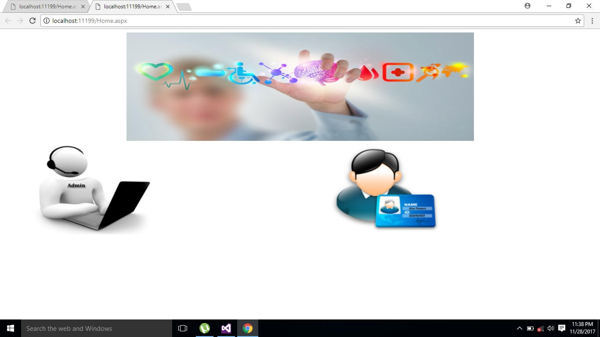
Screenshots : -
Admin
User

Slide 11
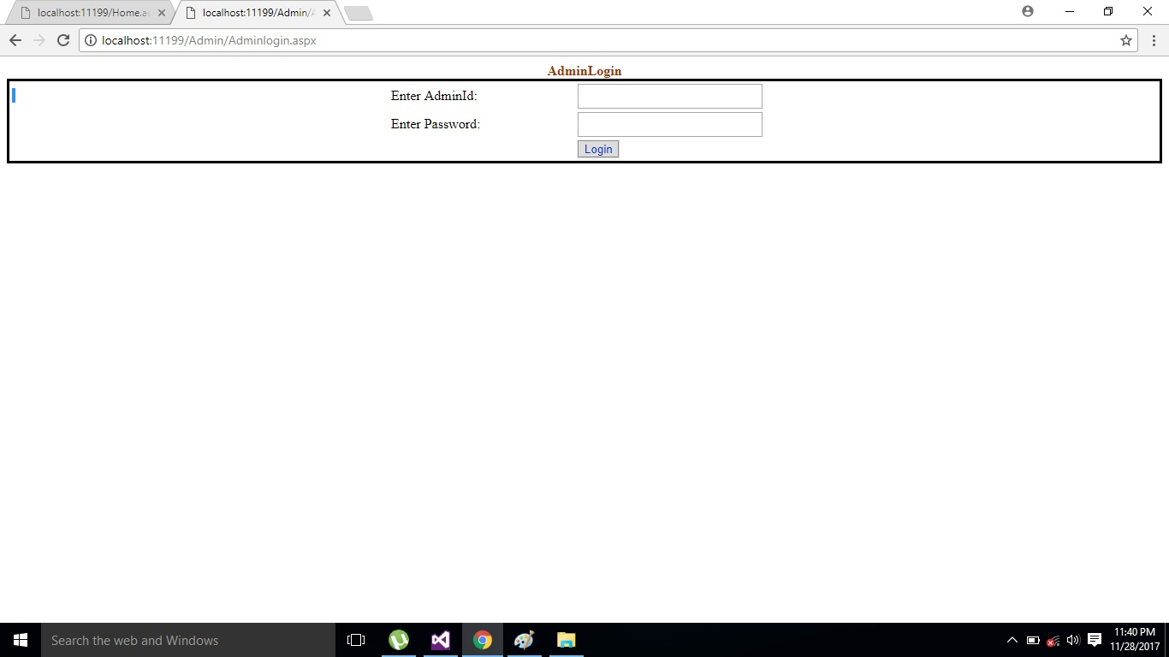
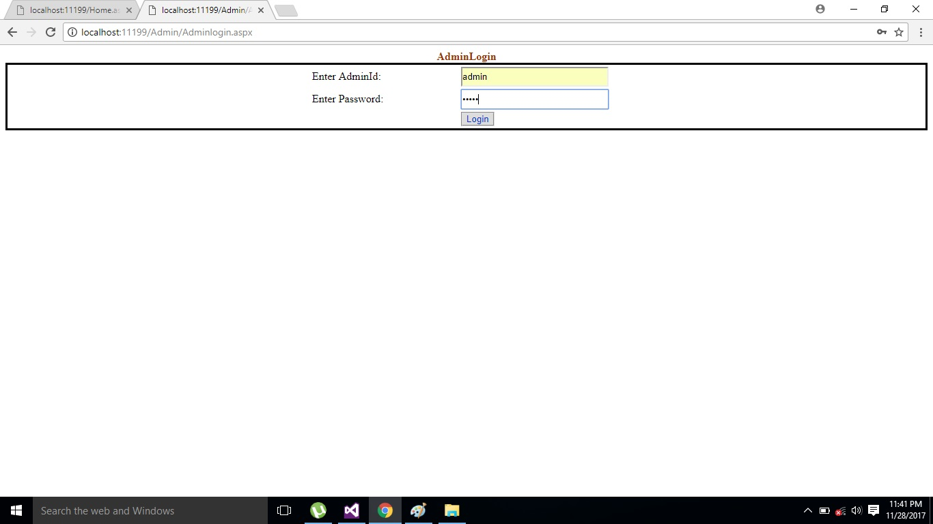
Admin Log in page:-

Slide 12
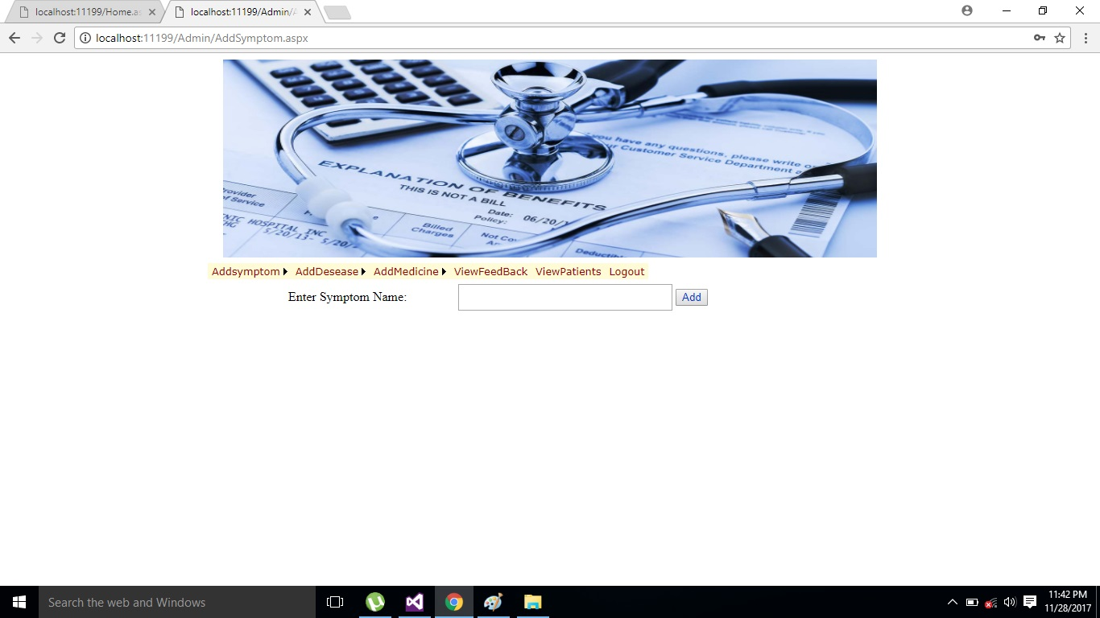
Add Symptom page:-
Admin Can Add new symptoms here.

Slide 13
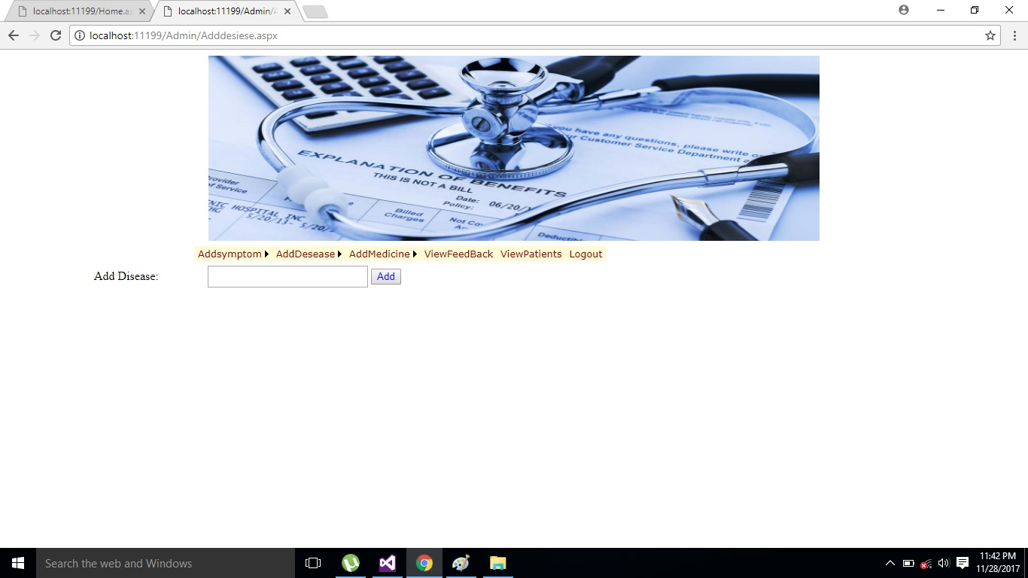
Add Disease page:-
Admin Can Add new disease here.

Slide 14

Add medicine page:-
Admin can add new medicines here.

Slide 15
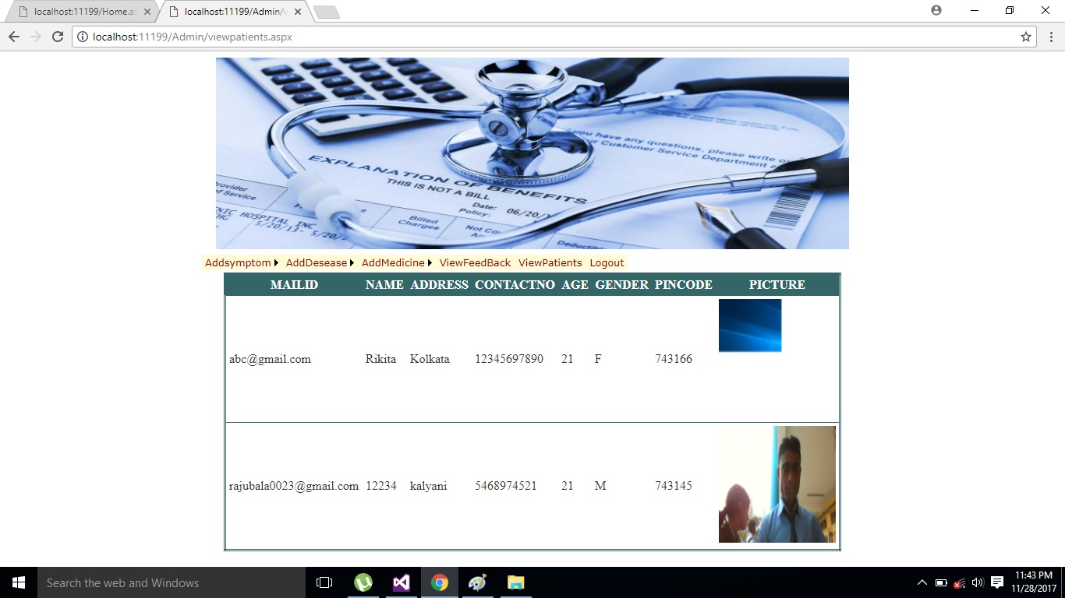
View Patients Page :-
Here admin can view the registered patients’ details.

Slide 16
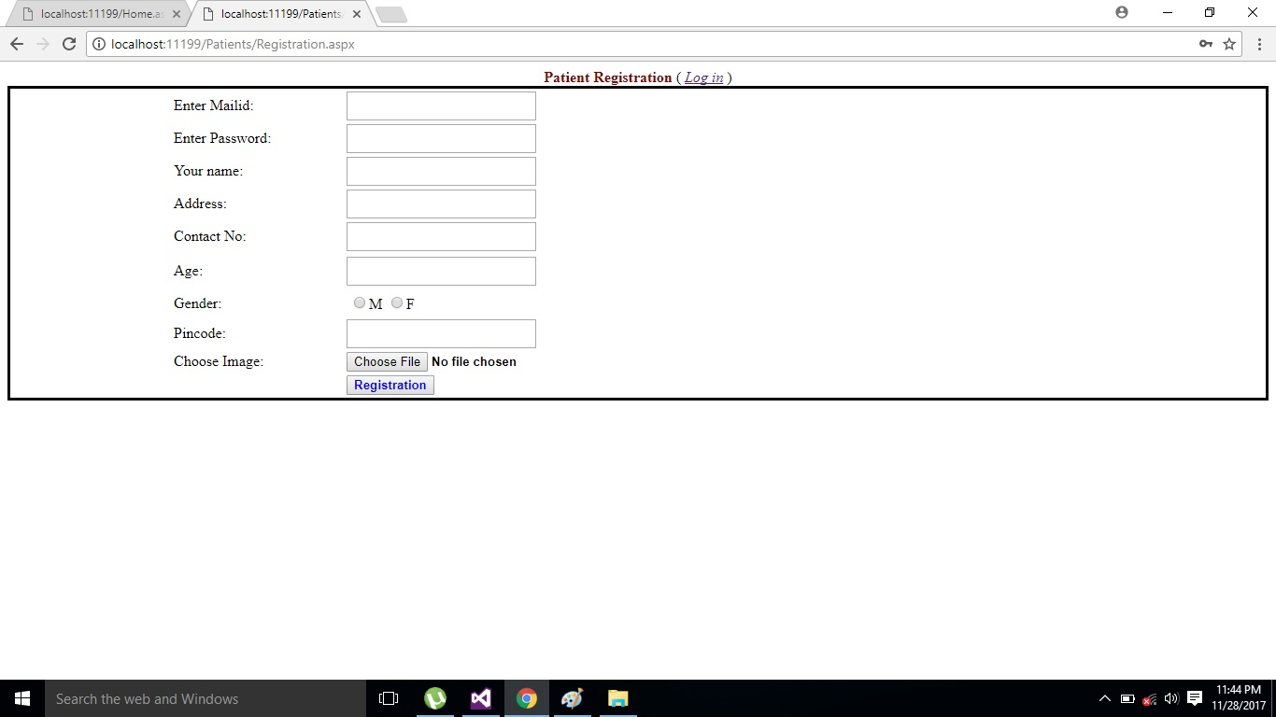
Registration page :-
Here user have to register his/her details.

Slide 17
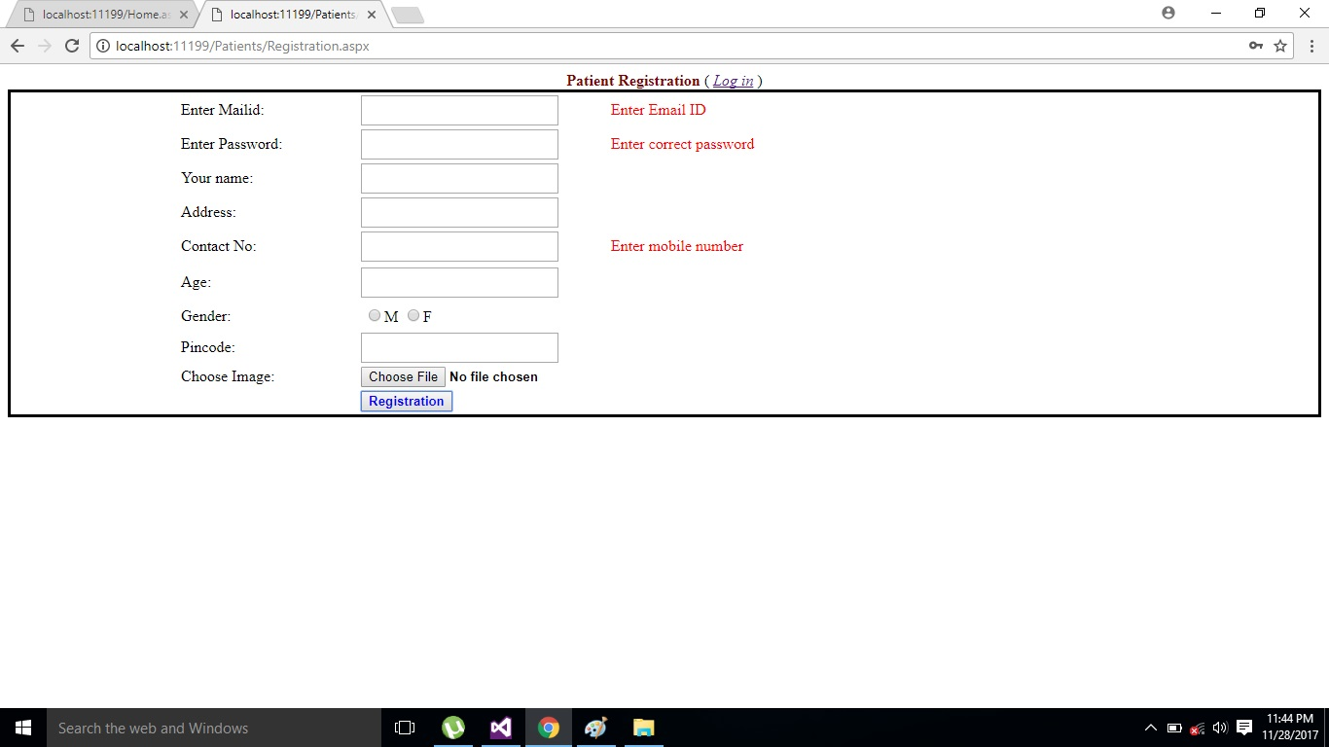
Validation:-
User have to fill all the fields correctly.

Slide 18
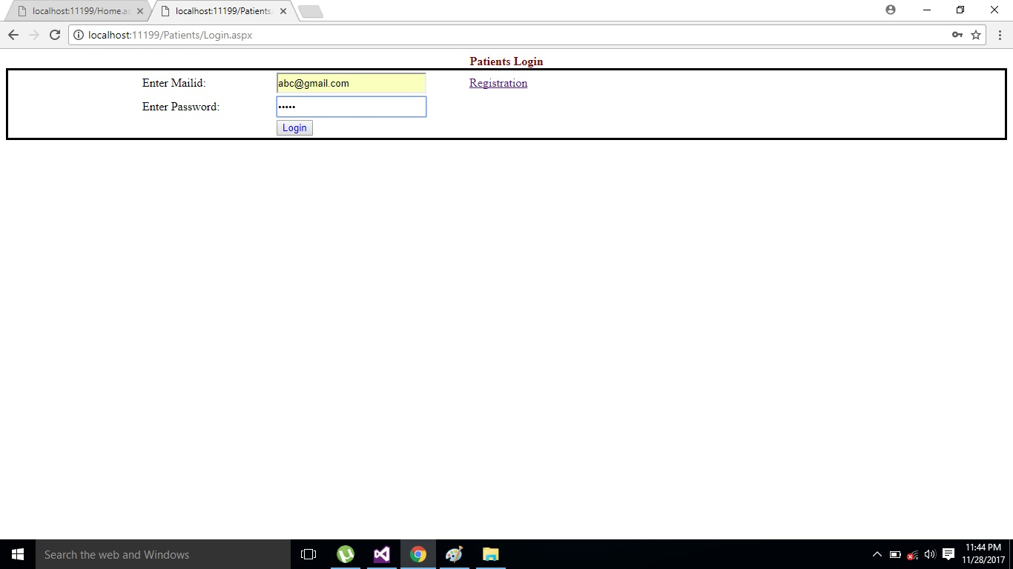
User Log in page :-
After registration user can log in.

Slide 19
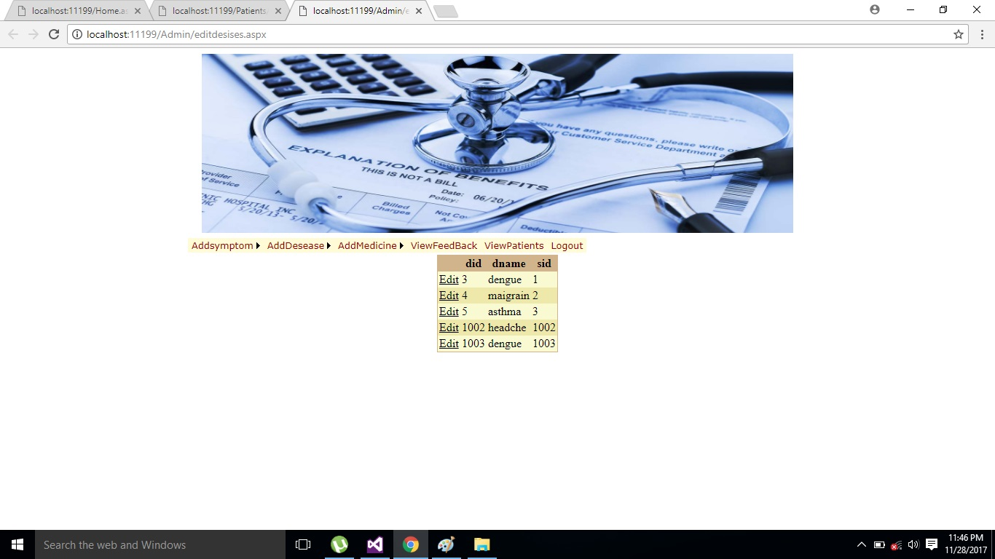
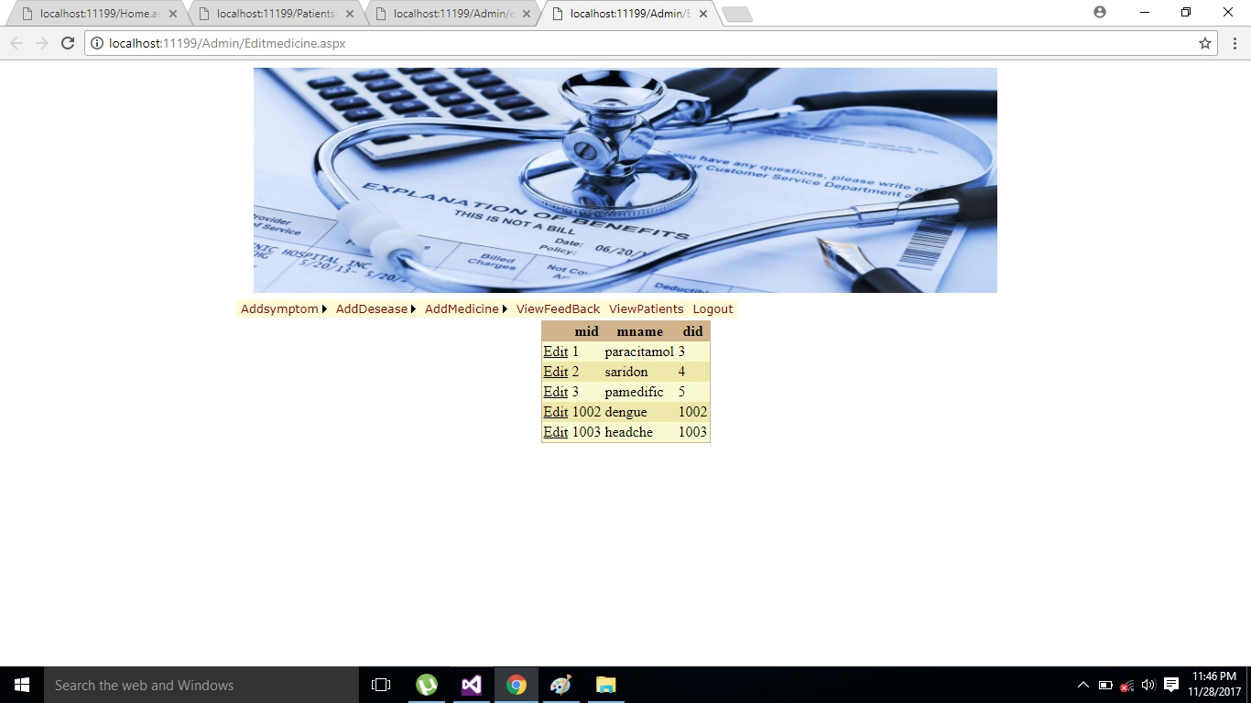
Update or edit:-
Admin can update or edit the symptoms, disease, medicines respect to their ID in the database table.

Slide 20
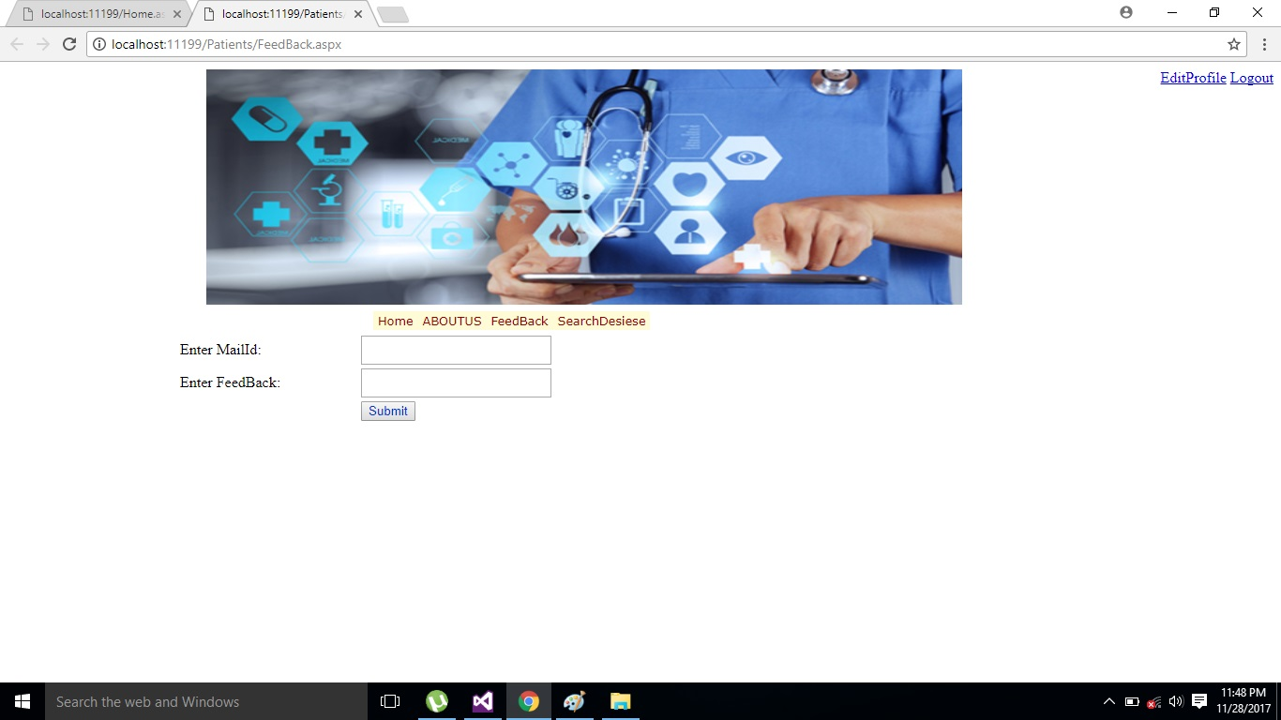
User Feedback page :-
User can leave their feedback here. First they have to enter their Mail ID.

Slide 21
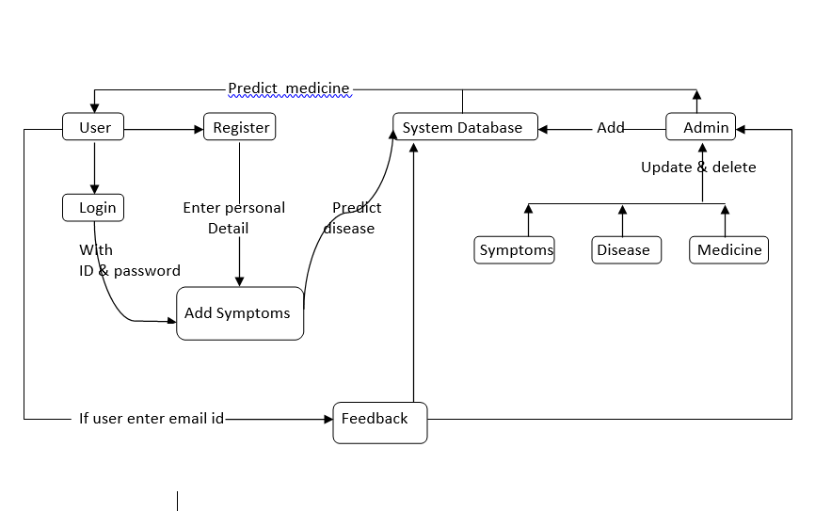
DFD

Slide 22
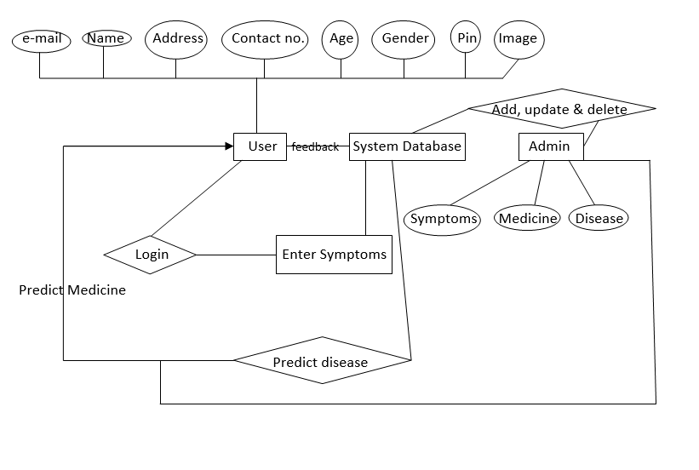
ER Diagram :-

Slide 23
Future scope of improvements:-
We have successfully completed the project on “Astro_Health”. There are still many improvements that we are planning to add in the near future. The planned changes are stated below:-
To add a Doctor field so that user can search for doctor’s help at any point of time.
User can talk about their illness and get instant diagnosis.
Doctors get more clients online.
To make the application environment more useful.

Slide 24

THANK YOU

