Slide 1
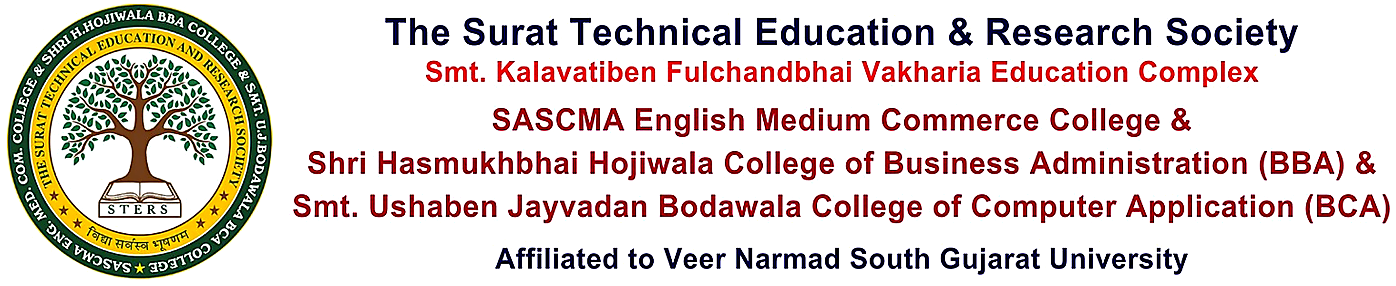
PustakSetu
Liabrary Management System
Submitted By :
STD 1 name
STD 2 name
STD 3 name
Project Guided By :
Mrs. Minal Desai

Slide 2
Table Content
Page No | Contents
1. | Overview
2. | Introduction
3. | Scope & Objectives
4. | Data Dictionary
5. | ER Diagram
6. | Data Flow Diagram
7. | User Interface
8. | Limitation and System Enhancement
9. | Conclusion
10. | Reference

Slide 3
Overview
PustakSetu is a web-based Library Management System designed to simplify and digitize library operations. It connects students and library administrators through a centralized platform where users can discover books, search and filter available resources, and monitor their borrowed books. Administrators can efficiently manage books, categories, members, inventory, book issues, returns, overdue records, and fines. The system reduces manual paperwork, improves book and inventory tracking, and provides secure role-based access. It is built using modern technologies like React, Node.js, Express.js, and a relational database.

Slide 4
Introduction
PustakSetu is a modern web-based Library Management System developed to digitize and simplify traditional library operations. The system provides a centralized platform for managing books, categories, students, members, inventory, book issues, returns, overdue records, and fines. Students can register and securely log in to search and filter books, check availability, view book details and shelf locations, and monitor their borrowed books. Administrators can efficiently manage library resources and circulation activities through a secure role-based system. The platform is built using modern technologies like React, Node.js, Express.js, and a relational database.

Slide 5
Scope
Scope :
Category Management – Organize books into different categories.
Member Management – Manage student/member registration and information.
Inventory Management – Track total, available, issued, damaged, and lost books.
Book Search & Discovery – Search and filter books by title, author, ISBN, and category.
Book Issue & Return – Manage book issuing, due dates, and returns.
Overdue & Fine Management – Track overdue books and applicable fines.
Borrowing History – Allow students to view current and previous borrowed books.
Role-Based Access – Provide separate access and functionality for Admins and Students/Members.
Centralized Management – Maintain library records through a single digital platform.
Book Management – Add, update, delete, and manage book details.

Slide 6
Objectives
Objectives :
To provide a centralized system for managing books, members, and inventory.
To make book searching and discovery faster and easier.
To efficiently manage book issue, return, due dates, and overdue records.
To maintain accurate inventory and book availability information.
To track fines and borrowing history effectively.
To provide secure role-based access for Admins and Students/Members.
To reduce manual paperwork and administrative effort.
To improve the overall efficiency and accuracy of library operations.
To digitize and automate traditional library management operations.

Slide 7
Whole System’s ER Diagram

Slide 8
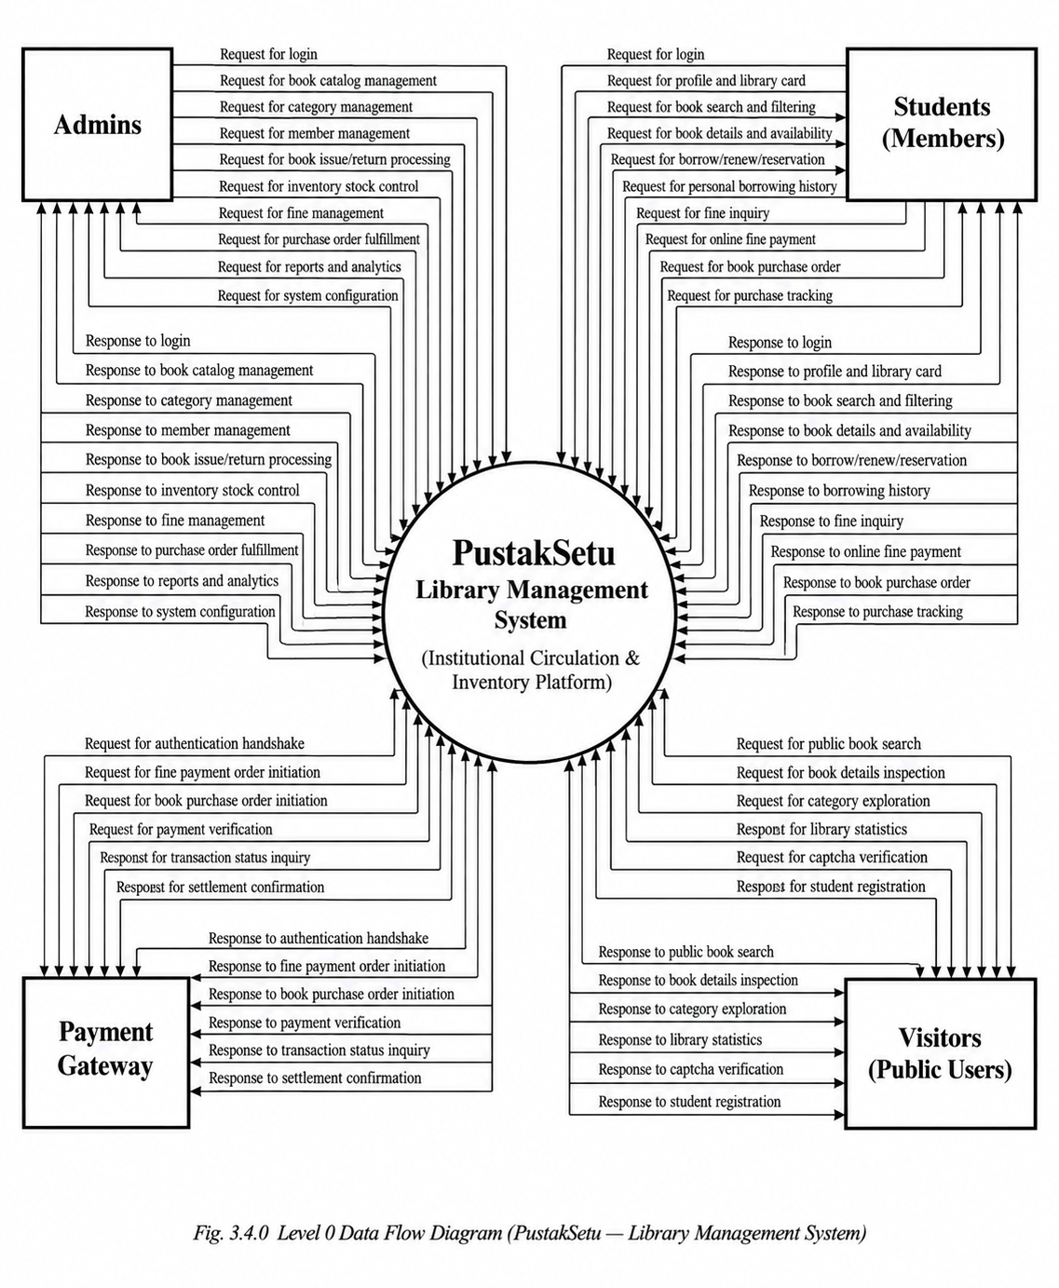
Level 0
Data Flow Diagram

Slide 9
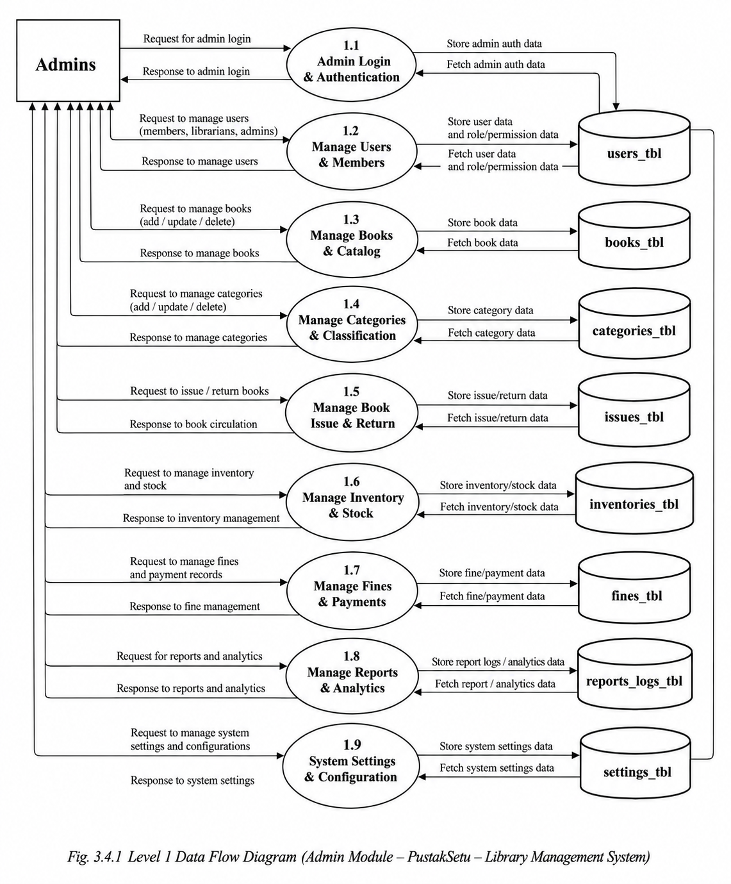
Level 1
Data Flow Diagram For admin

Slide 10
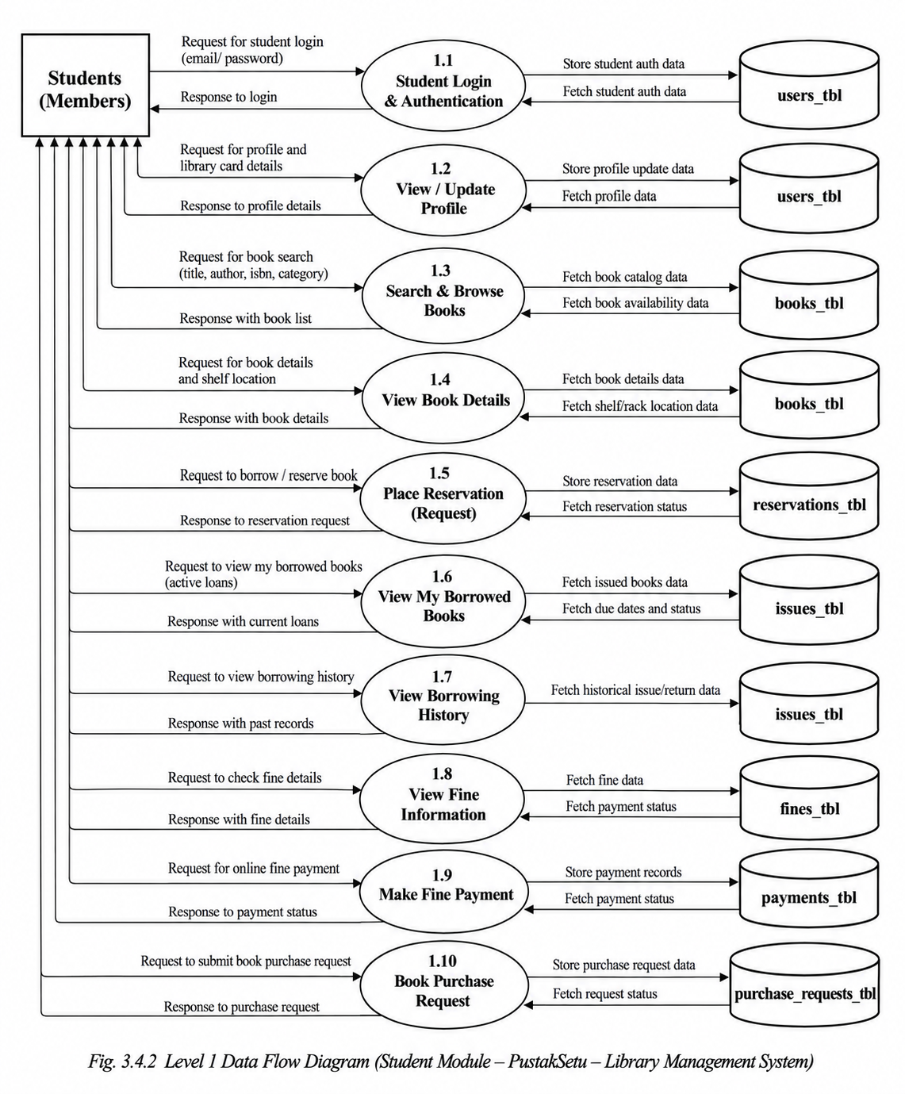
Level 1
Data Flow Diagram for Student

Slide 11
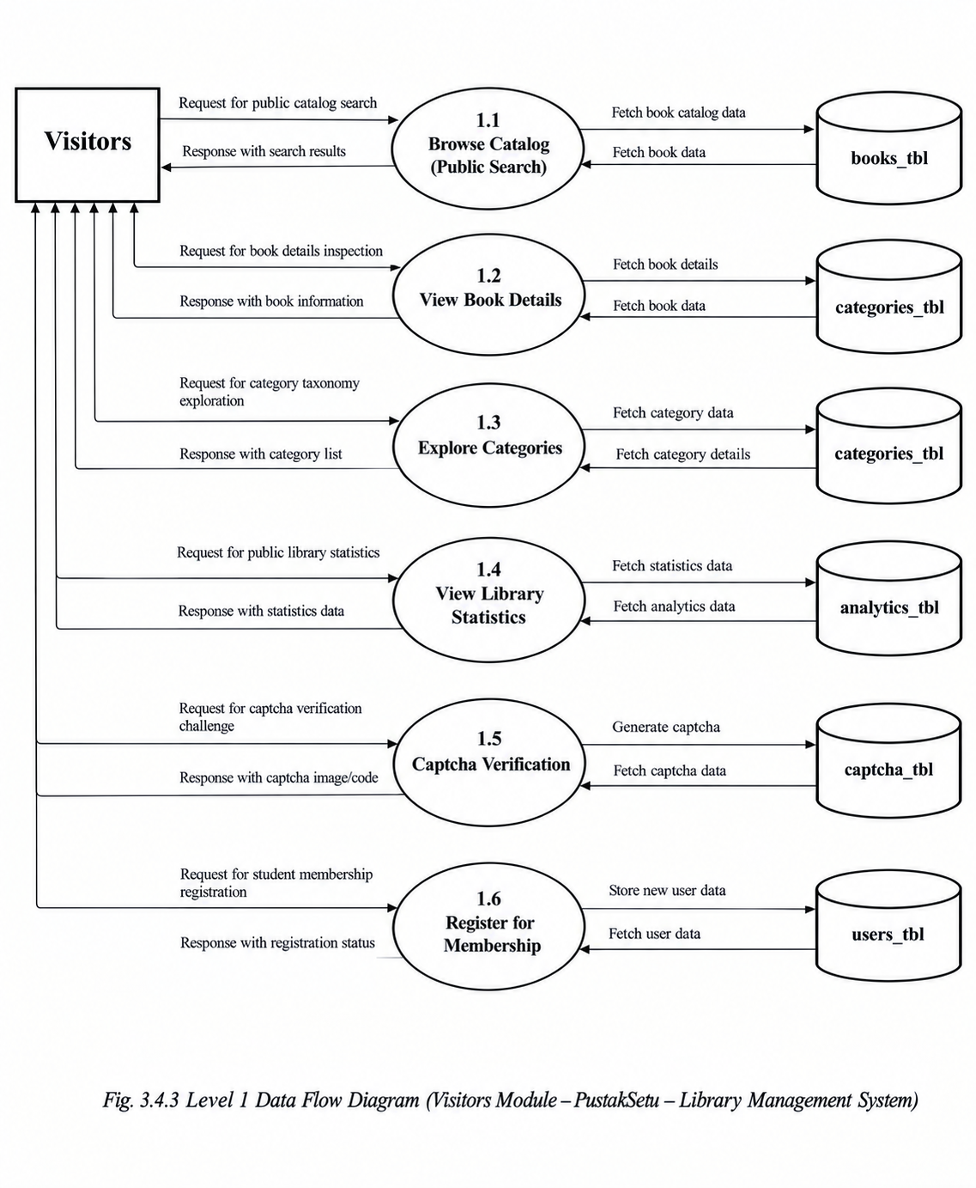
Level 1
Data Flow Diagram for visitor

Slide 12
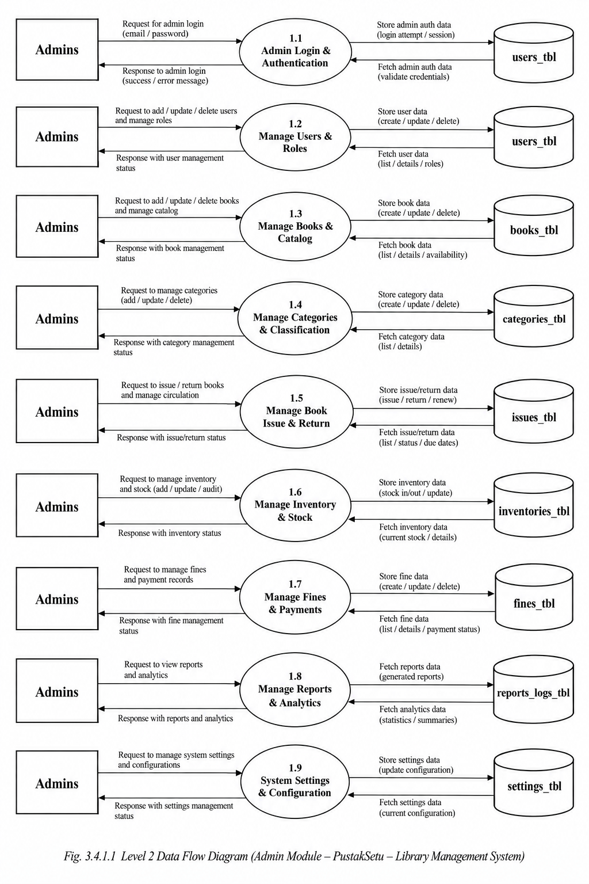
Level 2
Data Flow Diagram for admin

Slide 13
Level 2
Data Flow Diagram for admin

Slide 14
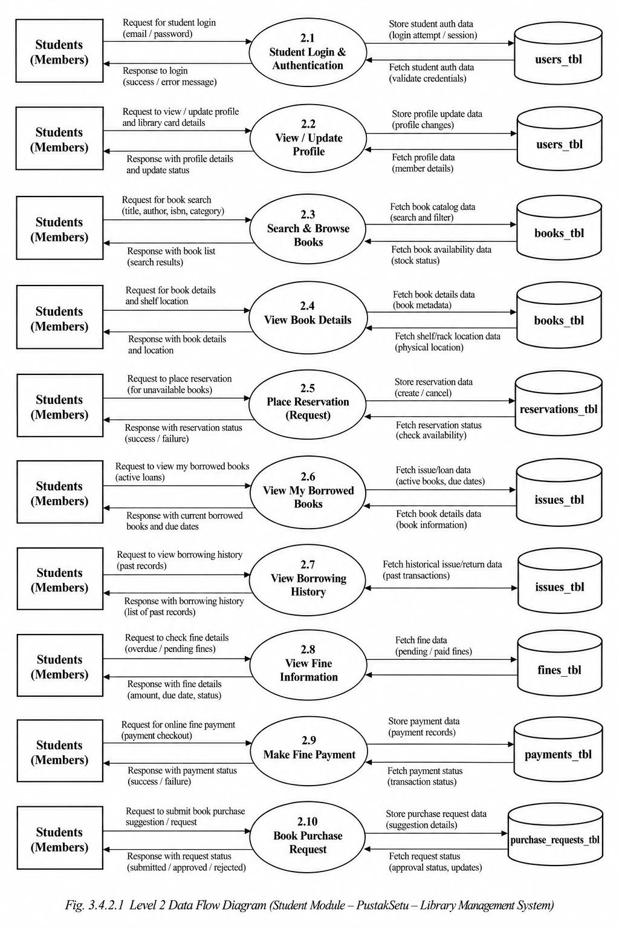
Level 2
Data Flow Diagram for student

Slide 15
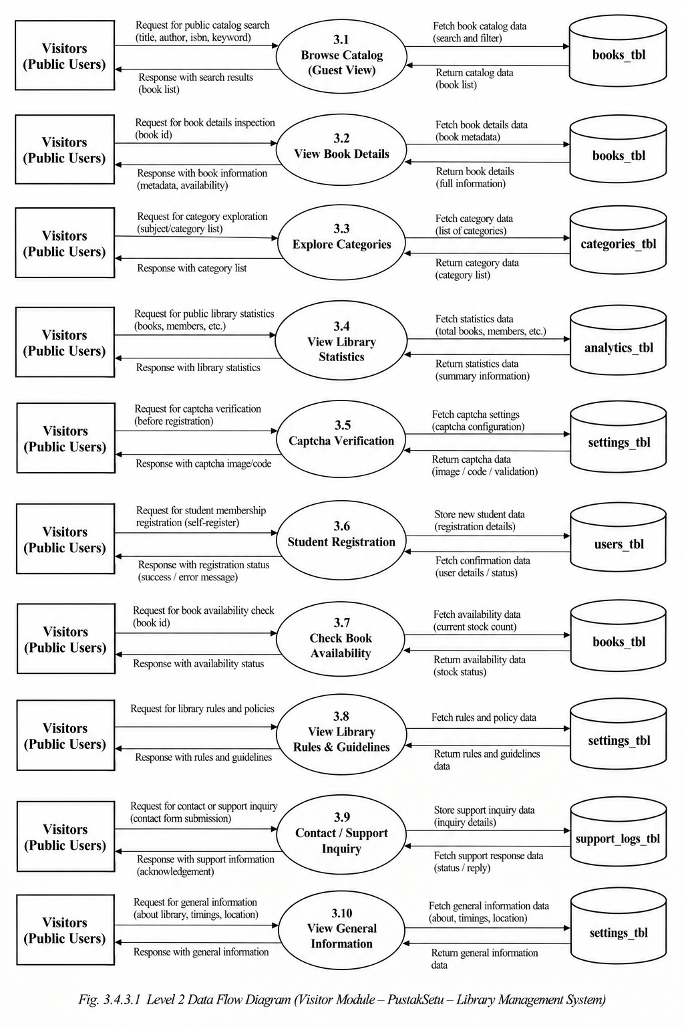
Level 2
Data Flow Diagram for visitors

Slide 16
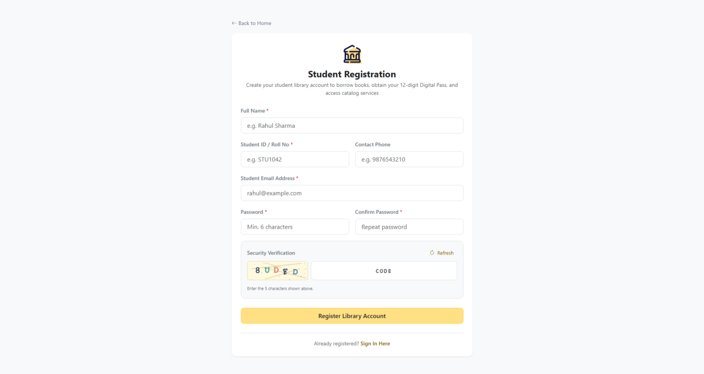
User Interface
Registration From

Slide 17
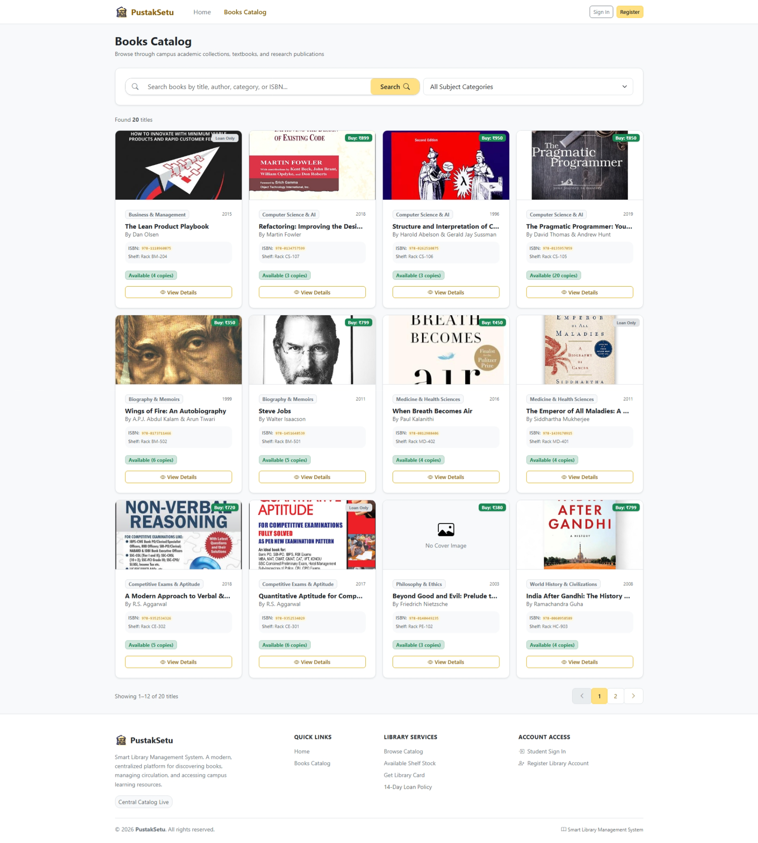
User Interface
Book catalog

Slide 18
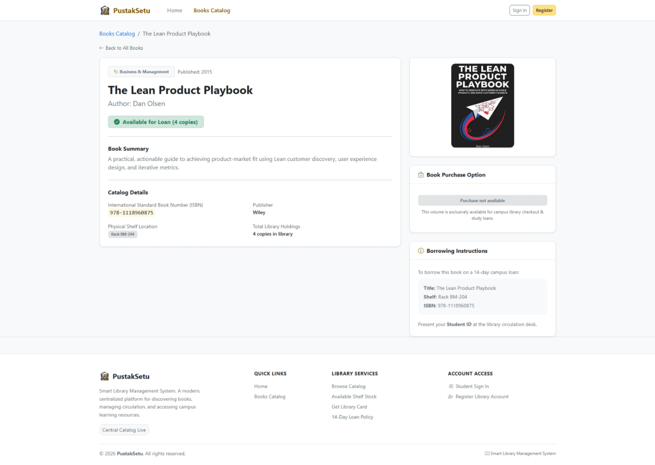
User Interface
Book Details

Slide 19
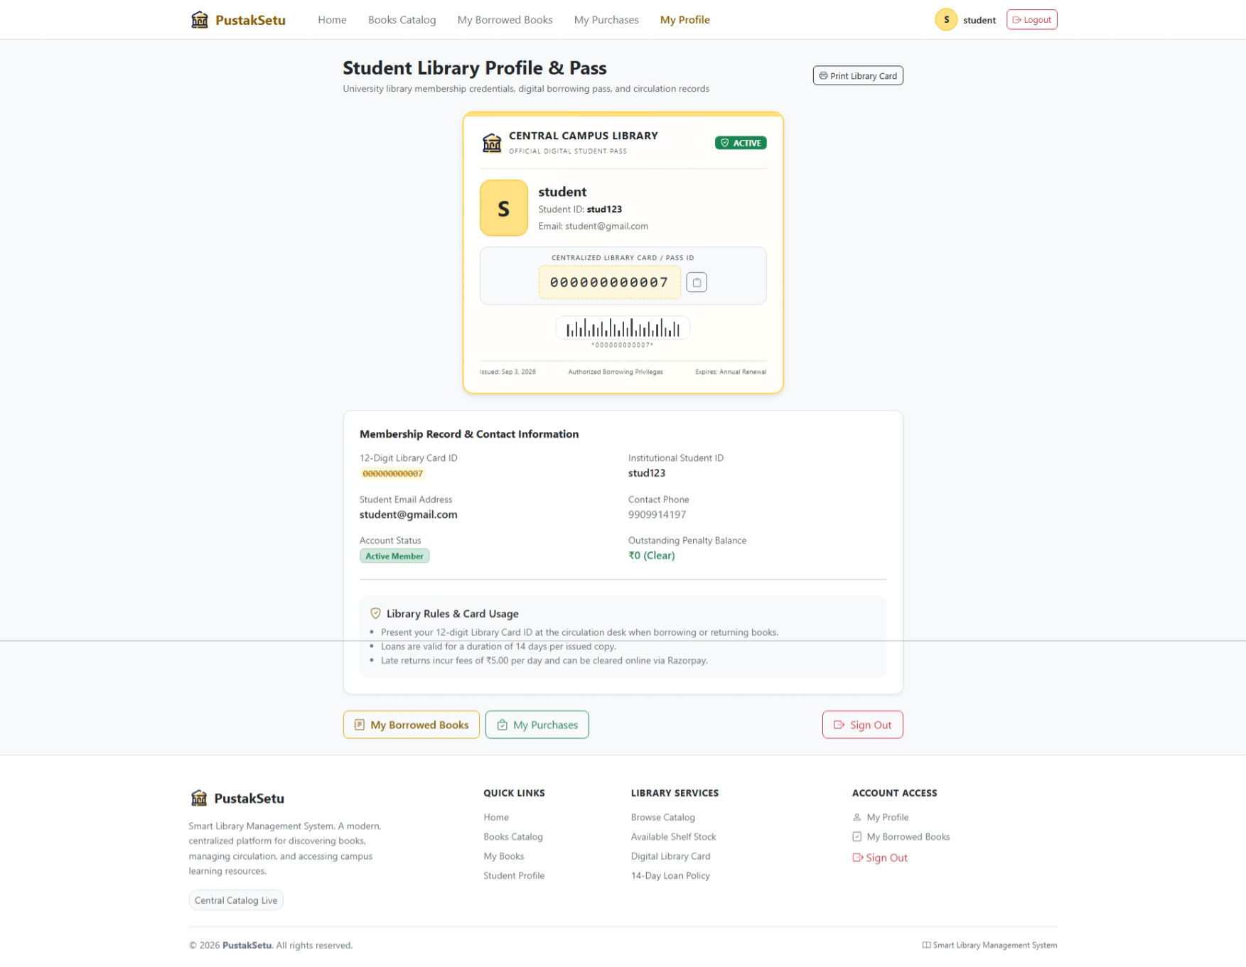
User Interface
Student Profile

Slide 20
Limitation
Requires a stable internet/network connection for accessing the system.
System performance depends on the backend server and database availability.
Currently focused on core library management operations.
Does not provide a dedicated mobile application.
Advanced features such as barcode/QR-based book tracking are not included.
Automated email/SMS notifications for due dates and overdue books are not currently available.

Slide 21
System Enhancement
Develop a dedicated mobile application for Android and iOS.
Add barcode/QR code scanning for faster book issue and return.
Implement automated email/SMS notifications for due dates and overdue books.
Introduce advanced reports and analytics for books, members, inventory, and fines.
Add online fine payment and payment tracking.
Provide automated book recommendations based on student interests and borrowing history.
Implement real-time notifications for important library activities.

Slide 22
Conclusion
PustakSetu provides a centralized and efficient solution for managing library operations digitally. It simplifies book management, inventory tracking, member management, book issue and return, overdue records, and fines. Students can easily search for books and monitor their borrowing activities, while administrators can manage library resources through secure role-based access. Overall, the system reduces manual work, improves accuracy, and enhances the efficiency of library management, while providing a strong foundation for future enhancements.

Slide 23
Reference
React.js Documentation :
Used to design and develop the frontend of PustakSetu, including reusable components, interactive pages, forms, and user dashboards.
Node.js Documentation :
Helped in creating backend APIs, handling server logic, and managing requests
Vite & Bootstrap 5 Documentation :
Vite was used for fast project development and optimized builds, while Bootstrap 5 was used to create responsive and consistent user interfaces.

Slide 24
Axios & JWT Documentation :
Axios was used for communication between the frontend and backend, while JWT was used to implement secure authentication and role-based access.
Relational Database Documentation :
Used to structure and manage important library data, including users, books, categories, inventory, book issues, returns, and fines.

Slide 25
Thank You

