Slide 1

DDS Analytics – Data Science Project
Banu Pullaiahnaidu
April 15th 2023
Notes:
Hello and Welcome to DDS Analytics – Data Science Project. This is Banu Pullaiahnaidu presenting.

Slide 2
Agenda
DDS Analytics and Data Science
Review Dataset
Key observations from the Dataset
Predicting Attrition
Predicting Salary
Q & A
Notes:
Our Agenda for Today, we will look at who DDS Analytics are and what is their ask from the Data Science Project, We will review the dataset provided by FritoLays to Data Analytics for this project, we will see some key observations from the dataset provided, we will also look at Predicting Attrition and Predicting Salary.

Slide 3
DDS Analytics and Data Science
Talent Management Solutions Provider for Fortune 100 Companies
Workforce Planning
Employee Training
Identifying high-potential employees
Reducing Attrition
Notes:
DDS Analytics use Data Science., a Talent Management Solution Company that helps Fortune 100 Companies develop and retain talent

Slide 4
EDA – Exploratory Data Analysis
870 rows of data with 36 attributes
140 row with Attrition Yes and 730 with Attrition No
60% of Employee are Lab Technicians, Research Scientists and Sales Executives
74% of Total Employees are in Job Levels 1 and 2
Employees median Age is 35 years
Non-Manager to Manager ratio is 80/20
Notes:
DDS Analytics use Data Science., a Talent Management Solution Company that helps Fortune 100 Companies

Slide 5
EDA – Exploratory Data Analysis
18% of Employees Travel Frequently for Business
30% of Employees work Over Time
83% of Employees have no Stock Options or very low Stock Options
83% of the Employees have been with the Company for 10 years or less and only 9% of the Employees are with the Company for over 15 years
Notes:
DDS Analytics use Data Science., a Talent Management Solution Company that helps Fortune 100 Companies

Slide 6
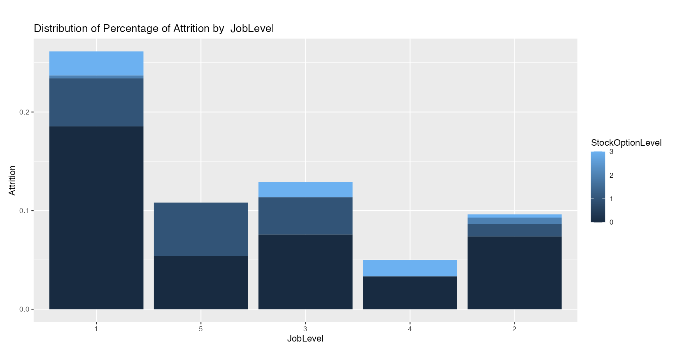
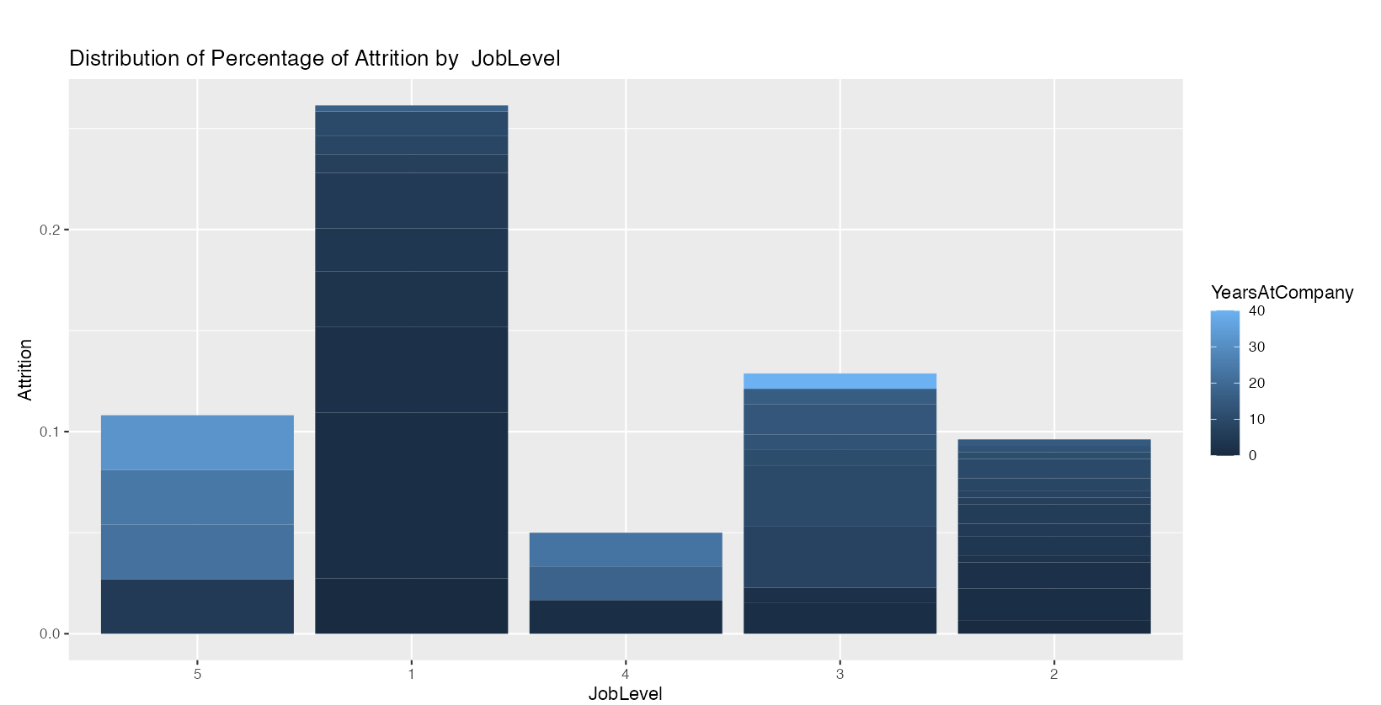
Predicting Attrition
JobLevel
StockOptionLevel
YearsAtCompany
Notes:
DDS Analytics use Data Science., a Talent Management Solution Company that helps Fortune 100 Companies

Slide 7
Predicting Attrition
JobLevel
StockOptionLevel
YearsAtCompany
Attribute | KNN Unbalanced | KNN Undersampling | KNN Oversampling | NB Unbalanced | NB Undersampling | NB Oversampling
Accuracy | 0.8115 | 0.7071 | 0.7795 | 0.8621 | 0.631 | 0.6598
Sensitivity | 0.8863 | 0.7357 | 0.6849 | 1 | 0.5652 | 0.598
Specificity | 0.4214 | 0.6786 | 0.874 | 0 | 0.7105 | 0.7113
Notes:
DDS Analytics use Data Science., a Talent Management Solution Company that helps Fortune 100 Companies

Slide 8
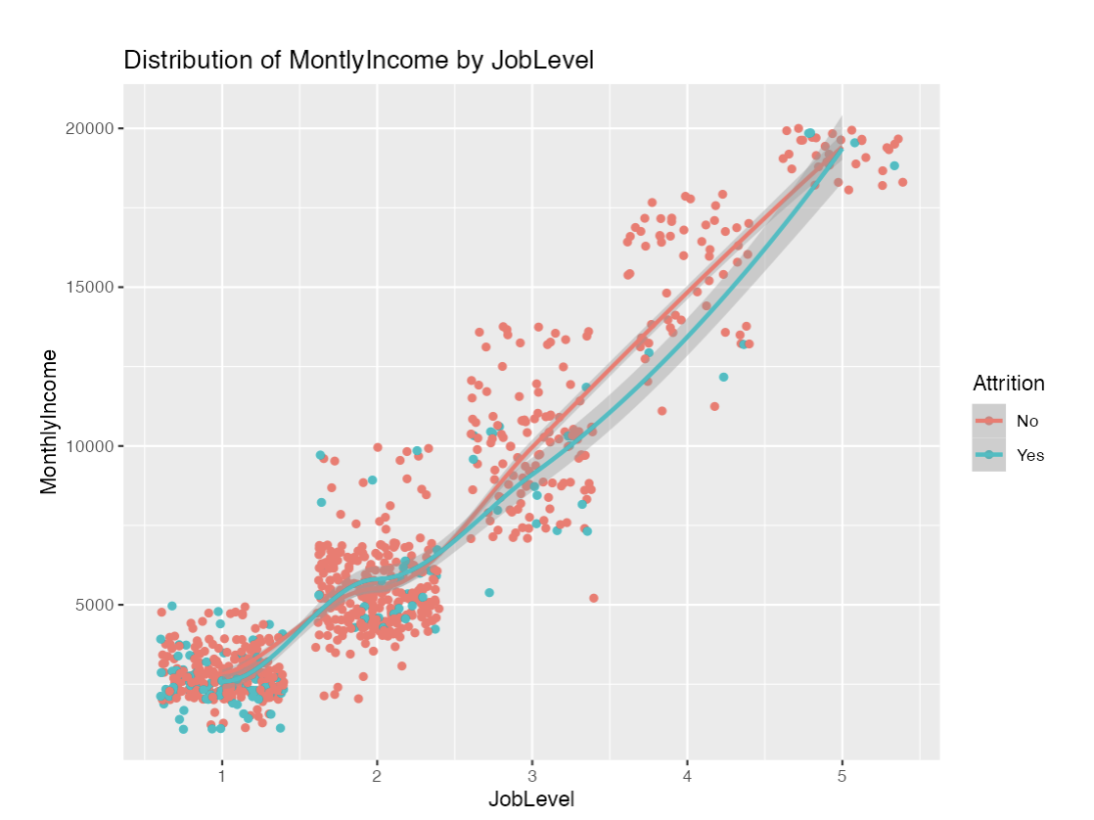
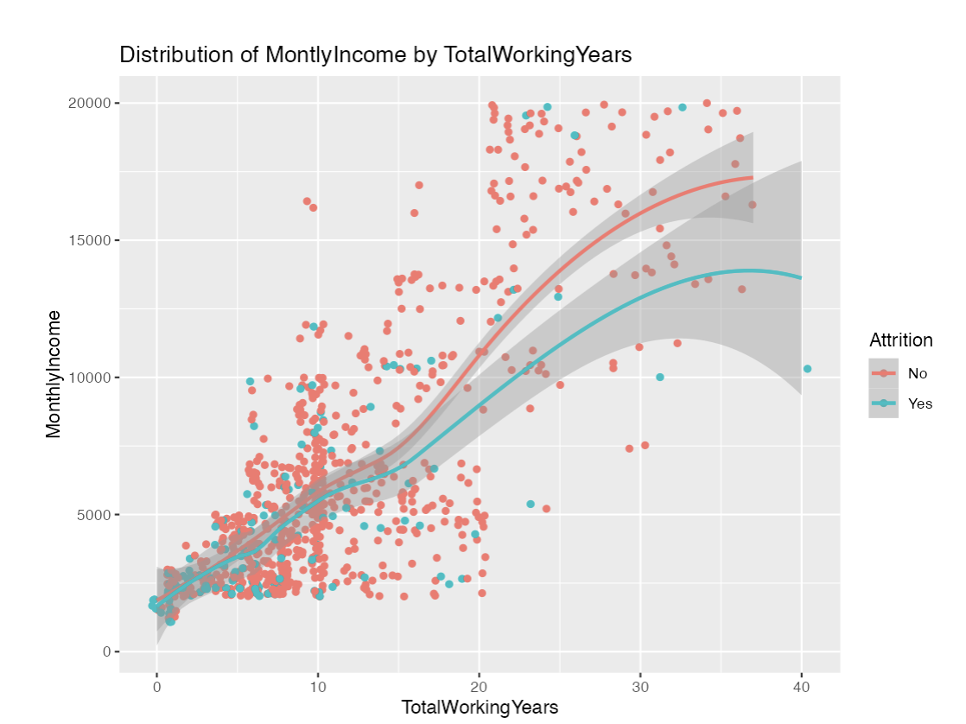
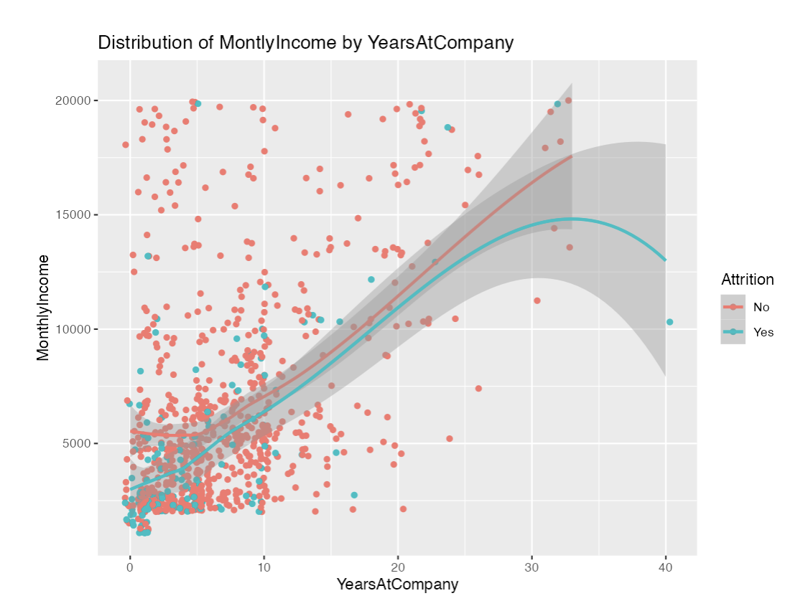
Predicting Salary
JobLevel
TotalYearsWorked
YearsAtCompany
Notes:
DDS Analytics use Data Science., a Talent Management Solution Company that helps Fortune 100 Companies

Slide 9
Key takeaways from the analysis
Highest % of Attrition @ 26% is in Level1
Sales Reps have the most Attrition at 45%
Most % Salary Hikes are given to Level 1 & 2 Ees
83% of the Employees have been with the Company for 10 years or less and only 9% of the Employees are with the Company for over 15 years
Notes:
DDS Analytics use Data Science., a Talent Management Solution Company that helps Fortune 100 Companies
Shiny App – Modeling Attrition – JobLevel/JobRole JobRole/JobLevel JobLevel/PerCentSalaryHike
Shiney App – DataReview – JobLevel/JobLevel YearsAtCompany/Attrition

Slide 10
Questions and Answers
Contact Banu Pullaiahnaidu (bpullaiahnaidu@mail.smu.edu) for more information related to this presentation.

