Slide 1
AI Powered Online Recruitment

Slide 2
INDEX
Abstract
Objective of project
Problem Statement
Scope And Motivation
Introduction
Literature survey
Existing Method
Disadvantages
Proposed method
Advantages
Project Flow
Hardware and Software Requirements
Architecture
Modules
UML Diagram
Output Screens
Conclusion
Future Work
References

Slide 3
ABSTRACT
Artificial Intelligence (AI) can play a pivotal role in the company recruiting process, facilitating excellence. This app faces challenges AI faces in the hiring process and the outcomes results of using AI in the hiring process. The benefits of using AI in the hiring process include identifying AI vendors and firms that have adopted AI in the hiring process, analyzing the present state of AI to facilitate the hiring process, and the impact of adopting AI in the hiring process. Through this app different perceptions, ideas, and opinions are presented to modulate the use of AI in human resource management. The findings indicate that AI is adopted mainly in high-tech or large companies. The reports presented by these companies on the use of AI thus do not provide an actual picture of the usage and step by step evaluation as interviews are still a part of the recruitment process providing space for human bias. The aspect of AI to support human resources in decision making, not a threat as AI is considered to take over the human roles in human resource management, should also be studied in detail.
Keywords: Artificial Intelligence (AI), Hiring process, Challenges, Outcomes, Adoption, Human resource management

Slide 4
OBJECTIVE OF PROJECT
The objective of this abstract is to provide a comprehensive overview of the use of AI in the hiring process. It aims to explore the challenges and outcomes associated with AI adoption, while highlighting the benefits it brings to recruitment. The abstract also seeks to present diverse perspectives on AI in human resource management, emphasizing the need for a balanced approach to address biases and support decision-making. It recognizes the prevalent utilization of AI in high-tech or large companies but raises concerns about the limited evaluation due to the continued reliance on interviews. Ultimately, the objective is to foster a deeper understanding of AI's role in recruiting and its potential to drive excellence in human resource management.

Slide 5
PROBLEM STATEMENT
AI adoption in recruitment faces challenges, including incomplete integration and reliance on human biases in the hiring process. Despite being used in large and high-tech companies, the actual impact of AI is unclear, with interviews still playing a major role. A detailed understanding of AI's role in decision-making and bias reduction is essential.

Slide 6
SCOPE
This app investigates the use of Artificial Intelligence (AI) in the recruitment process, focusing on its benefits, challenges, and impact on hiring outcomes. It analyzes AI adoption by companies, identifies AI vendors, and evaluates how AI affects human resource decisions. The app provides insights into AI's potential role in improving recruitment practices and reducing bias.
.
.

Slide 7
MOTIVATION
The motivation behind this project is to explore how AI can revolutionize the recruitment process by making it more efficient, fair, and less biased. By investigating AI adoption in hiring, this project aims to understand its challenges and benefits, ultimately providing insights that can improve hiring practices, reduce human biases, and enhance decision-making in human resource management.

Slide 8
INTRODUCTION
Artificial Intelligence (AI) has emerged as a transformative technology across various industries, and the field of human resource management is no exception. In recent years, AI has increasingly played a pivotal role in the company recruiting process, revolutionizing the way organizations attract and select talent. By leveraging AI-powered tools and algorithms, companies aim to enhance efficiency, accuracy, and fairness in their hiring practices. However, the integration of AI in the hiring process is not without its challenges.

Slide 9
LITERATURE SURVEY
Serial No. | Authors | Title | Outcome
1 | Sujoy Sen, Sanjeev Kadam, V.V. Ravi Kumar | Role of Artificial Intelligence-Enabled Recruitment Processes in Sourcing Talent | AI recruitment is evolving from a supporting tool to a key business asset, improving recruitment efficiency and time savings.
2 | Beneduce | Artificial Intelligence in Recruitment: Just Because It’s Biased, Does It Mean It’s Bad? | AI in recruitment offers benefits, but concerns over bias hinder its widespread adoption despite its potential.
3 | Brishti, J.K., & Javed. A | Application of Artificial Intelligence for Recruitment in Manufacturing Industries | AI and automation in recruitment help manufacturing industries hire talent more efficiently, reducing costs and time.
4 | Madia, S.A. | Best Practices for Using Social Media as a Recruitment Strategy | Examines social media recruitment best practices and emphasizes the importance of a strategy, content, and policies.

Slide 10
Existing method:
Traditional Recruitment process and selection is a term that is often used to define the process when people apply for jobs using traditional paper applications and resumes. This is in contrast to the digital-only world of today, where job applications and resumes are mostly conducted online. This method of job application is referred to as traditional recruitment and selection. This method of job application is often used by large companies and organizations that have the time, space, and human resource to conduct traditional recruitment and selection.

Slide 11
Disadvantages in Existing method:
News papers
Internal hiring process
Local employment offices

Slide 12
Proposed method:
The reports presented by these companies on the use of AI thus do not provide an actual picture of the usage and step by step evaluation as interviews are still a part of the recruitment process providing space for human bias. The aspect of AI to support human resources in decision making, not a threat as AI is considered to take over the human roles in human resource management, should also be studied in detail. Google ML Kit provided a very good technique which is Google OCR API kit. Which can read the text from pdf using camera v2 vision. Recommendation with text recognition useful to get key technologies from resume this makes useful sort the resumes for different technologies.
.

Slide 13
Advantages of Proposed method:
Google vision API.
Camera v2 vision.
Fast and accurate.

Slide 14
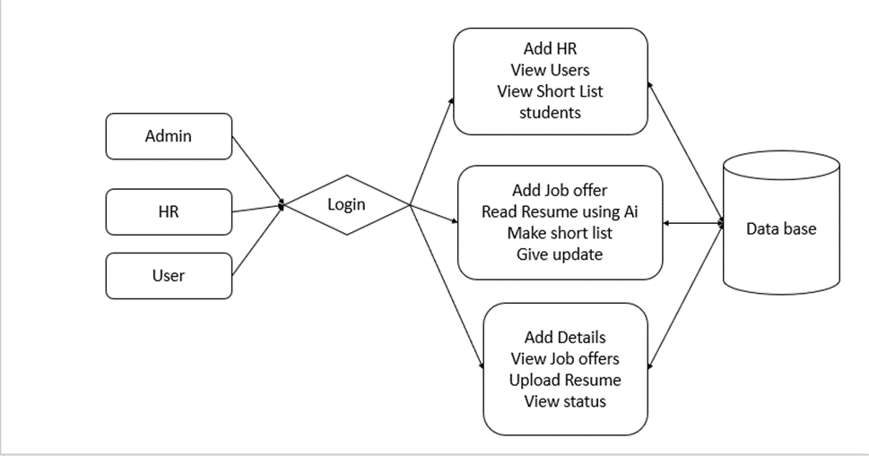
Propose System Flow

Slide 15
HARDWARE & SOFTWARE REQUIREMENTS
SOFTWARE REQUIREMENS
Operating System - Windows 10
JDK - Java(kotlin)
SDK - Android
IDE - Android studio
Database - my SQL

Slide 16
HARDWARE & SOFTWARE REQUIREMENTS
HARDWARE REQUIREMENTS
Processor - I3/Intel Processor
RAM - 8 GB
Hard Disk - 1TB

Slide 17
Modules
Admin: The admin module allows the addition of HR personnel, viewing user details, and accessing a list of shortlisted students. Admins also have the ability to update records in the database.
HR: HR has access to add job offers, read resumes using AI, and make shortlists of candidates. HR can also update the job status and provide feedback, ensuring the recruitment process is efficient.
User: Users can add personal details, view available job offers, upload resumes, and check their application status. Users can apply to job offers, and the system helps match them to suitable roles based on their profiles.

Slide 18
UML DIAGRAMS
Use Case Diagram:
A use case diagram in the Unified Modeling Language (UML) is a type of behavioral diagram defined by and created from a Use-case analysis. Its purpose is to present a graphical overview of the functionality provided by a system in terms of actors, their goals (represented as use cases), and any dependencies between those use cases. The main purpose of a use case diagram is to show what system functions are performed for which actor. Roles of the actors in the system can be depicted.

Slide 19
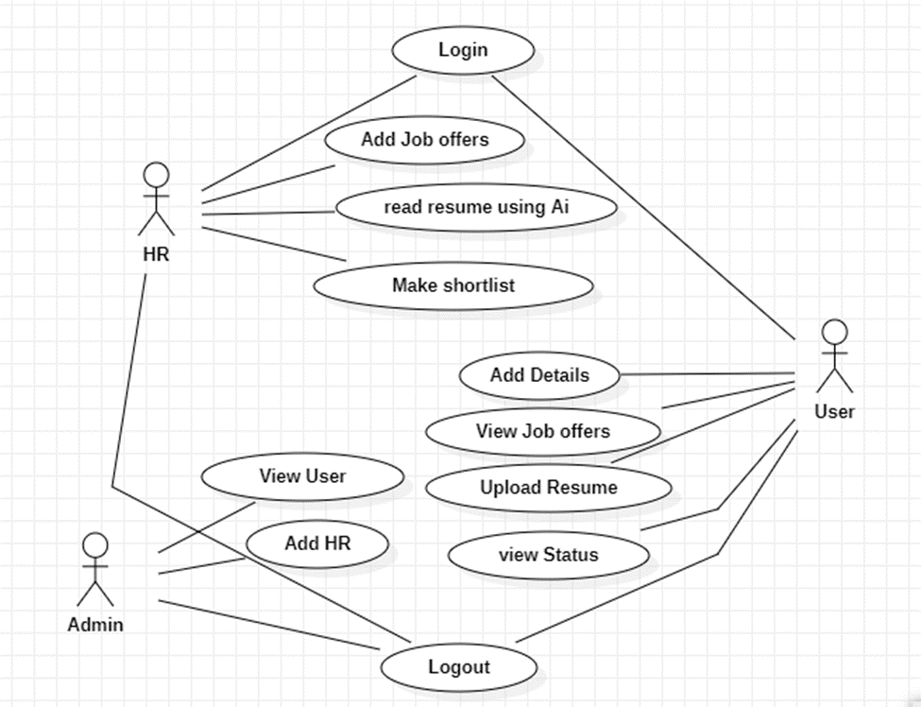
UML DIAGRAMS
Figure: Use Case Diagram

Slide 20
UML DIAGRAMS
Class Diagram:
In software engineering, a class diagram in the Unified Modelling Language (UML) is a type of static structure diagram that describes the structure of a system by showing the system's classes, their attributes, operations (or methods), and the relationships among the classes. It explains which class contains information.

Slide 21
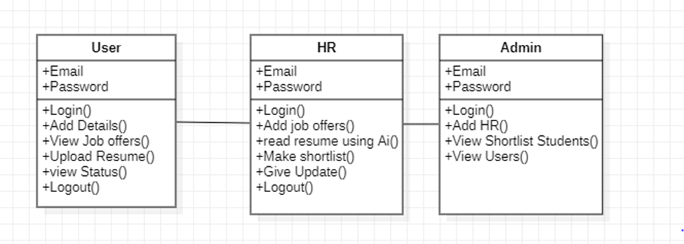
UML DIAGRAMS
Figure: Class diagram

Slide 22
UML DIAGRAMS
Sequence Diagram:
A sequence diagram in Unified Modelling Language (UML) is a kind of interaction diagram that shows how processes operate with one another and in what order. It is a construct of a Message Sequence Chart. Sequence diagrams are sometimes called event diagrams, event scenarios, and timing diagrams.

Slide 23
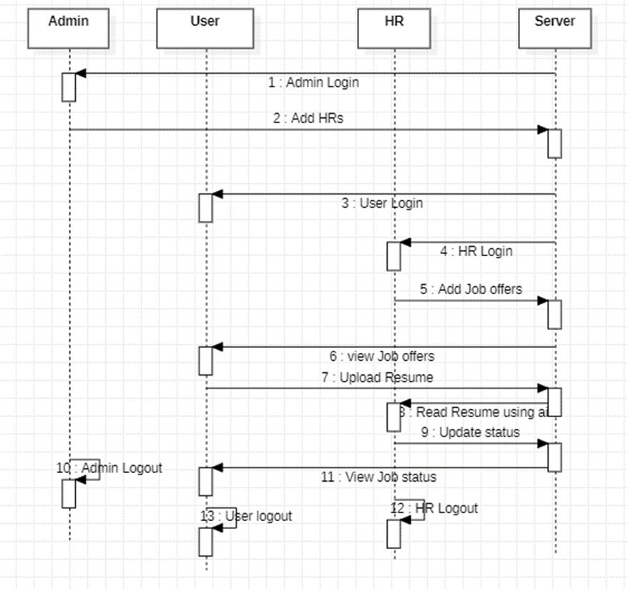
UML DIAGRAMS
Figure: Sequence diagram

Slide 24
UML DIAGRAMS
Collaboration Diagram:
In collaboration diagram the method call sequence is indicated by some numbering technique as shown below. The number indicates how the methods are called one after another. We have taken the same order management system to describe the collaboration diagram. The method calls are similar to that of a sequence diagram. But the difference is that the sequence diagram does not describe the object organization whereas the collaboration diagram shows the object organization.

Slide 25
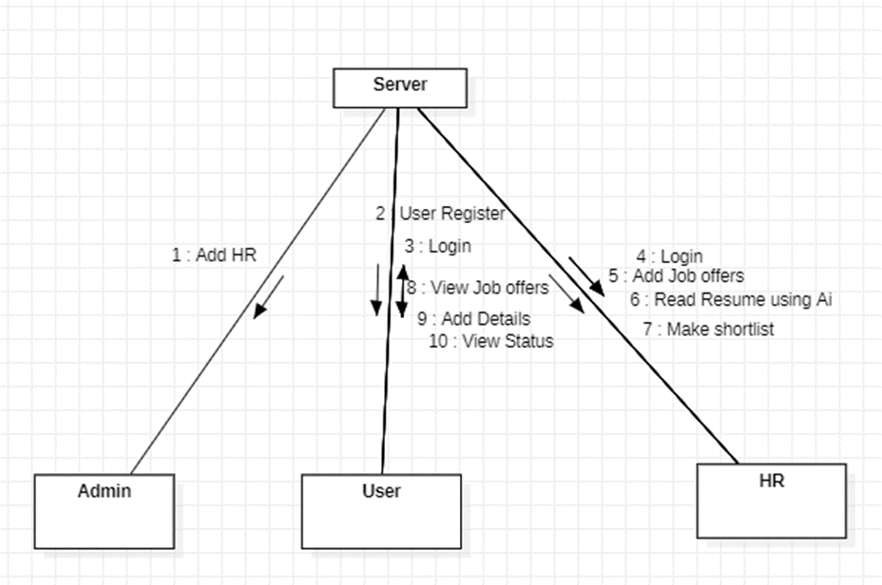
UML DIAGRAMS
Figure: Collaboration diagram

Slide 26
UML DIAGRAMS
Deployment Diagram
Deployment diagram represents the deployment view of a system. It is related to the component diagram. Because the components are deployed using the deployment diagrams. A deployment diagram consists of nodes. Nodes are nothing but physical hardware’s used to deploy the application.

Slide 27
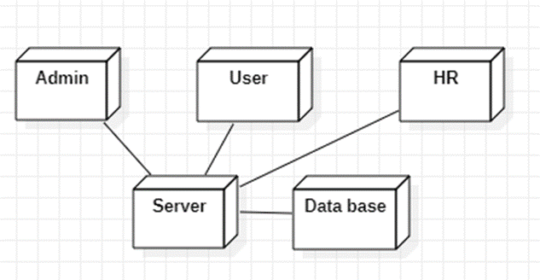
UML DIAGRAMS
Figure: Deployment diagram

Slide 28
UML DIAGRAMS
Activity Diagram:
Activity diagrams are graphical representations of workflows of stepwise activities and actions with support for choice, iteration and concurrency. In the Unified Modelling Language, activity diagrams can be used to describe the business and operational step-by-step workflows of components in a system. An activity diagram shows the overall flow of control.

Slide 29
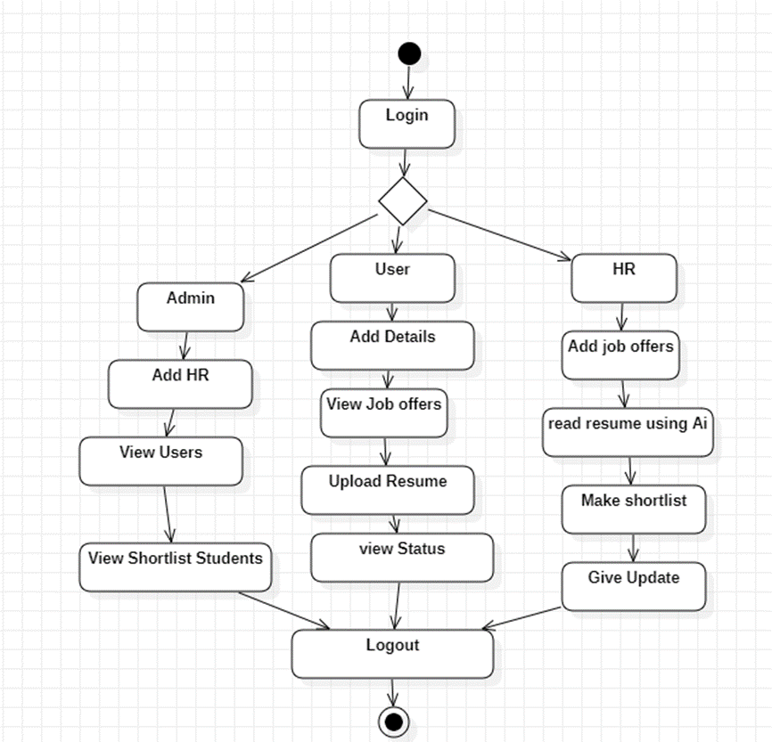
UML DIAGRAMS
Figure: Activity diagram

Slide 30
UML DIAGRAMS
Component Diagram:
A component diagram, also known as a UML component diagram, describes the organization and wiring of the physical components in a system. Component diagrams are often drawn to help model implementation details and double-check that every aspect of the system's required functions is covered by planned development.

Slide 31
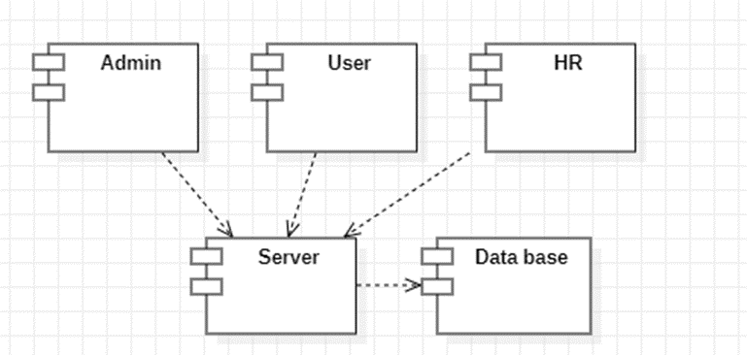
UML DIAGRAMS
Figure: Component diagram

Slide 32
UML DIAGRAMS
ER Diagram:
An Entity–relationship model (ER model) describes the structure of a database with the help of a diagram, which is known as Entity Relationship Diagram (ER Diagram). An ER model is a design or blueprint of a database that can later be implemented as a database. The main components of E-R model are: entity set and relationship set.
An ER diagram shows the relationship among entity sets. An entity set is a group of similar entities and these entities can have attributes. In terms of DBMS, an entity is a table or attribute of a table in database, so by showing relationship among tables and their attributes, ER diagram shows the complete logical structure of a database. Let’s have a look at a simple ER diagram to understand this concept.

Slide 33
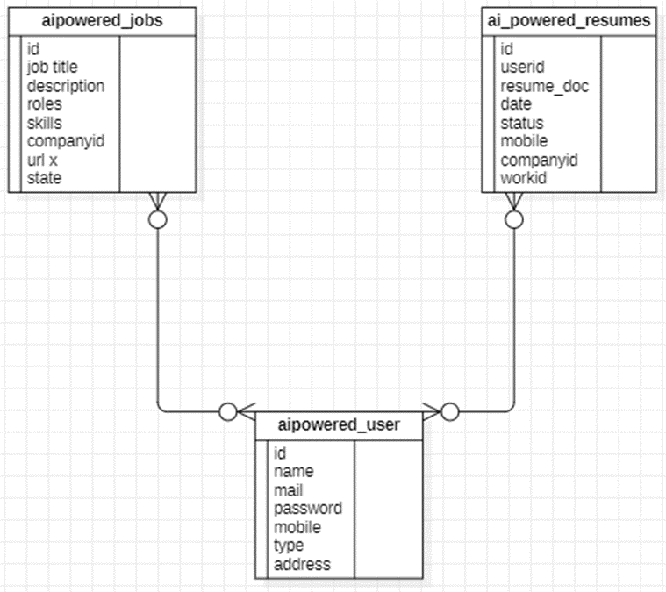
UML DIAGRAMS
Figure: ER diagram

Slide 34
UML DIAGRAMS
DFD Diagram:
A Data Flow Diagram (DFD) is a traditional way to visualize the information flows within a system. A neat and clear DFD can depict a good amount of the system requirements graphically. It can be manual, automated, or a combination of both. It shows how information enters and leaves the system, what changes the information and where information is stored. The purpose of a DFD is to show the scope and boundaries of a system as a whole. It may be used as a communications tool between a systems analyst and any person who plays a part in the system that acts as the starting point for redesigning a system.

Slide 35
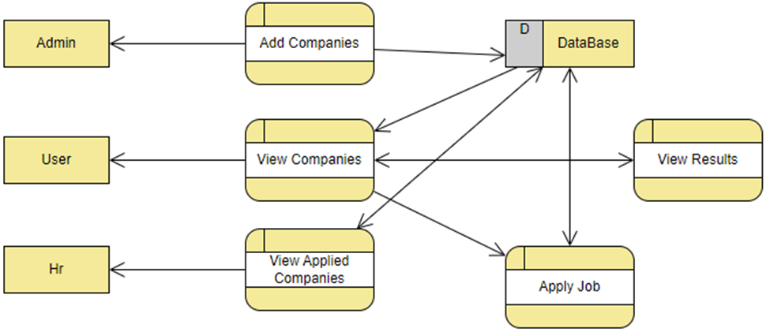
UML DIAGRAMS
Figure: Context Level diagram

Slide 36


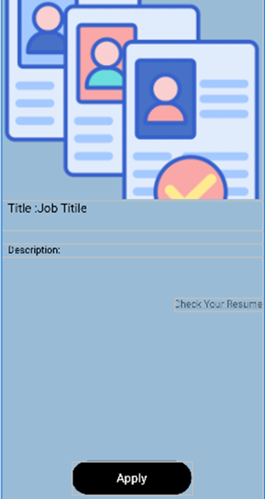
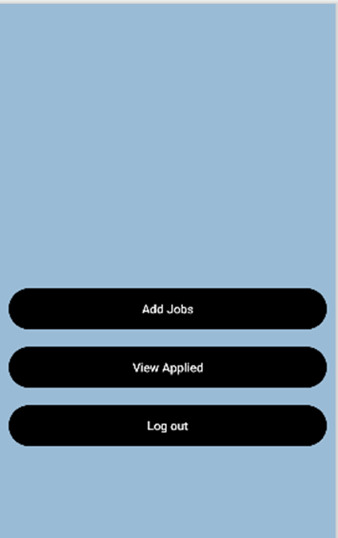
OUTPUT SCREENS

Slide 37
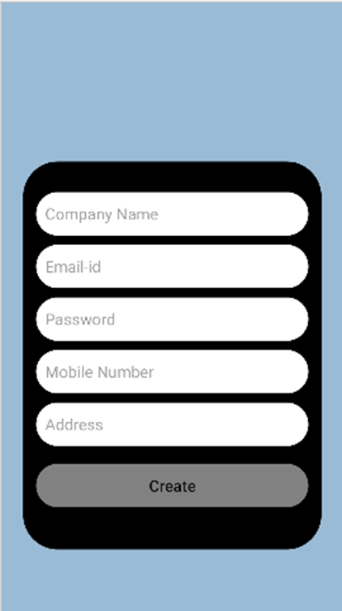
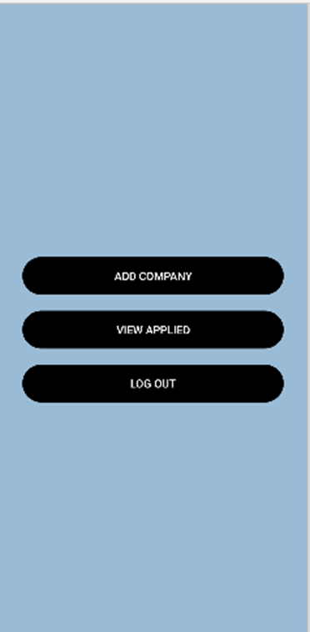
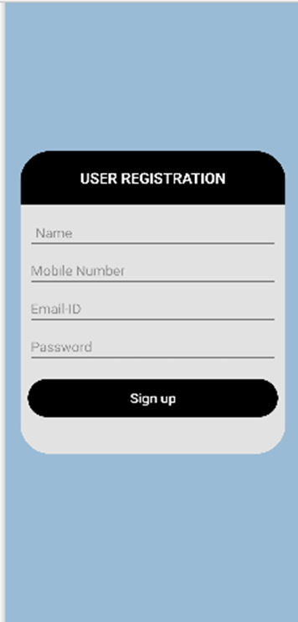
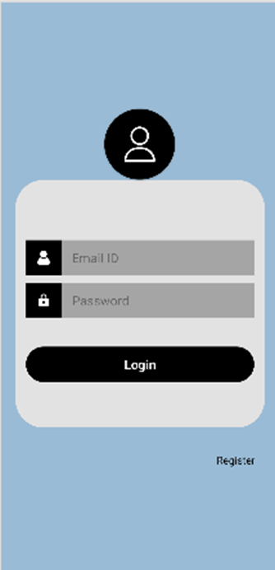
OUTPUT SCREENS

Slide 38
CONCLUSION
Artificial Intelligence (AI) has the potential to revolutionize the company recruiting process and enhance excellence in human resource management. Throughout this app, we have explored the challenges that AI faces in the hiring process and the outcomes that result from its implementation. We have also delved into the benefits of using AI in recruitment, such as identifying AI vendors and firms that have successfully adopted AI in their hiring practices, analyzing the present state of AI to facilitate the hiring process, and assessing the impact of AI adoption on recruitment outcomes

Slide 39
FUTURE ENHANCEMENT
Future improvements will focus on enhancing AI's ability to minimize bias in recruitment, provide comprehensive assessments of its impact, and ensure better integration with human decision-making. This will help create more efficient, transparent, and fair hiring practices across various industries, leading to more consistent and accurate recruitment outcomes.

Slide 40
REFERENCES
[1]. Role of Artificial Intelligence-Enabled Recruitment Processes in Sourcing Talent; Sujoy Sen; Sanjeev Kadam; V.V. Ravi Kumar; 04 May 2023
[2]. Role of Artificial Intelligence-Enabled Recruitment Processes in Sourcing Talent; 03-04 March 2023
[3]. AI Recruiting Tools Aim to Reduce Bias in the Hiring Process; https://spectrum.ieee.org/ai-tools-bias-hiring; September 2020
[4]. Beneduce, G. (2020). Artificial Intelligence in Recruitment: just because it´ s biased, does it mean it´s bad? (Doctoral dissertation). [Google Scholar]
[5]. Brishti, J.K. & Javed, A. (2020). The viability of ai-based recruitment process: A systematic literature review. [Google Scholar]

