Slide 1

THE FUTURE HUMAN AND THE HUMAN SOCIETY
BANUKA
www.slquiz.ml
Now there are lots of information regarding the future
Environment, the human and the wonderful society . Specialy lots of people in lots of places have told about the future human. The beginning of that society has already started today. The human has already started to convert to a such society. There for we must also be ready convert to a such human .The help need for this convertion is given by doctors ,ingineers , scientists , inventers and etc . How ever the world changes fast . LET US KNOW ! NOW I AM TO GIVE SOME KNOWLADGE ON THEM.
Notes:
Created by Master Banuka Kumara Ambegoa

Slide 2

IT STARTED LIKE THIS.BY WINNING THE MOON.

Slide 3
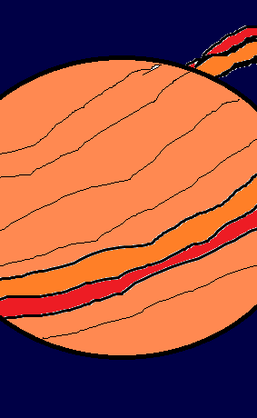
THE PRESENT WORLD WHICH WE LIVE
In the present human has won the world . But not completely.
They have won even mars.
They know every information regarding our solar system. And
The crust of saturne shown by this picture has filled only with gases. Like that they know not only the outer surface of those
planets but also the interior. The other sides like physical and electronic information have also improved wonderfully. Now I will give that things shortly after this one by one.

