Slide 1
Employee Data Analysis using Excel
STUDENT NAME: Banupriya S
REGISTER NO: 122203069 unm1451(2022H07)
DEPARTMENT: B.com (Corporate Secretaryship)
COLLEGE: Mahalahshmi Women's college of arts and science

Slide 2
PROJECT TITLE
Employee Performance Analysis using Excel

Slide 3


AGENDA
Problem Statement
Project Overview
End Users
Our Solution and Proposition
Dataset Description
Modelling Approach
Results and Discussion
Conclusion
3/21/2024 Annual Review

Slide 4

PROBLEM STATEMENT
1. Employee performance problems may manifest in the form of decreased productivity, difficulty prioritizing tasks, committing errors in projects, or missing deadlines.
2. The obstacles involved in these performance problems are as varied as the employees you have.

Slide 5

PROJECT OVERVIEW
1.Develop a data-driven approach to analyze employee performance, identifying strengths, weaknesses, and areas for improvement to enhance productivity and organizational efficiency.
.
2.Analyze employee data to identify trends, patterns, and areas for improvement, enabling informed decisions to boost performance and drive business success.

Slide 6

WHO ARE THE END USERS?
1. IT COMPANIES. 2. BANKS. 3. INDUTRIES. 4. HUMAN RESOURCE DEPARTMENT.

Slide 7

OUR SOLUTION AND ITS VALUE PROPOSITION
1. Conditional Formatting. 2.Filtering. 3.Employee data. 4.Formula used to identify performance level.
5.Pivotal table for summarising. 6.Pie chart. 7.Bar graph.

Slide 8
Dataset Description
1. Employee data downloaded from Edunet dashboard. 2. Features: Totally 26 features are available in that 11 considered.

Slide 9

THE "WOW" IN OUR SOLUTION
Performance level=IFS(Z8>=5,"VERY HIGH",Z8>=4,"HIGH",Z8>=3,"MED", TRUE, "LOW")
3/21/2024 Annual Review
9

Slide 10
1. Data Collection: Downloaded the data from edunet student's dashboard. 2. Feature Collection:
Highlighted data which is required using the fill option. 3. Data Cleaning: Identified the missing values using conditional formatting.
Removed/Filtered the missing data using filter-filter by colour. 4. Performance level: Performance Analysis is based on Department type is filtered by gender (Male employees).
MODELLING
10

Slide 11
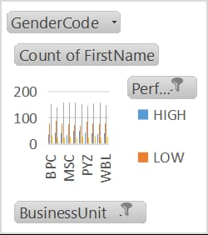
RESULTS
11

Slide 12
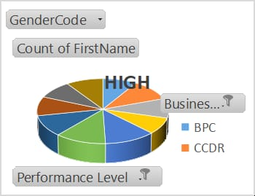

Slide 13
conclusion
Our analysis provides a data-driven framework to evaluate employee performance, identify areas for improvement, and inform strategic talent management decisions. By leveraging predictive analytics and AI-driven insights, organizations can unlock hidden potential and drive business success. Data-informed performance management is the key to unlocking a high-performing workforce.

