Slide 2
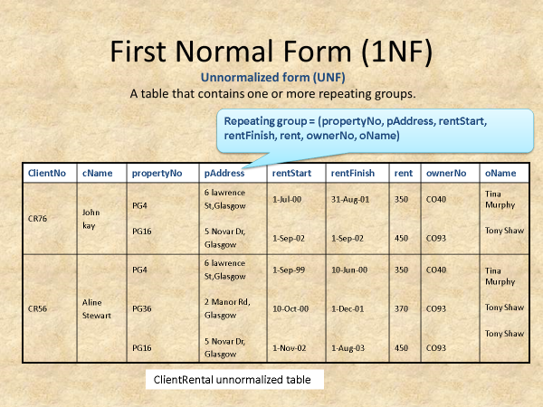
Normalize the below using the Functional dependency techniques

