Slide 1
Normalize the Data

Slide 2
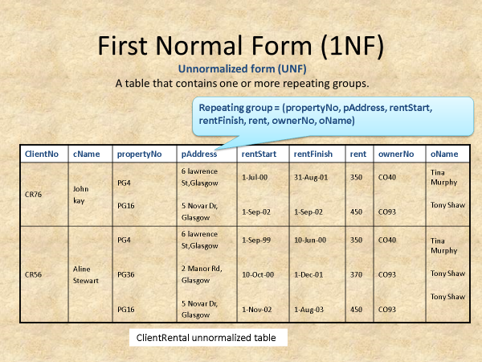
Normalize the below using the Functional dependency techniques

