Slide 1
MVC 5

Slide 2
ASP.NET MVC is a very popular framework for developing Web Based Application.
ASP.NET MVC is based on Model – View – Controller pattern that makes it more robust, fast, and secure.
ASP.NET MVC5 is the next generation technology and it is the successor of ASP.NET Webforms.
There are many benefits of MVC over traditional asp.net .aspx web forms.

Slide 3
FEATURES OF MVC PATTERN
1. It is based on Model View Controller Pattern. 2. It is lightweight, fast and secure. 3. Designs and Codes are neatly separated. 4. It uses Pure HTML Control or HTML Helpers (No Server Control) 5. It uses controller based url. 6. Implements no view state. 7. It uses Razor Syntax for customization. 8. It uses Layout at the place of Master page for consistent looks and feel. 9. ASP.NET MVC is open source.

Slide 4
UNDERSTAND MVC PATTERN
MVC is short form for Model, View and Controller.
Model: It is responsible for keeping database operational logic like connecting and retrieving information from database/Classes/Objects
View: It is responsible for serving web page user interface to client.
Controller: It keeps all the programming logics

Slide 5
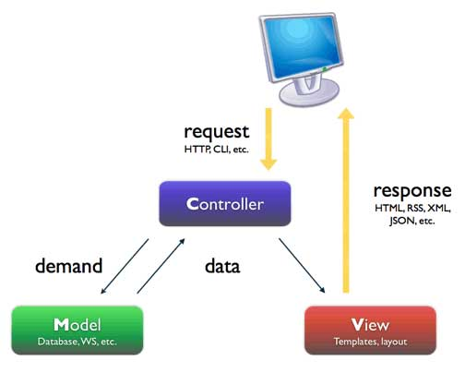
MVC - Working
MVC works in 3 steps.
Step 1: User hits the button on page or makes a request through View Page. Step 2: Request comes to controller. Step 3: Depending on the user request, the controller creates object of the model. Then model comes in action and retrieve information from database/Objects Step 4: After that, this data filled model, is passed to a View page by the controller to server the user.

Slide 6
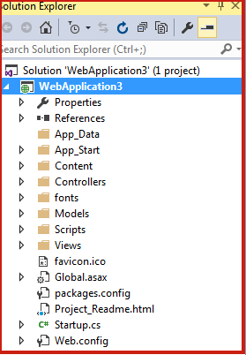
ASP.Net MVC 5 Folder Structure
App_Data – This folder contains data files like LocalDB, .mdf files, xml files etc.
App_Start – It contains class files which gets executed when application starts. Normally it contains files like BundleConfig.cs, RouteConfig.cs, AuthConfig.cs, FilterConfig.cs etc.
Content – It contains static files like css files, images and icon files.
Controllers – It contains class files which handle user's request and response. All the controller file name ends with Controller word like HomeController, LoginController, ManagerController etc.
Models – It contains model class files which handles database task.
Scripts – It contains scripts file like JavaScript, VBScript, JQuery etc.
Views – It contains HTML files. There may be separate folder for each controller. For HomeController.cs; there is Home folder inside View folder.

Slide 7
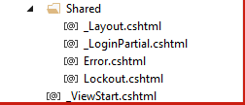
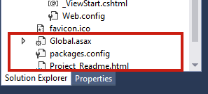
Shared - It is under view folder and it contains shared files like master page layout, Error Page, etc. Shared folder content can be accessed by any controller.
_Viewstart.cshtml is used to place common UI logic across the Views in the folder, where it is located.
_LoginPartial.cshtml is a partial view of a Razor markup file (.cshtml) that renders HTML output within another markup file's rendered output.
Lockout.cshtml is used to manage user roles and their accessibility.
Global.asax – It allows you to write code at application level events such as Application_BeginRequest, application_start, application_error, sesson_start, sesson_end etc.
Package.config – It is managed by NuGet to keep track of what packages and versions you have installed in the application.
Web.config – It contains application level configuration.
SOME IMPORTANT FILES

Slide 8
UNDERSTANDING BASICS OF MVC CONTROLLERS
1. The controller is a main part of MVC. 2. It is a mediator between client-side request and server-side response. 3. The controller is like a bridge between view page and models. 4. Controller works with HTTP request that comes from the browser. 5. Even, if a user requests a simple static page, the controller comes in action and returns the requested page. 6. Each browser request is mapped with the particular controller and each controller has several action methods to handle browser requests. 7. In MVC, URL doesn’t map with a direct static page. It is mapped with controllers. 8. All controller class must be named by using the “Controller” suffix.
Lets see how to create a controller

Slide 9
WHAT IS ACTION METHOD IN ASP.NET MVC 5?
All the public methods which are written inside a Controller are known as Action Method. Certain rules to follow for Action Method
a. Action methods must be public. b. It cannot be overloaded. c. It cannot be a static method. d. Every controller has at least one default Action method Index() that returns the view page. e. ActionResult is a base class of all the result type action methods.

Slide 10
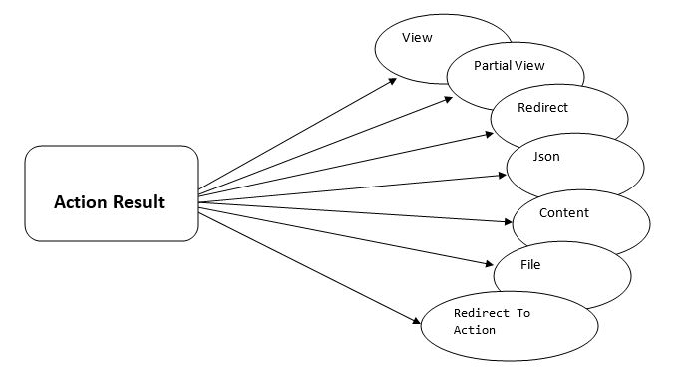
TYPES OF ACTION METHOD

Slide 11
ActionResult is the base class of all the result type action method. There are following Result type action method in MVC.
ViewResult - Represents HTML and markup.
EmptyResult - Represents no result.
RedirectResult - Represents a redirection to a new URL.
JsonResult - Represents a JavaScript Object Notation result that can be used in an AJAX application.
JavaScriptResult - Represents a JavaScript script.
ContentResult - Represents a text result.
FileContentResult - Represents a downloadable file (with the binary content).
FilePathResult - Represents a downloadable file (with a path).
FileStreamResult - Represents a downloadable file (with a file stream).

Slide 12
1. ViewResult
// GET: Item
public ViewResult Index()
{
ViewBag.ItemList = “This is ViewResult ";
return View();
}
EmptyResult
//GET: Item
public EmptyResult Index()
{
ViewBag.ItemList = “Empty Result";
return new EmptyResult();
}
Content Result
It returns user-defined content type. It is useful when you want to send some plain
text message to browser screen.
public ContentResult Index()
{
return Content("Hello ASP.NET MVC 5”);
}
Redirect Results is used for returning results to specific url. When you need to redirect to another action method, you can use RedirectResult Action Method.
public RedirectResult Index()
{
return Redirect("Home/Contact");
}
JSONResult
JSON Result returns simple text file format and key value pairs. Sometimes you may want to return data in JSON Format and that situation you JSONResult is the best option.
public JsonResult Index()
{
Employee emp = new Employee(){
ID = "Emp11",
Name = “BenJohnson",
Mobile = "825415426"
}; return Json(emp, JsonRequestBehavior.AllowGet);
}
public class Employee{
public string ID { get; set; }
public string Name { get; set; }
public string Mobile { get; set; }}

Slide 13
Views
Views is a folder in MVC structure which contains .cshtml file and design layout which is used in displaying and rendering web pages onto the user’s computers.
The Views folder keeps a separate folder for each controller and each folder keeps different.cshtml pages for all action methods that belong to that controller.
Views folders name is same as Controllers name and .cshtml pages name same as action methods.
Let us learn to add a view

Slide 14
Razor Syntax
Razor Syntax is a powerful and easiest way to write server-based code directly into your view pages.
Razor is a markup syntax that allows you to embed C# Programming directly into your view page.
It is generally written in the .cshtml file.

Slide 15
Use the below guidelines to write Razor Syntax in ASP.NET MVC View page
1. Use @{ … } block to write C# code.
2. All the Inline Expressions like Variables and Functions starts with @.
3. Variables are declared with the var keyword and all the code statements end with a semicolon(;).
4. Keep String value within double quotes (" ")
5. Use HTML Markup for adding HTML code inside Razor block.

Slide 16
Comments in Razor
@*
@{
/* C# comment */
// Another C# comment
}
<!-- HTML comment -->
*@
@model: Accessing Model data.
The @model command is used for adding and accessing model variables and data into the view page.
@model LoginViewModel

Slide 17
ViewBag, ViewData, TempData
ViewBag, ViewData and TempData are used for passing information from controllers to views. Most of the time, you want to display calculated information using views.
ViewBag – Dynamic datatype
is used to pass data from controllers to views.
has a short life, means once it passed value from controllers to views, it becomes null.
doesn't require typecasting. You can create ViewBag like this:
Example :
ViewBag.MyData = “This is Your Data”;
And,
You can access this data in View Pages like this:
@ViewBag.MyData

Slide 18
ViewData
It is also used for sending information from controllers to views.
Once it sends information, it becomes null.
ViewData is a Dictionary Object that is derived from ViewDataDictionary.
ViewData uses Key-Value pair for storing and retrieving information.
It requires typecasting for complex data type.
Example:
You can create ViewData like this:
ViewData[“MyData"] = "Hello World";
And,
You can access ViewData information like this:
@ViewData[“MyData"]

Slide 19
TempData
TempData internally use Session to store value.
You must check for null before using TempData in order to avoid Runtime Error.
TempData is alive in two subsequent request. It uses TempData.Keep() method for third request.
TempData is also an dictionary object that stores information in key-value pair. It is derived from TempDataDictionary.
Other Facts:
TempData is also used for sending data from controllers to view but it is little different from ViewBag and ViewData. TempData is mostly used to transfer value from one controller to another controller. It is most useful when you redirect one page to another page and want to send some information along with it. It has a bigger life than ViewBag and ViewData and you can access TempData value in 2 to 3 HTTP Request.

Slide 20
Models
Are class files that represent an Entity/Object

Slide 21
Filters

Slide 22
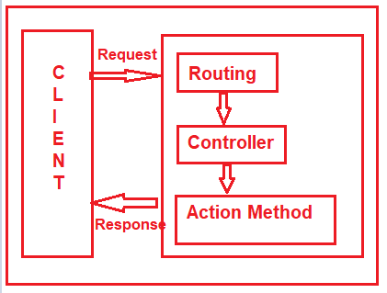
when a client makes a request, then that request comes to the Routing Engine and then the Routing Engine navigates that Request to the Controller. The controller then selects the appropriate action method to execute. So, it is the Controller action method which is going to handle the incoming request and send the response back to the client who initially made the request as shown in the below image.

Slide 23
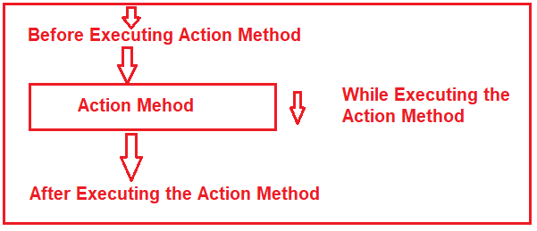

Slide 24
Basically, ASP.NET MVC Filters are used to perform the following common functionalities in your application.
Caching
Logging
Error Handling
Authentication and Authorization, etc.

Slide 25
The ASP.NET MVC5 framework provides five different types of Filters. They are as follows
Authentication Filter (Introduced in MVC 5)
Authorization Filter
Action Filter
Result Filter
Exception Filter

Slide 26
Some of the filters are already built by the ASP.NET MVC framework and they are ready to be used. For example
Authorize
ValidateInput
HandleError
RequireHttps
OutputCache, etc

Slide 27
You can configure the filters at three different levels of our application. They are as follows
Global Level
Controller Level
Action Level

Slide 28
Global Level:
protected void Application_Start()
{
FilterConfig.RegisterGlobalFilters(GlobalFilters.Filters);
}
Controller Level:
[Authorize(Roles = "Admin")]
public class AdminController : Controller
{
//Code
}
Action Method Level:
public class UserController : Controller
{
[Authorize(Users = "User1,User2")]
public ActionResult LinkToLogin(string provider)
{
// Code
return View();
}
}

Slide 29
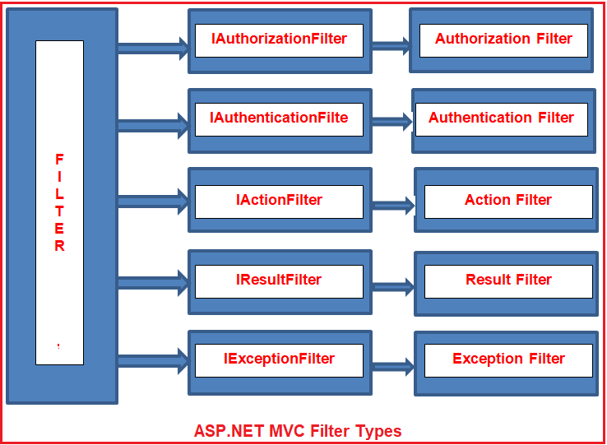

Slide 30
The Process ..
The Authentication filter is the first filter that is going to be executed before executing any other filter or action method. This filter checks that the user from where the request is coming is a valid user or not. The Authentication filters in MVC implements the IAuthenticationFilter interface.
The Authorization Filters executed after the Authentication Filter. This filter is used to check whether the user has the rights to access the particular resource or page. The built-in AuthorizeAttribute and RequireHttpsAttribute are examples of Authorization Filters.
The Action Filter will be executed before the action method starts executing or after the action has executed. So, if you want to execute some custom logic that should be get executed before and after an action method executes, then you need to use the Action Filters in MVC applications.
The Action filters implement the IActionFilter interface that has two methods OnActionExecuting and OnActionExecuted.
The Result filters in MVC application are executed before or after generating the result for an action. Action Result type can be ViewResult, PartialViewResult, RedirectToRouteResult, RedirectResult, ContentResult, JsonResult, FileResult and EmptyResult which derives from the ActionResult abstract class. Result filters are called after the Action filters. The in-built OutputCacheAttribute is an example of Result Filters.
The Result Filters in MVC implements the IResultFilter interface and provides two methods OnResultExecuting and OnResultExecuted which will be executed before or after generating the result for an action respectively

Slide 31
The Exception filters are executed when there is an unhandled exception occurs during either the execution of actions or filters. The in-built HandleErrorAttribute class is an example of Exception Filters.
The IExceptionFilter interface is used which provides the OnException method which will be executed when there is an unhandled exception during the actions or filters execution.

