Slide 1
Introduction to .Net Framework

Slide 2
Delegates
C# delegates are similar to pointers to functions, in C or C++. A delegate is a reference type variable that holds the reference to a method. The reference can be changed at runtime.
Delegates are especially used for implementing events and the call-back methods. All delegates are implicitly derived from the System.Delegate class.
Declaring Delegates
Delegate declaration determines the methods that can be referenced by the delegate. A delegate can refer to a method, which has the same signature as that of the delegate.

Slide 3
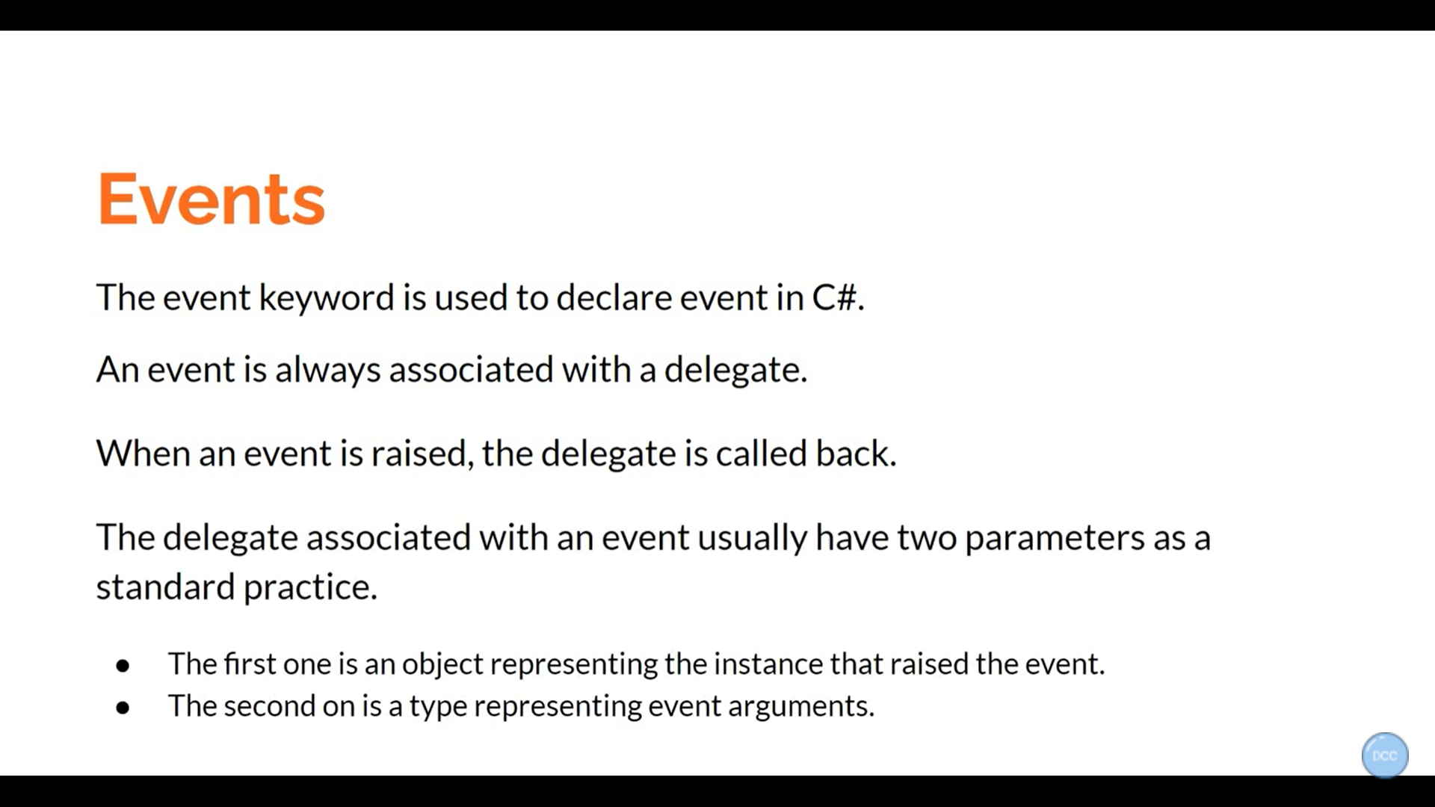

Slide 4
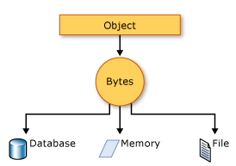
What is Serialization in C#?
Serialization in C# is the process of bringing an object into a form that it can be written on stream. It's the process of converting the object into a form so that it can be stored on a file, database, or memory; or, it can be transferred across the network. Its main purpose is to save the state of the object so that it can be recreated when needed.

Slide 5
What is Deserialization in C#?
As the name suggests, deserialization in C# is the reverse process of serialization. It is the process of getting back the serialized object so that it can be loaded into memory. It resurrects the state of the object by setting properties, fields etc.
Types
Binary Serialization
XML Serialization
JSON Serialization

Slide 6
Threads
What is a Thread?
A thread is defined as the execution path of a program.
Threads are lightweight processes
The thread that will be first executed in the entire process is called as Main thread
The main thread is automatically created when the execution of C# program begins. The threads that are created using the classes of Thread are called as the child threads of the main thread
Each thread defines a unique flow of control, with each thread performing a particular job..
The CurrentThread property of Thread class is used to access a thread.

Slide 7
What Is A Task In C#?
A task in C# is used to implement Task-based Asynchronous Programming and was introduced with the .NET Framework 4. The Task object is typically executed asynchronously on a thread pool, rather than synchronously on the main thread of the application.
A task scheduler is responsible for starting the Task and also responsible for managing it.
By default, the Task scheduler uses threads from the thread pool to execute the Task.
Tasks in C# basically are used to make application more responsive. If the thread that manages the user interface offloads the works to other threads from the thread pool, then it can keep processing user events which will ensure that the application can still be used.

Slide 8
What is Thread pool in C#?
A Thread pool in C# is a collection of threads which can be used to perform a number of task in the background.
Once a thread completes its task, then it is sent to the thread pool, again, so that it can be reused.
This reusability of threads avoids an application to create a number of threads which ultimately helps in less memory consumption.

Slide 9
Task Parallel Library (TPL)
The Task Parallel Library (TPL) is a set of public types and APIs in the System.Threading and System.Threading.Tasks namespaces.
The purpose of the TPL is to make developers more productive by simplifying the process of adding parallelism and concurrency to applications.
TPL handles the partitioning of the work, the scheduling of threads on the ThreadPool, cancellation support, state management, and other low-level details.
By using TPL, you can maximize the performance of your code while focusing on the work that your program is designed to accomplish.

Slide 10
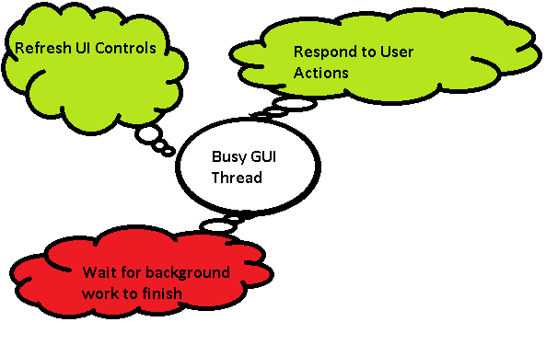

Slide 11
What is Parallel Programming?
Parallel Programming is a type of programming in which many calculations or the execution of processes are carried out simultaneously.
Points to Remember while working with Parallel Programming:
The Tasks must be independent.
Order of the execution does not matter

Slide 12
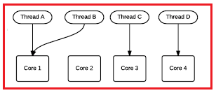
Why (TPL)?
Today’s desktop typically has 4 cores but the latest experimental multi-core chips have up to 1000 cores.
So in the simple word, we can say that the multicore processor machines are now becoming standard and the aim is to improve the performance by running a program on multiple processors in parallel.
So by considering the above scenario, the .NET Framework 4 introduces Task Parallel Library (TPL) that makes it easier for developers to write parallel programs that target multi-core machines (automatically use multiple processors) which improve the performance.

Slide 13
Tasks vs. Threads
TASKS | THREADS
A Task represents some asynchronous operation and is part of the Task Parallel Library, for running tasks asynchronously and in parallel. | The Thread class is used for creating and manipulating a thread (flow of work)in Windows
The task can return a result. | There is no direct mechanism to return the result from a thread.
A task can have multiple processes happening at the same time. | Threads can only have one task running at a time.
We can easily implement Asynchronous programming using ’async’ and ‘await’ keywords. | ---------
A Task is a higher level concept than Thread.

