Slide 1
Introduction to .Net Framework

Slide 2
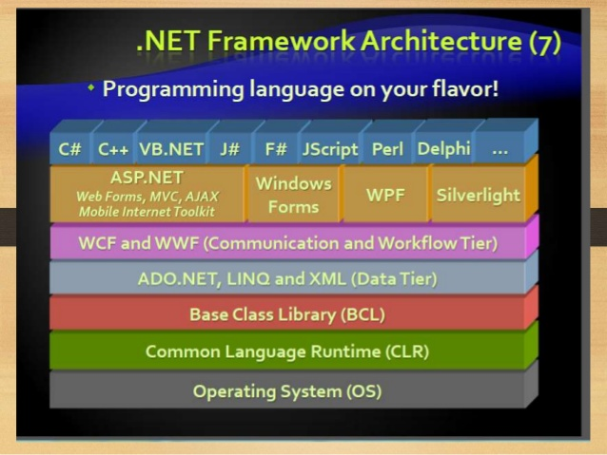
Architecture

Slide 3
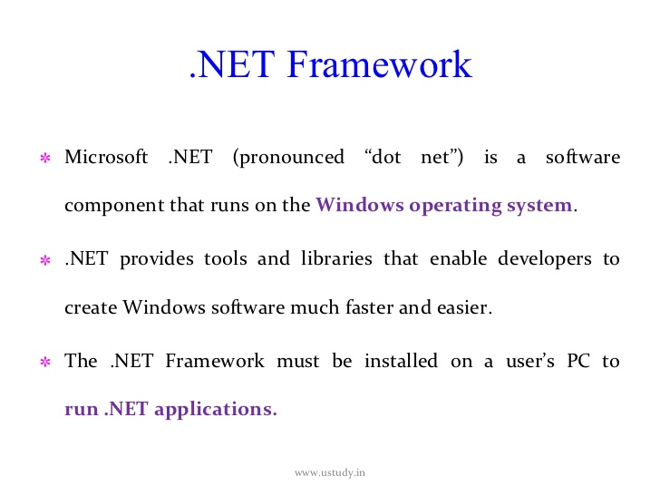

Slide 4
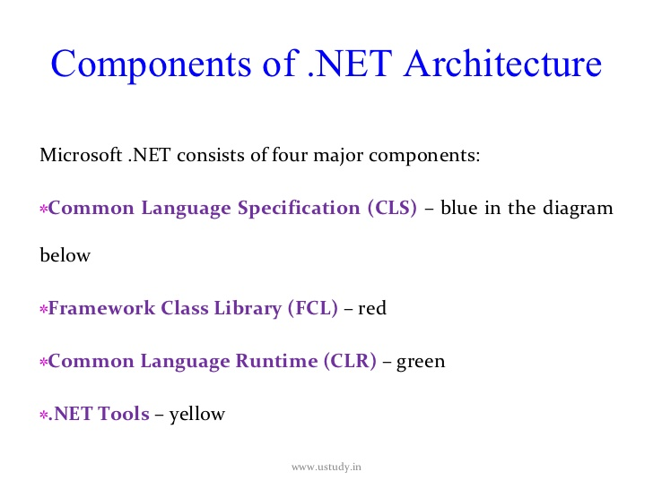

Slide 5
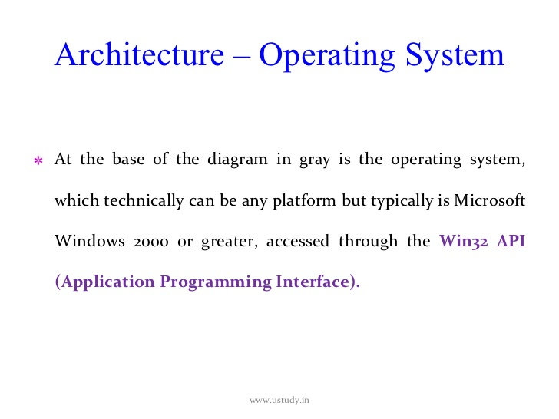

Slide 6
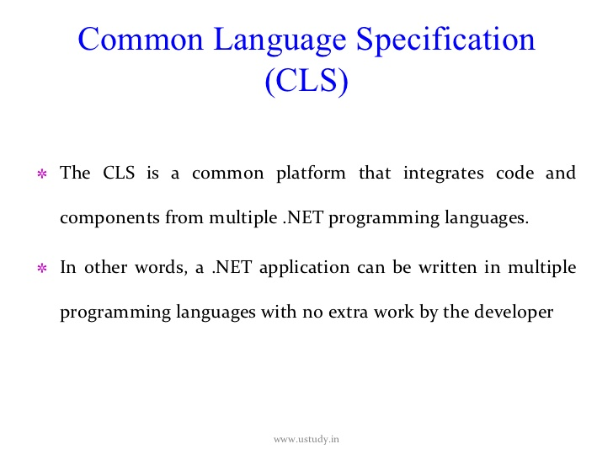

Slide 7
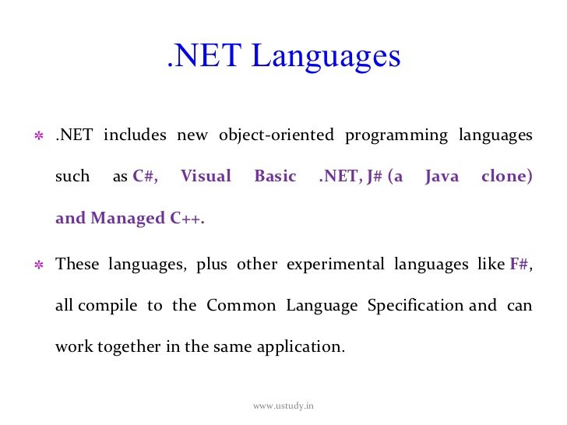

Slide 8
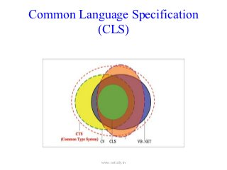

Slide 9
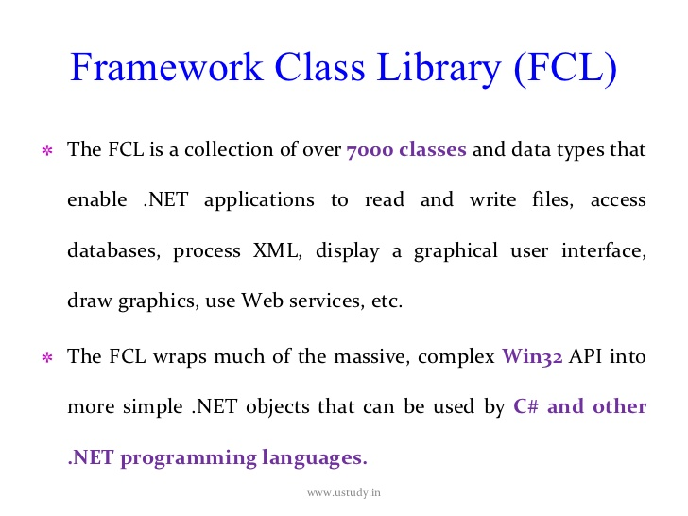

Slide 10
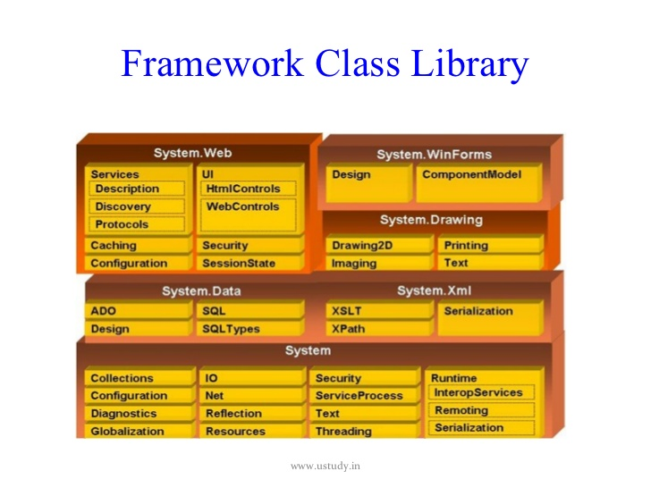

Slide 11
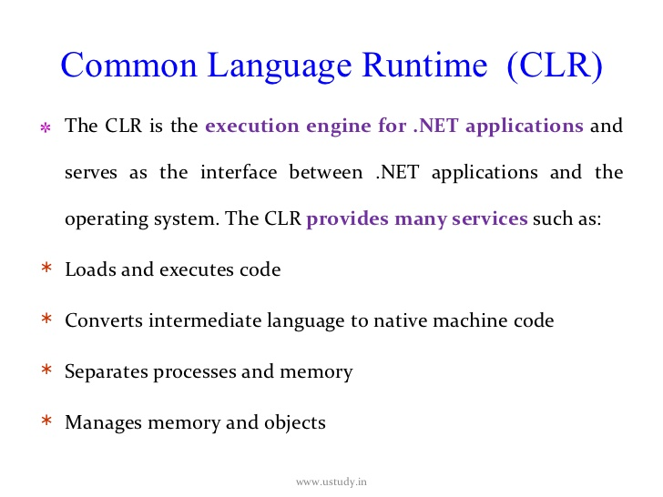

Slide 12
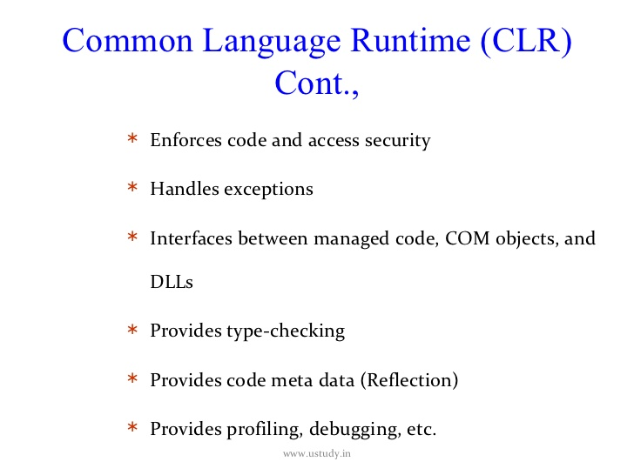

Slide 13
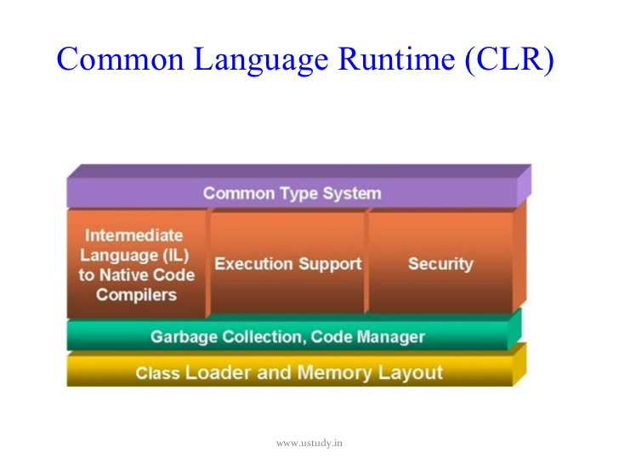

Slide 14
Points to remember
IL is also called as MSIL,CIL, Managed Code
Assemblies have an extension of either .dll, or.exe depending on the type of application.
.Net assemblies contain IL, whereas pre .Net assemblies contain native code.
.Net Application on execution contains 2 steps
Compilation – source code to IL
Execution on JIT compilation – IL to platform specific native code
The native code is not stored permanently anywhere. Once the program execution is over, it is thrown away. When we execute the program again, the native code is generated.

Slide 15
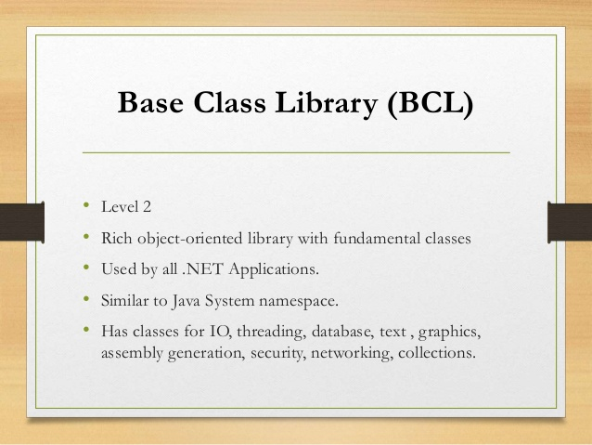

Slide 16
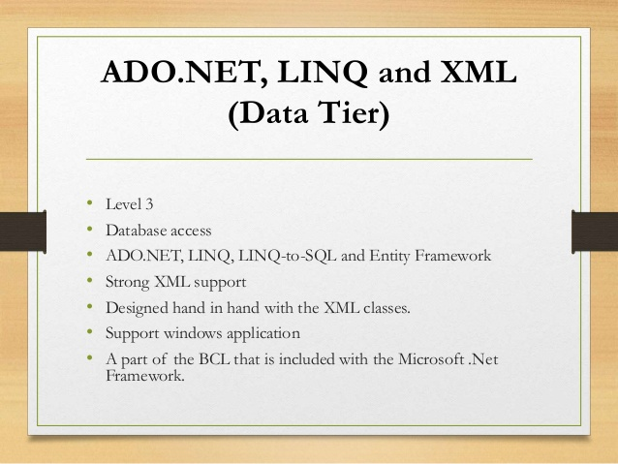

Slide 17
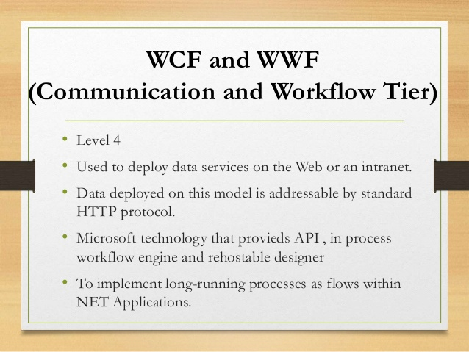

Slide 18
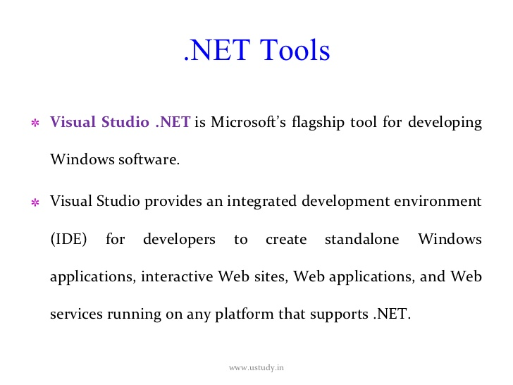

Slide 19
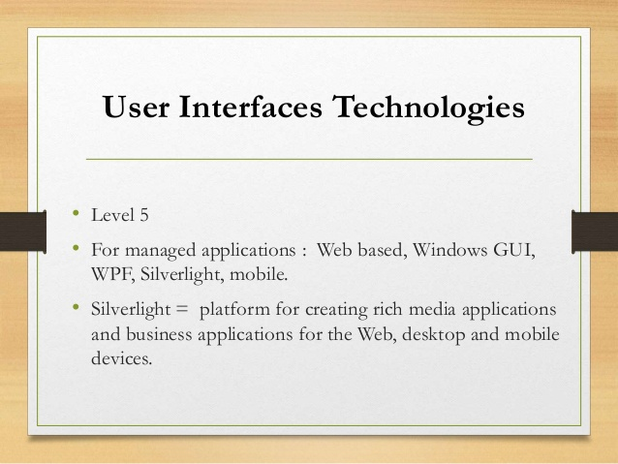

Slide 20
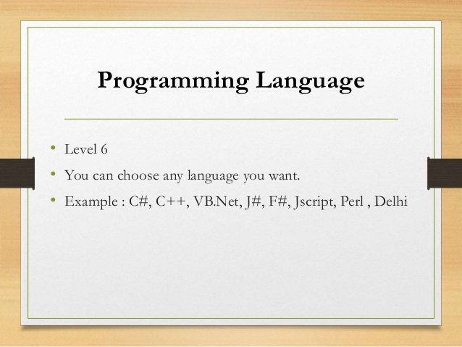

Slide 21
In Conclusion..
.Net is the Microsoft Web Services Strategy to connect information, people, systems and device through software.
.Net is a platform that provides a standardized set of services
Data Access and connectivity (ADO.Net)
Use Interfaces (Winforms, WPF)
Web Applications (ASP.net , Silverlight)
Network Communication (WCF), Workflow(WF)

Slide 22
Kinds of Application
Desktop - deployed in each machine
Console , Windows Application
Web – Internet based Application, accessed through browser
ASP.Net, MVC Core
Mobile - Xamarin

Slide 23
Assemblies
Any .Net Application on compilation gives assembly files(.dll or .exe)
Assemblies are fundamental unit of deployment, version control, reuse and security for a .net application.
Assembly contains – PE Header, CLR Header, Manifest and IL
Manifest files contain metadata
Assemblies can be private or shared
Shared Assemblies are placed in GAC

Slide 24
Assemblies contd….
Some information in the assembly manifest can be modified using attributes
We use ILDASM to peek into the assembly Manifest and IL file. We can use this tool to export the same to a text file.
We use ILASM to reconstruct an assembly from the text file into assembly Manifest and the IL.

Slide 25
Global Assembly Cache
Machine wide central repository of assemblies
Assemblies in GAC must be strongly named
Strong name consists of simple text name, version number, and culture information(if provided), a public key and a digital signature
gacutil / i for installing and / u for uninstalling

Slide 26
Assembler Tools
ILDASM – IL Disassembler
ILASM – IL Assembler

Slide 27
C Sharp

Slide 28
Major Objectives
C# Basics
Namespaces
Data Types
Data Conversions and Typecasts
Nullables
Operators
Decision Making
Loops
Classes
Encapsulation
Method Parameters
Polymorphism
Inheritance

Slide 29
C Sharp Basics
C# is a modern, general-purpose, object-oriented programming language developed by Microsoft
C# was developed by Anders Hejlsberg and his team during the development of .Net Framework.
C# is designed for Common Language Infrastructure (CLI), which consists of the executable code and runtime environment that allows use of various high-level languages on different computer platforms and architectures.

Slide 30
Namespace
It is a logical way to organize your program
It is a collection of Classes, Interfaces, Events, Delegates, Structures, Enums and also other Namespaces.
Provides assistance in avoiding name clashes.

Slide 31
Data Types
Are basically either
Value Types - All integral data types (primitive/systemic/fundamental)
Reference Types – All objects of Classes, Interfaces, Delegates, Arrays etc.
Boolean
Integer
Floating
Decimal

Slide 32
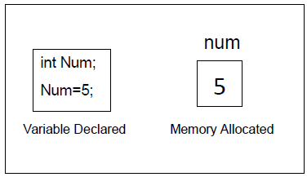
Value types
Value types are derived from System.ValueType
Value type variables stores the data
Value types are stored in Stack Memory

Slide 33
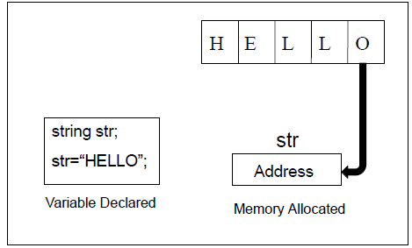
Reference types
A type that is defined as a class,delegate,array or interface is a reference type
String and object are also reference types
Contains the address of the memory where data is stored
Reference types are stored in heap memory
Notes:
The reference types do not contain the actual data stored in a variable, but they contain a reference to the variables.
In other words, they refer to a memory location. Using more than one variable, the reference types can refer to a memory location. If the data in the memory location is changed by one of the variables, the other variable automatically reflects this change in value.
Example of built in reference types are:object, dynamic and string.

Slide 34
Data Types in C#(contd …)
Structures
User Defined
Enumerations
Value Type
Pre Defined
All Primitive Types
Data Type
string
Pre Defined
object
Reference Type
User Defiled
Classes
Arrays
Interface

Slide 35
Literals in C#
Real Literals
String Literals
Integer Literals
Literals
Character Literals
Null Literals
Boolean Literals
Notes:
A literal is a source code representation of a value.
literal:boolean-literal integer-literal real-literal character-literal string-literal null-literal

Slide 36
Data Types In C# contd…
Integer Literals
Ex: 1234
Real Literals
Ex: 10.5
Character Literals
Ex: ‘a’ or ’1’
Notes:
The number that are represented without decimal point. Whole numbers having positive or negative values.
Real Literals are floating point constants or numbers with decimal points .ex 80.5,0.001,-3.2,1.0E-03.
Character Literals are Constants which are alphanumeric in character, Alphabets(Upper and Lower), Digits, Special Characters.
String is a Set of alphanumeric characters. Group of characters enclosed within double quotes. Ex:”String in Java”.
Boolean represent true or false and is applied in logical situation, there will be no quotes.
Null Literal It is represented as ‘/0’ ,String terminator Marks the end of the String.

Slide 37
Data Types In C# contd…
String Literals
Ex: “Hello World”
Boolean Literal
Ex: true/false
Null Literal
Ex: ‘/0’

Slide 38
Boxing and Unboxing
Boxing
When a Value Type is converted to Object Type / Reference Type
Eg. Object obj; obj=100;
Unboxing
When an Object type / Reference type is converted to Value Type
Eg : Obj obj;
Int n =(int)obj;

Slide 39
Type Conversions
Implicit type conversion − These conversions are performed by C# in a type-safe manner. For example, conversions from smaller to larger integral types and conversions from derived classes to base classes.
Eg :
Explicit type conversion − These conversions are done explicitly by users using the pre-defined functions. Explicit conversions require a cast operator.
Eg:
C # provides various conversion methods
ToInt16, ToInt32, ToBoolean, ToChar, ToString etc.
Parse()

Slide 40
Nullables
C# provides a special data type, the nullable types, to which you can assign normal range of values as well as null values.
nullable types bridge the difference between C# types and the Database types
Transformation of nulls and non nulls.

Slide 41
Operators
Arithmetic Operators
Relational Operators
Logical Operators
Assignment Operators
Misc. Operators :
Sizeof(), Typeof(), ?: etc
Null Coalescing Operator : ??

Slide 42
Visual Studio
IDE for creating .NET application
Console Applications
Web Applications
Windows Applications
Web Services
Features
Page Design
Automatic error detection
Debugging tools
IntelliSense
Short cut keys
Notes:
Visual Studio Is a software development environment (also know as an Integrated Development Environment or IDE), It's used primarily by Software Developers to build Software products, websites and Utilities.
Visual Studio was introduced by Microsoft in 1998 and has seen many evolutions, product versions are:
Visual Studio 6.0 (1998)
5.2 Visual Studio .NET (2002)
5.3 Visual Studio .NET 2003
5.4 Visual Studio 2005
5.5 Visual Studio 2008
5.6 Visual Studio 2010
The current Version of Visual Studio is 2012 and is available in a number of different versions, each designed to suite a different type of user:
Visual Studio 2010 - Express (Free Version)
Visual Studio 2010 - Professional
Visual Studio 2010 - Premium
Visual Studio 2010 - Ultimate
Visual Studio 2010 - Test Professional
Visual Studio 2012

Slide 43
Control Statements
Control statements control the execution path of the program
Selection Statements
If
Switch
Notes:
Control statements give you additional means to control the processing within the applications you develop. This section explores the syntax and function of the if, switch, do-while, for, for each, goto, break, continue, and return statements.

Slide 44
Control Statements
Iteration Statement
While
Do while
For
For each
Jump Statements
break
continue
goto
return
Throw

Slide 45
Control Statements contd…
If-else Statement
if (<conditional expression>) < statement action> else < statement action>
Notes:
The if/else statement is an extension of the if statement. If the statements in the if statement fails, the statements in the else block are executed.
When executing a switch statement, the program falls through to the next case. Therefore, if you want to exit in the middle of the switch
statement code block, you must insert a break statement, which causes the program to continue executing after the current code block.

Slide 46
Control Statements contd…
Switch Case Statement
switch (<non-long integral expression>)
{ case label : <statement>
break; case label: <statement>
break; case label: <statement>
break; default: <statement>
}

Slide 47
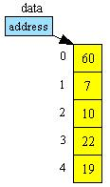
Arrays in C#
Array is a collection of values of same data type
The following figure shows the array structure in system memory
Notes:
In C#, an array index starts at zero. That means the first item of an array starts at the 0thposition. The position of the last item on an array will total number of items - 1. So if an array has 10 items, the last 10th item is at 9th position. In C#, arrays can be declared as fixed length or dynamic.
A fixed length array can store a predefined number of items.
A dynamic array does not have a predefined size. The size of a dynamic array increases as you add new items to the array. You can declare an array of fixed length or dynamic. You can even change a dynamic array to static after it is defined.
Arrays can be divided into the following four categories.
Single-dimensional arrays
Multidimensional arrays or rectangular arrays
Jagged arrays

Slide 48
Arrays in C# contd…
There are 3 types of arrays
Single-Dimensional
Two-Dimensional/Multi-Dimensional
Jagged Array

Slide 49
Array Instantiation
Datatype [] Array_name=new Data type[size];
Data type: specifies what type of data is stored
Array_name: Indicates name of the array
new: It allocates memory to the array at runtime
Size: Indicates number of elements
Notes:
In C#, arrays are objects. That means that declaring an array doesn't create an array. After declaring an array, you need to instantiate an array by using the "new" operator.
The following code snippet defines arrays of double, char, bool, and string data types.
double[] doubleArray = new double[5];
char[] charArray = new char[5];
bool[] boolArray = new bool[2];
string[] stringArray = new string[10];

Slide 50
Array Instantiation
ex: int []a=new int[5];
string []names=new string[3];
Int []data=new int[5]{1,2,3,4,5};
int []data=new int[]={10,20,30,40,50} ;

Slide 51
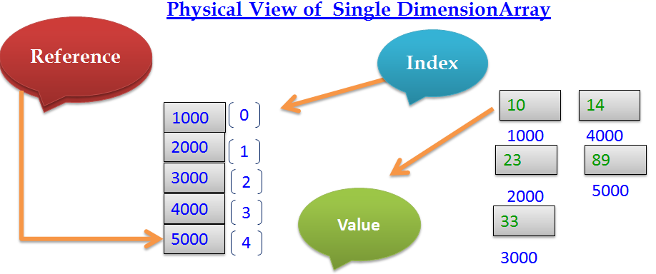
Arrays in C# contd…

Slide 52
Arrays in C# contd…
Assigning values to array
int []a= new int[4]
a[0]=10
a[1]=20
a[2]=30
a[3]=40
int []a=new int[4]{10,20,30,40}
int []a={10,20,30,40} //Dynamic allocation
a[index]- returns the array value at particular index
Notes:
Once an array is declared, the next step is to initialize an array. The initialization process of an array includes adding actual data to the array.
The following code snippet creates an array of 3 items and values of these items are added when the array is initialized.
// Initialize a fixed array
int[] staticIntArray = new int[3] {1, 3, 5};
Alternative, we can also add array items one at a time as listed in the following code snippet.
// Initialize a fixed array one item at a time
int[] staticIntArray = new int[3];
staticIntArray[0] = 1;
staticIntArray[1] = 3;
staticIntArray[2] = 5;
The following code snippet declares a dynamic array with string values.
// Initialize a dynamic array items during declaration
string[] strArray = new string[] { "Mahesh Chand", "Mike Gold", "Raj Beniwal", "Praveen Kumar", "Dinesh Beniwal" };

Slide 53
System.Array Class
sort() : It sorts array elements in ascending order.
System.Array.Sort(array name)
reverse(): It arrange array elements in reverse order
System.Array.Reverse(array name)
copy() : It copies one Array elements into to another array
System.Array.Copy(source array name, destination array name, count)
Length: It returns size of the array
Rank: It returns dimension of the array
Notes:
Array class is the mother of all arrays and provides functionality for creating, manipulating, searching, and sorting arrays in .NET Framework.
Array class, defined in the System namespace, is the base class for arrays in C#. Array class is an abstract base class that means we cannot create an instance of the Array class.

Slide 54
Two-Dimensional Array
It stores values in one or more columns
Has rows and columns
Ex: int [,] table=new table[4,3];
Notes:
A multi-dimensional array, also known as a rectangular array is an array with more than one dimension. The form of a multi-dimensional array is a matrix.
Declaring a multi-dimensional array
A multi dimension array is declared as following:
string[,] mutliDimStringArray;
A multi-dimensional array can be fixed-sized or dynamic sized.
int[,] numbers = new int[3, 2] { { 1, 2 }, { 3, 4 }, { 5, 6 } };
string[,] names = new string[2, 2] { { "Rosy", "Amy" }, { "Peter", "Albert" } };

Slide 55
Two-Dimensional Array contd…
Assigning Values to 2-Dimensional Arrays
int [,] a=new int[2,2]{{12,32},{34,54}};
int[,]table =new table[4,3] {
{400, 450, 510},
{500, 560, 630},
{625, 676, 740},
{1000, 1250, 1600}
};

Slide 56
Jagged Arrays
Jagged arrays are often called array of arrays
An element of a jagged array itself is an array
Datytype [][] Array_name = new Datatype[size][] ;
Size indicates no of arrays stored in jagged array
Ex: int [][]j _array =new int[3][];
j_array[0]=new int[] {1,2,3,4};
j_array[1]=new int[] {5,6,7};
j_array[2] =new int[] { 8,9};
Notes:
Jagged arrays are arrays of arrays. The elements of a jagged array are other arrays.
Declaring Jagged Arrays
Declaration of a jagged array involves two brackets. For example, the following code snippet declares a jagged array that has three items of an array.
int[][] intJaggedArray = new int[3][];
The following code snippet declares a jagged array that has two items of an array.
string[][] stringJaggedArray = new string[2][];
Initializing Jagged Arrays
Before a jagged array can be used, its items must be initialized. The following code snippet initializes a jagged array; the first item with an array of integers that has two integers, second item with an array of integers that has 4 integers, and a third item with an array of integers that has 6 integers.
// Initializing jagged arrays
intJaggedArray[0] = new int[2];
intJaggedArray[1] = new int[4];
intJaggedArray[2] = new int[6];
We can also initialize a jagged array's items by providing the values of the array's items. The following code snippet initializes item an array's items directly during the declaration.
// Initializing jagged arrays
intJaggedArray[0] = new int[2]{2, 12};
intJaggedArray[1] = new int[4]{4, 14, 24, 34};
intJaggedArray[2] = new int[6] {6, 16, 26, 36, 46, 56 };

Slide 57
Strings in c#
String is a collection of characters
Memory is allocated on the heap
string s=“abc”;
string s1 = @"D:/Sample/ConsoelAPp“;
String is a predefined reference type
Strings are Immutable
Strings have fixed size
String memory cannot be changed dynamically
Notes:
The System.String data type is used to represent a string. A string in C# is an object of type System.String. The string class in C# represents a string. The following code creates three strings with a name, number and double values. // String of characters System.String authorName = "Mahesh Chand";
// String made of an Integer System.String age = "33"; // String made of a double System.String numberString = "33.23";

Slide 58
Methods of String Class
copy()- copies one string into another
String. Copy(value)
concat()-concats two strings
String.Concat(s1,s2)
compare()-compares two strings
compare(string s1,string s2,bool ignorecase)
Equal(String s)- Compares two strings and return boolean value
split()-splits string into substrings
string []s=s1.split('separator',' separator',....)
Notes:
join() -I t will join the array of strings into one string with separator
string s= string.join ( ‘separator', array name)

Slide 59
Methods of String Class
indexof("char")-finds the index of given char
indexof(“string”)-finds the index of given string
contains("substring")-checks if substring exists in the string
tolower()-returns string in lowercase
toupper()-returns string in uppercase
TocharArray()-converts string to char array
replace("old string", "new string")- replaces old string with new string
replace('old char', 'new char')-replaces old char with new char
Notes:
Substring( int index)-it return the substring stating from index to total string.
Substring(int index,int count)-it return the substring starting from index to given counted chars
String. Format(format, "string”)-it format the string
ex:string.format(“{0:C}”,”1234”)-$1234

Slide 60
Formatting strings
Formatting strings are used to format the output
{0:Fn}-To display fixed decimal points n=1,2,….
{0:E}-To display output in exponential format
{0:C}-To display in currency format-$123
{0:P}-To display in percentage format-123%
{0:D}-To display date in long format-March 5 2011
{0:d}-To display date in small format-02/5/2011
{0:T}-To display time in long format-12:23:12
{0:t}-To display time in small format-12:23
Notes:
Format controls appear inside the braces ({}) of the place holders. The format of a place holder with a format control is as follows:
{n:controlx}
Where n is the place holder number and control is the special format control sequence to be applied to the argument. The x is an optional number which further formats the output for certain controls.

