Slide 1

IMDB Top 250 Analysis
Lavy Ngo
Bao Ngo

Slide 2
Overview
We are using the IMDB Top 250 Movies Dataset which contains the top 250 rated movies on IMDB as of 2021 to analyze:
What are the notable directors on this list?
What genre usually gets high ratings?
Which decade produces the most movies on this list?
What is the average IMDB rating over time?

Slide 3
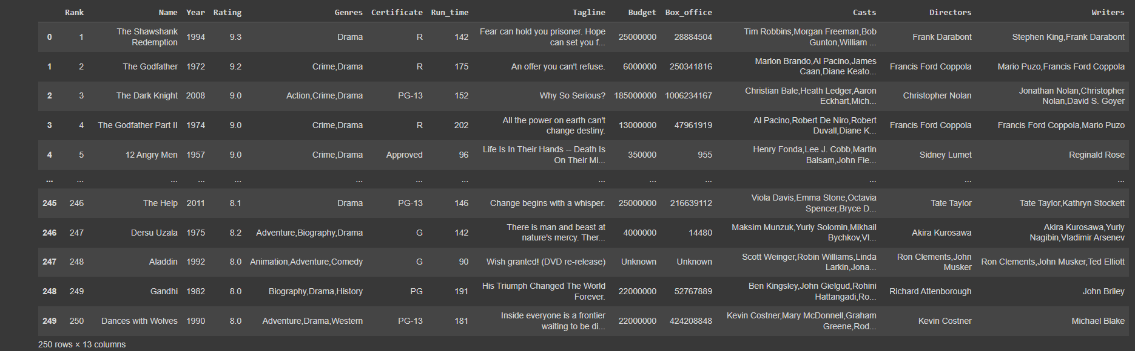
Dataset

Slide 4
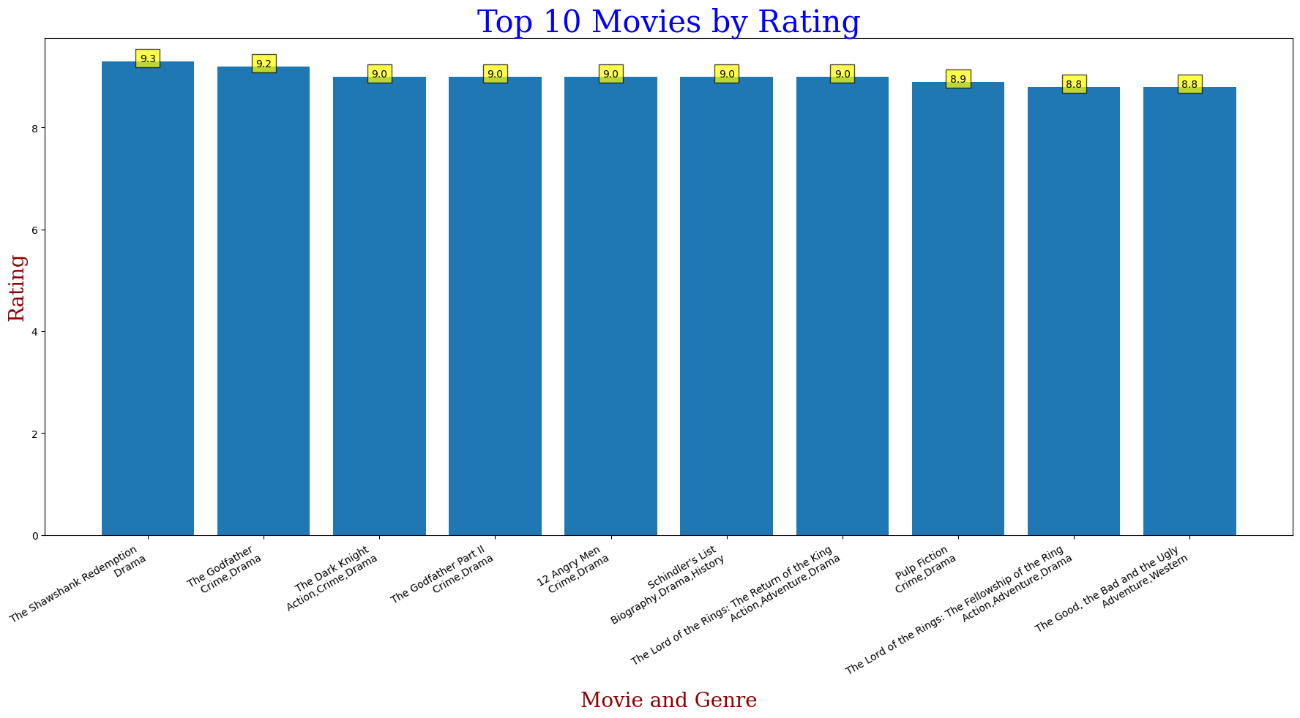

Slide 5
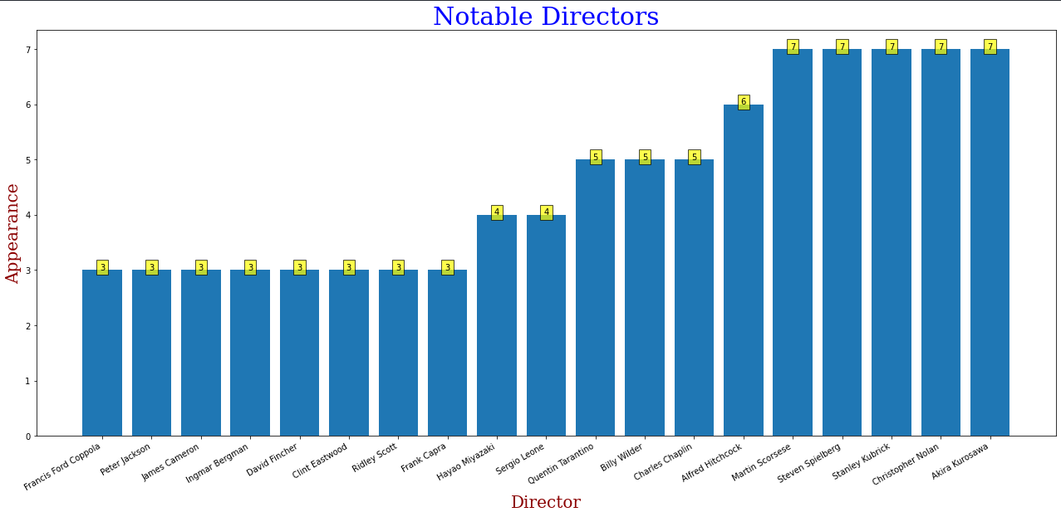

Slide 6
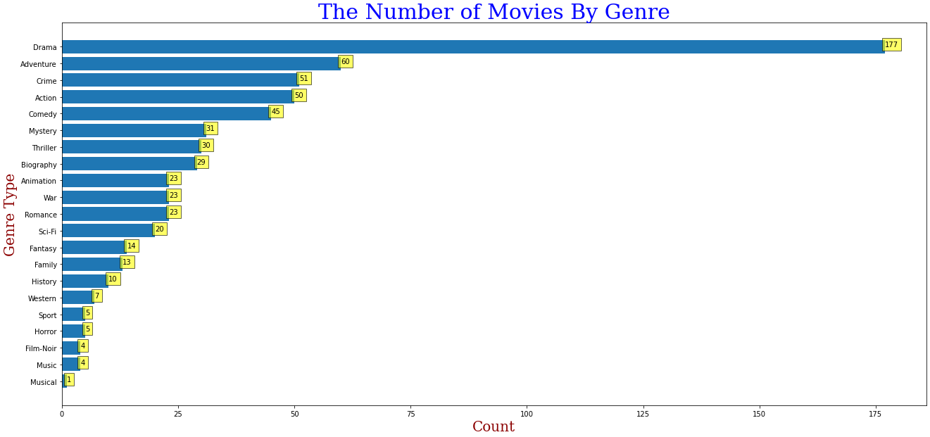

Slide 7
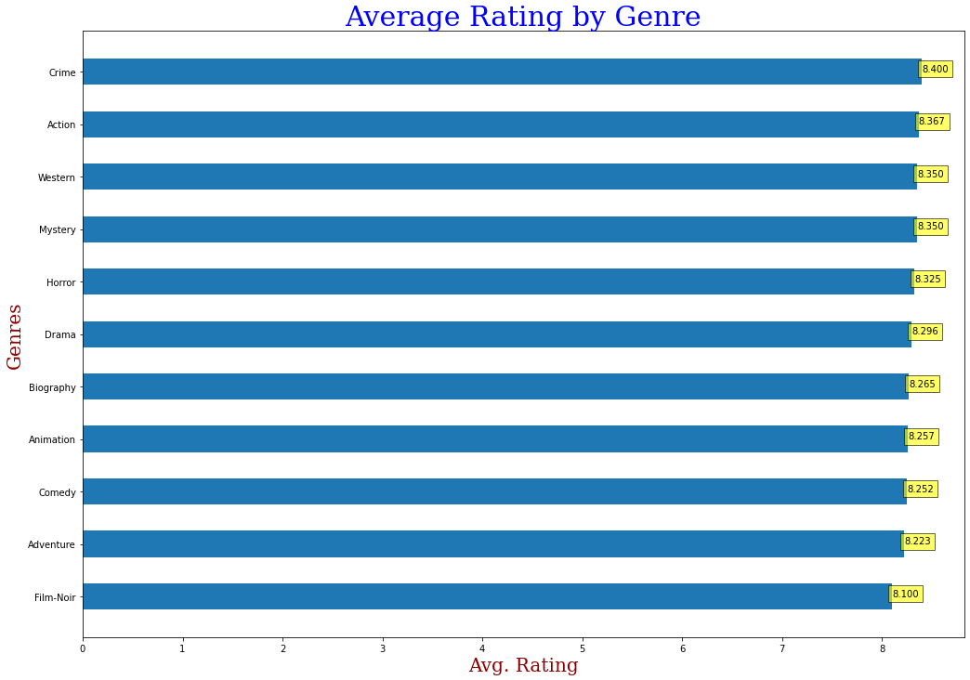

Slide 8
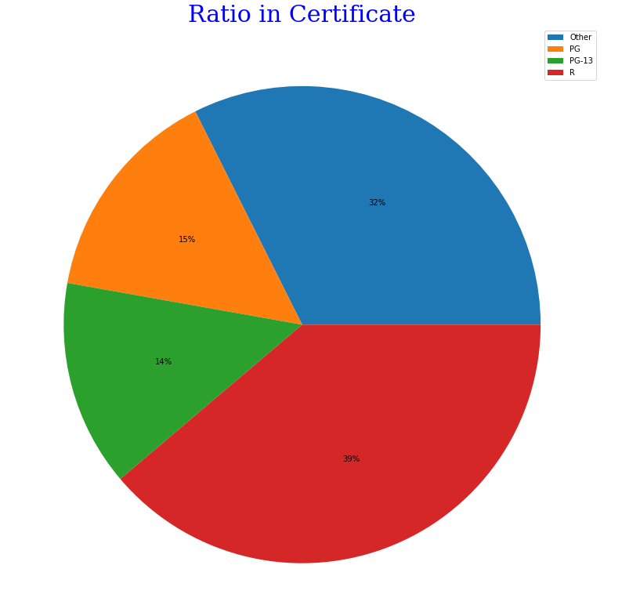
Certificate
Certificate: The rating is given to the movie by the relevant certification board, which indicates the age-appropriateness of the movie and may contain information about the content. The 3 most popular ones on this list are R, PG-13, PG.

Slide 9
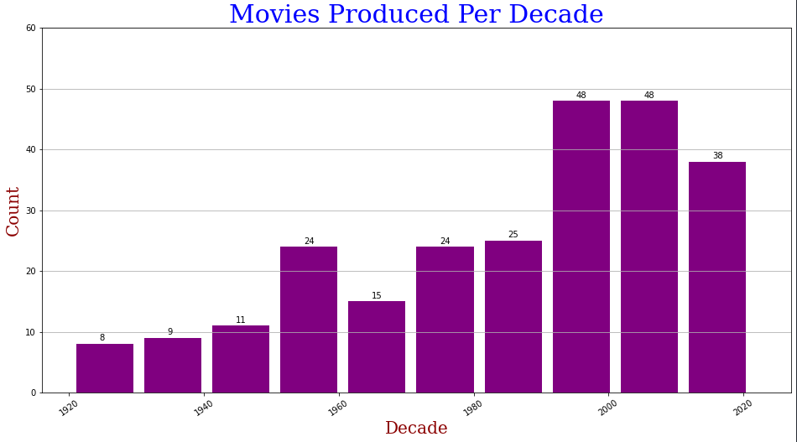

Slide 10
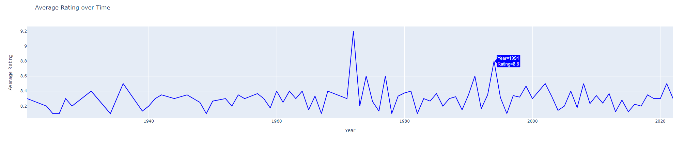
After 1994 no movie could even touch an 8.80 IMDB rating. What could have been the reason?
User votes: IMDb ratings are based on user votes, and as more people evaluate a film over time, its rating will change. Additionally, since IMDb's launch in 1990, its user base has increased significantly, which may make it more challenging for a film to receive a very high rating.
Movie taste: movies have become more diverse over time, and tastes in cinema have become more varied. With so many movies being made and released each year, it may be more difficult for any one movie to achieve widespread critical acclaim and appeal to a broad range of viewers.
Media consumption: the way we consume media has also evolved over time, with streaming services and other digital platforms making it simpler to access a greater variety of films and TV series. This might have made it more difficult for any one movie to have the same kind of cultural influence and enduring appeal as some of the earlier famous movies.

Slide 11
THANK YOU

