Slide 1
Wit.ai
Natural Language for Developers

Slide 2
Table of content
About wit.ai
Quick start
Wit.ai on production
Alternatives

Slide 3
About wit.ai-1
AI platform:
“As a Facebook company, we are building the AI platform
that helps 45,000+ developers create apps that
understand human language”

Slide 4
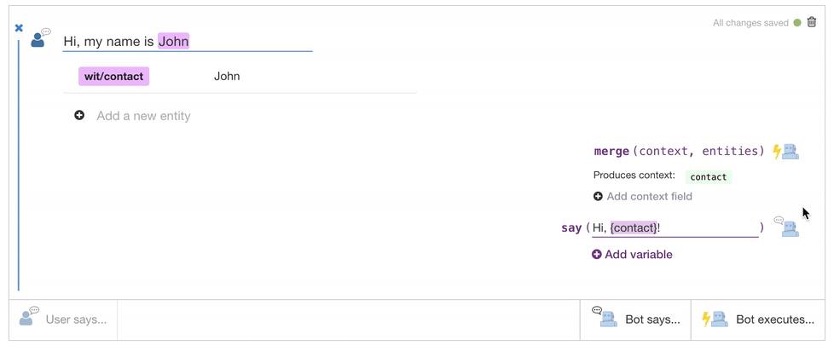
About wit.ai-2
Wit.ai as a Bot Engine:
“Build bots easily. You tell us what your user said,
we tell you what your bot should do next.”

Slide 5
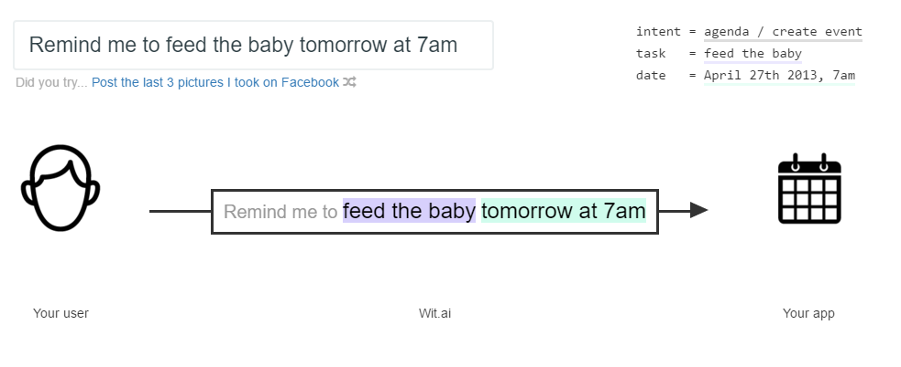
About wit.ai-3
Wit.ai as a Intent Parser:
“Your users give us voice or text, you get back structured data.
It's that simple”

Slide 6
Quick start-1
Visit: https://wit.ai/docs/quickstart

Slide 7
Quick start-2
Highlight: Story

Slide 8
Quick start-3

Slide 9
Quick start-4

Slide 10
Wit.ai on production-1
Pricing:
“Wit is free, including for commercial use. So both private and public Wit apps are free and are governed by our terms.”
Rate limit:
“We don't have a strict rate limit. Use common sense and please contact us if you plan to hit our API quite heavily
(sustained rate of 1 request/sec).”

Slide 11
Wit.ai on production-2
Language support:
“We currently support Albanian, Arabic, Azerbaijani, Bengali, Bosnian, Bulgarian, Burmese, Catalan, Chinese, Croatian, Czech, Danish, Dutch, English, Estonian, Finnish, French, Georgian, German, Greek, Hebrew, Hindi, Hungarian, Icelandic, Indonesian, Italian, Japanese, Korean, Latin, Lithuanian, Macedonian, Malay, Norwegian, Persian, Polish, Portuguese, Romanian, Russian, Serbian, Slovak, Slovenian, Spanish, Swahili, Swedish, Tagalog, Tamil, Thai, Turkish, Ukrainian and Vietnamese”

Slide 12
Wit.ai on production-3
Ownership on data:
“You have the ownership of your data but you agree to let us use them to improve Wit. If your app is private, your data (intents, entities, expressions, logs) will be accessible only by you and the developers you decide to share your app with. If your app is open, you agree to share some data. ”
Terms: 8-B-iii – Private App

Slide 13
Wit.ai on production-4
Supported platforms:
Node.js client
Python client
Ruby client
Others: HTTP API

Slide 14
Alternatives
Api.ai
Microsoft bot framework
Converse.ai
Pandorabots
ALICE

Slide 15
Thanks for watching got any questions?

