Slide 1

SWR302
Group 3
Hotel Management
Overall Requirements

Slide 2
SWR302
Group 3
Product Vision – Hà Trí Dũng
Context diagram – Vũ Trí Hiền
Feature Tree – Nguyễn Viết Bảo Châu
User classes – Trần Ngọc Thắng
Events List – Trần Hải Long

Slide 3
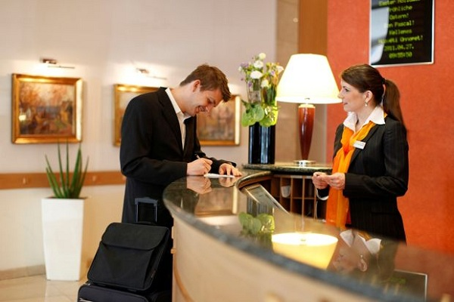
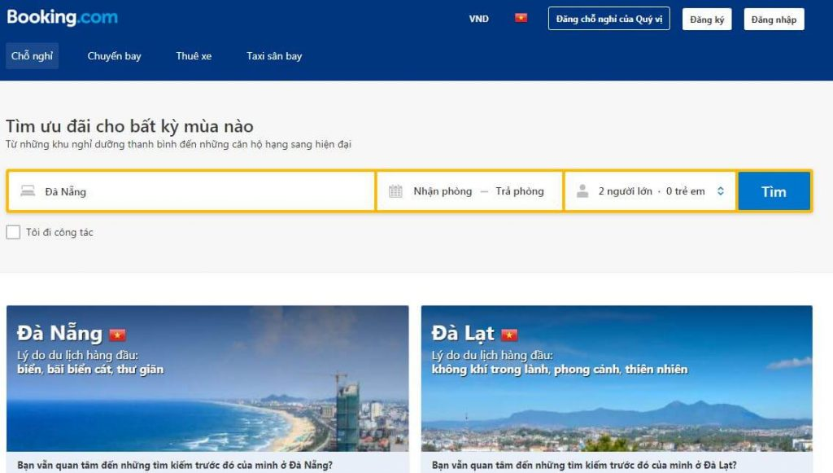
Product Vision
Accept individual check-ins or group check-ins, check-out, manage rooms, manage staffs, and manage services in the hotel.
Save time, increase the performance of hotel staff working

Slide 4
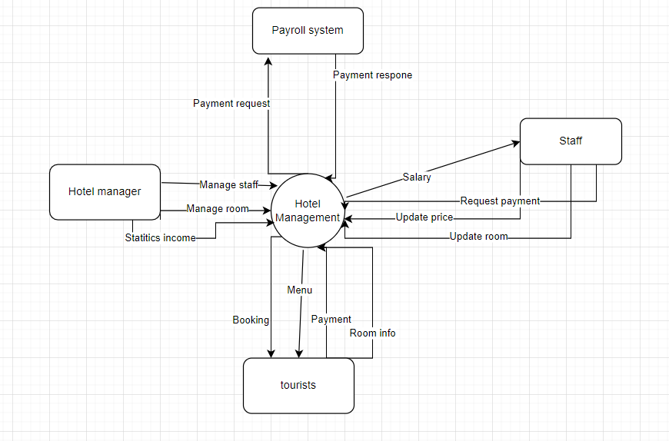
2. Context diagram

Slide 5
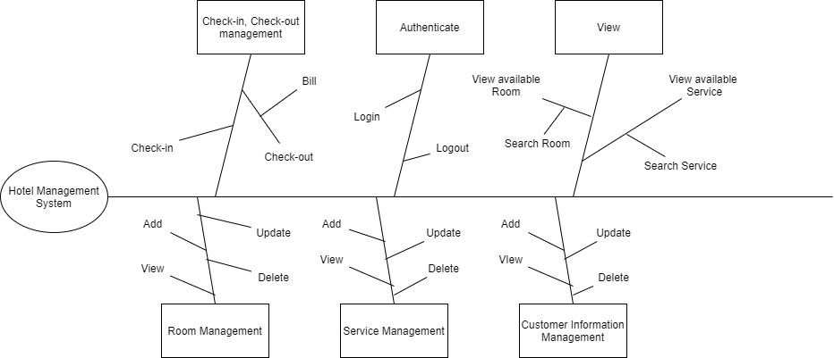
3. Feature Tree

Slide 6
Customer
Receptionist
Room Manager
Service Manager
4. User classes
Boss
Customer:
+ View available Room
+ View available Service
+ Booking Room
+ View Feedback
Receptionist:
+ Handle customer Check in, check out
+ Manage basic information of customer
Service Manager
+ Establishes/maintain services available
+ Edit the changes of Service
Boss
+ Manage Staff
+ Revenue statistics
Room Manager:
+ Establishes/maintain available rooms
+ Edit the changes of Rooms

Slide 7
5. Event list
+ Customer requests to make a reservation with the hotel
+ Enter customer information into the customer system
+ See room list, room details, price
+ Booking according to customer's request
+ Successful booking notification
+ Order services at the request of customers (Food, housekeeping ...)
+ Add or remove employees
+ Check out, pay bills
+ Time for customers to give feedback
+ View a list of customers
+ See the list of employees
+ Enter employee information
+ Notice to staff
+ Employee's salary

