Slide 1
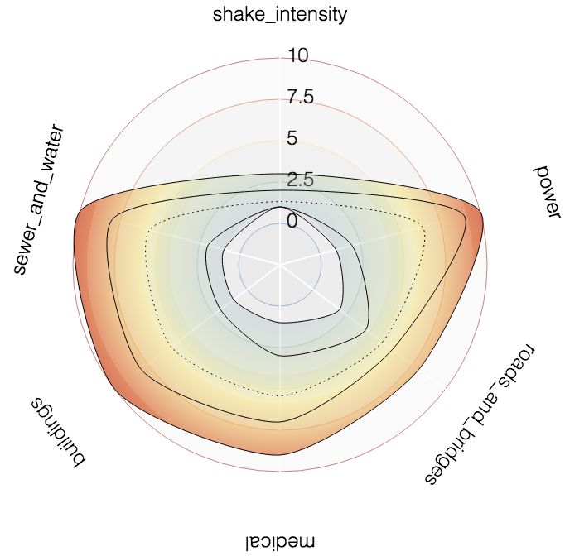
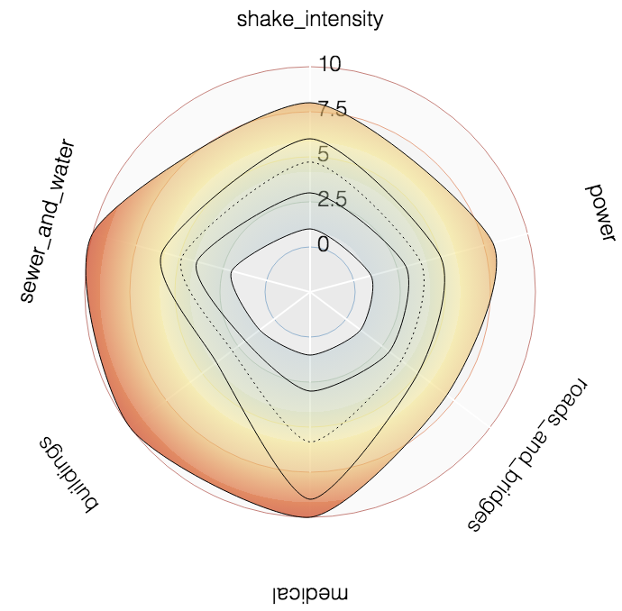
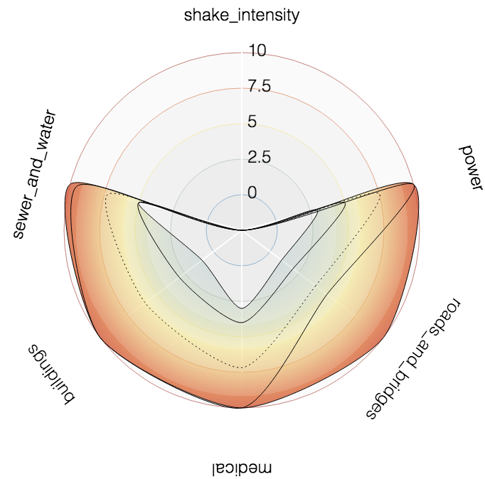
1 Palace Hills at 9AM, Wed 08
4 Safe Town at 9AM, Wed 08
16 Southton at 12PM, Tue 07

