Slide 1
SHOP CHECKING REPORT - SOUTH
Date Report : lbldate
Report by: Hung Long
Hitachi Home Electronics Vietnam Co., Ltd

Slide 2
Shop Checking Report Summary
STT | Province Shops | Checking Date
1 | 2
2 | 2
3 | 2
4 | 2
5 | 2
6
7
8
9
10
11
12
13
14
15
16
17
18
19
20
21
22
23
24

Slide 3

ShopTitle

Slide 4
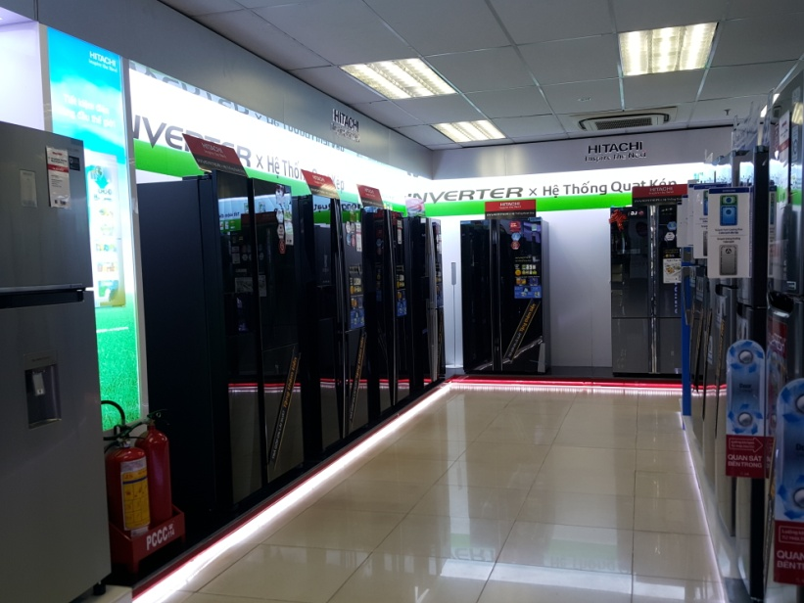
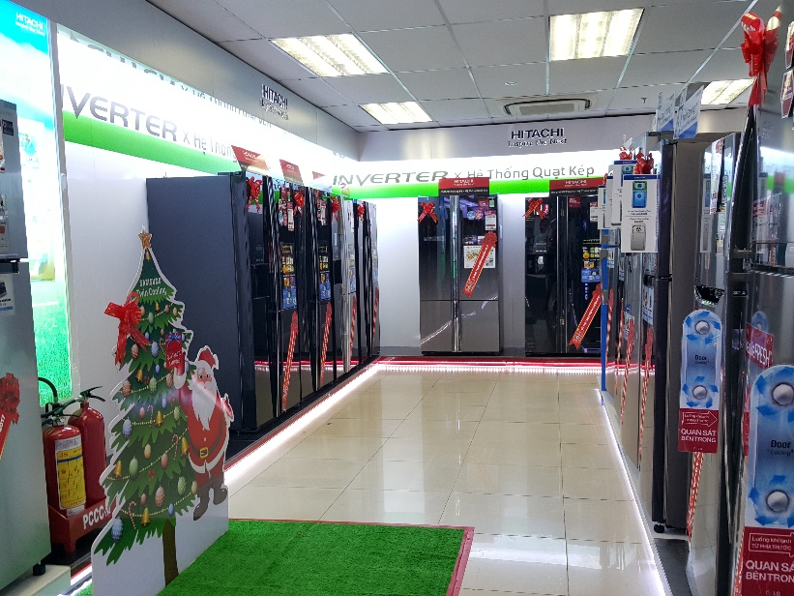
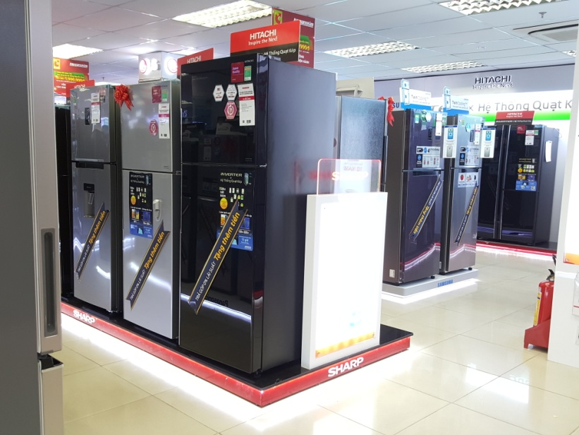
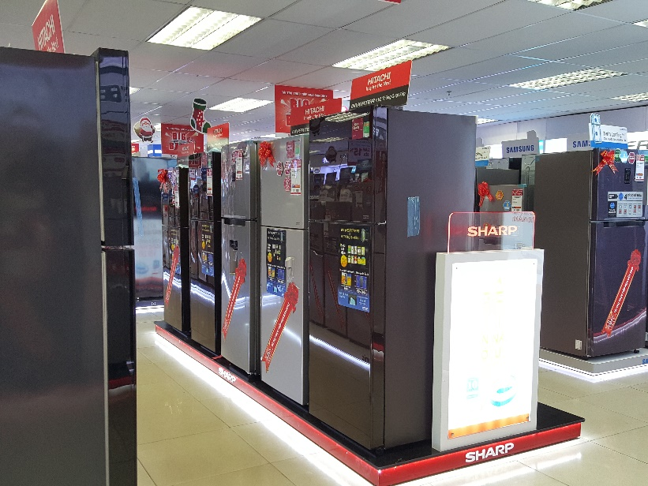
lblShopName
lastmonth
currentmonth

