Slide 1
Minimum Diameter Spanning Tree (MDST)

Slide 2
Minimum Diameter Spanning Tree (MDST)
The diameter of a tree (diam): the maximum distance between any two nodes in the tree
0
1
5
3
7
1
2
3
4
2
8
6
Connected graph
0
0
0
0
5
5
1
5
5
3
7
7
3
7
1
4
1
2
3
4
1
4
1
2
3
4
2
3
2
8
6
2
3
2
2
8
Spanning tree with diam = 12
Spanning tree with diam = 12
Spanning tree with diam = 22
Spanning tree with diam = 21

Slide 3
MDST Algorithm
Step1: Use Kariv-Hakimi Algorithm to find the absolute
center c
Step2: Compute the total weights of shortest path tree
from c

Slide 4
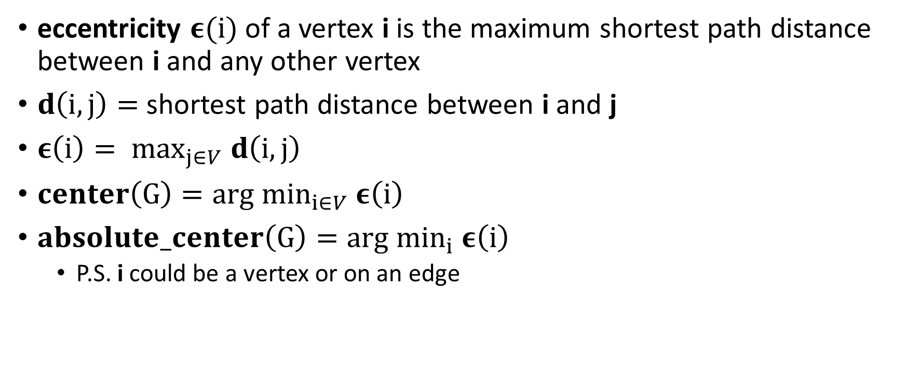
Terminology
eccentricity $ε(i)$ of a vertex i is the maximum shortest path distance between i and any other vertex
$d\left(i, j\right)=$ shortest path distance between i and j
$ε\left(i\right)= \max_{j∈V} d\left(i, j\right)$
$center\left(G\right)=arg \min_{i∈V} ε\left(i\right)$
$absolute_center\left(G\right)=arg$ $\min_{i} ε\left(i\right)$
P.S. i could be a vertex or on an edge
absolute_center
3
4
3
4
0
1
2
0
1
2
1
9
3
c
3
center
8
4
3
4
3
7
7
eccentricity(1) = 9
eccentricity(c) = 8

Slide 5

Center
$center\left(G\right)=arg\min_{i∈V} ε\left(i\right)$
$ε\left(0\right)=d\left(0, 4\right)=12$
$ε\left(1\right)=d\left(1, 4\right)=9$
$ε\left(2\right)=d\left(2, 4\right)=10$
$ε\left(3\right)=d\left(3, 0\right)=10$
$ε\left(4\right)=d\left(4, 0\right)=12$
$center\left(G\right)=1$
3
4
0
1
2
9
3
center
4
3
7
eccentricity(1) = 9

Slide 6
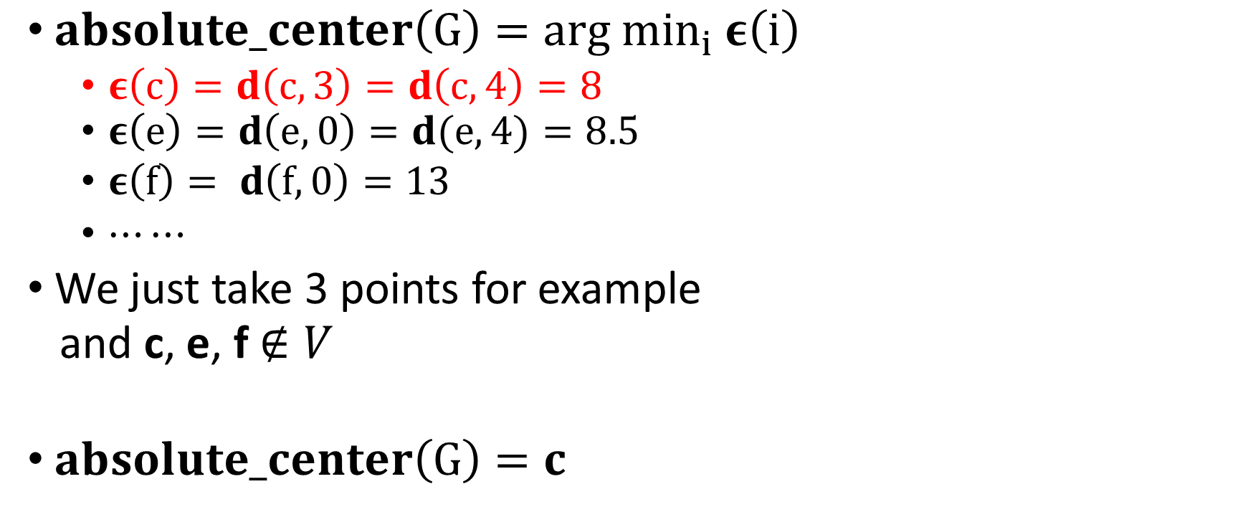
Absolute Center
$absolute_center\left(G\right)=arg \min_{i} ε\left(i\right)$
$ε\left(c\right)=d\left(c, 3\right)=d\left(c, 4\right)=8$
$ε\left(e\right)=d\left(e, 0\right)=d(e,4)=8.5$
$ε\left(f\right)= d\left(f, 0\right)=13$
$⋯⋯$
We just take 3 points for example
and c, e, f $∉V$
$absolute_center\left(G\right)=c$
absolute_center
3
4
0
1
2
1
1.5
c
e
8
1.5
4
f
3
4
3
eccentricity(c) = 8

Slide 7
Kariv-Hakimi Algorithm
Step1: Find all pairs shortest paths
Step2: Record the source to all vertices in descending
shortest path distance order
Step3: Enumerate all edges to find the absolute center c

Slide 8
Step1
Use Floyd-Warshall’s Algorithm
Array D stores the shortest path distance between vertex i and j
in V
3
4
0
1
2
D⁻¹ | 0 | 1 | 2 | 3 | 4
0 | 0 | 3 | ∞ | ∞ | ∞
1 | 3 | 0 | 4 | ∞ | 9
2 | ∞ | 4 | 0 | 3 | ∞
3 | ∞ | ∞ | 3 | 0 | 7
4 | ∞ | 9 | ∞ | 7 | 0
9
3
4
3
7

Slide 9
Step1
Use Floyd-Warshall’s Algorithm
Array D stores the shortest path distance between vertex i and j
in V
3
4
0
1
2
D⁰ | 0 | 1 | 2 | 3 | 4
0 | 0 | 3 | ∞ | ∞ | ∞
1 | 3 | 0 | 4 | ∞ | 9
2 | ∞ | 4 | 0 | 3 | ∞
3 | ∞ | ∞ | 3 | 0 | 7
4 | ∞ | 9 | ∞ | 7 | 0
9
3
4
3
7

Slide 10
Step1
Use Floyd-Warshall’s Algorithm
Array D stores the shortest path distance between vertex i and j
in V
3
4
0
1
2
D¹ | 0 | 1 | 2 | 3 | 4
0 | 0 | 3 |  | ∞
1 | 3 | 0 | 4 | ∞ | 9
2 |  | 4 | 0 | 3
3 | ∞ | ∞ | 3 | 0 | 7
4 |  | 9 |  | 7 | 0
7
∞
∞
12
9
3
7
13
∞
∞
4
3
7
∞
∞
12
13

Slide 11
Step1
Use Floyd-Warshall’s Algorithm
Array D stores the shortest path distance between vertex i and j
in V
3
4
0
1
2
D² | 0 | 1 | 2 | 3 | 4
0 | 0 | 3 | 7 |  | 12
1 | 3 | 0 | 4 |  | 9
2 | 7 | 4 | 0 | 3 | 13
3 |  |  | 3 | 0 | 7
4 | 12 | 9 | 13 | 7 | 0
10
∞
7
9
3
∞
10
7
4
3
∞
∞
7

Slide 12
Step1
Use Floyd-Warshall’s Algorithm
Array D stores the shortest path distance between vertex i and j
in V
3
4
0
1
2
D³ | 0 | 1 | 2 | 3 | 4
0 | 0 | 3 | 7 | 10 | 12
1 | 3 | 0 | 4 | 7 | 9
2 | 7 | 4 | 0 | 3
3 | 10 | 7 | 3 | 0 | 7
4 | 12 | 9 |  | 7 | 0
9
3
13
10
4
3
7
10
13

Slide 13
Step1
Use Floyd-Warshall’s Algorithm
Array D stores the shortest path distance between vertex i and j
in V
3
4
0
1
2
D⁴ | 0 | 1 | 2 | 3 | 4
0 | 0 | 3 | 7 | 10 | 12
1 | 3 | 0 | 4 | 7 | 9
2 | 7 | 4 | 0 | 3 | 10
3 | 10 | 7 | 3 | 0 | 7
4 | 12 | 9 | 10 | 7 | 0
9
3
4
3
7

Slide 14
Kariv-Hakimi Algorithm
Step1: Find all pairs shortest paths
Step2: Record the source to all vertices in descending
shortest path distance order
Step3: Enumerate all edges to find the absolute center c

Slide 15
Step2
D⁴ | 0 | 1 | 2 | 3 | 4
0 | 0 | 3 | 7 | 10 | 12
1 | 3 | 0 | 4 | 7 | 9
2 | 7 | 4 | 0 | 3 | 10
3 | 10 | 7 | 3 | 0 | 7
4 | 12 | 9 | 10 | 7 | 0
Array r stores the vertex index in
descending shortest path distance order
r[i][j] = v, representing from vertex i,
vertex v is the j-th farthest vertex
Vertex 1 is the second farthest vertex from vertex 3
j
rank (descending order)
r | 0 | 1 | 2 | 3 | 4
0 | 0 | 1 | 2 | 3 | 4
1 | 0 | 1 | 2 | 3 | 4
2 | 0 | 1 | 2 | 3 | 4
3 | 0 | 1 | 2 | 3 | 4
4 | 0 | 1 | 2 | 3 | 4
r | 0 | 1 | 2 | 3 | 4
0 | 4 | 3 | 2 | 1 | 0
1 | 4 | 3 | 2 | 0 | 1
2 | 4 | 0 | 1 | 3 | 2
3 | 0 | 1 | 4 | 2 | 3
4 | 0 | 2 | 1 | 3 | 4
i
vertex

Slide 16
Step2
Array r stores the vertex index in
descending shortest path distance order
D⁴ | 0 | 1 | 2 | 3 | 4
0
1 | 3 | 0 | 4 | 7 | 9
2 | 7 | 4 | 0 | 3 | 10
3 | 10 | 7 | 3 | 0 | 7
4 | 12 | 9 | 10 | 7 | 0
0 3 7 10 12
0 3 7 10 12
0 3 7 10 12
0 3 7 10 12
0 3 7 10 12
0 3 7 10 12
0 3 7 10 12
0 3 7 10 12
0 3 7 10 12
0 3 7 10 12
0 3 7 10 12
0 3 7 10 12
You could use any sorting method to accomplish this
Take bubble sort and vertex i = 0 for example
If D[i][r[i][j]] < D[i][r[i][j+1]], then swap (r[i][j], r[i][j+1])
j
State: i = 0, j = 1
State: i = 0, j = 3
State: i = 0, j = 0
State: i = 0, j = 0
State: i = 0, j = 0
State: i = 0, j = 1
State: i = 0, j = 0
State: i = 0, j = 2
State: i = 0, j = 1
State: i = 0, j = 2
r | 0 | 1 | 2 | 3 | 4
0 | 0 | 1 | 2 | 3 | 4
1 | 0 | 1 | 2 | 3 | 4
2 | 0 | 1 | 2 | 3 | 4
3 | 0 | 1 | 2 | 3 | 4
4 | 0 | 1 | 2 | 3 | 4
r | 0 | 1 | 2 | 3 | 4
0
1
2
3
4
1 2 3 4 0
2 3 4 1 0
3 2 4 1 0
2 1 3 4 0
1 2 3 0 4
2 3 1 4 0
4 3 2 1 0
3 4 2 1 0
1 0 2 3 4
1 2 0 3 4
0 1 2 3 4
4 3 2 0 1
i
4 0 1 3 2
0 1 4 2 3
0 2 1 3 4

Slide 17
Kariv-Hakimi Algorithm
Step1: Find all pairs shortest paths
Step2: Record the source to all vertices in descending
shortest path order
Step3: Enumerate all edges to find the absolute center c

Slide 18
Step3
We assume weight of edges are positive (作業的weights都是正的)
Let p = moving point on edge(i, j)
x-axis: length from i to p
y-axis: d(p, u) for a certain vertex u
The possible figures are on the right
圖只是示意圖，並不需要真的畫出
i j
i j
i j

Slide 19
How to get the figure?
3
4
0
1
2
Let p = moving point on edge(i, j)
x-axis: length from i to p
y-axis: d(p, u) for a certain vertex u
We take edge(1, 4) and vertex u = 2 for example
t
p
3
9 - t
4
3
7
How to get the max y value
of blue lines?
d(p, 2) = 11.5
3
4
0
1
2
7.5
4 + t = (9 – t) + 10
2t = 15
t = 7.5
d(p,2) = 11.5
9
3
d(4, 2) = 10
p
j to u
1.5
d(1, 2) = 4
4
3
i to u
7
i=1 p j=4
i=1 j=4

Slide 20
How to get the figure?
3
4
0
1
2
Let p = moving point on edge(i, j)
x-axis: length from i to p
y-axis: d(p, u) for a certain vertex u
We take edge(3, 4) and vertex u = 2 for example
9
3
4
p
3
t
7-t
13 + t = (7 – t) + 3
2t = -3
t = -1.5
3
4
0
1
2
d(p, 2) = 6
d(4, 2) = 10
3
如果求出的 t>length(i, j) or t<0
折點不在edge(i, j)上
(表示shortest path from p to u
只能從 i 或 j 其中一個端點過去)
9
d(3, 2) = 3
4
3
p
7
i=3 p j=4
4
3
i=3 j=4

Slide 21



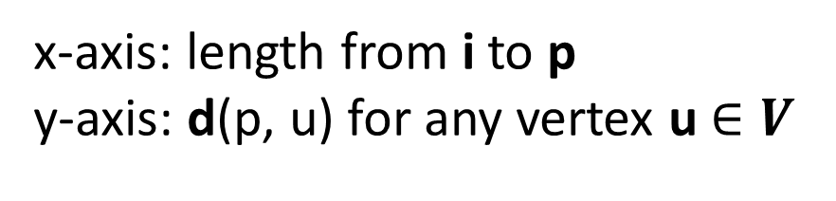
Step3
There is a blue line for any vertex u$∈V$
If we draw all blue lines on one chart,
the y values of yellow line are$ε\left(p\right)$
$$for any moving point p on edge(i, j)$$
( $∵ε\left(p\right)= \max_{u∈V} d\left(p, u\right)$ )
$$ε\left(i\right)$$
$$ε\left(j\right)$$
x-axis: length from i to p
y-axis: d(p, u) for any vertex u$∈V$
i j

Slide 22

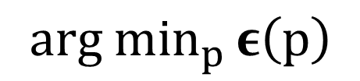
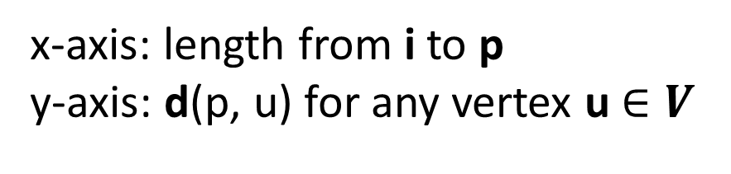
Step3
$$arg \min_{p }ε\left(p\right)$$
Recall $absolute_center\left(G\right)=arg$ $\min_{p} ε\left(p\right)$
so we want to get the smallest$ε\left(p\right)$
The smallest$ε\left(p\right)$ would happen on
endpoints or intersection of blue lines
The red points are those we want to check
And the red point having the smallest y value
is $arg \min_{p }ε\left(p\right)$
x-axis: length from i to p
y-axis: d(p, u) for any vertex u$∈V$
i p j

Slide 23
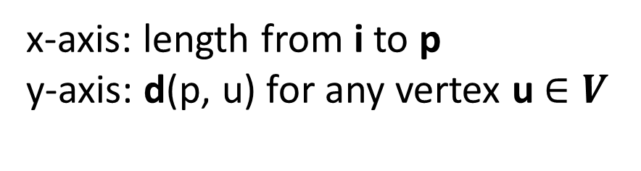

How to check red points and their eccentricity?
It is easy for endpoints i, j
Let v = r[i][0], the farthest vertex from i
$ε\left(p\right)$
= d(i, v)
( $∵ε\left(p\right)= \max_{u∈V} d\left(p, u\right)$ )
d(i, v)
x-axis: length from i to p
y-axis: d(p, u) for any vertex u$∈V$
p
i j

Slide 24

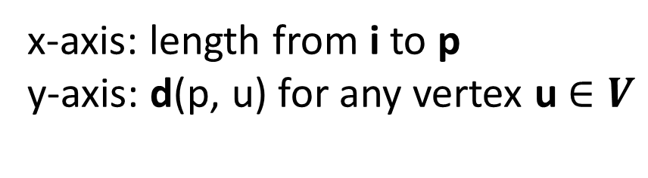
How to check red points and their eccentricity?
It is easy for endpoints i, j
Let v = r[j][0], the farthest vertex from j
$ε\left(p\right)$
= d(j, v)
( $∵ε\left(p\right)= \max_{u∈V} d\left(p, u\right)$ )
d(j, v)
x-axis: length from i to p
y-axis: d(p, u) for any vertex u$∈V$
p
i j

Slide 25
How to check red points and their eccentricity?
For inside red points, the key idea is that from endpoint i,
choose the highest line to intersect with the lower line
And when getting an intersection, keep the lower line to intersect
with the other lower lines
Determine whether having intersection
The ranks calculated in step2 is used here
// D[i][j] stores the shortest path distance from i to j // r[i][j] stores the vertex index in descending shortest path order // ecc stores the eccentricity of absolute center // Let i, j be the endpoints of edge for(int a = 0, b = 1; b < n; b++){ // On the endpoint j, line of b is higher than line of a, // so the two lines will intersect if(D[j][r[i][b]] > D[j][r[i][a]]){ ecc = min(ecc, (D[i][r[i][b]] + D[j][r[i][a]] + length(i, j)) / 2); a = b; } }

Slide 26
How to determine whether having intersection?
Determine whether having intersection
// D[i][j] stores the shortest path distance from i to j // r[i][j] stores the vertex index in descending shortest path order // ecc stores the eccentricity of absolute center // Let i, j be the endpoints of edge for(int a = 0, b = 1; b < n; b++){ // On the endpoint j, line of b is higher than line of a, // so the two lines will intersect if(D[j][r[i][b]] > D[j][r[i][a]]){ ecc = min(ecc, (D[i][r[i][b]] + D[j][r[i][a]] + length(i, j)) / 2); a = b; } }
State: a = 1, b = 2
State: a = 2, b = 3
State: a = 2, b = 4
State: a = 0, b = 1
The key observation: the orange line is higher in i side,
but lower in j side
i j

Slide 27
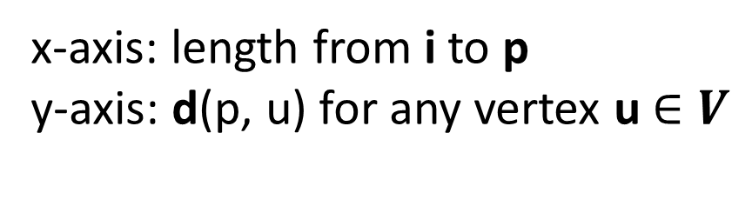

How to check red points and their eccentricity?
Let o = vertex for the orange line
g = vertex for the green line
$ε\left(p\right)$
= d(i, g) + length(p, i)
= d(j, o) + length(p, j)
= ( d(i, g) + d(j, o) + length(i, j) ) / 2
所有線的斜率必為$± 1$
(∵ x方向與y方向的變化率一樣)
length(p, i)
length(p, j)
d(i, g)
d(j, o)
i p j
x-axis: length from i to p
y-axis: d(p, u) for any vertex u$∈V$

Slide 28
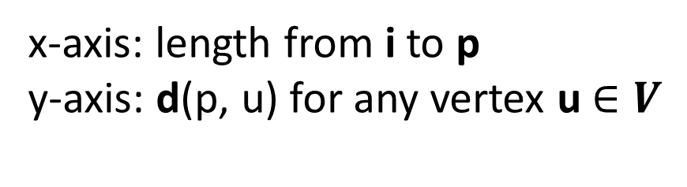

How to check red points and their eccentricity?
Let o = vertex for the orange line
g = vertex for the green line
$ε\left(p\right)$
= d(i, g) + length(p, i)
= d(j, o) + length(p, j)
= ( d(i, g) + d(j, o) + length(i, j) ) / 2
所有線的斜率必為$± 1$
(∵ x方向與y方向的變化率一樣)
length(p, i)
length(p, j)
d(i, g)
d(j, o)
i p j
x-axis: length from i to p
y-axis: d(p, u) for any vertex u$∈V$

Slide 29

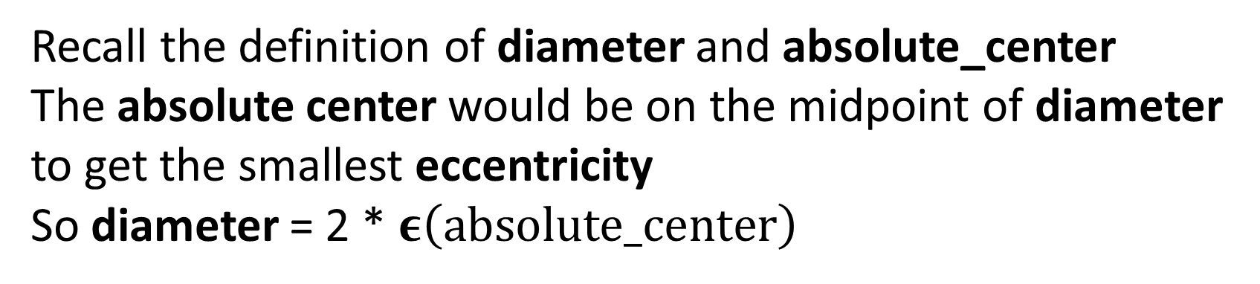
Step3
The diameter of a tree
= the maximum distance between any two nodes in the tree
Check every edges,
absolute_center = $arg \min_{p} ε\left(p\right)$
diameter = 2 * $ε\left(absolute_center\right)$
Why diameter = 2 * $ε\left(absolute_center\right) ?$
Recall the definition of diameter and absolute_center
The absolute center would be on the midpoint of diameter to get the smallest eccentricity
So diameter = 2 * $ε\left(absolute_center\right)$

Slide 30
MDST Algorithm
Step1: Use Kariv-Hakimi Algorithm to find the absolute
center c
Step2: Compute the total weights of shortest path tree
from c

Slide 31
Dijkstra’s Algorithm
vertex | π
c
0
1
2
3
4
3
4
NULL
0
1
2
1
NULL
1
c
c
NULL
3
8
NULL
1
4
3
NULL
2
7
c
NULL
S | c | 0 | 1 | 2 | 3 | 4
{c}
0 ∞ 1 ∞ ∞ 8
{c, 1}
0 4 1 5 ∞ 8
{c, 1, 0}
0 4 1 5 ∞ 8
{c, 1, 0, 2}
0 4 1 5 8 8
{c, 1, 0, 2, 3}
0 4 1 5 8 8
{c, 1, 0, 2, 3, 4}
0 4 1 5 8 8

Slide 32
The End

