Slide 1
EECS 204001 Data Structures 資料結構
C++ Standard Template Library
Department of Computer Science
National Tsing Hua University

Slide 2
Agenda
C++ Fast Review
STL Architectures
Containers
Generic Algorithm

Slide 3
Today’s Mission
Let you know what’s STL and show several examples about it.

Slide 4
review

Slide 5
Default Arguments
The function argument can has default value
int my_func(int a, int b, int c=12);
The programmer may call this function in two ways:
// C = 3
result = my_func(1, 2, 3);
// C = 12
result = my_func(1, 2);
http://msdn.microsoft.com/en-us/library/91563f79(v=vs.100).aspx

Slide 6
Default Arguments – Notices
Default arguments are used only in function calls where trailing arguments are omitted — they must be the last argument(s).
Therefore, the following code is illegal:
int print( double dvalue = 0.0 , int prec );
A default argument cannot be redefined in later declarations even if the redefinition is identical to the original.
Therefore, the following code produces an error:
// Prototype for print function.
int print( double dvalue, int prec = 2 );
...
// Definition for print function.
int print( double dvalue, int prec = 2 )
{...}

Slide 7
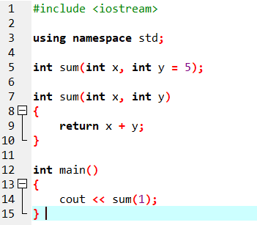
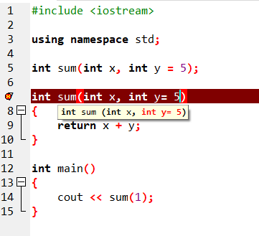
Default Arguments – Notices

Slide 8
Review of C++ template
Class template
template< typename T , class T2 , int SIZE=3 >
class Foo{
public:
T data;
T2 * data2;
Foo() {
data2 = new T2[SIZE];
}
};
Foo<int , char , 4 > f1;
Instance of call:
Foo<int , char , 4 > f1;
class Foo{
public:
int data;
char * data2;
Foo() {
data2 = new T2[4];
}
};

Slide 9
STL archItecture

Slide 10
// vector example
#include <iostream>
#include <vector>
int main ()
{
//initialize
std::vector<int> myVector;
//---------------------------------------
// ADD ELEMENTS
int myData=9;
// add ten integer
for( int i=0 ; i < 10 ; i++) {
myVector.push_back(myData);
}
return 0 ;
}
This example code shows:
A standard dynamic ‘array-like’ class.
Provide some functions to let you add data.
The data can be any value like class or any primitive type.

Slide 11
What is STL
Standard Template Library (STL)
Provide a good generic framework to speed up developing
Notes:
STL裡面的演算法，並不局限於int double string...等單一類型 而是可以實作一種演算法，不預先指定型態，透過template的幫忙，在實際呼叫時，可以輸入不同型態的資料。 generic programming 泛型程式設計，的泛型指的就是這個意思(單個演算法、可搭配不同的類型 ex:int/double/string...)

Slide 12
Generalizing example (concrete algorithms)
double sum(double array[], int n) // one concrete algorithm (doubles in array)
{
double s = 0;
for (int i = 0; i < n; ++i ) s = s + array[i];
return s;
}
struct Node { Node* next; int data; };
int sum(Node* first) // another concrete algorithm (ints in list)
{
int s = 0;
while (first) {
s += first->data;
first = first->next;
}
return s;
}

Slide 13
Generalizing example (abstract the data structure)
// pseudo-code for a more general version of both algorithms
int sum(data) // somehow parameterize with the data structure
{
int s = 0; // initialize
while (not at end) { // loop through all elements
s = s + get value; // compute sum
get next data element;
}
return s; // return result
}
We need three operations (on the data structure):
not at end
get value
get next data element

Slide 14
Generalizing example (STL version)
// Concrete STL-style code for a more general version of both algorithms
template<class Iter, class T> // Iter should be an Input_iterator
// T should be something we can + and =
T sum(Iter first, Iter last, T s) // T is the “accumulator type”
{
while (first!=last) {
s = s + *first;
++first;
}
return s;
}
Let the user initialize the accumulator
float a[] = { 1,2,3,4,5,6,7,8 };
double d = 0;
d = sum(a,a+sizeof(a)/sizeof(*a),d);

Slide 15
Ideals
Code that’s
Easy to read
Easy to modify
Regular
Short
Fast
Uniform access to data
Independently of how it is stored
Independently of its type

Slide 16
Ideals (continued)
Type-safe access to data
Easy traversal of data
Compact storage of data
Fast
Retrieval of data
Addition of data
Deletion of data
Standard versions of the most common algorithms
Copy, find, search, sort, sum, …

Slide 17
Basic model
Algorithms
sort, find, search, copy, …
Separation of concerns
Algorithms manipulate data, but don’t know about containers
Containers store data, but don’t know about algorithms
Algorithms and containers interact through iterators
Each container has its own iterator types
iterators
Containers
vector, list, map, hash_map, …

Slide 18
The STL
An ISO C++ standard framework of about 10 containers and about 60 algorithms connected by iterators
Other organizations provide more containers and algorithms in the style of the STL
Boost.org, Microsoft, SGI, …
Probably the currently best known and most widely used example of generic programming

Slide 19
The STL Implementations
Specification:
ISO C++ (ISO14882) , US$30
Last Working Draft of C++17,Free
GCC:
Use SGI STL
Doc: http://www.sgi.com/tech/stl/
Micosoft Visual C++:
Use Dinkumware STL
Doc: http://msdn.microsoft.com/en-us/library/c191tb28(v=vs.100).aspx

Slide 20
Basic model
A pair of iterators define a sequence
The beginning (points to the first element – if any)
The end (points to the one-beyond-the-last element)
begin:
end:
…
An iterator is a type that supports the “iterator operations”
++ Go to next element
* Get value
== Does this iterator point to the same element as that iterator?
Some iterators support more operations (e.g. --, +, and [ ])

Slide 21
Containers (hold sequences in difference ways)
vector
(array)
list
(doubly linked)
set
(a kind of tree)
0
1
2
3
0
1
2
6
2
7
0
1
5
3
4

Slide 22
The simplest algorithm: find()
…
begin:
end:
// Find the first element that equals a value
template<class In, class T>
In find(In first, In last, const T& val)
{
while (first!=last && *first != val) ++first;
return first;
}
We can ignore (“abstract away”) the differences between containers

Slide 23
Algorithms and iterators
The end of the sequence is “one past the last element”
not “the last element”
That’s necessary to elegantly represent an empty sequence
One-past-the-last-element isn’t an element
You can compare an iterator pointing to it
You can’t dereference it (read its value)
Returning the end of the sequence is the standard idiom for “not found” or “unsuccessful”
some iterator:
An empty sequence:
the end:
0
1
2
3
Notes:
demo

Slide 24
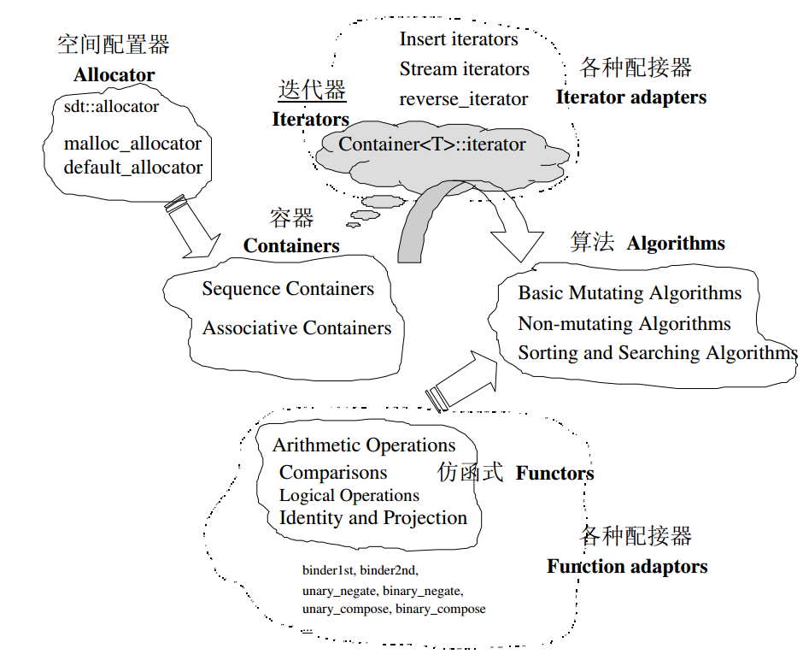
Architectures of STL
Sources: The Annotated STL Sources, ch1

Slide 25
THE STEPS OF LEARNING USING LIBRARY
Primary User:
Read official documents or related book or the short lectures
C++ Primer 5th, Lippman
http://www.stroustrup.com/Programming/lecture-slides.html
Writes and plays example codes
Check its behaviors
Be an expert:
Try to understand design idiom from the official documents.
Refer professional books about that library.
e.g.
Efficient C++ , by scott meyers
Efficient STL , by scott meyers

Slide 26
Documents
CPP Reference
http://www.cplusplus.com/reference/stl/
http://en.cppreference.com/w/
M$ Doc
http://msdn.microsoft.com/en-us/library/c191tb28(v=vs.100).aspx
SGI DOC
http://www.sgi.com/tech/stl/table_of_contents.html

Slide 27
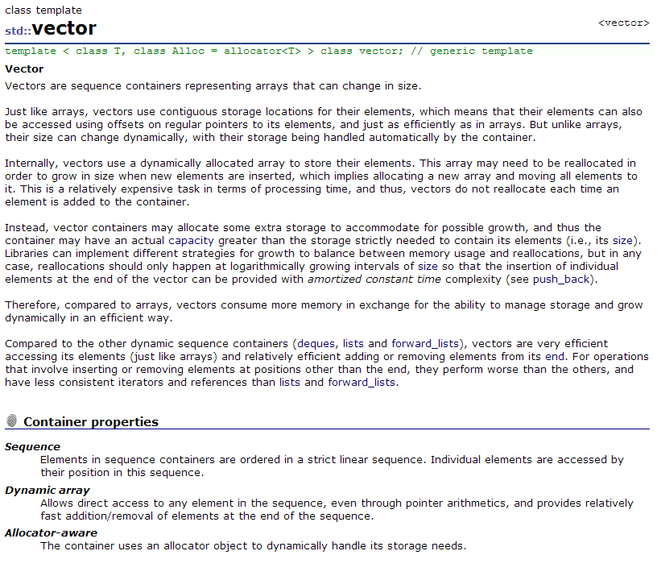
Example: <vector>
http://www.cplusplus.com/reference/vector/vector/
Implement Concepts
Container properties

Slide 28
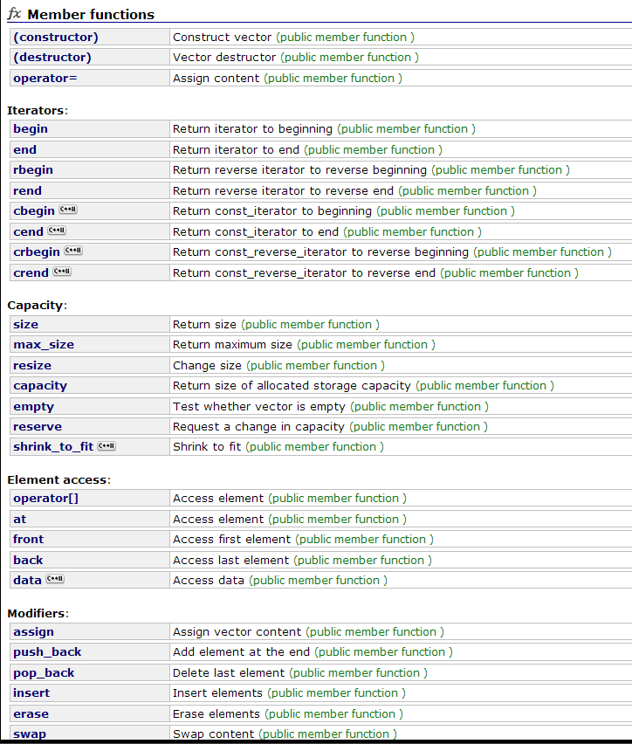
Functions List

Slide 29
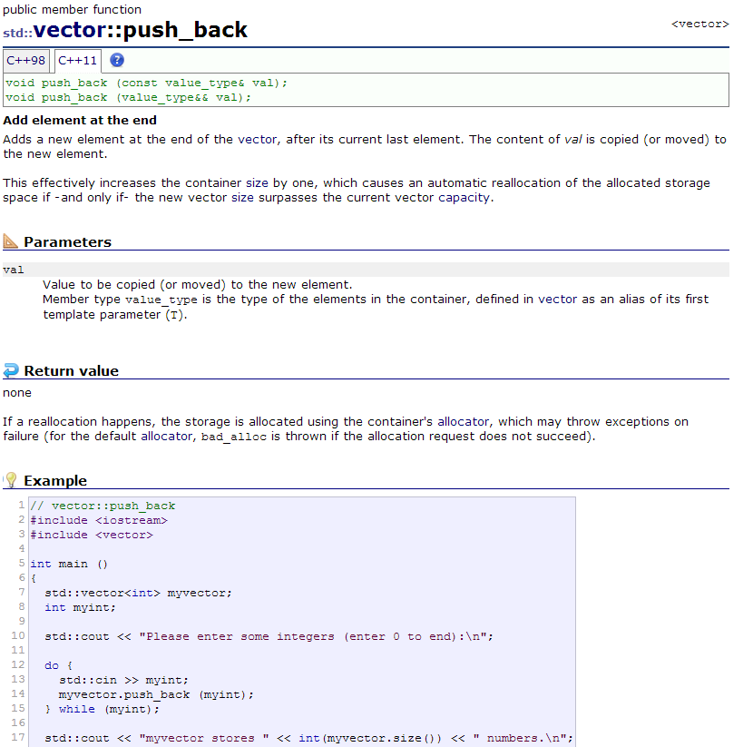

Slide 30
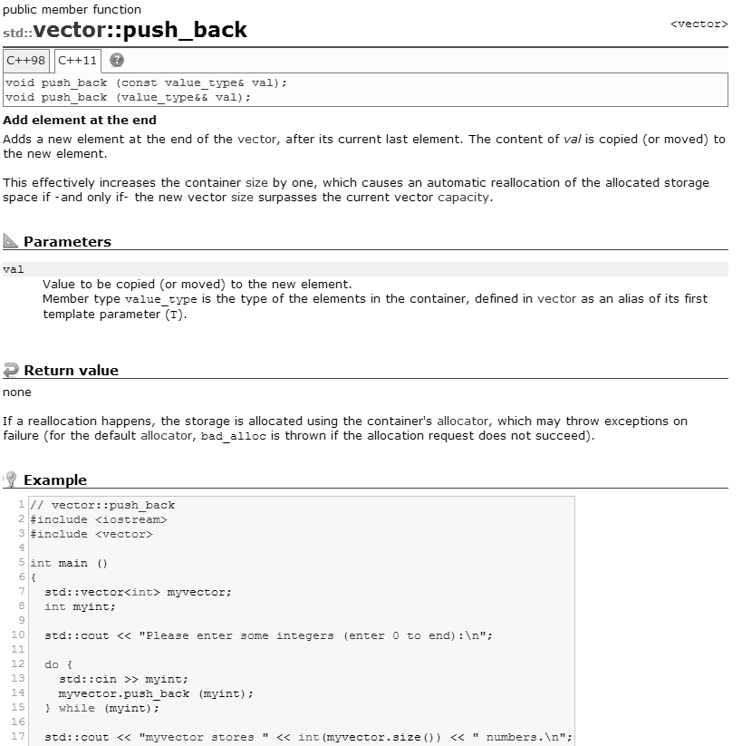
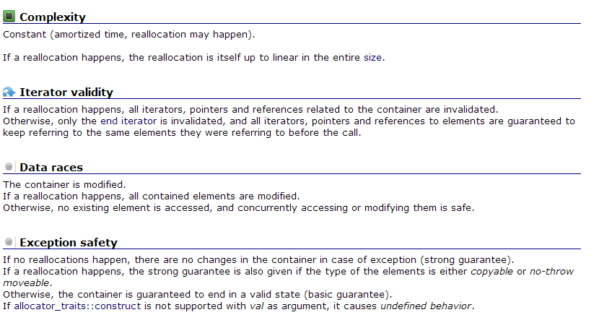
Notes:
第一天楚河交界

Slide 31
container

Slide 32
Container Class : Objective
Collect data into containers
Organize data
For printing
For fast access
Retrieve data items
By index (e.g., get the Nth element)
By value (e.g., get the first element with the value "Chocolate")
By properties (e.g., get the first elements where “age<64”)
Add data
Remove data
Sorting and searching
Simple numeric operations

Slide 33
Simple Example Code : <vector> (Like Dynamic Array)
// vector example
#include <iostream>
#include <vector>
int main ()
{
//initialize
std::vector<int> myVector;
//---------------------------------
// ADD ELEMENTS
int myData=9;
// add ten integer
for( int i=0 ; i < 10 ; i++) {
myVector.push_back(myData);
}}
//------------------------------------
// TRAVEL ELEMENTS
// get the number of elements
int vSize = myVector.size();
for( int i=0 ; i < vSize ; i++)
std::cout<< myVector[i] << “ “;
//----------------------------------
// DELETE SPECIFIED ELEMENT
// get the iterator of beginning elements
auto iter = myVector.begin();
// remove 2nd element in this vector
myVector.erase(iter+1);
std::cout<< “\nAfter earse” <<endl;
// print out
for( int i=0 ; i < myVector.size() ; i++){
std::cout<< myVector[i] << “ ”;
}

Slide 34
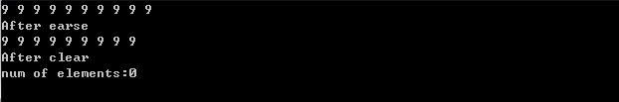
//------------------
// CLEAR ENTIRE VECTOR
myVector.clear();
std::cout<< "\nAfter clear“ <<endl;
std::cout<< "num of elements:" << myVector.size() << std::endl;
return 0;
}
Reallocation is not guaranteed to happen
Output:

Slide 35
Reallocation version
Swap with empty vector

Slide 36
<vector> - Constructors
// vector example
#include <vector>
int main(){
// empty vector of ints
std::vector<int> first;
// allocate four ints and fill with value 100
// ( size , value )
std::vector<int> second (4,100);
// iterating through second
std::vector<int> third (second.begin() , second.end());
// a copy of third
std::vector<int> fourth (third);
…

Slide 37
<vector> - Constructors
Class definitions:
template< class ValueType, class Allocator = std::allocator<T> > class vector;
Constructor definitions:
default (1) | explicit vector( const Allocator& alloc = Allocator() );
fill (2) | explicit vector ( size_type n, const ValueType& val = ValueType(), const Allocator& alloc = Allocator() );
range (3) | template< class InputIterator > vector( InputIterator first, InputIterator last, const Allocator& alloc = Allocator() );
copy (4) | vector ( const vector& x );
http://en.cppreference.com/w/cpp/container/vector/vector
http://www.cplusplus.com/reference/vector/vector/

Slide 38
// vector example
#include <vector>
int main(){
// empty vector of ints
std::vector<int> first;
// allocate four ints and fill with value 100
// ( size , value )
std::vector<int> second (4,100);
// iterating through second
std::vector<int> third (second.begin() , second.end());
// a copy of third
std::vector<int> fourth (third);
…
default(1) | explicit vector( const Allocator& alloc = Allocator() );
fill (2) | explicit vector ( size_type n, const ValueType& val = ValueType(), const Allocator& alloc = Allocator() );
range (3) | template< class InputIterator > vector( InputIterator first, InputIterator last, const Allocator& alloc = Allocator() );
copy (4) | vector ( const vector& x );

Slide 39

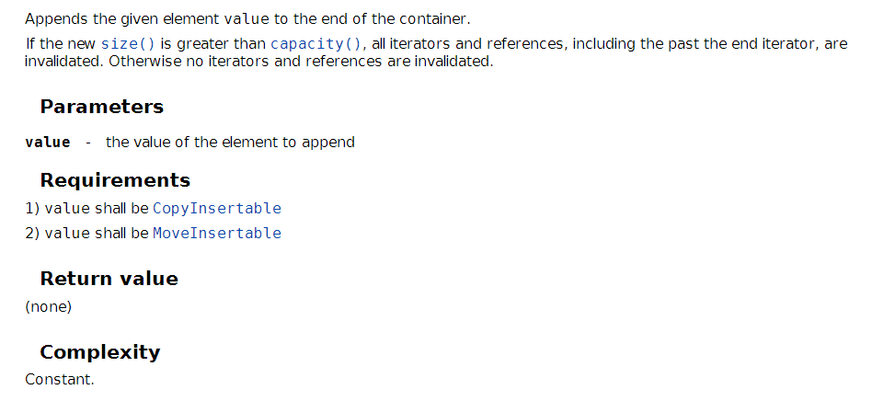
<vector> push element
http://en.cppreference.com/w/cpp/container/vector/push_back
http://www.cplusplus.com/reference/vector/vector/push_back/

Slide 40
// vector example
#include <iostream>
#include <vector>
int main ()
{
//initialize
std::vector<int> myVector;
//---------------------------------------
// ADD ELEMENTS
int myData=9;
// add ten integer
for( int i= 0 ; i < 10 ; i++) {
myVector.push_back(myData);
}}
myVector
9
9
9
9
.
.
.

Slide 41
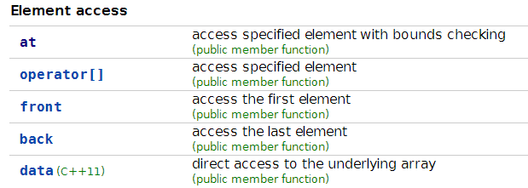
<vector> access element

Slide 42
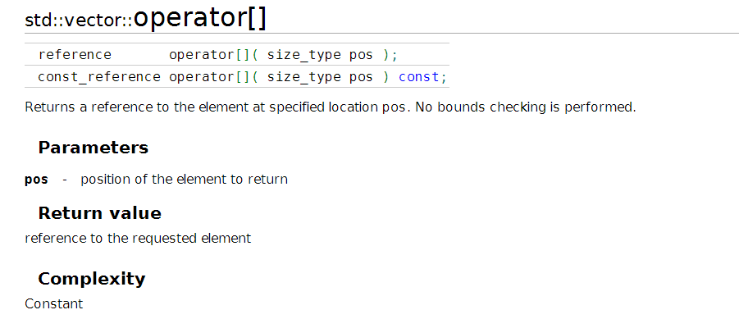
<vector> access element
An integer type(e.g. unsigned int ), platform depended
http://en.cppreference.com/w/cpp/container/vector/operator_at
http://www.cplusplus.com/reference/vector/vector/operator[]/

Slide 43
int main()
{
int myData=9;
// add ten integer
for( int i=0 ; i < 5 ; i++) {
myVector.push_back(myData);
} }
myVector[0] = 5 ;
for( int i=0 ; i < vSize ; i++){
std::cout<< myVector[i] << ' ';
}
std::cout << '\n';
}
Output:
5 9 9 9 9

Slide 44
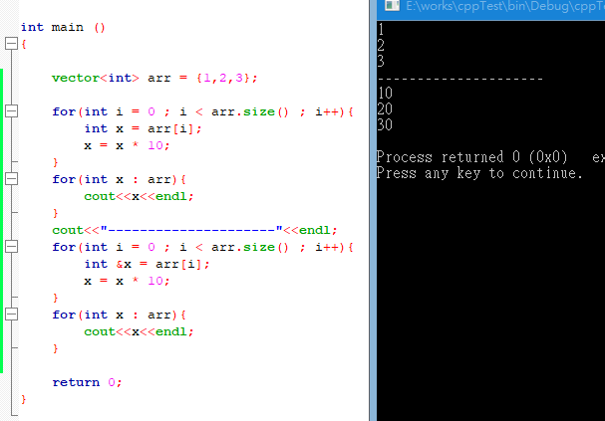
Value
Reference

Slide 45
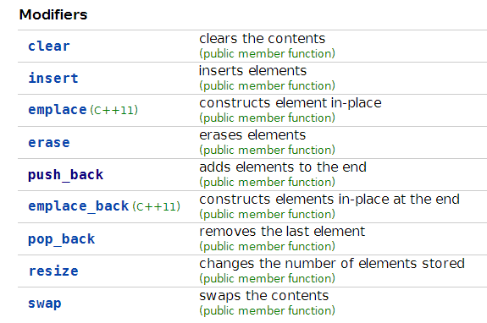
<vector> element modifier
http://www.cplusplus.com/reference/vector/vector/
http://en.cppreference.com/w/cpp/container/vector

Slide 46
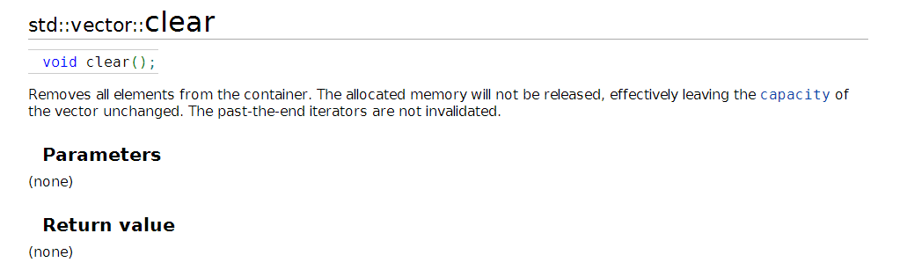
Delete all elements
int main()
{
int myData=9;
// add ten integer
for( int i=0 ; i < 5 ; i++) {
myVector.push_back(myData);
} }
myVector.clear();
// size become 0
std::cout << " size= " << myVector.size() << '\n';
}

Slide 47
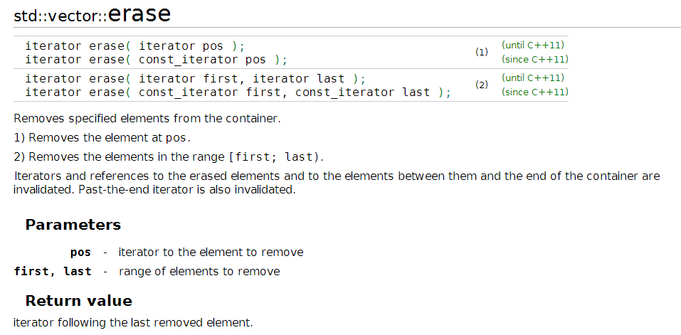
Delete one element by iterator (like delete by pointer)
Delete SOME elements( in range )
http://www.cplusplus.com/reference/vector/vector/erase/
http://en.cppreference.com/w/cpp/container/vector/erase

Slide 48
int main ()
{
std::vector<int> myvector;
// set some values (from 1 to 10)
for (int i=1; i<=10; i++) myvector.push_back(i);
// erase the 6th element
myvector.erase (myvector.begin()+5);
// erase the first 3 elements:
myvector.erase (myvector.begin(),myvector.begin()+3);
}
myVector
1
2
3
4
5
6
7
8
9
10

Slide 49
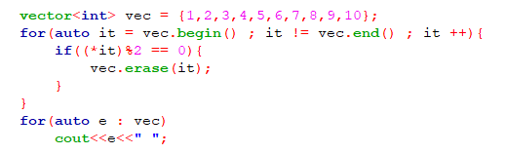
Case study: erase in for loop
Segment fault

Slide 50
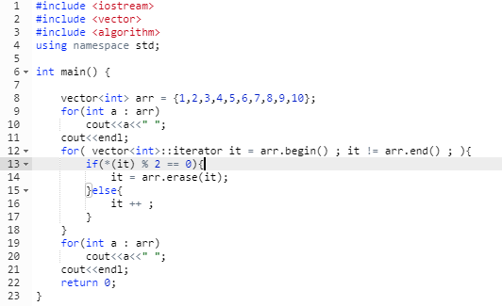

Case study: erase in for loop

Slide 51


Case study: erase in for loop

Slide 52
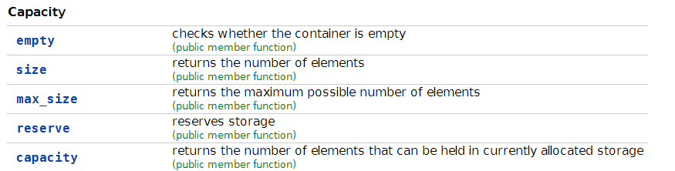
<vector> Capacity
Query the size (number) of elements
Manipulate inner size
http://www.cplusplus.com/reference/vector/vector/
http://en.cppreference.com/w/cpp/container/vector

Slide 53

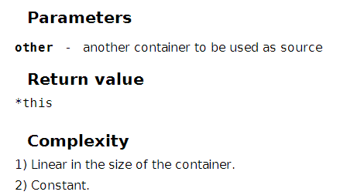
<vector> assign operator
http://www.cplusplus.com/reference/vector/vector/operator=/
http://en.cppreference.com/w/cpp/container/vector/operator%3D

Slide 54
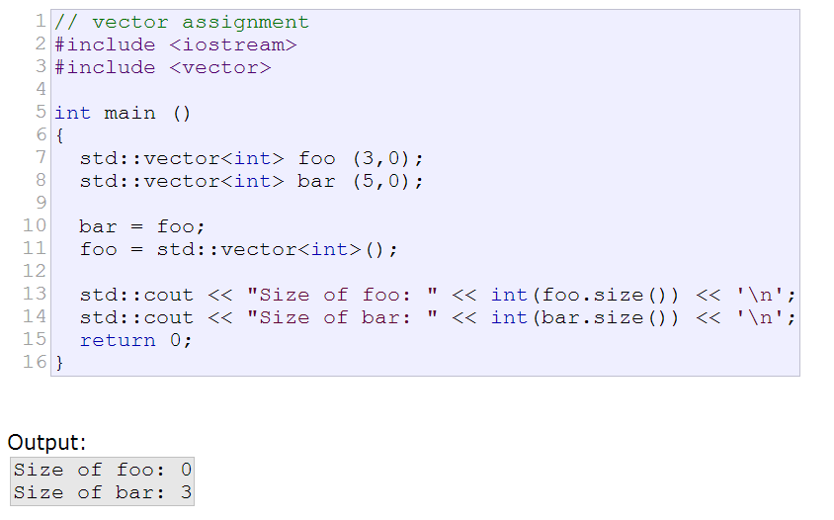

Slide 55
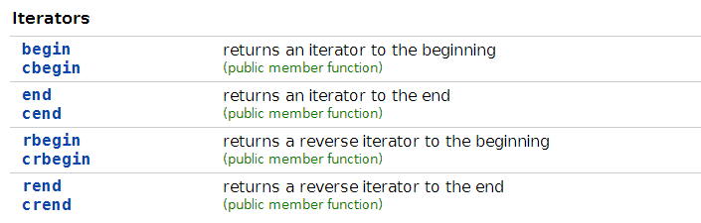
<vector> iterator
cbegin = const iterator of begin element

Slide 56
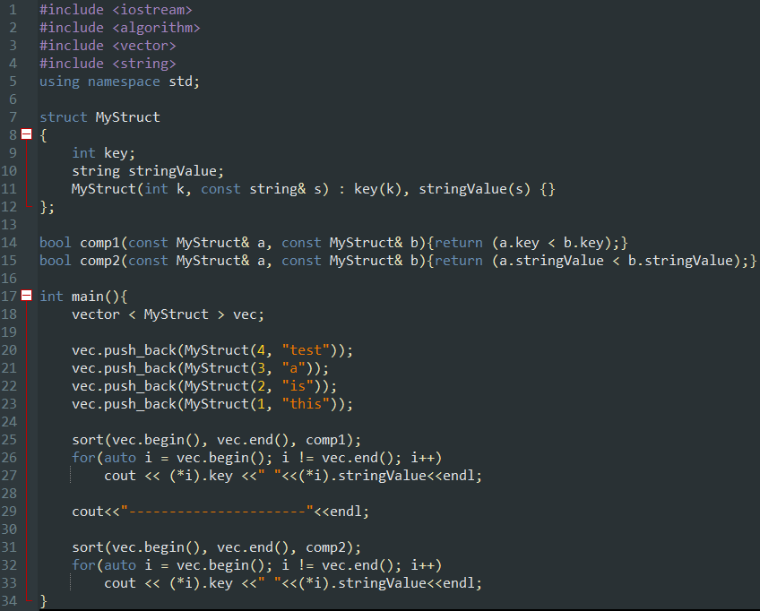
Example for using vector<object> to sort

Slide 57
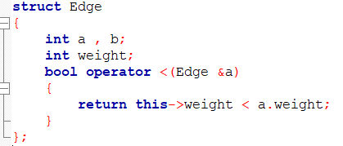
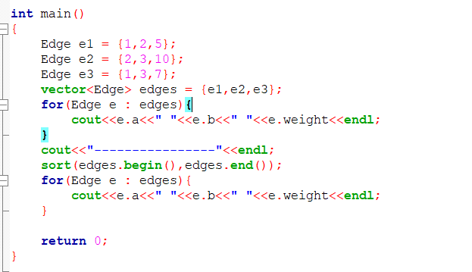
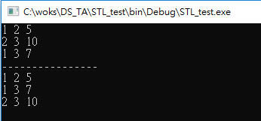
Example: sort edge by weight
Kruskal algorithm

Slide 58
Containers
A container is a way to store data, either built-in data types like int and float, or class objects
The STL provides several basic kinds of containers
<vector> : one-dimensional array
<list> : double linked list
<deque> : double-ended queue
<queue> : queue
<stack> : stack
<set> : set ( balanced binary search tree)
<map> : associative array (balanced binary search tree)
...
Sources: http://ext02.fh-kaernten.at/rts/intern/downloads/Info/Info%203/Standard%20Template%20Library.ppt

Slide 59
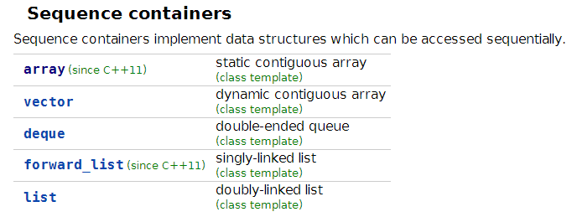
Containers Category: Sequence containers

Slide 60
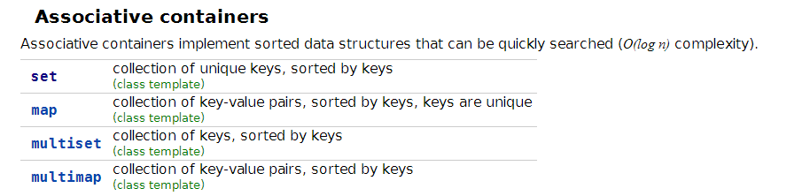
Containers Category: Associative containers

Slide 61
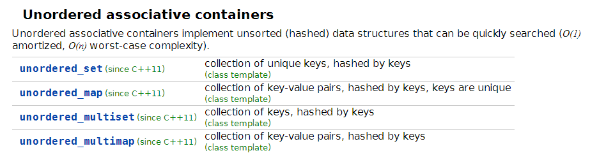
Containers Category: Unordered associative containers

Slide 62
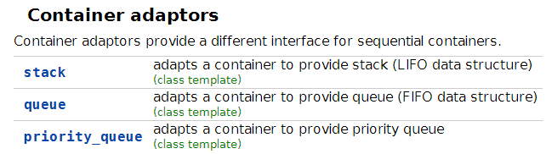
Containers Category: Container adaptors
Notes:
禮拜二講到這~~~~~~~~~~~~~~~~~~~~~~~~~~~~~~~~

Slide 63
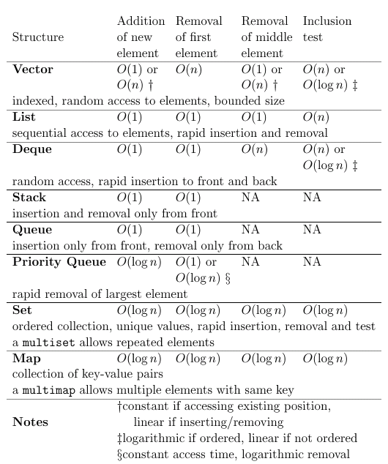
Time for Various Operations
Source: http://fit.mmu.edu.my/icpc/files/stl_intro1.ppt

Slide 64
Time for Various Operations
(like primitive array)
(heap)
(balance binary search tree)
Source: http://fit.mmu.edu.my/icpc/files/stl_intro1.ppt

Slide 65
Selecting a Container Class
How are values going to be accessed?
Random access – vector or deque
Access by key – set or map
Sequential – list
Is the order in which values are maintained in the collection important?
Ordered – set or map
Can be sorted – vector or deque
Insertion time dependent – stack or queue

Slide 66
Selecting a Container Class - example
Store student id : name pair
[ ‘107062525’ : ‘楊真旭’ ]
map<string , string>: O(lgn)
unorder_map<string , string>: expected O(1)
Store multiple sets that may be union
Sorted vector: union in linear time

Slide 67
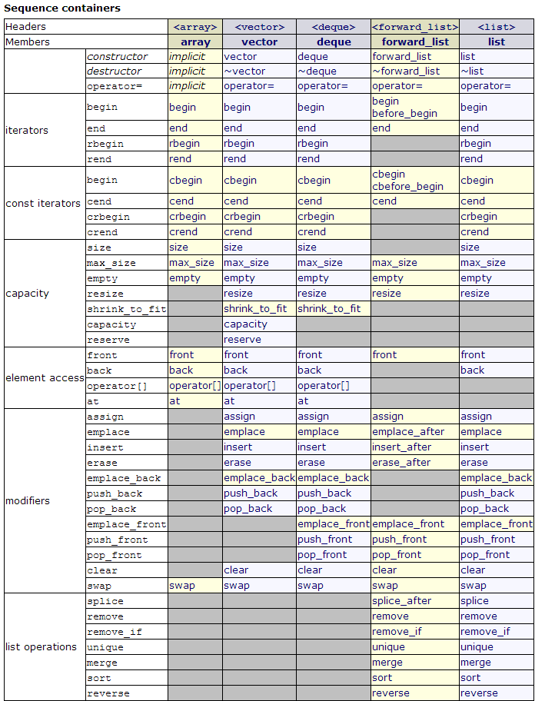
All Functions List
http://www.cplusplus.com/reference/stl/

Slide 68
Class name
Function
Categories

Slide 69
Can Container storage every objects ?
ANS: NO ! (damn)
Because some class are not value like class. They may contain pointers. ( dynamic object )
Basically, there are two type of object can not be hold by STL container.
Class don’t support copy & assign
Class don’t support default constructor
E.g. reference type( int & )

Slide 70
Example of a class forbid copy sematic
class Foo{
private:
Foo( const Foo & ) {}
public:
}
class Foo{
private:
Foo& operator=(const Foo&)
public:
}

Slide 71
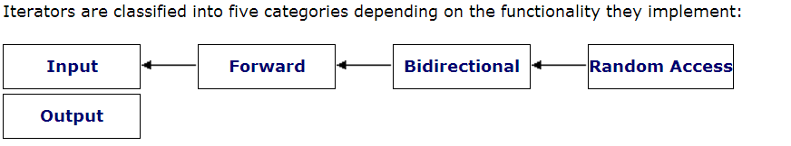
Iterator
Limited
operations
Provide
All operations
(like real pointer)
* Note that this diagram is not a class inherence diagram.
http://www.cplusplus.com/reference/iterator/

Slide 72
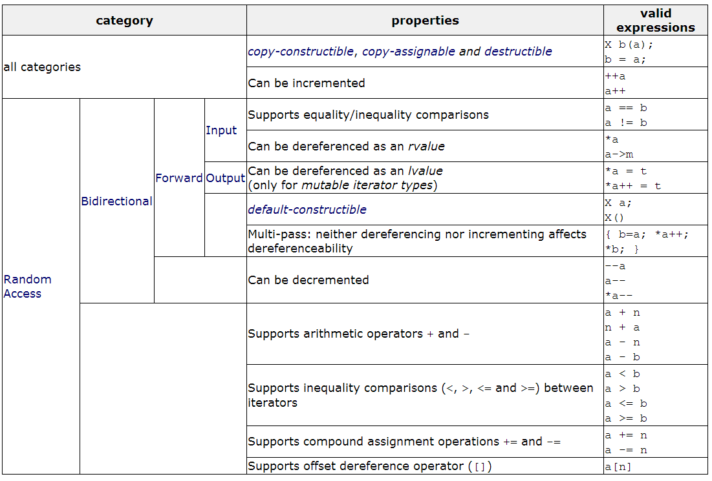
Common
Step to next element
Back to previous element

Slide 73
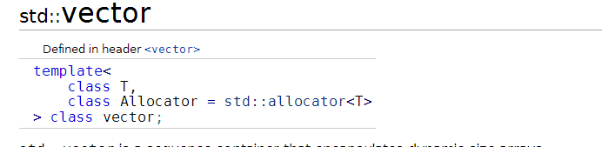
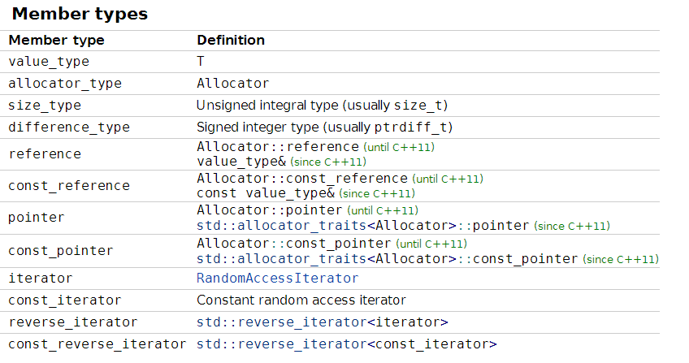
Check Container Support of Iterator

Slide 74
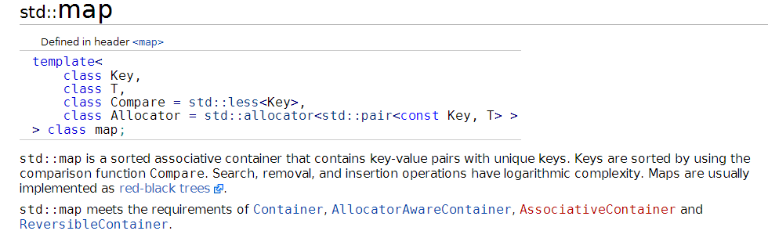
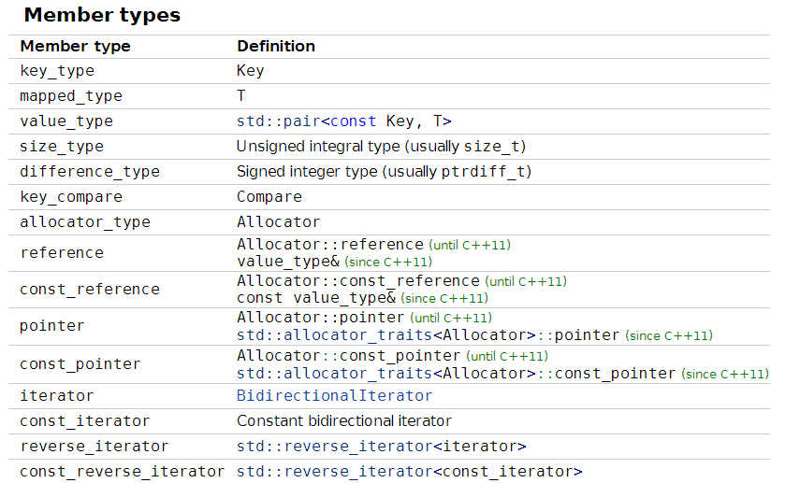
Check Container Support of Iterator
Notes:
第二天楚河交界

Slide 75
<algorithm>
We just introduce two examples
std::find
std::sort
http://en.cppreference.com/w/cpp/algorithm

Slide 76
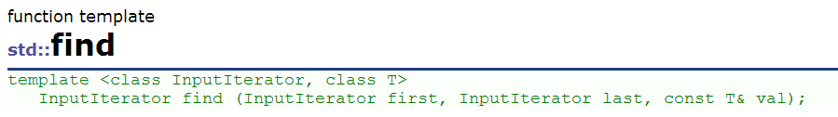
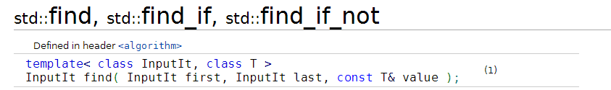

<Algorithm> - find
http://www.cplusplus.com/reference/algorithm/find/
http://en.cppreference.com/w/cpp/algorithm/find

Slide 77
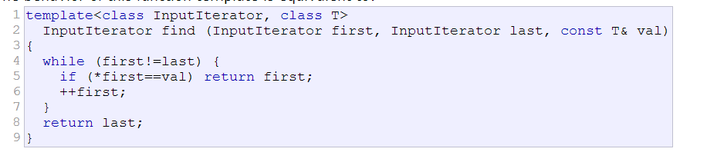
<algorithm> - find example source code
Find value in range
Returns an iterator to the first element in the range [first,last) that compares equal to val.
If no such element is found, the function returns last.

Slide 78
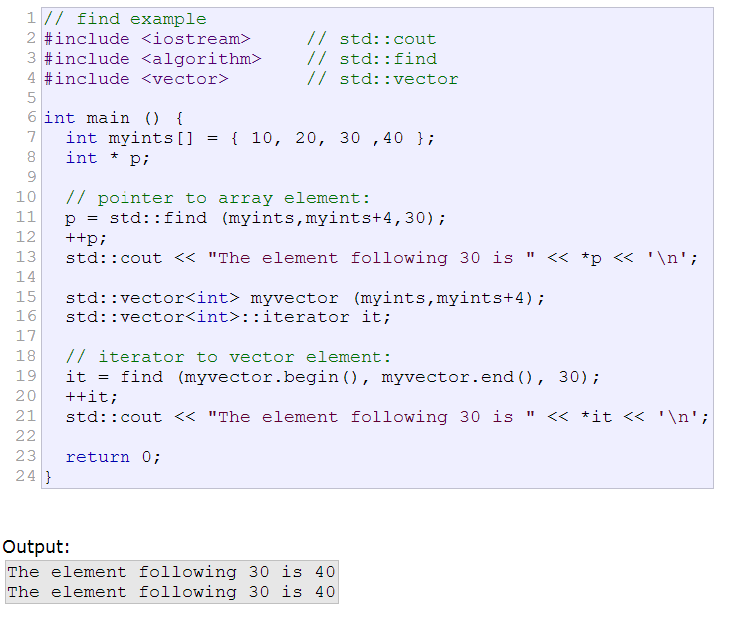

Slide 79
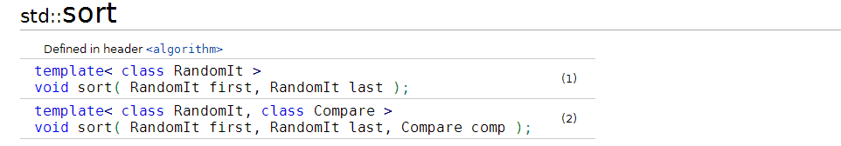
<algorithm> sort
http://en.cppreference.com/w/cpp/algorithm/sort

Slide 80
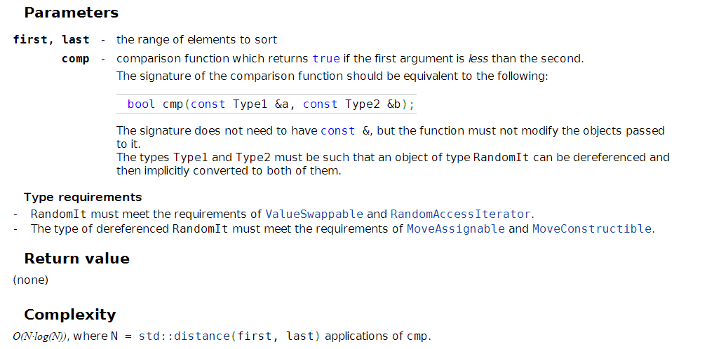

Slide 81
Functor
A Functor can be an general function
Functor can also be an class object, which overloads the operator()
STL only define the signature of function/operator()

Slide 82
Functor ii
Use Functor the STL algorithm can know how to call user’s function to provide customized actions.
In the std::sort, Functor Comp can let user define customized comparison function.
By this way, you can compare your own objects or define a complexed compare function
E.g. triple comparsion : (1,1,3) ? (1,2,1)

Slide 83
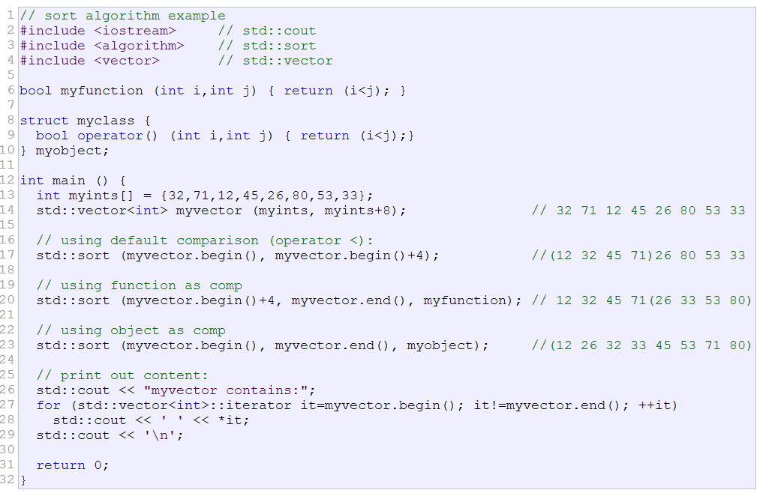
<algorithm> sort
http://www.cplusplus.com/reference/algorithm/sort/

Slide 84
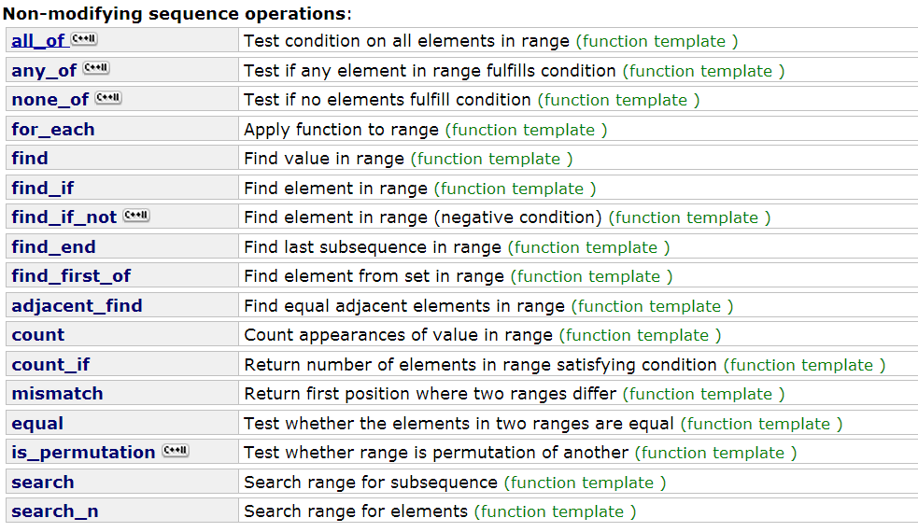

Slide 85
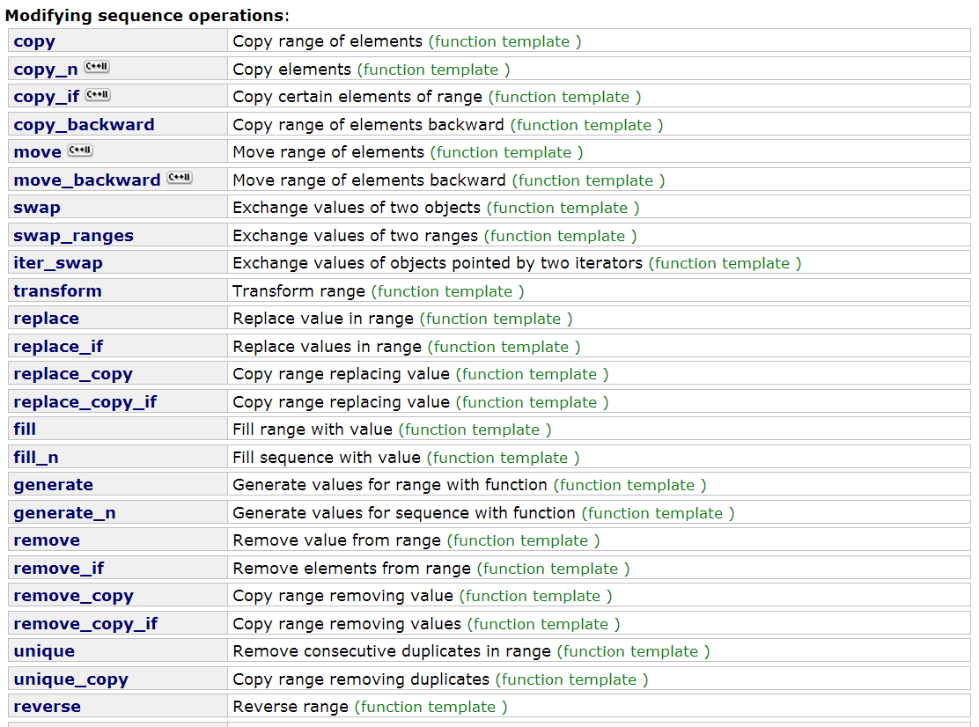

Slide 86
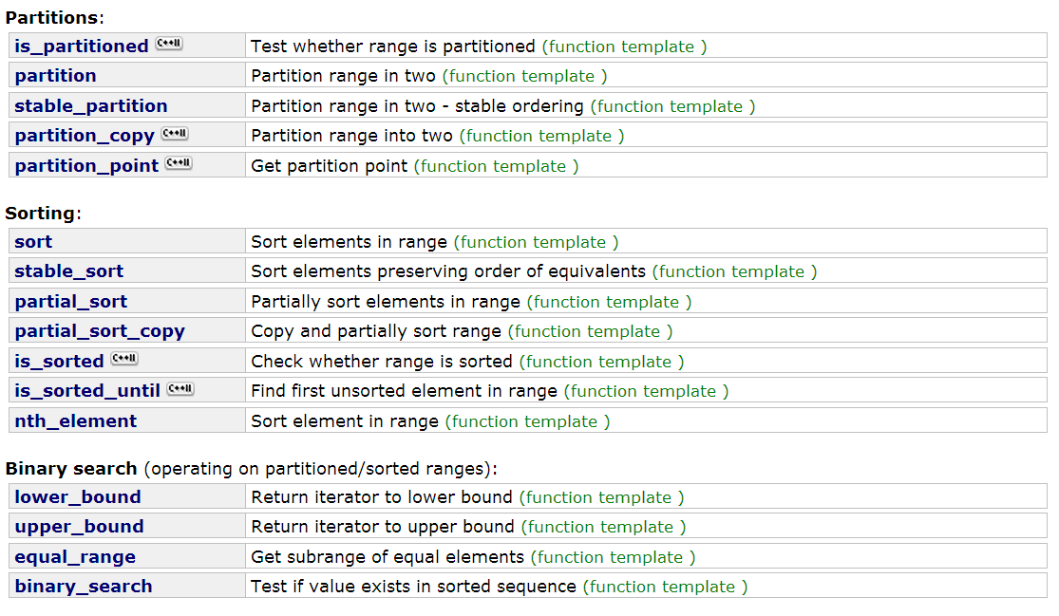

Slide 87
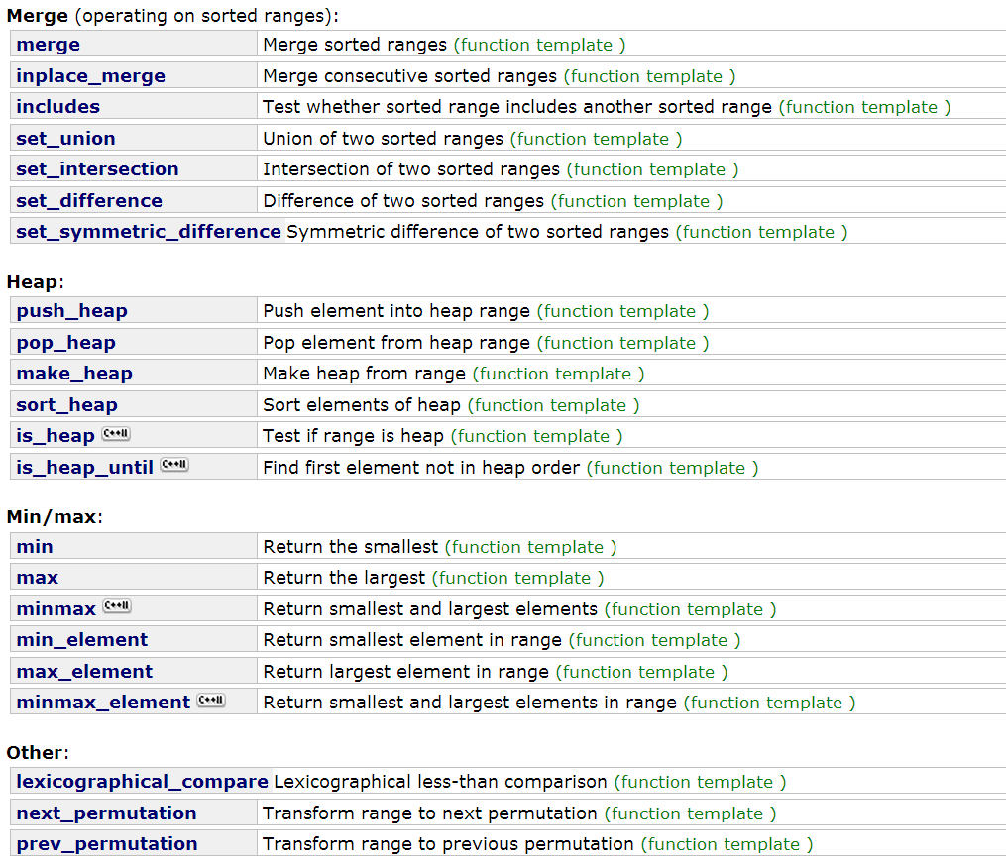

Slide 88
Something not mention in this lectures
Template Specialization
Traits in STL
C++ Template the Complete Guide
Allocator
Move sematic (in C++11)
Performance issues of STL
Effective STL

