Slide 1
Linked List

Slide 2
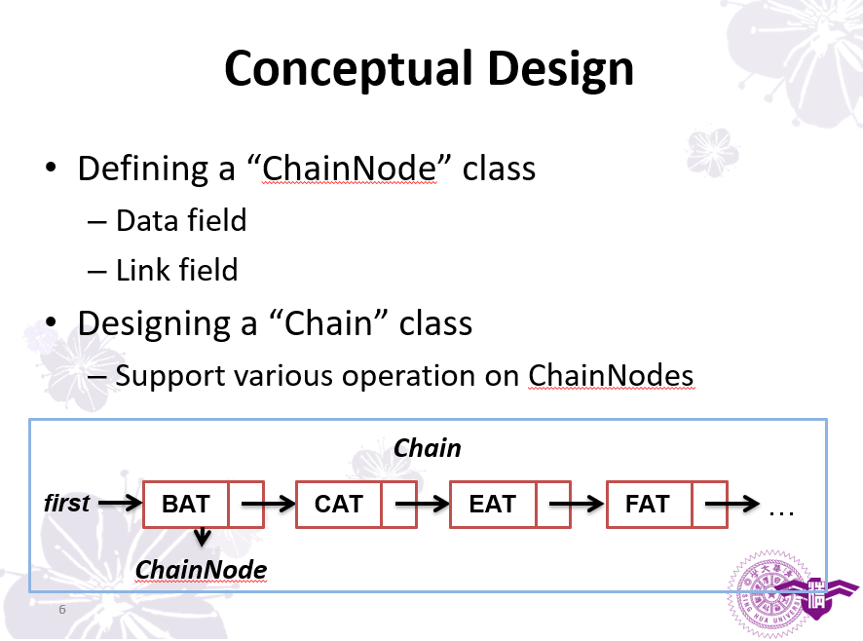
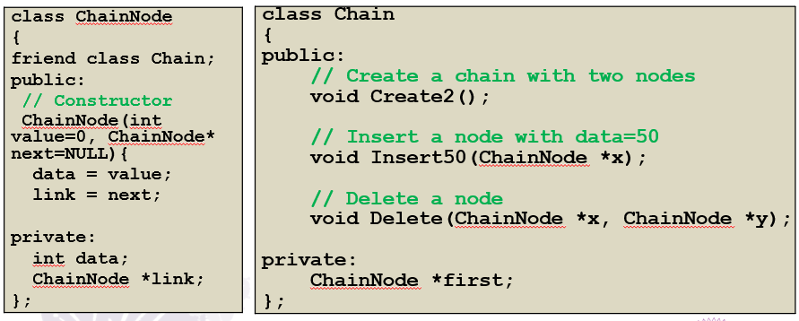

Slide 3
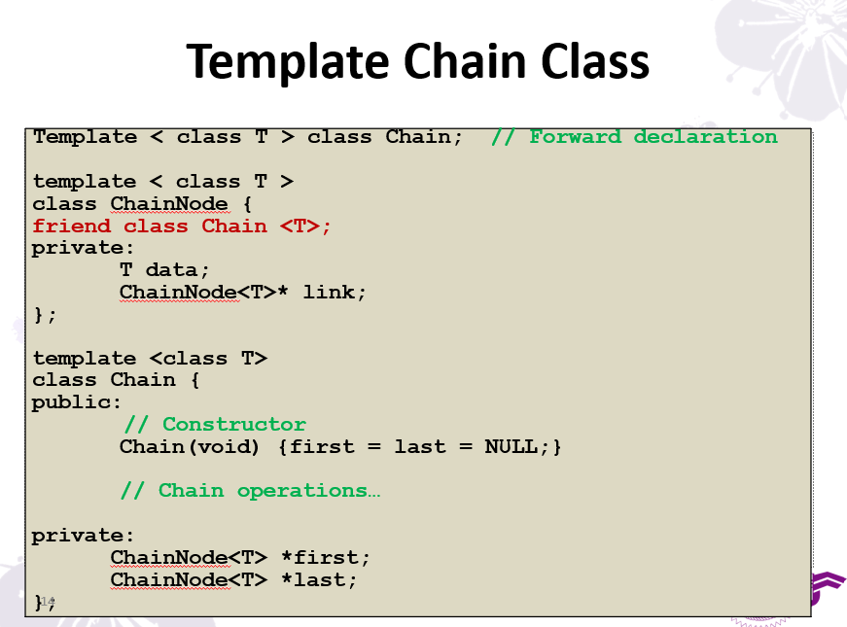

Slide 4
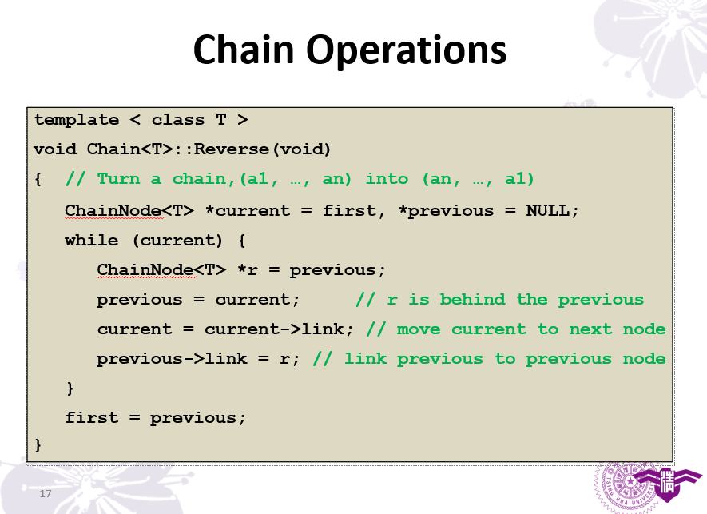

Slide 5
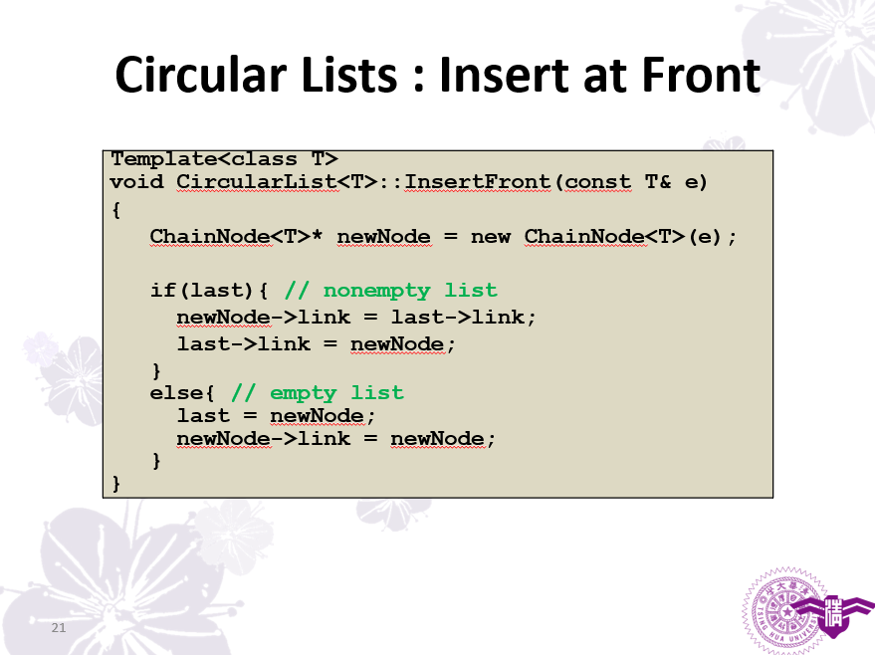
要指回自己

Slide 6
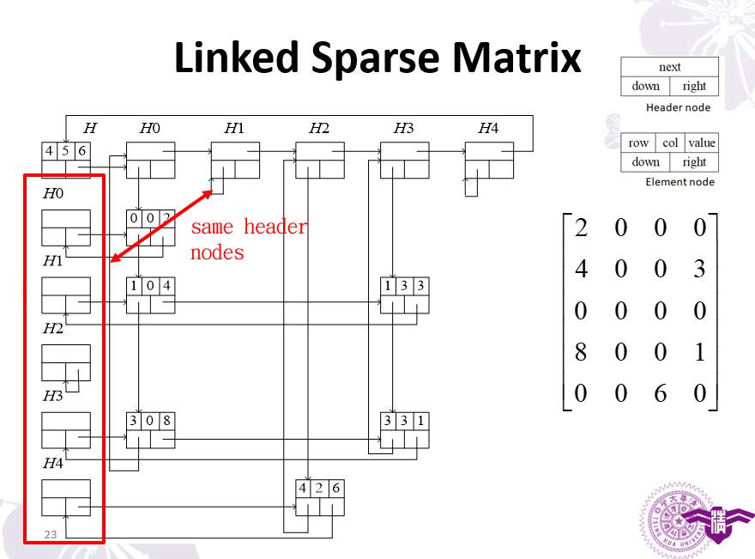

Slide 7
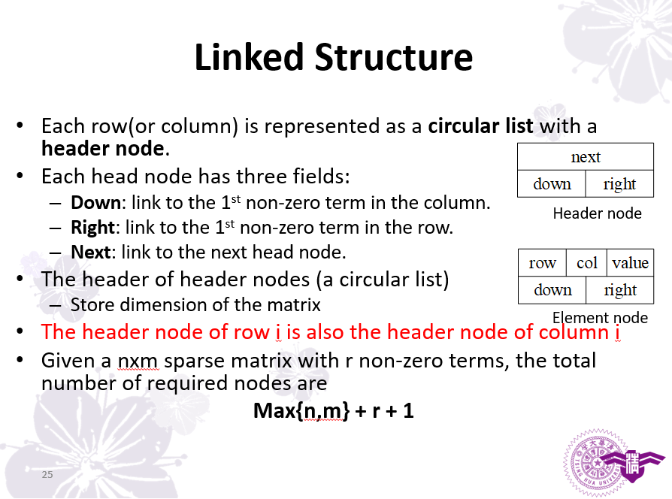

Slide 8
Tree

Slide 9
Inorder Traversal : Codes
template < class T >
void Tree<T>::Inorder()
{ // Start a recursive inorder traversal
// This function is a public member function of Tree
Inorder(root);
}
template <class T>
void Tree<T>::Inorder(TreeNode<T>* currentNode)
{ // Recursive inorder traversal function
// This function is a private member function of Tree
if(currentNode){
Inorder(currentNode->leftChild);
Visit(currentNode); // e.g., printout information
Inorder(currentNode->RightChild);
}
}

Slide 10
Preorder Traversal : Codes
template < class T >
void Tree<T>::Preorder()
{ // Start a recursive preorder traversal
// This function is a public member function of Tree
Preorder(root);
}
template <class T>
void Tree<T>::Preorder(TreeNode<T>* currentNode)
{ // Recursive preorder traversal function
// This function is a private member function of Tree
if(currentNode){
Visit(currentNode); // e.g., printout information
Preorder(currentNode->leftChild);
Preorder(currentNode->RightChild);
}
}

Slide 11
Postorder Traversal : Codes
template < class T >
void Tree<T>::Postorder()
{ // Start a recursive postorder traversal
// This function is a public member function of Tree
Postorder(root);
}
template <class T>
void Tree<T>::Postorder(TreeNode<T>* currentNode)
{ // Recursive postorder traversal function
// This function is a private member function of Tree
if(currentNode){
Postorder(currentNode->leftChild);
Postorder(currentNode->RightChild);
Visit(currentNode); // e.g., printout information
}
}

Slide 12
Tree Iterator
We would like to visit nodes in a fashion like using iterator visit elements in a container
Recursive traversal is no long suitable
We need an iterative version, but how?
Using stack to store non-visited nodes!

Slide 13
Non-Recursive Inorder Traversal
template < class T >
void Tree<T>::NonrecInorder()
{ // Non recursive inorder traversal using stack
Stack<TreeNode<T>*> s; // declare and init a stack
TreeNode<T>* currentNode = root;
while(1){
while(currentNode){ // move down leftChild field
s.Push(currentNode); // add to stack
currentNode = currentNode->leftChild;
}
if(s.IsEmpty()) return; // all nodes are visited
currentNode = s.Top();
s.Pop();
Visit(currentNode); // e.g., printout information
currentNode = currentNode->rightNode;
}
}
We only need this part to develop tree iterator

Slide 14
Inorder Iterator
Class InorderIterator{ // A nested class within Tree
public:
InorderIterator() { currentNode = roor}
T* Next();
private:
Stack<TreeNode<T>*> s;
TreeNode<T>* currentNode;
};
T* InorderIterator::Next()
{
while(currentNode){ // Move down leftChild field
s.Push(currentNode); // Add to stack
currentNode = currentNode->leftChild;
}
if(s.IsEmpty()) return NULL; // All nodes are visited
currentNode = s.Top();
s.Pop();
T& temp = currentNode->data;
currentNode = currentNode->rightNode;
return &temp;
}

Slide 15
Level-Order Traversal
Visit nodes in a top to down, left to right manner.
LEVEL
1
A
2
B
C
A
B
C
E
F
G
D
H
3
E
F
G
D
H
4
Preorder
Inorder
Postorder
Level-Order
Stack
Stack
Stack
Queue

Slide 16
Level-Order Traversal : Codes
template <class T>
void Tree<T>::LevelOrder()
{ // Traverse the binary tree in level order
Queue<TreeNode<T>*> q;
TreeNode<T>* currentNode = root;
while(currentNode){
Visit(currentNode);
if(currentNode->leftChild) q.Push(currentNode->leftChild);
if(currentNode->rightChild) q.Push(currentNode->rightChild);
if(q.IsEmpty()) return;
currentNode = q.Front();
q.Pop();
}
}

Slide 17
Priority Queue
In a priority queue, the element to be processed/deleted is the one with highest (or lowest) priority
Operations
Get the max/min element
Insert an element to the priority queue
Delete element with max/min priority

Slide 18
ADT : Priority Queue
template < class T >
class MaxPQ
{
public:
MaxPQ();
~MaxPQ();
// Check if PQ is empty
bool IsEmpty() const;
// Return reference to the max element
T& Top() const;
// Add an element to the PQ
void Push(const T&);
// Delete element with max priority
void Pop();
private:
// Data representation here
// …
};

Slide 19
PQ Representations
Unsorted linear list
Array, chain,..,etc
Sorted linear list
Sorted array, sorted chain,…,etc
Heap
 | Top() | Push() | Pop()
Unsorted linear list
Sorted linear list
Heap
O(n)
O(1)
O(n)
O(1)
O(n)
O(1)
O(1)
O(logn)
O(logn)

Slide 20
Max Heap
Definition: A max (min) tree is a tree in which the key value in each node is no smaller (larger) than the key values in its children (if any). A max(min) heap is a complete binary tree that is also a max(min) tree.
14
14
10
7
12
7
12
8
6
8
6
Not a heap
(12 > 10)
Not a heap
(Not a complete binary tree)

Slide 21
ADT : Priority Queue
template < class T >
class MaxPQ
{
public:
MaxPQ();
~MaxPQ();
// Check if PQ is empty
bool IsEmpty() const;
// Return reference to the max element
T& Top() const;
// Add an element to the PQ
void Push(const T&);
// Delete element with max priority
void Pop();
private:
T* heap // Element array
int heapSize; // # of elements
int capacity; // size of the array “heap”
};

Slide 22
BST : Search an Element by Rank
Definition of rank:
A rank of a node is its position in inorder traversal
30
Need r visits of nodes
Any faster ways?
5
40
2
Inorder traversal : 2 -> 5 -> 30 -> 40
Rank : 1 2 3 4
Therefore, the r^{th} smallest element is the node with rank r

Slide 23
BST: Search by Rank - leftSize
If we are searching for the rank-r element, we perform:
Set currentNode = root
Consider 3 cases
leftSize < r: currentNode = left child; repeat 2)
leftSize > r: r = r – leftSize; currentNode = right child, repeat 2)
leftSize = r: bingo; break
5
30
Example: r=7
4
5
2
40
2
2
1
35
1
80
1
1
1
3

Slide 24
BST: Search by Rank - leftSize
If we are searching for the rank-r element, we perform:
Set currentNode = root
Consider 3 cases
leftSize < r: currentNode = left child; repeat 2)
leftSize > r: r = r – leftSize; currentNode = right child, repeat 2)
leftSize = r: bingo; break
5
30
Example: r=6
4
5
2
40
2
2
1
35
1
80
1
1
1
3

Slide 25
BST : Delete
Scenario 3 : The element is a non-leaf node with two children
The deleted element is replaced by either
the smallest element in right subtree or
the largest element in left subtree
30
To delete 30
5
40
7
35
41
6
The smallest element in right subtree

Slide 26
BST : Time Complexity
Search, insertion, or deletion takes O(h)
h = Height of a BST
Worst case h=n
Insert keys
Best case h=logn
Insert keys : 4, 2, 6, 1, 3, 5, 7
1,
2,
3,
…
1
4
2
2
6
3
1
3
5
7
n

Slide 27

Self-Study Topics
Write pseudo codes of BST deletion
Selection trees
AVL/Red-Black trees (Chapter 10)
Worst case height : O(logn)

Slide 28
Rebalancing
BST insertion/deletion operation may cause nodes with balance factor >1 or <–1.
Rebalancing process
Update the heights (balance factors) from the inserted/deleted node up to the root.
Fix unbalanced situations using “rotations”.
2
0
4
2
4
<3>
<2>
<2>
1
0
0
Insert 1
2
Rotation
1
4
2
<2>
<1>
<1>
<1>
1
<1>

Slide 29
Rotation - Outside Cases
A
A
B
h
B
h
h
h
h+1
h+1
Right rotation
Left rotation
LL Rotation: The new node is inserted in the left subtree of the left subtree of A
RR Rotation: The new node is inserted in the right subtree of the right subtree of A

Slide 30
Rotation - Outside Cases
A
A
B
h
B
h
h
h
h+1
h+1
Right rotation
Left rotation
LL Rotation: The new node is inserted in the left subtree of the left subtree of A
RR Rotation: The new node is inserted in the right subtree of the right subtree of A

Slide 31
Rotation - Outside Cases
A
A
B
h
B
h
h
h
h+1
h+1
Right rotation
Left rotation
LL Rotation: The new node is inserted in the left subtree of the left subtree of A
RR Rotation: The new node is inserted in the right subtree of the right subtree of A

Slide 32
Rotation - Outside Cases
B
B
A
A
h+1
h
h
h
h
h+1
Height Balanced!
Height Balanced!
LL Rotation: The new node is inserted in the left subtree of the left subtree of A
RR Rotation: The new node is inserted in the right subtree of the right subtree of A

Slide 33
Rotation – Inside Cases
A
A
B
B
h
h
h
h
h+1
h+1
LR Rotation: The new node is inserted in the right subtree of the left subtree of A
RL Rotation: The new node is inserted in the left subtree of the right subtree of A

Slide 34
Rotation – Inside Cases
A
A
B
B
h
h
C
C
h
h
h
h
h
h
Left rotation
Right rotation
LR Rotation: The new node is inserted in the right subtree of the left subtree of A
RL Rotation: The new node is inserted in the left subtree of the right subtree of A

Slide 35
Rotation – Inside Cases
A
A
C
h
h
C
B
B
h
h
h
h
h
h
Left rotation
Right rotation
LR Rotation: The new node is inserted in the right subtree of the left subtree of A
RL Rotation: The new node is inserted in the left subtree of the right subtree of A

Slide 36
Rotation – Inside Cases
A
A
C
h
h
C
B
B
h
h
h
h
h
h
Left rotation + Right rotation
Right rotation + Left rotation
LR Rotation: The new node is inserted in the right subtree of the left subtree of A
RL Rotation: The new node is inserted in the left subtree of the right subtree of A

Slide 37
Rotation – Inside Cases
C
C
B
A
A
B
h
h
h
h
h
h
h
h
Left rotation + Right rotation
Right rotation + Left rotation
LR Rotation: The new node is inserted in the right subtree of the left subtree of A
RL Rotation: The new node is inserted in the left subtree of the right subtree of A

Slide 38
AVL Tree: Delete 16
To delete 16
16>12
12
<4>
14 replaces 16
Delete 14!
5
16
<2>
<3>
4
6
14
18
<1>
<1>
<1>
<2>
17
20
<1>
<1>

Slide 39
AVL Tree: Delete 16
Update the heights from 14 up to the root.
12
<4>
Use rebalancing
RR rotation!
14
-2
5
<3>
<2>
4
6
18
<1>
<1>
<2>
17
20
<1>
<1>

Slide 40
AVL Tree: Delete 16
Update the heights from 14 up to the root.
Finish!
-1
12
<4>
18
0
5
<3>
<2>
4
6
14
20
<1>
<1>
<2>
<1>
17
<1>

Slide 41
ADT: AVL Tree
template < class T > class AVLTree;
template < class T >
Class TreeNode {
friend class AVLTree <T>;
private:
T data;
int height;
void updateHeight();
int bf();
TreeNode<T>* left, right;
};
template <class T>
Class AVLTree{
public:
// Constructor
AVLTree(void) {root=NULL;}
// Tree operations here…
private:
TreeNode<T> *root;
};

Slide 42
AVL Tree Insert/delete
template < class T >
TreeNode<T>* AVLTree<T>::insert(TreeNode<T> *node, T data)
{
// BST Insert
// ...
// rebalance from node to root
node->updateHeight();
return rebalance( node );
}
template < class T >
TreeNode<T>* AVLTree<T>::delete(TreeNode<T> *node, T data)
{
// BST Delete
// ...
// rebalance from node to root
node->updateHeight();
return rebalance( node );
}

Slide 43
AVL Tree Rebalance
template < class T >
TreeNode<T>* AVLTree<T>::rebalance(TreeNode<T> *node){
// LL Rotation
if ( node->bf()>1 && node->left->bf()>=0 ){
return rightRotate( node );
}
// RR Rotation
if ( node->bf()<-1 && node->right->bf()<=0 ){
return leftRotate( node );
}
// LR Rotation
if ( node->bf()>1 && node->left->bf()<0 ){
node->left = leftRotate( node->left );
return rightRotate( node );
}
// RL Rotation
if ( node->bf()<-1 && node->right->bf()>0 ){
node->right = rightRotate( node->right );
return leftRotate( node );
}
}

Slide 44
AVL Tree Left/Right Rotation
template < class T >
TreeNode<T>* AVLTree<T>::leftRotate(TreeNode<T> *node)
{
TreeNode<T>* node_r = node->right;
TreeNode<T>* node_rl = node_r->left;
node_r->left = node;
node->right = node_rl;
node->UpdateHeight();
node_r->UpdateHeight();
return node_r;
}
template < class T >
TreeNode<T>* AVLTree<T>::rightRotate(TreeNode<T> *node)
{
TreeNode<T>* node_l = node->left;
TreeNode<T>* node_lr = node_l->right;
node_l->right = node;
node->left = node_lr;
node->UpdateHeight();
node_l->UpdateHeight();
return node_l;
}

Slide 45
Forests

Slide 46
Array

Slide 47
Running Time Comparison
Trivial Transpose | Smart Transpose | Fast Transpose
O(rows ∙ cols) | O(cols ∙ terms) | O(cols + terms)
For a dense matrix (terms = rows∙cols)
Fast equals to trivial: O(rows ∙ cols)
Smart is slowest: O(rows ∙ cols²)
For a sparse matrix (terms << rows∙cols)
Fast transpose is faster than trivial and smart ones

Slide 48
Sparse Matrix Multiplication
Compute the transpose of b
c: m x p
a: m x n b: n x p
x
0 5 2 0 0 7
3
0
4
3
6
5
=

Slide 49
Sparse Matrix Multiplication
Use approach similar to “Polynomial Addition” to compute the X!
c: m x p
a: m x n b^{T}: p x n
x
0 5 2 0 0 7
3 0 4 3 6 5
=
p
p
p
q
q
q
q
q
Please refer textbook for codes!
x =
(2)(4)
+ (7)(5)
= 43

Slide 50
Time Complexity
Complexity:
O(rows ∙ b.cols ∙ (Term[i] + b.Terms[j]))
rows ∙ Term[i] = a.terms and b.cols ∙ b.Terms[j] = b.terms
O(rows ∙ b.terms + b.cols ∙ a.terms)
SparseMatrix SparseMatrix::Multiply(SparseMatrix b)
{ // Compute the transpose of b
SparseMatrix bT = b.FastTranspose(); // O(b.terms + b.cols)
for ith row in smArray // O(rows) for jth row in bT.smArray // O(b.cols) Perform “Polynomal Addition” // O(Terms[i] + b.Terms[j]) }

Slide 52
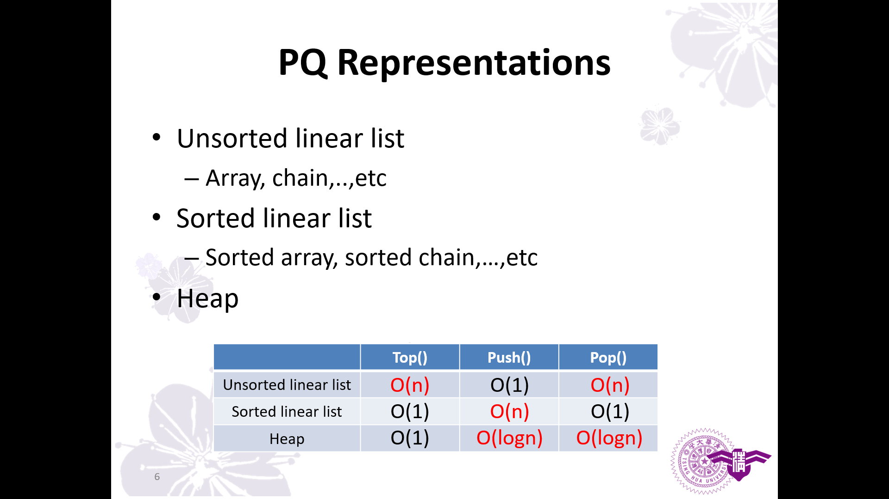

Slide 53
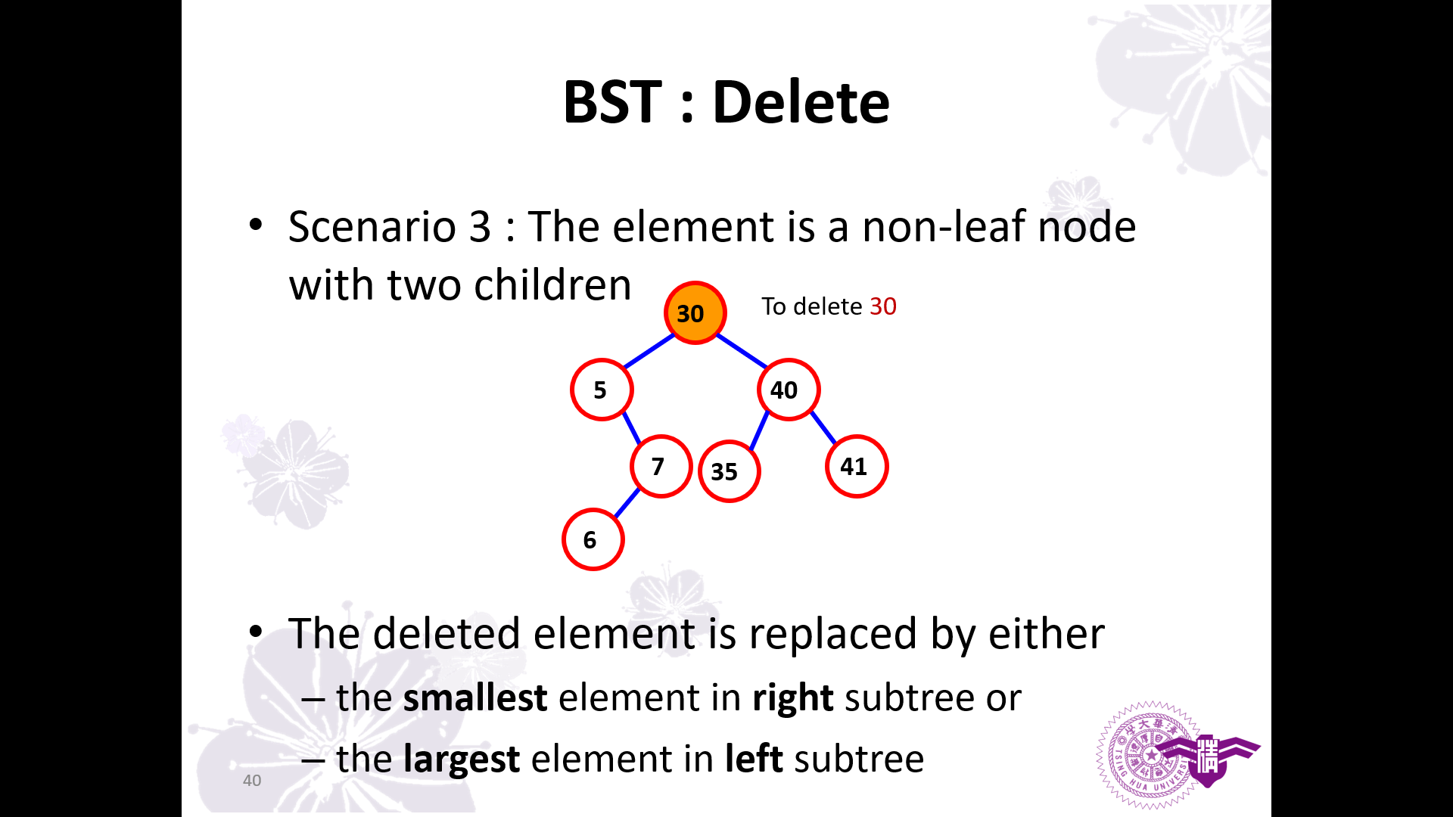

Slide 54
BST : Search an Element by Rank
Definition of rank:
A rank of a node is its position in inorder traversal
30
Need r visits of nodes
Any faster ways?
5
40
2
Inorder traversal : 2 -> 5 -> 30 -> 40
Rank : 1 2 3 4
Therefore, the r^{th} smallest element is the node with rank r

Slide 55
BST: Search by Rank - leftSize
To facilitate searching for rank-r element, we store the additional information, leftSize
leftSize = 1 + # of nodes in left subtree
5
30
4
5
2
40
2
2
1
35
1
80
1
1
1
3

Slide 56
BST: Search by Rank - leftSize
If we are searching for the rank-r element, we perform:
Set currentNode = root
Consider 3 cases
leftSize > r: currentNode = left child; repeat 2)
leftSize < r: r = r – leftSize; currentNode = right child, repeat 2)
leftSize = r: bingo; break
5
30
4
5
2
40
2
2
1
35
1
80
1
1
1
3

Slide 57
BST: Search by Rank - leftSize
If we are searching for the rank-r element, we perform:
Set currentNode = root
Consider 3 cases
leftSize > r: currentNode = left child; repeat 2)
leftSize < r: r = r – leftSize; currentNode = right child, repeat 2)
leftSize = r: bingo; break
5
30
Example: r=3
4
5
2
40
2
2
1
35
1
80
1
1
1
3

Slide 58
BST: Search by Rank - leftSize
If we are searching for the rank-r element, we perform:
Set currentNode = root
Consider 3 cases
leftSize < r: currentNode = left child; repeat 2)
leftSize > r: r = r – leftSize; currentNode = right child, repeat 2)
leftSize = r: bingo; break
5
30
Example: r=7
4
5
2
40
2
2
1
35
1
80
1
1
1
3

Slide 59
BST: Search by Rank - leftSize
If we are searching for the rank-r element, we perform:
Set currentNode = root
Consider 3 cases
leftSize < r: currentNode = left child; repeat 2)
leftSize > r: r = r – leftSize; currentNode = right child, repeat 2)
leftSize = r: bingo; break
5
30
Example: r=6
4
5
2
40
2
2
1
35
1
80
1
1
1
3

Slide 60
