Slide 1

Fourier Transforms

Slide 2
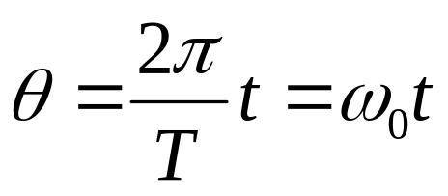
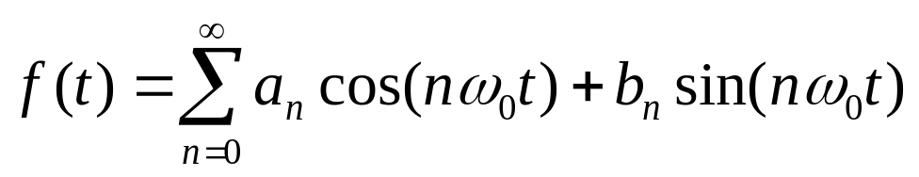
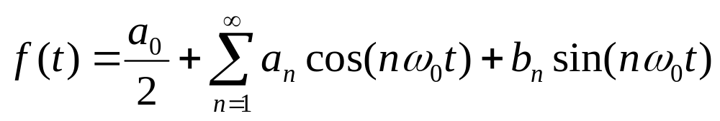

Fourier series
To go from f( ) to f(t) substitute
To deal with the first basis vector being of length 2 instead of , rewrite as

Slide 3
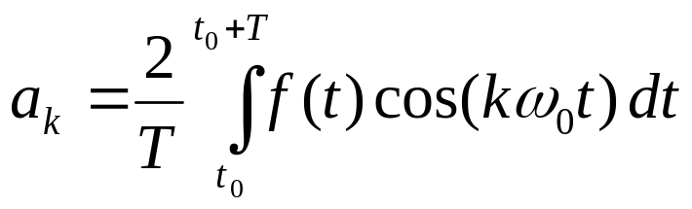
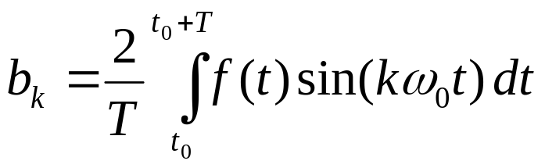
Fourier series
The coefficients become

Slide 4
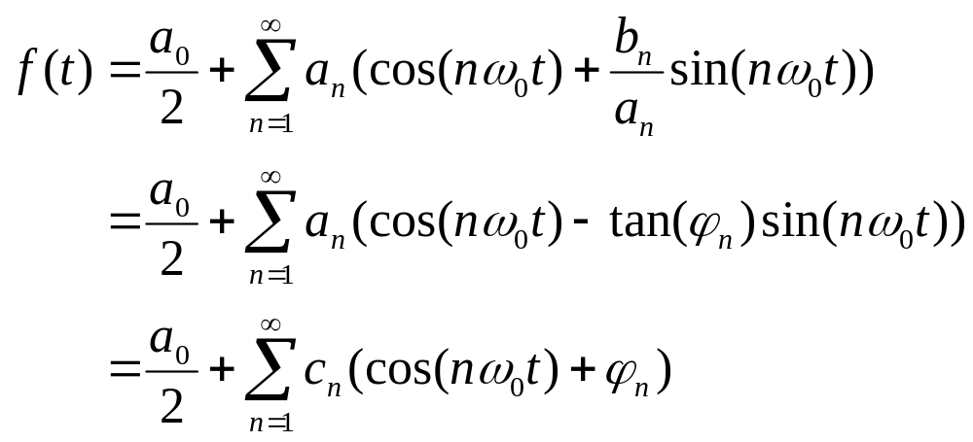
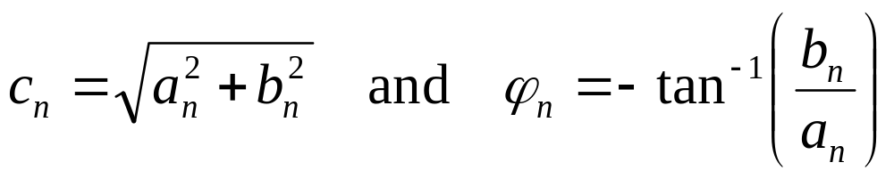

Fourier series
Alternate forms
  where

Slide 5
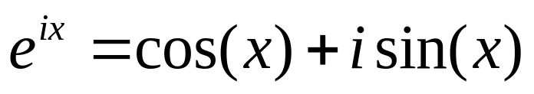
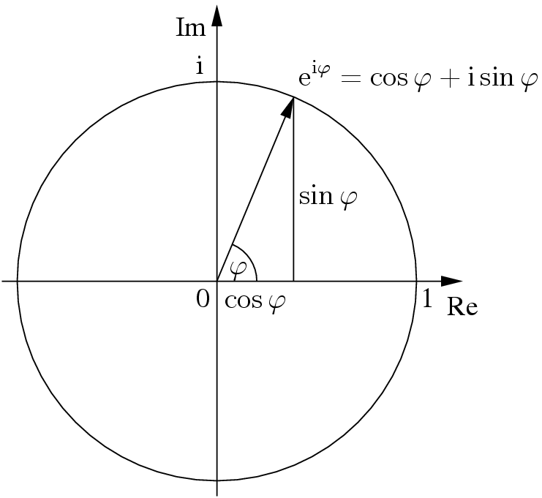
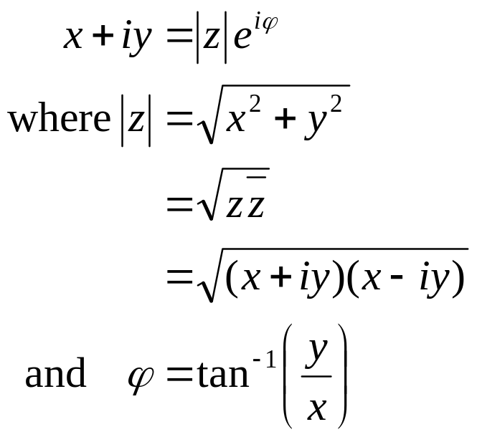
Complex exponential notation
Euler’s formula
Phasor notation:

Slide 6
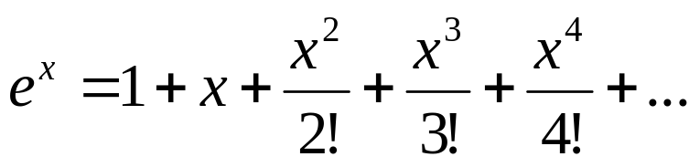
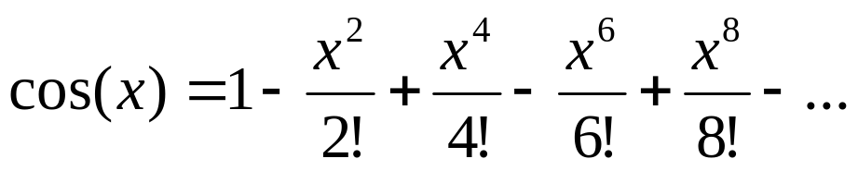
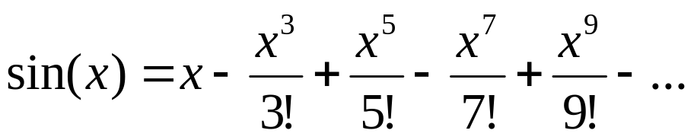
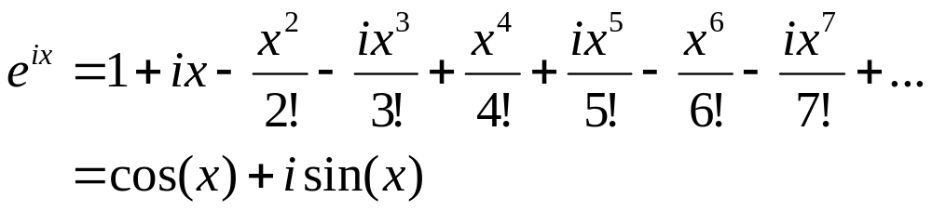
Euler’s formula
Taylor series expansions
Even function ( f(x) = f(-x) )
Odd function ( f(x) = -f(-x) )

Slide 7
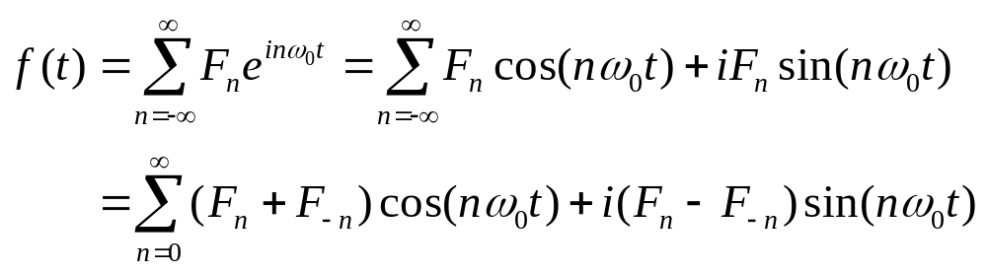
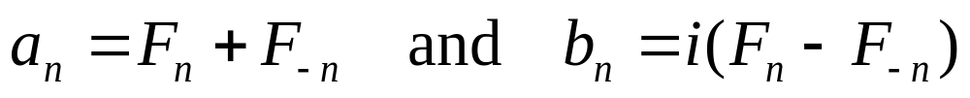
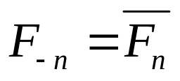
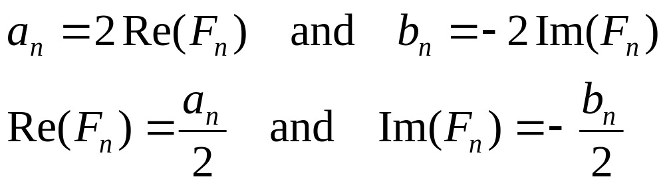
Complex exponential form
Consider the expression
So
Since a_{n} and b_{n} are real, we can let
and get

Slide 8
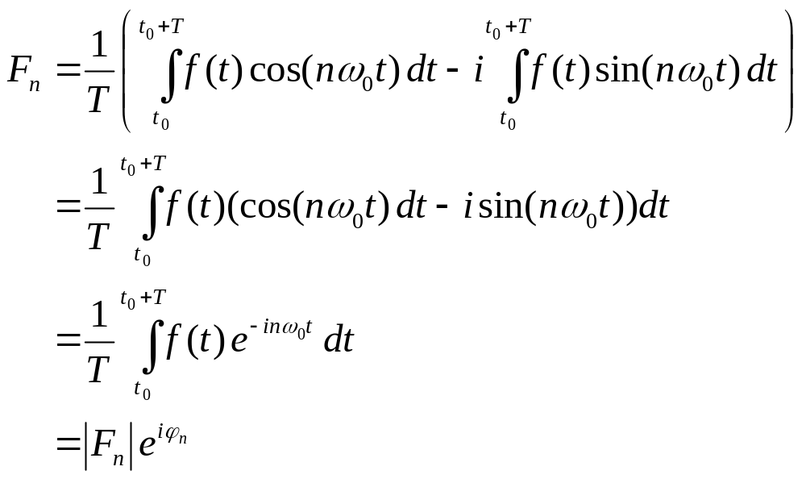
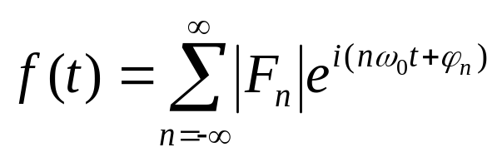
Complex exponential form
Thus
So you could also write

Slide 9
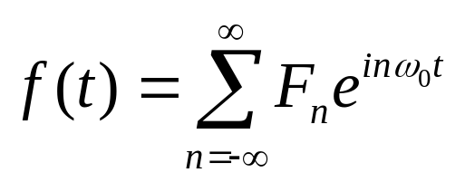
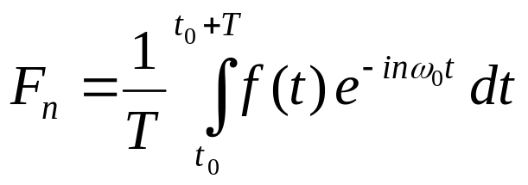
Fourier transform
We now have
Let’s not use just discrete frequencies, n₀ , we’ll allow them to vary continuously too
We’ll get there by setting t₀=-T/2 and taking limits as T and n approach 

Slide 10
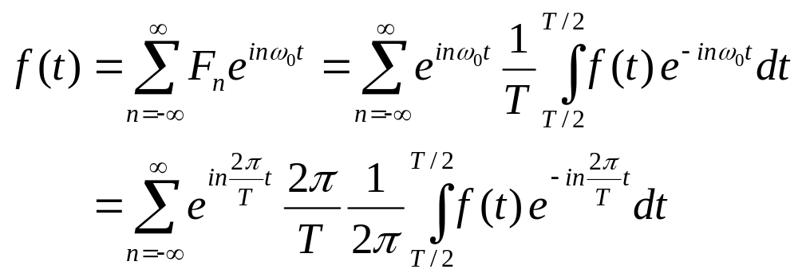
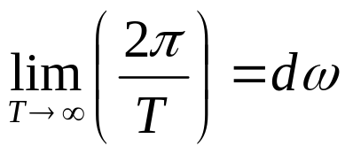
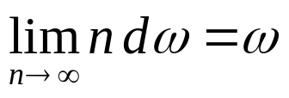
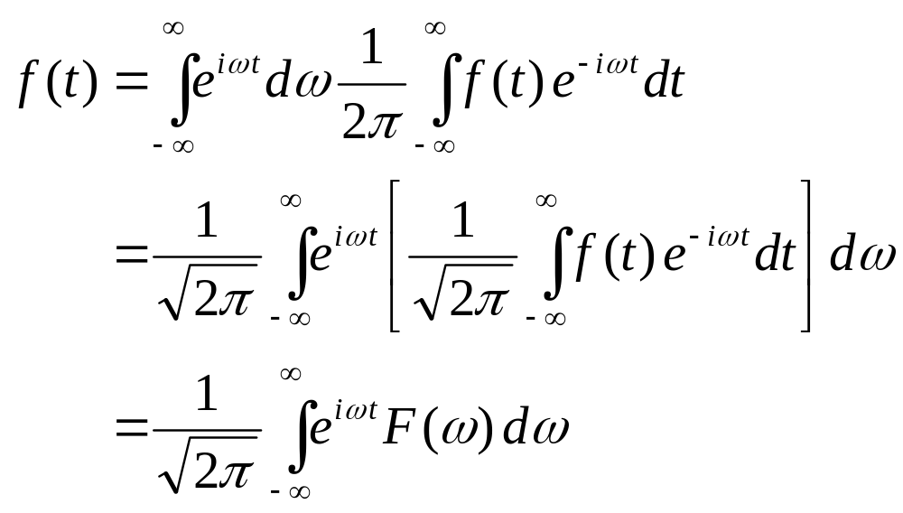
Fourier transform

Slide 11
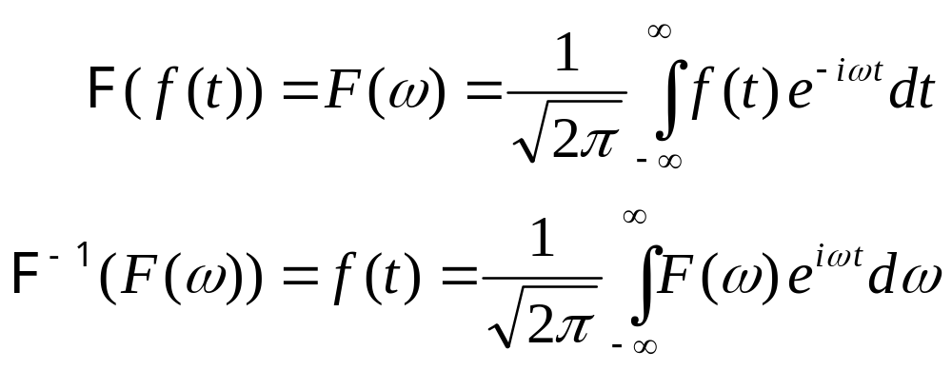
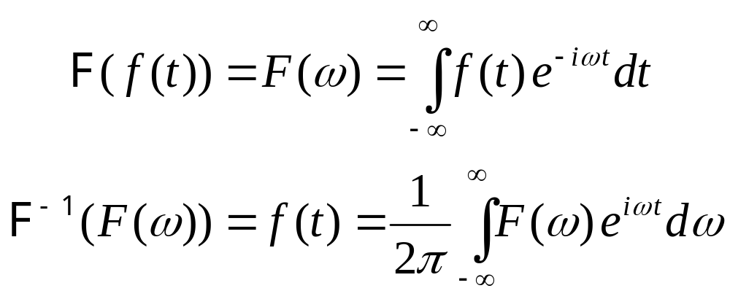

Fourier transform
So we have (unitary form, angular frequency)
Alternatives (Laplace form, angular frequency)

Slide 12
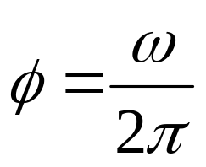
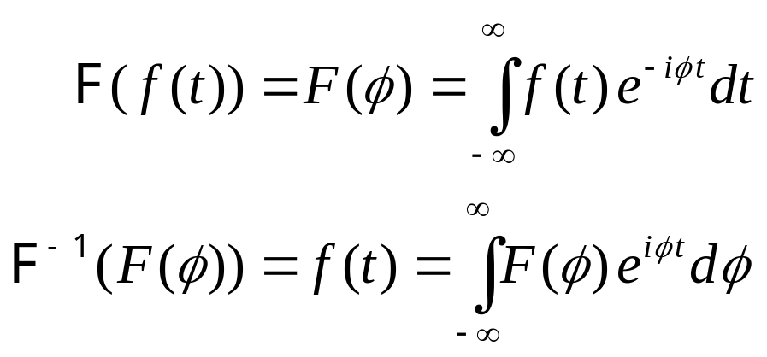
Fourier transform
Ordinary frequency

Slide 13
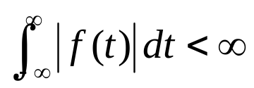
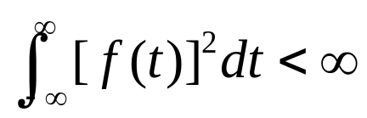
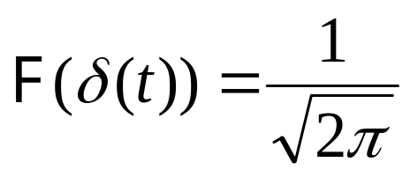
Fourier transform
Some sufficient conditions for application
  Dirichlet conditions
    f(t) has finite maxima and minima within any finite interval
    f(t) has finite number of discontinuities within any finite interval
  Square integrable functions (L² space)
  Tempered distributions, like Dirac delta

Slide 14
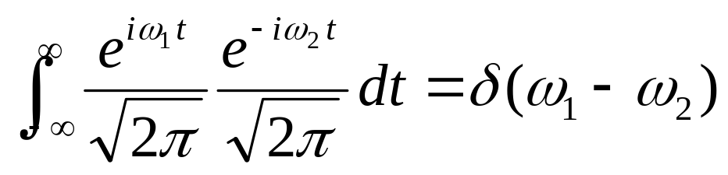
Fourier transform
Complex form – orthonormal basis functions for space of tempered distributions

Slide 15
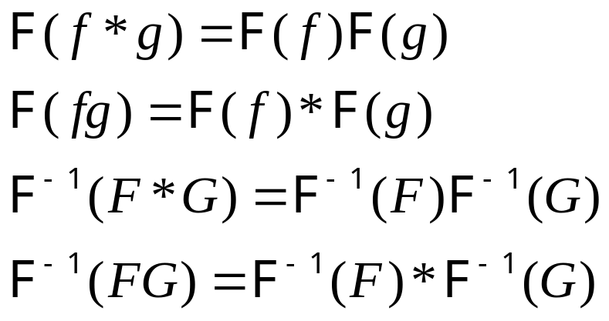
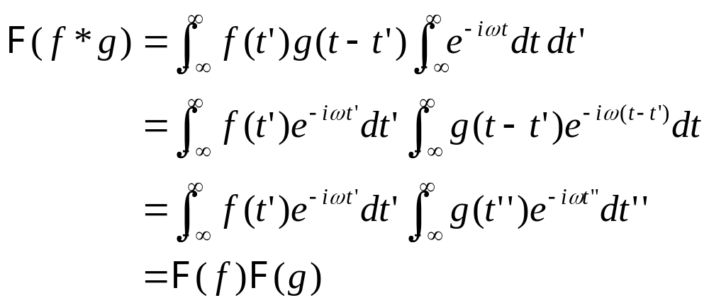
Convolution theorem
Theorem
Proof (1)

