Slide 1
MASTER OF SOFTWARE ENGINEERING — THESIS DEFENSE
Integrating Speech-to-Text and RVC-Based
Voice Conversion into an AI Assistant
Nguyen Hoang Ngoc Bao — 24MSE23204
Supervisor: Dr. Nguyen Xuan Sam
FPT University · 2026

Slide 2
OVERVIEW
Agenda
• 1. Problem & motivation
• 2. Research objectives and questions
• 3. Related work — why this combination
• 4. Proposed solution & architecture
• 5. Implementation status
• 6. Legal & ethical compliance (new VN laws)
• 7. Evaluation methodology & preliminary results
• 8. Results & deliverables
2

Slide 3
1. PROBLEM & MOTIVATION
A text-only RAG legal assistant is a bottleneck
• Existing system: ChromaDB + BGE embeddings + Llama-3.1 (Groq), Vietnamese enterprise law — works, but text only.
• Users must type every question and read every answer.
• Typing ≈ 40 wpm vs. speech ≈ 120–150 wpm.
• Long legal answers on a phone screen: high cognitive load, poor accessibility.
• Natural extension: add a voice loop on both sides — ASR in, personalised TTS/RVC out.
Task | Typing | Dictation | Saved
500-word email | 12.5 min | 4 min | 68%
1,000-word report | 25 min | 8 min | 68%
2,000-word article | 50 min | 17 min | 66%
5,000-word document | 125 min | 42 min | 66%
Estimated, adapted from prior speech-input productivity studies [1]
3

Slide 4
2. RESEARCH OBJECTIVES
Objectives and research questions
Objectives
Research Questions
• Integrate speech-to-text (PhoWhisper, local PhoWhisper-small fallback) so users can ask by voice in Vietnamese.
• Train a custom RVC voice-conversion model on Google Colab and integrate it into the response pipeline.
• Compare TTS+RVC against a zero-shot baseline (F5-TTS-Vietnamese-ViVoice).
• Evaluate on objective (latency, WER, SNR) and subjective (MOS) metrics.
RQ1
How can an RVC model trained on Colab be integrated into a production RAG assistant without rewriting the retrieval pipeline?
RQ2
Does TTS + RVC outperform a zero-shot baseline (F5-TTS-Vietnamese-ViVoice) in MOS naturalness and speaker similarity?
RQ3
What latency does voice add, and is it still ≤ 4 s end-to-end?
4

Slide 5
3. RELATED WORK
Why this combination: RVC + F5-TTS baseline
Criterion | Classical TTS | TTS + RVC (this work) | Zero-shot cloning
Naturalness | Robotic | Natural, target timbre | Natural, generic
Personalisation | Limited | High (per-speaker) | Medium (zero-shot)
Training cost | None | 10–30 min (Colab) | None
Latency (CPU) | ≈ 0.5 s/sentence | ≈ 1.5 s/sentence | ≈ 1.0 s/sentence
• RVC v2 (HuBERT + HiFi-GAN + FAISS): best timbre when ≈ 10 min of reference data is available; the per-speaker training step is itself an evaluation point — does it beat zero-shot cloning?
• F5-TTS-Vietnamese-ViVoice chosen as baseline over XTTS-v2 / OpenVoice: already fine-tuned on Vietnamese speech → fairer comparison on a Vietnamese-only legal test set.
• ASR: PhoWhisper (VinAI, 17–24% relative WER reduction over multilingual Whisper on Vietnamese) as primary, local PhoWhisper-small as offline fallback.
5

Slide 6
4. PROPOSED SOLUTION
A bidirectional voice loop, built as a separate service
Input side
Output side
• Browser mic records the question.
• Sent to clone-voice-station → transcribed by PhoWhisper-large on Colab (PhoWhisper-small local fallback).
• Resulting text forwarded to rag-legal-assistant's existing RAG pipeline, unchanged.
• LLM answer text → edge-TTS base Vietnamese WAV.
• Re-voiced with the user's trained RVC model.
• Prefixed with an AI-disclosure notice + provenance watermark.
• Streamed back to the browser as playable audio.
Voice features are opt-in — the assistant degrades gracefully to text-only mode, and clone-voice-station itself falls back to plain TTS whenever the Colab-hosted RVC/PhoWhisper session is offline.
6

Slide 7
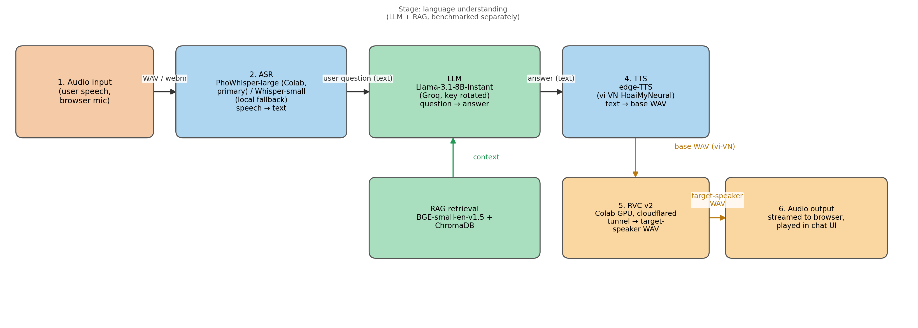
4. PROPOSED SOLUTION
High-level pipeline (6 measurable stages)
Figure 1: LLM and RAG are surfaced as separate, independently benchmarkable sub-components.
7

Slide 8
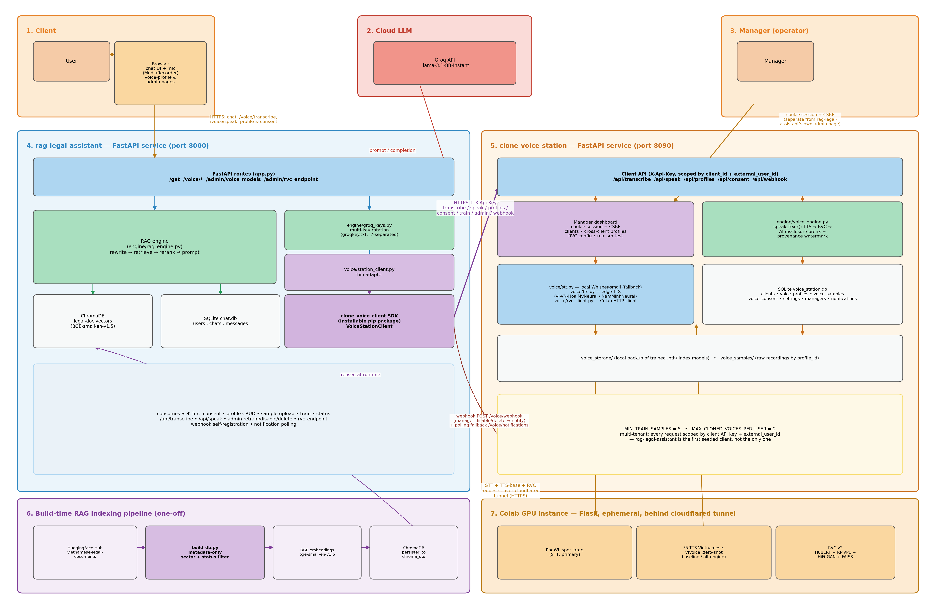
4. PROPOSED SOLUTION
Software architecture — 3 independent services
rag-legal-assistant ↔ clone-voice-client SDK ↔ clone-voice-station ↔ Colab (PhoWhisper / F5-TTS / RVC v2)
8

Slide 9
4. PROPOSED SOLUTION
Technology stack
Layer | Technology
Application | FastAPI, Starlette, Jinja2, vanilla JS, MediaRecorder
LLM | Meta Llama-3.1-8B-Instant via Groq API
RAG | LangChain, BGE-small-en-v1.5, ChromaDB
ASR | PhoWhisper-large (Colab, primary) / PhoWhisper-small (local fallback)
TTS | edge-TTS — vi-VN-HoaiMyNeural / vi-VN-NamMinhNeural
RVC | RVC v2 — HuBERT + HiFi-GAN + FAISS, trained on Colab T4
Baseline | F5-TTS-Vietnamese-ViVoice (zero-shot, RQ2 comparison)
Voice architecture | clone-voice-station (FastAPI, SQLite, API-key) + clone-voice-client (SDK)
Compliance | Spoken AI-disclosure prefix + WAV provenance watermark
9

Slide 10
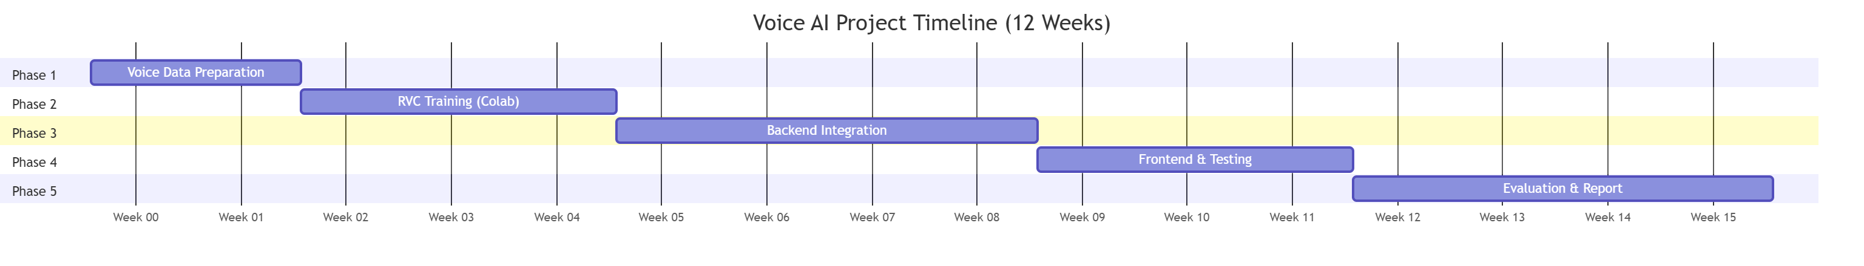
5. IMPLEMENTATION STATUS
Four of five stages complete
✓
Voice dataset preparation — 8 scripts + browser recording flow
✓
RVC training on Colab — F0/RMVPE, RVC v2, FAISS index, export
✓
Backend integration — /api/transcribe, /api/speak, SDK adapter
✓
Frontend integration — mic button + voice-output toggle
○
Evaluation & write-up — metrics, MOS survey, manuscript
10

Slide 11
5. IMPLEMENTATION STATUS
Continued implementation — voice reliability & live transcription
Voice-service reliability fix
Live speech-to-text
• Diagnosed: clone-voice-station wasn't running, so profile lookups silently returned an empty list.
• Added GET /voice/status (VoiceStationClient.is_available()) so the UI can tell “no voices yet” from “service is down”.
• Added start_all.bat to launch clone-voice-station then rag-legal-assistant together, health-checked.
• 2026-08-12: found and fixed a session-identity leak — manager and STT Lab guest login shared one cookie, so a manager could silently resolve as a guest whose account they'd also logged into in the same browser.
• MediaRecorder now captures audio in 500 ms chunks instead of one shot.
• Live tick cadence is now local/remote-aware, not a flat 2.5 s: 1 s while running Whisper in-process (local), 2 s when calling clone-voice-station remotely — decided fresh via /voice/status at the start of every recording.
• 2026-08-12: admin can upload a .stt-pack.zip from STT Lab and toggle transcription to run locally in rag-legal-assistant itself — verified end to end with zero requests reaching clone-voice-station.
• Same local/remote-aware live-transcribe brought to voice-lab-example's main chat demo the same day, closing the gap with its own /compare page.
Both fixes ship at the frontend/integration layer only — no changes were needed to clone-voice-station's API surface, matching the split-service architecture's design goal of independent iteration.
11

Slide 12
5. IMPLEMENTATION STATUS
STT Lab Tier 2 — adapter-acceptance gate for self-serve fine-tuning
Validation-gate problem
Current gate design
• Naive shipping of the last epoch measurably worsened recognition: 62.8% WER vs base’s own 32.0% on the same held-out audio.
• The held-out gate was itself fooled: adapters accepted as “9–15pp better” internally still lost 20–27pp on an independent eval set, twice.
• Cause: any split from one guest’s own upload shares that batch’s recording/speaker/domain traits, regardless of split size.
• Gate 0/1: separate early-stopping and final-gate splits remove the double-dipping bias (one split picking the epoch AND judging accept/reject).
• A fixed 500-clip general-Vietnamese benchmark was tried as Gate 2 — dropped after 5 runs cleared none of it; it tests general capability, not domain adaptation.
• Replaced by an independent holdout split (e.g. a dataset's own official test partition) serving as the final gate directly — no unrelated benchmark stacked on top.
• First pass under the new gate: 400-sample whisper-tiny adapter, 47.0% WER vs. 61.7% base on the held-out split — shipped.
Provably safe to expose publicly — never ships a regression — and now has shipped its first genuine win over base Whisper: 47.0% vs. 61.7% WER on an independent split.
12

Slide 13
6. LEGAL & ETHICAL COMPLIANCE
Two Vietnamese laws that took effect during this thesis
Law 91/2025/QH15 — Personal Data Protection
Law 134/2025/QH15 — Artificial Intelligence
• Voice sample + trained RVC model = biometric data.
• Consent screen names biometric use + cross-border transfer to Colab.
• Every profile/sample/model deletable on demand.
• Data scoped per client app + per external_user_id in the DB.
• AI-generated voice must carry a spoken disclosure notice + watermark.
• clone-voice-station prefixes every RVC-cloned response with a Vietnamese disclosure clip.
• Exported WAV carries a provenance tag in its metadata.
• Builtin (non-cloned) voices are exempt — no real-person impersonation.
13

Slide 14
7. EVALUATION METHODOLOGY & PRELIMINARY RESULTS
Metrics, thresholds, and a first pilot pass
Fixed test set: 30 Vietnamese legal questions with expert-curated reference answers.
Layer | Metric | Type | Threshold
ASR | Word Error Rate | Objective | ≤ 15%
LLM + RAG | Faithfulness (Likert) | Subjective | Mean ≥ 4.0
Pipeline | End-to-end latency | Objective | ≤ 4 s
RVC output | Signal-to-noise ratio | Objective | ≥ 20 dB
RVC output | MOS naturalness (n=20) | Subjective | Mean ≥ 3.8
RVC output | MOS speaker similarity (n=20) | Subjective | Mean ≥ 3.5
• RQ3 latency techniques: model-size selection • Colab GPU offload • streaming TTS+RVC • spoken-answer truncation.
• ASR pilot: PhoWhisper-large (Colab) 11.7% WER vs. local PhoWhisper-small fallback's 21.2%, on one held-out utterance.
• Latency pilot: 18.7s remote / 8.4s local — both above the ≤4s target; motivates the GPU-offload technique above.
• RVC pilot: full train-and-convert pass completed end-to-end on Colab T4 in 44 min; verified live via /api/speak.
14

Slide 15
8. RESULTS & DELIVERABLES
What's implemented vs. remaining
Implemented
Remaining
• clone-voice-station: FastAPI voice service (STT/TTS/RVC), SQLite, manager dashboard, webhooks.
• clone-voice-client: installable Python SDK.
• rag-legal-assistant: mic input + cloned-voice read-aloud, via the SDK.
• Colab notebook: trains & serves RVC v2 + PhoWhisper end-to-end over HTTPS.
• AI-disclosure watermarking + biometric-consent flow (Section 6).
• 2 trained RVC voice models: “TestGiong1” (male, 2026-08-05) + “GiọngNữ” (female, 2026-08-12) — both live, callable via /api/speak.
• STT Lab: guest self-serve adapter publish/default + PhoWhisper-small as a Tier 2 base-model option (2026-08-12).
• Orphaned-training auto-recovery on server startup — fixed after a real host power-loss interruption.
• Quantitative evaluation report: WER, latency, SNR, MOS vs. F5-TTS baseline.
• Full thesis manuscript + short demonstration video.
15

Slide 16
CONCLUSION
• A bidirectional voice loop was integrated into an existing RAG legal assistant — as an independently deployable service, not embedded code.
• The service/SDK split makes RQ1's modularity claim structural: rag-legal-assistant and clone-voice-station never import each other.
• TTS + per-speaker RVC will be benchmarked against a Vietnamese-tuned zero-shot baseline (RQ2) under a ≤ 4 s latency budget (RQ3).
• Compliance with Vietnam's new Personal Data Protection and AI laws is built into the system, not deferred to policy.
Thank you — Questions?

