Slide 1
Structural Directive
Nhóm A2: Môn: Các vấn đề hiện đại của CNTT
- Hoàng Giang GV: Trương Anh Hoàng
- Phan Thị Thanh Hải
- Đào Thị Thanh Huyền
- Ngụy Khắc Quân

Slide 2
Content
What are structual directives?
ngIf case study
<template> tag
The asterick (*)

Slide 3
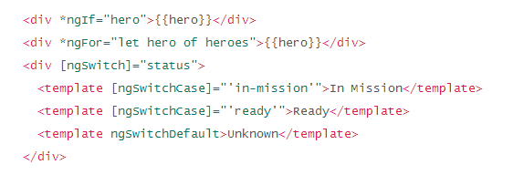
What are structual directives?
There are three kinds of Angular directives:
- Component is ready a directive with the template. It's the most common of the three directives and we write lots of them as we build our application.
- Attribute directive changes the appearance or behavior of an element.
- A Structural directive changes the DOM layout by adding and removing DOM elements: ngIf, ngSwitch and ngFor.

Slide 4
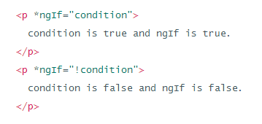

ngIf case study
- ngIf is a great example of a structural directive: it takes a boolean and makes an entire chunk of DOM appear or disappear.
- ngIf true => in DOM
- ngIf false => not in Dom => <script></script>

Slide 5
ngIf case study(2)
Hide, display: none
- The element would remain in the DOM while invisible.
- the component's behavior continues. It remains attached to its DOM element. It continues to listen to events. Angular keeps checking for changes that could affect data bindings.
- the component and all of its descendent components tie up resources that might be more useful elsewhere. The performance and memory burden can be substantial and the user may not benefit at all.
- showing the element again is very quick. The component's previous state is preserved and ready to display, the component doesn't re-initialize
ngIf
- Set ngIf to false, Angular removes the element from DOM, stops change detection for the associated component, detaches it from DOM events and destroys the component. The component can be garbage-collected and free up memory.
- ngIf destroys the common ancestor. This cleanup effort is usually a good thing.
- ngIf might be a bad thing if we need that particular component again soon.
- The component's state might be expensive to re-construct. When ngIf becomes true again, Angular recreates the component and its subtree. Angular runs every component's initialization logic again.

Slide 7
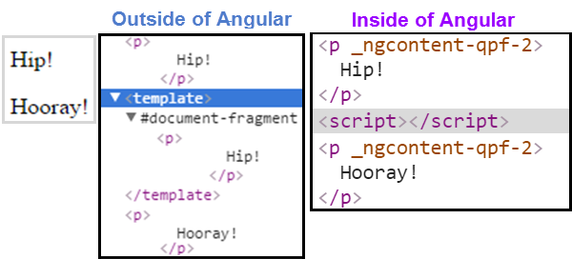
<template> tag
- Outside of an app, the <template> tag’s default CSS display: none;
- Inside of an app, Angular removes <template> tag and their children.
- When one of those, ngSwitch conditions is true, Angular inserts the template's content into the DOM.

Slide 8
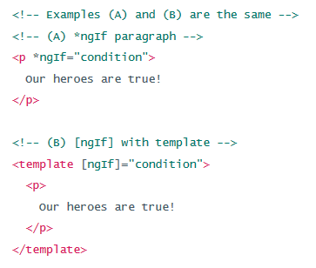
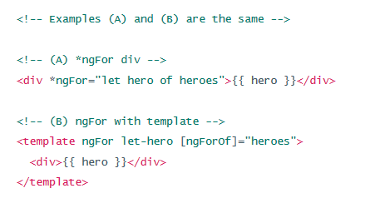
The asterisk (*)
- The asterisk (*) simplifies ngIf, ngFor for both the writer and the reader, Under the hood, Angular replaces the asterisk version with a more verbose <template> form.

Slide 9

Thank you for your attention
Any questions?

