Slide 1

Introducing Angular Modules
Nhóm A2:
Hoàng Giang
Phan Thị Thanh Hải
Đào Thị Thanh Huyền
Ngụy Khắc Quân
Môn Các Vấn Đề Hiện Đại Của CNTT
Giảng Viên: Trương Anh Hoàng

Slide 2
Content
Angular Modules
@NgModule
Root module
Feature modules
Demo

Slide 3
Angular Modularity
Modules are a great way to organize the application and extend it with capabilities from external libraries.
Angular modules consolidate components, directives and pipes into cohesive blocks of functionality
Many Angular libraries are modules (FormsModule, HttpModule…)
Modules can also add services to the application.
Modules can be loaded eagerly when the application starts. They can also be lazy loaded asynchronously by the router.
Notes:
Consolidate: cung co

Slide 4
@NgModule
An Angular module is a class decorated with @NgModule metadata. The metadata:
declare which components, directives and pipes belong to the module.
make some of those classes public so that other component templates can use them.
import other modules with the components, directives and pipes needed by the components in this module.
provide services at the application level that any application component can use.

Slide 5
Root Module
Every Angular app has at least one module class, the root module.

Slide 6
Feature Modules
The root AppModule grows larger with each new application class and shows no signs of stopping.
We have conflicting directives: two different classes trying to do the same thing.
The app lacks clear boundaries between contact functionality and other application features. That lack of clarity makes it harder to assign development responsibilities to different teams.
=> We mitigate these problems with feature modules.

Slide 7
Feature Module
A feature module is a class adorned by the @NgModule decorator and its metadata, just like a root module. Feature module metadata have the same properties as the metadata for a root module.
A feature module delivers a cohesive set of functionality focused on an application business domain, a user workflow, a facility (forms, http, routing), or a collection of related utilities.
While we can do everything within the root module, feature modules help us partition the app into areas of specific interest and purpose.
A feature module collaborates with the root module and with other modules through the services it provides and the components, directives, and pipes that it chooses to share.
Notes:
Có 2 ý nghĩa khi phân tách module như trên:
Chúng ta dung root module để chạy khởi chạy chương trình, chúng ta them feature module để mở rộng chương trình
Feature có thể phô ra hoặc che giấu sự thực hiện từ các module khác
Ngoài ra, một feature module được phân biệt dựa trên mục đích của mình

Slide 8
Lazy loading modules with the Router

Slide 9
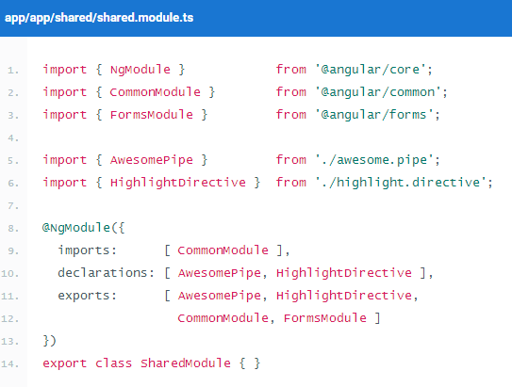
Shared modules
Let's add a SharedModule to hold the common components, directives, and pipes and share them with the modules that need them.
It imports the CommonModule because its component needs common directives.
It declares and exports the utility pipe, directive, and component classes as expected.
It re-exports the CommonModule
Notes:
Ứng dụng càng lớn thì có nhiều thứ bạn sẽ dùng lại. Share module chứa những component, directives, và pipes mà bạn dùng thường xuyên trong app.

Slide 10
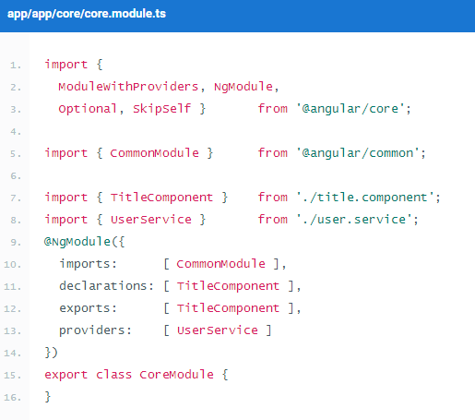
The Core module
We'll gather them in a single CoreModule that we import once when the app starts and never import anywhere else.
Create an app/core folder
Move components, directives, pipes to app/core
Create CoreModule class
Update AppRoot module import to CoreModule
Notes:
Core module là nơi chứa những service,component.. Chỉ được import 1 lần khi chương trình chạy và không được import ở bất cứ nơi nào khác.
Ví dụ : Một số component inject UserService. Phải đảm bảo rằng chỉ có 1 thực thể UserService trong toàn bộ chương trình. Chúng ta không muốn mỗi module lại có một thực thể riêng. Sẽ vô cùng nguy hiểm nếu Share Module cung cấp UserService

Slide 11
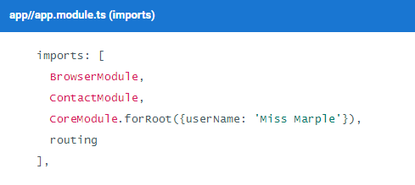
Configure core services with CoreModule.forRoot
By convention, the forRoot static method both provides and configures services at the same time. It takes a service configuration object and returns a ModuleWithProviders which is a simple object with two properties
ngModule – the coreModule class
Providers – the configured providers

Slide 12
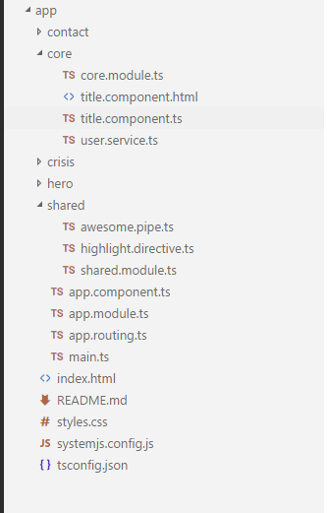
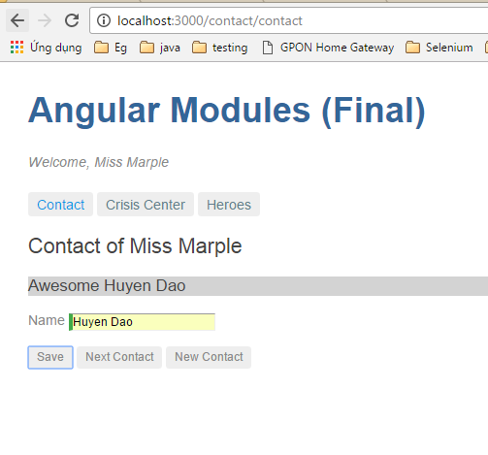
Demo

Slide 13

Thank you for listening!
Any questions?

