Slide 1
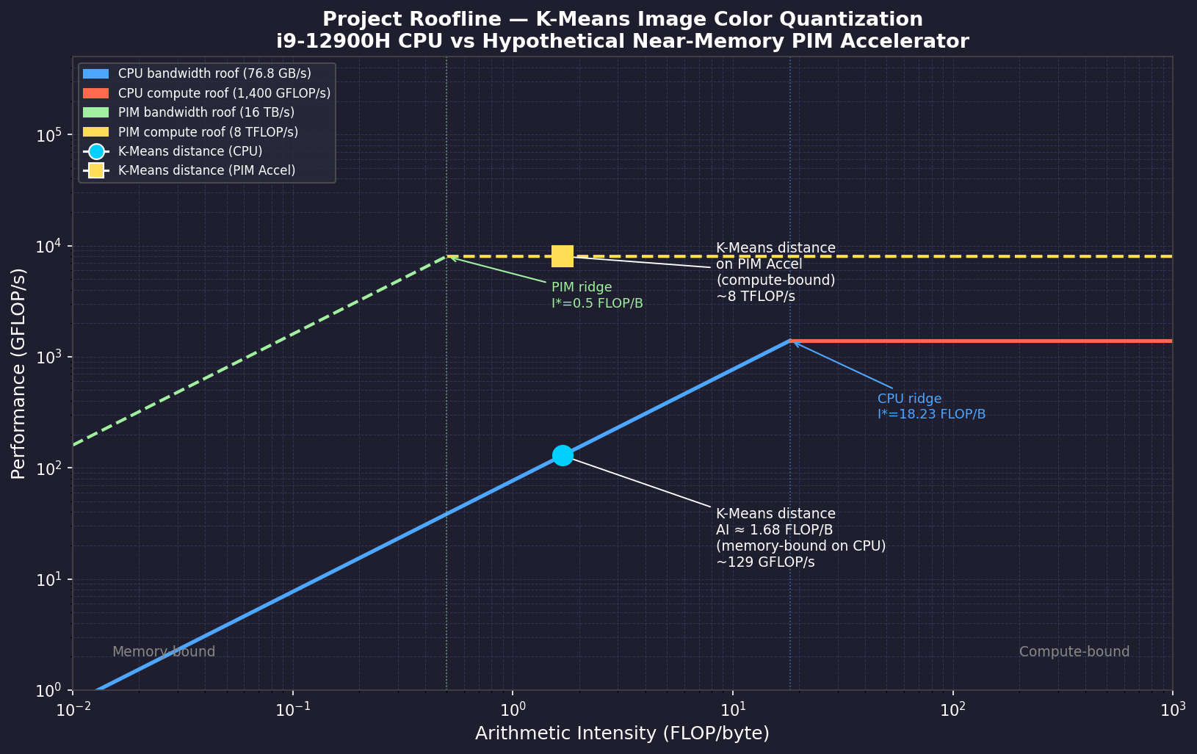
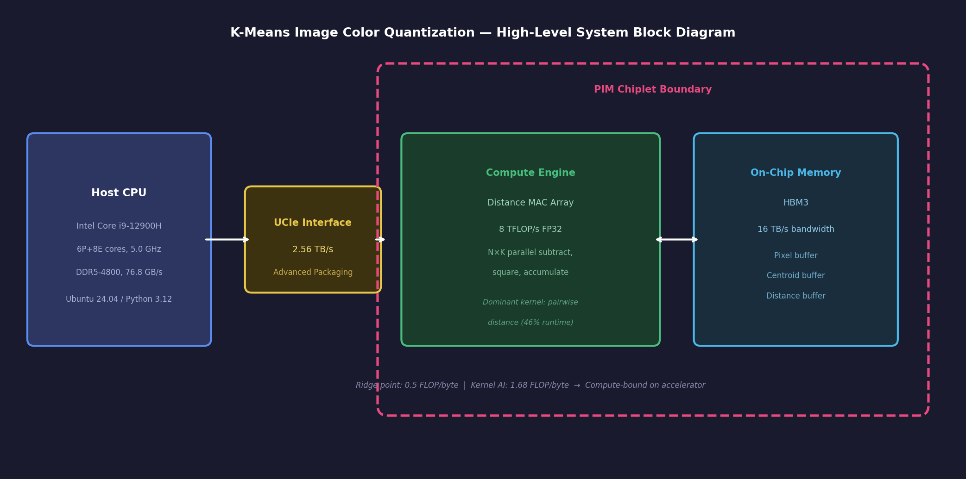
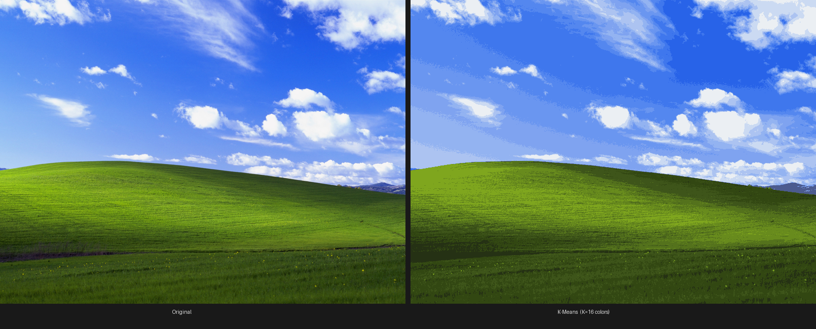
K-Means Image Color Quantization Accelerator
Bao Nguyen | ECE 410/510 | Spring 2026
62×
Roofline — CPU vs PIM Accelerator
System Architecture
projected speedup
What am I doing?
• Custom chip: reduces any photo to 16 colors by grouping similar pixels
How is it done today?
• CPU takes ~9 sec/image using <1% of its power
• 46% of runtime spent waiting for data from memory
What am I doing differently?
• Memory & math sit side-by-side — no waiting
• 16 TB/s bandwidth → ~62× speedup
Accomplished so far
• Benchmarked CPU baseline, found bottleneck
• Distance engine, AXI4-Lite & compute core all passing sim
What's next?
• Full system integration + timing verification
• Compare vs 9-sec baseline → declare success
Bliss.jpg — Original (left) vs K-Means K=16 colors (right)

Slide 2
Codefest 6 — CLLM
4×4 Binary-Weight Crossbar MAC Unit in SystemVerilog
LLM: Claude Sonnet 4.6 · Tool: iverilog -g2012

Slide 3
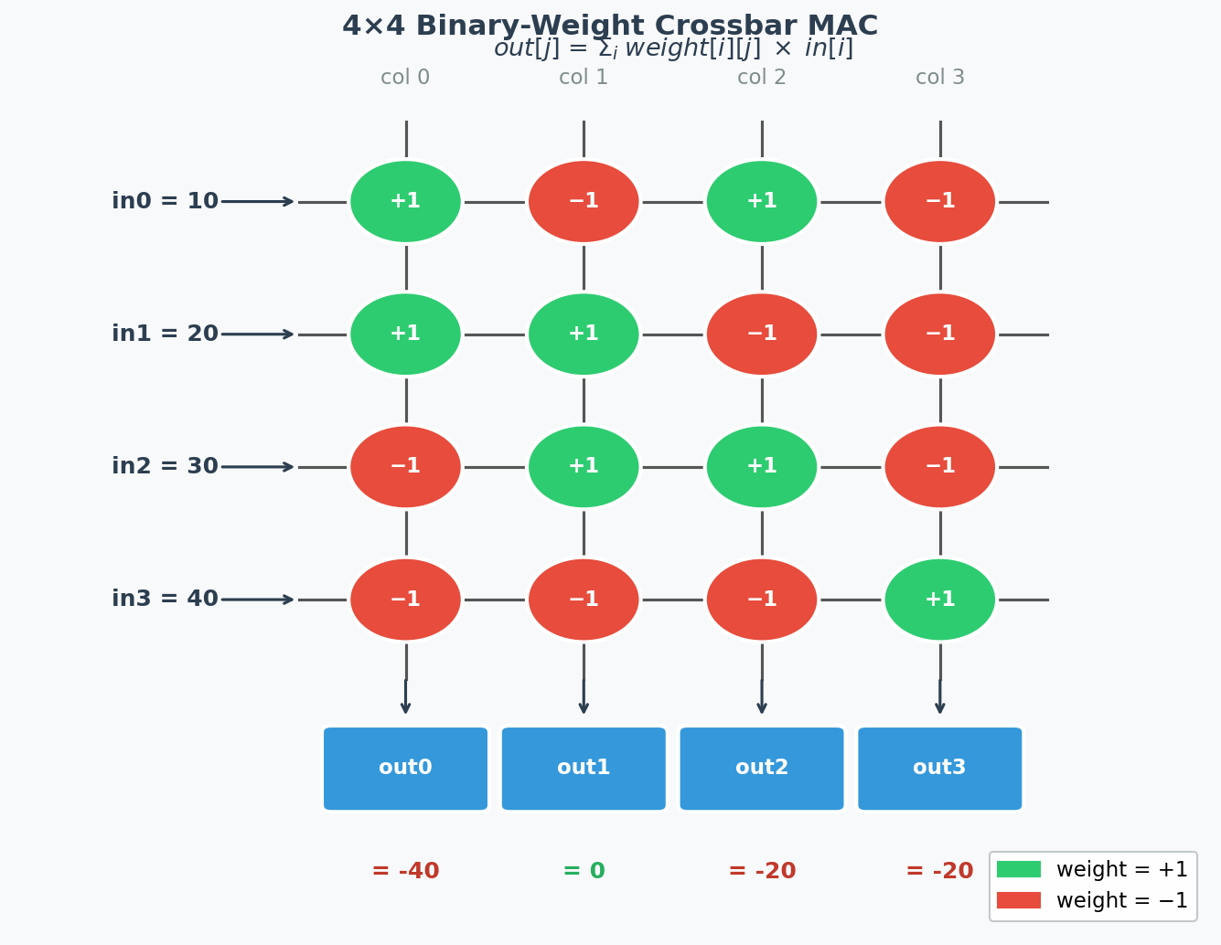
The Design
out[j] = Σᵢ weight[i][j] × in[i]
3-stage pipeline:
① Weight register (16-bit flat, 1 cycle load)
② Combinational MAC (all 4 outputs parallel)
③ Output register (10-bit signed)
Key choices:
Flat 16-bit reg → load full matrix in 1 cycle
Scalar ports → iverilog compatibility
10-bit out → 4×127=508 fits in 511 max

Slide 4
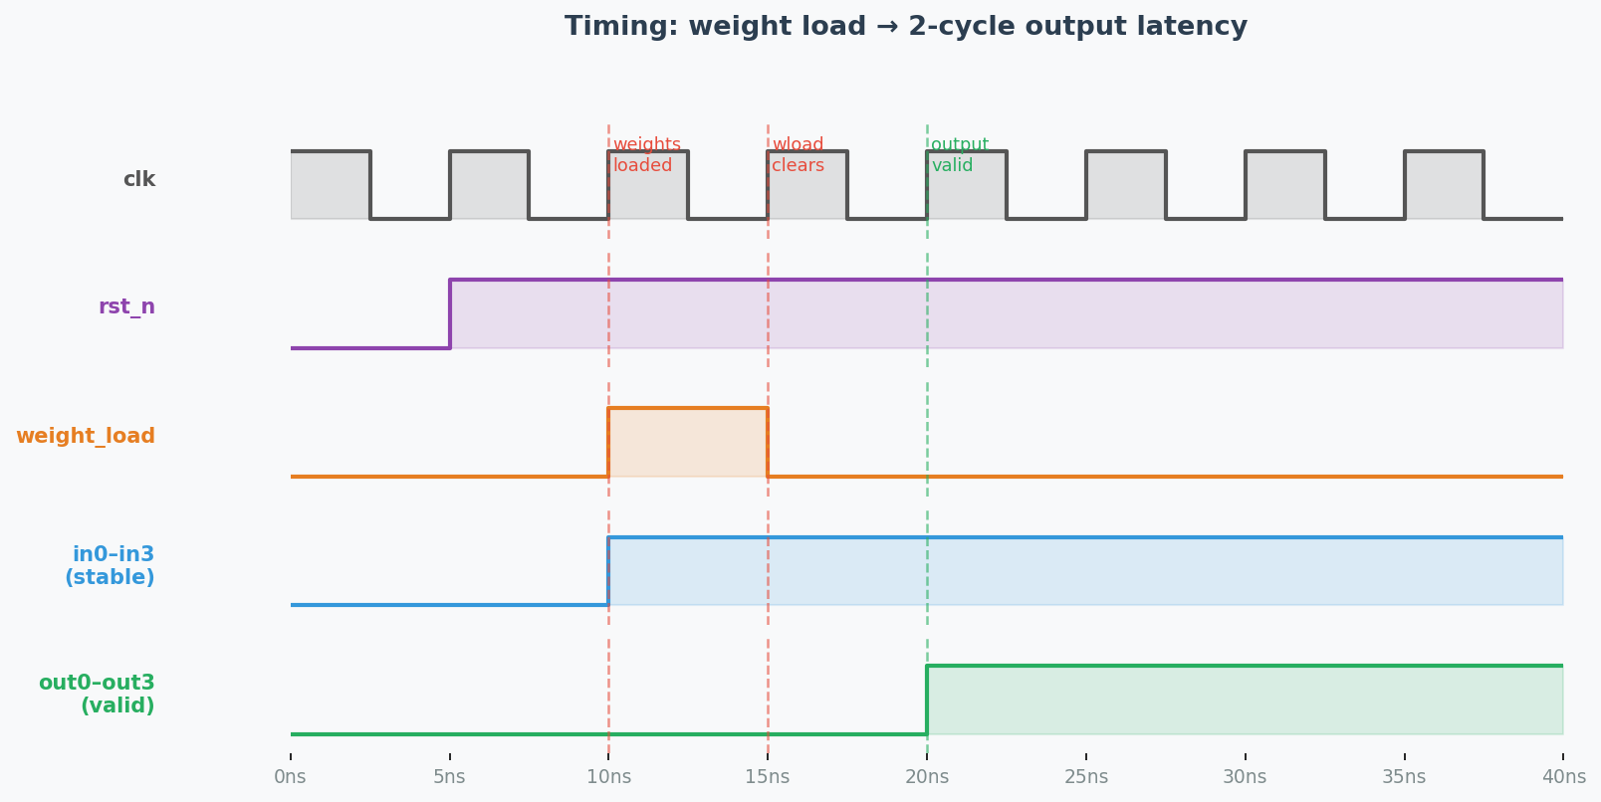
The Testbench
Why 2 cycles?
Cycle 1 (weight_load=1):
wreg ← weight_in
out ← MAC(old wreg) ✗
Cycle 2 (weight_load=0):
wreg stays
out ← MAC(new wreg) ✓
Weights loaded: [[+1,-1,+1,-1], [+1,+1,-1,-1], [-1,+1,+1,-1], [-1,-1,-1,+1]]
Inputs: in = [10, 20, 30, 40]
Hand-calc before running: out = [−40, 0, −20, −20]
Key: wait 2 cycles after weight_load — output register clocks on same edge as weight register

Slide 5
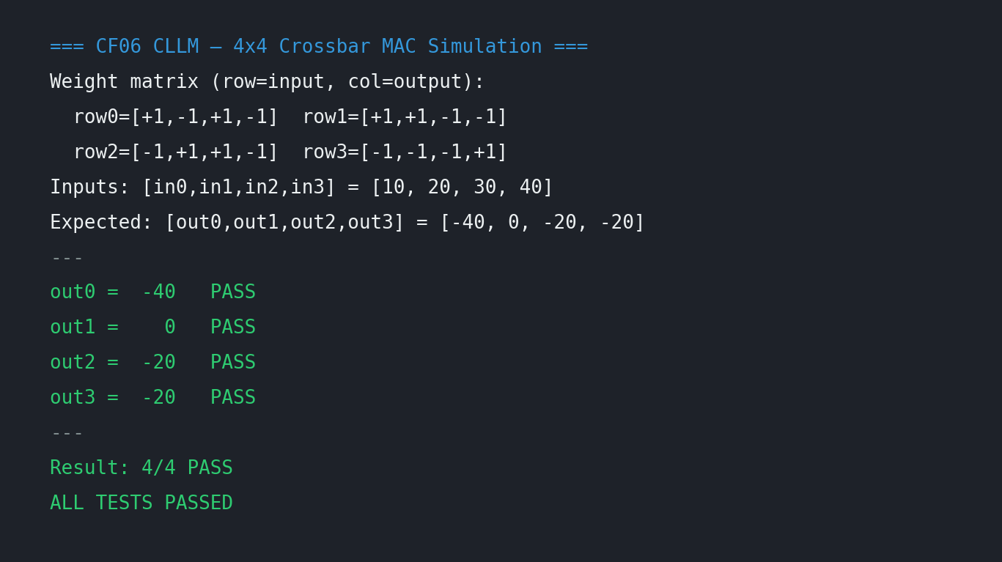
Simulation Results
out0 = −40
✓ PASS
+10+20−30−40
out1 = 0
✓ PASS
−10+20+30−40
out2 = −20
✓ PASS
+10−20+30−40
out3 = −20
✓ PASS
−10−20−30+40
4 / 4 PASS

