Slide 1
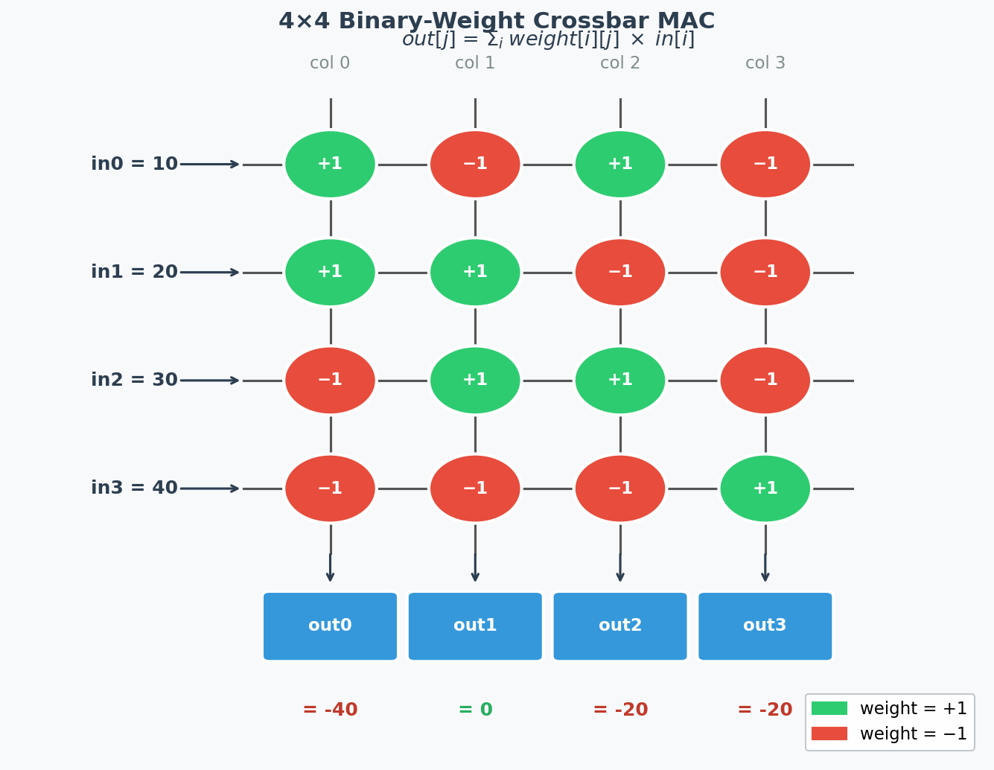
CF06 CLLM
4×4 Binary-Weight Crossbar MAC Unit in SystemVerilog
ECE 410/510 Spring 2026 · Bao Nguyen · LLM: Claude Sonnet 4.6
1 / 7
Notes:
For CF06 CLLM I had Claude Sonnet 4.6 generate a 4-by-4 binary-weight crossbar MAC unit in SystemVerilog. I'll walk through the design and the choices I made, the testbench I wrote to verify it, and then the results.

Slide 2
What is a Crossbar MAC?
Rows carry inputs, columns carry outputs
Each intersection = a weight (+1 or −1)
Formula:
out[j] = Σᵢ weight[i][j] × in[i]
Inputs: [10, 20, 30, 40]
out0: +10+20−30−40 = −40
out1: −10+20+30−40 = 0
out2: +10−20+30−40 = −20
out3: −10−20−30+40 = −20
2 / 7
Notes:
So about the crossbar — this is what I needed to build. Rows carry inputs, columns carry outputs, and at every intersection there's a weight that's either plus-one or minus-one. Each column computes a dot product every clock cycle — that's the formula at the top.
For example, take column zero. You get plus-ten from row 0, plus-twenty from row 1, and then minus-thirty and minus-forty from rows 2 and 3 because those weights are negative. And so that's minus-40. The other three columns work the same way — the arithmetic is right there on the slide.
So basically the spec is: four 8-bit signed inputs, a 4-by-4 weight matrix of plus-ones and minus-ones, and four output accumulators updated every clock cycle.

Slide 3
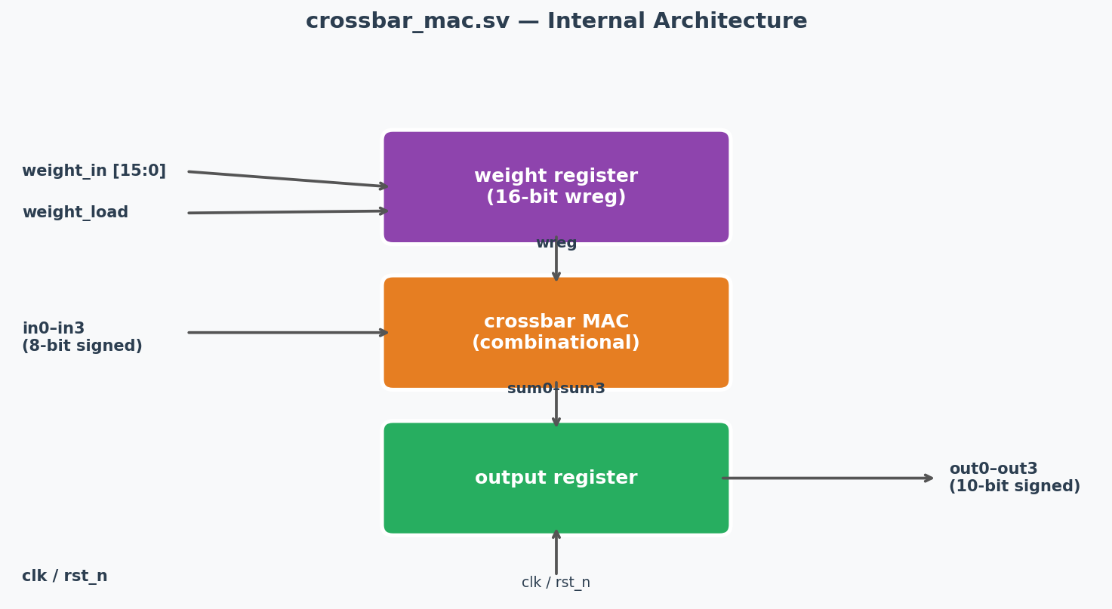
Module Architecture — crossbar_mac.sv
Ports
in0–in3 8-bit signed
out0–out3 10-bit signed
weight_in 16-bit flat
weight_load 1-cycle pulse
Pipeline
① Weight register (FF)
② Comb. MAC (wires)
③ Output register (FF)
Bit width: 4 × 127 = 508
→ 10-bit signed is safe
3 / 7
Notes:
So about the design — I structured it as three stages. And the reason I broke it into stages instead of just one big block is to keep the timing clean.
The weight register at the top is a flip-flop that latches the weight matrix whenever weight_load pulses. I chose a single 16-bit flat bus for the weights instead of a 2D array — for example, loading row by row would've cost four cycles and needed an address counter. One bus, one cycle, done.
The middle stage is purely combinational — just wires computing all four dot products in parallel. And then the output register latches the results on the next clock edge.
For the bit width — I chose 10-bit signed outputs. For example, worst case is 4 times 127 which is roughly 508, and 10-bit signed goes up to 511. So basically that's exactly enough.
And one choice I had to make about the implementation — iverilog doesn't support variable bit-selects on unpacked arrays inside always blocks. And so I switched to individual scalar ports and wires instead. That actually made the interface cleaner anyway.

Slide 4
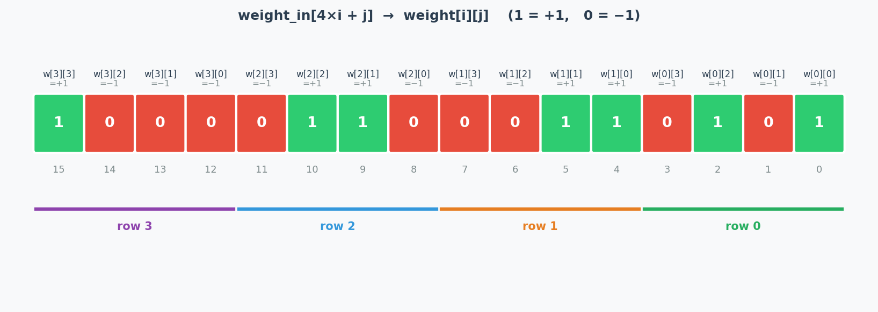
Weight Encoding — 16-bit Flat Register
bit (4×i + j) encodes weight[i][j] 1 → +1 0 → −1
Testbench weight matrix:
row 0 [+1, −1, +1, −1] → weight_in bits [3:0] = 4'b0101
row 1 [+1, +1, −1, −1] → weight_in bits [7:4] = 4'b0011
row 2 [−1, +1, +1, −1] → weight_in bits [11:8] = 4'b0110
row 3 [−1, −1, −1, +1] → weight_in bits [15:12]= 4'b1000
4 / 7
Notes:
So about the weight encoding — this was a key design choice. The rule is: bit 4i plus j in the 16-bit register holds weight[i][j], where 1 means plus-one and 0 means minus-one.
I chose this flat encoding because it lets you load the entire 4-by-4 matrix in a single clock cycle with a single signal. For example, row zero's weights are plus-one, minus-one, plus-one, minus-one — and so that maps to bits zero through three being 1, 0, 1, 0, which is exactly 0101. And then you concatenate all four rows to get the full 16-bit value.
The alternative would've been a serial load — like, one row per cycle — but that adds latency and control logic. The flat register keeps the hardware simple.

Slide 5
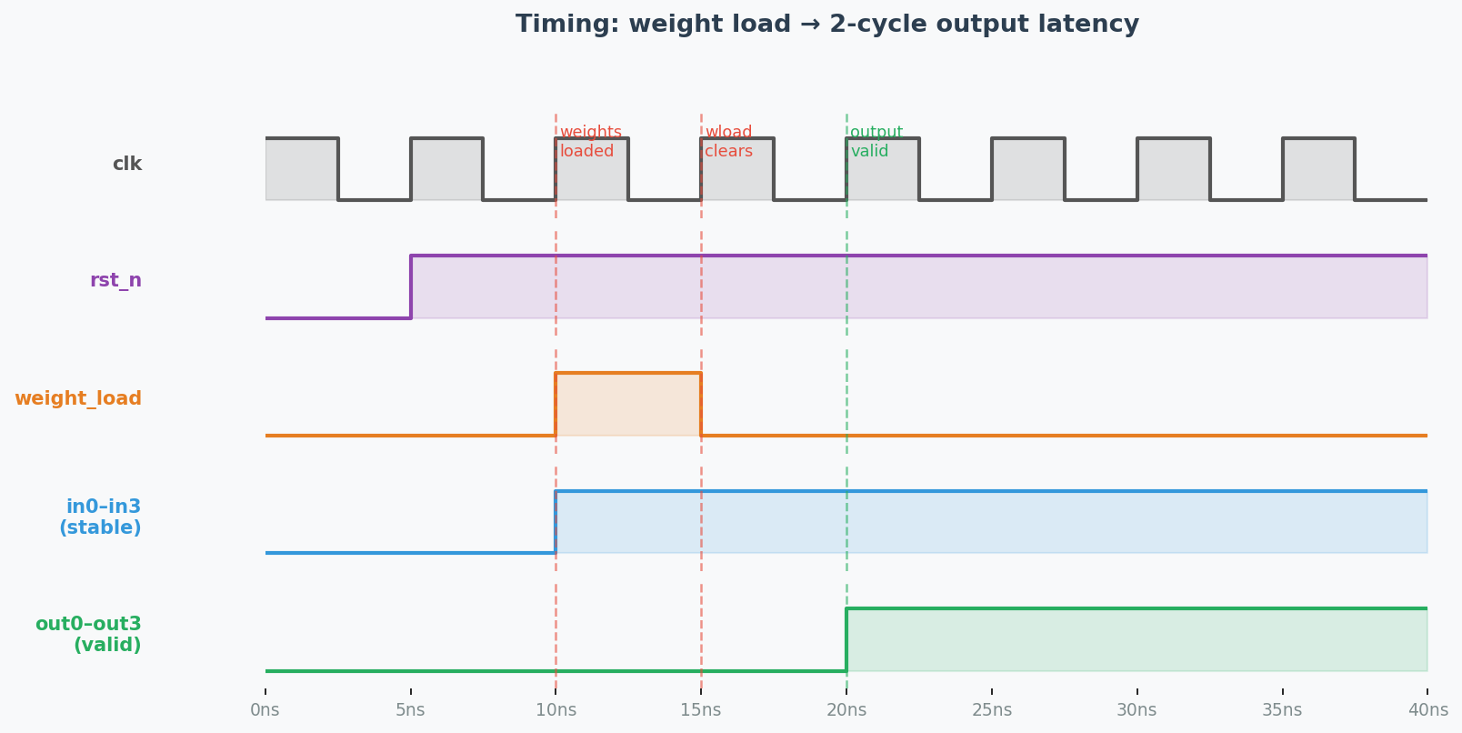
Testbench Strategy — 2-Cycle Pipeline
① Assert reset
Clear all registers
② weight_load pulse
16-bit weight_in latched
into wreg on posedge
③ Weight stable
MAC computes sum0–sum3
④ Output registered
out0–out3 valid
2 cycles after load
weight_in = {4'b1000, 4'b0110, 4'b0011, 4'b0101}; weight_load = 1; in0=10; in1=20; in2=30; in3=40; @(posedge clk); #1; weight_load = 0; @(posedge clk); #1; // read out0–out3 here
5 / 7
Notes:
So about the testbench — I needed to verify two things: that the weights load correctly, and that the outputs match the hand-calculated values.
The key choice here was understanding the 2-cycle pipeline. Basically here's why it matters: on the first rising edge after weight_load, the weight register latches the new weights. But the output register clocks on that same edge and it's still using the old weights. And so the correct output only appears one cycle later — cycle two.
For example, if I read the output after just one cycle I'd get zeros — not that accurate. And so the testbench explicitly waits two cycles before checking.
I chose the weight matrix from the assignment spec — and then applied inputs of 10, 20, 30, 40 — and hand-calculated the expected outputs before running the simulation. Like, you want to know what you're looking for before you run it, not after.

Slide 6
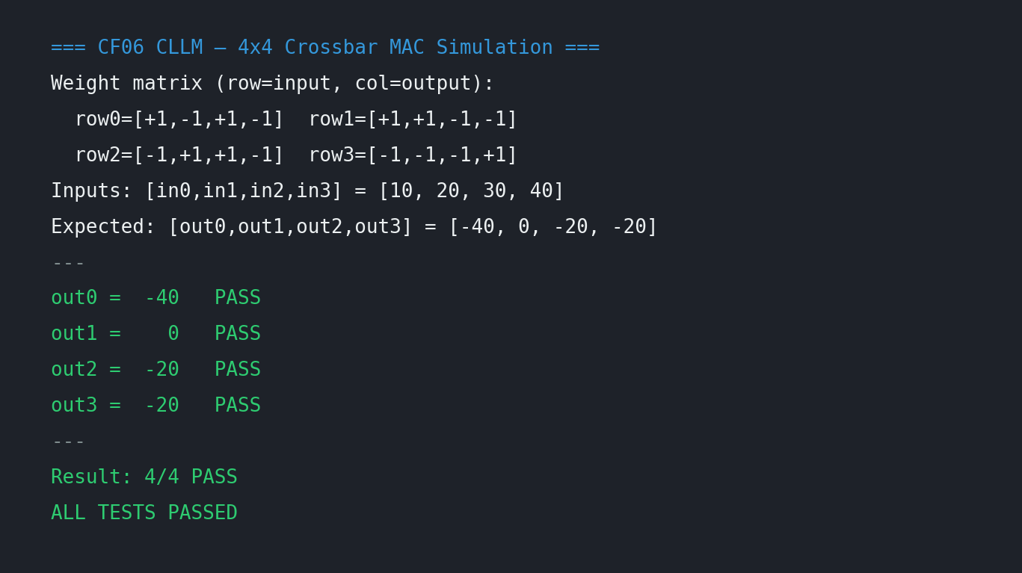
Simulation Results — iverilog -g2012
out0 = −40
✓ PASS
+10+20−30−40
out1 = 0
✓ PASS
−10+20+30−40
out2 = −20
✓ PASS
+10−20+30−40
out3 = −20
✓ PASS
−10−20−30+40
6 / 7
Notes:
All four outputs came out exactly right. Out-zero is minus-40, out-one is zero, out-two and out-three are both minus-20.
For example, out-zero — column zero gets plus-ten, plus-twenty, minus-thirty, minus-forty, and so that's exactly minus-40. Pretty close to what the hand calculation said.
So basically every design choice held up — the flat weight register loaded in one cycle, the 2-cycle pipeline timing was correct, and the 10-bit output width handled the range. 4 out of 4.

Slide 7
Summary
✓
LLM-generated crossbar_mac.sv using Claude Sonnet 4.6
✓
16-bit flat weight register — bit (4i+j) encodes weight[i][j]
✓
Fully combinational MAC, registered outputs, 10-bit signed
✓
Testbench loads [[1,−1,1,−1],[1,1,−1,−1],[−1,1,1,−1],[−1,−1,−1,1]]
✓
Inputs [10,20,30,40] → Simulation: 4/4 PASS [−40, 0, −20, −20]
Thank you!
7 / 7
Notes:
So to wrap up — the main choices were the flat 16-bit weight register for single-cycle loading, individual scalar ports to work around iverilog's unpacked array limitation, and a 3-stage pipeline to keep the timing predictable.
The testbench confirmed all four outputs match the hand-calculated values exactly. Thanks.

