Slide 1
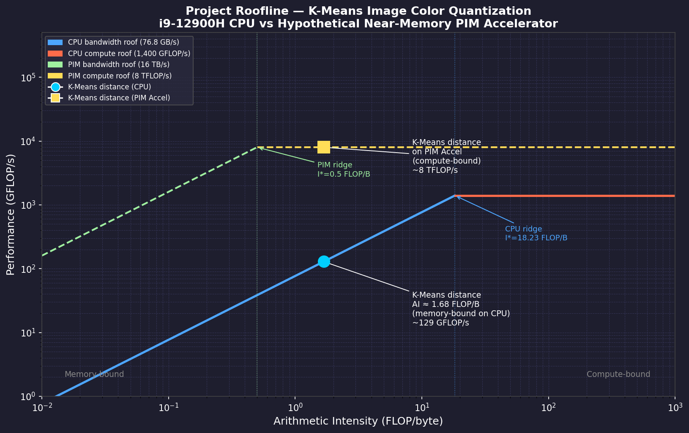
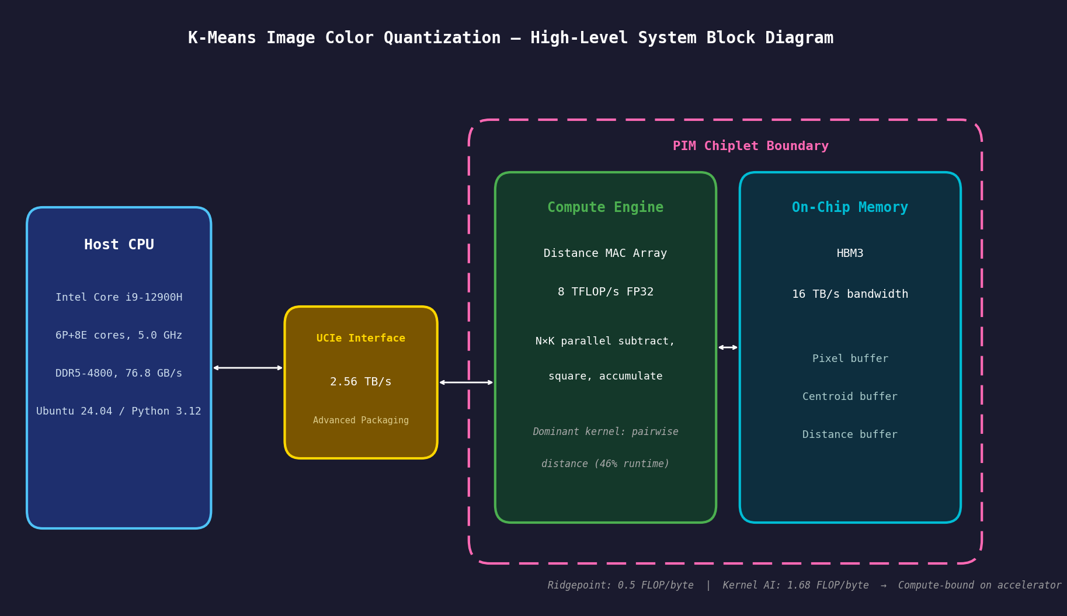
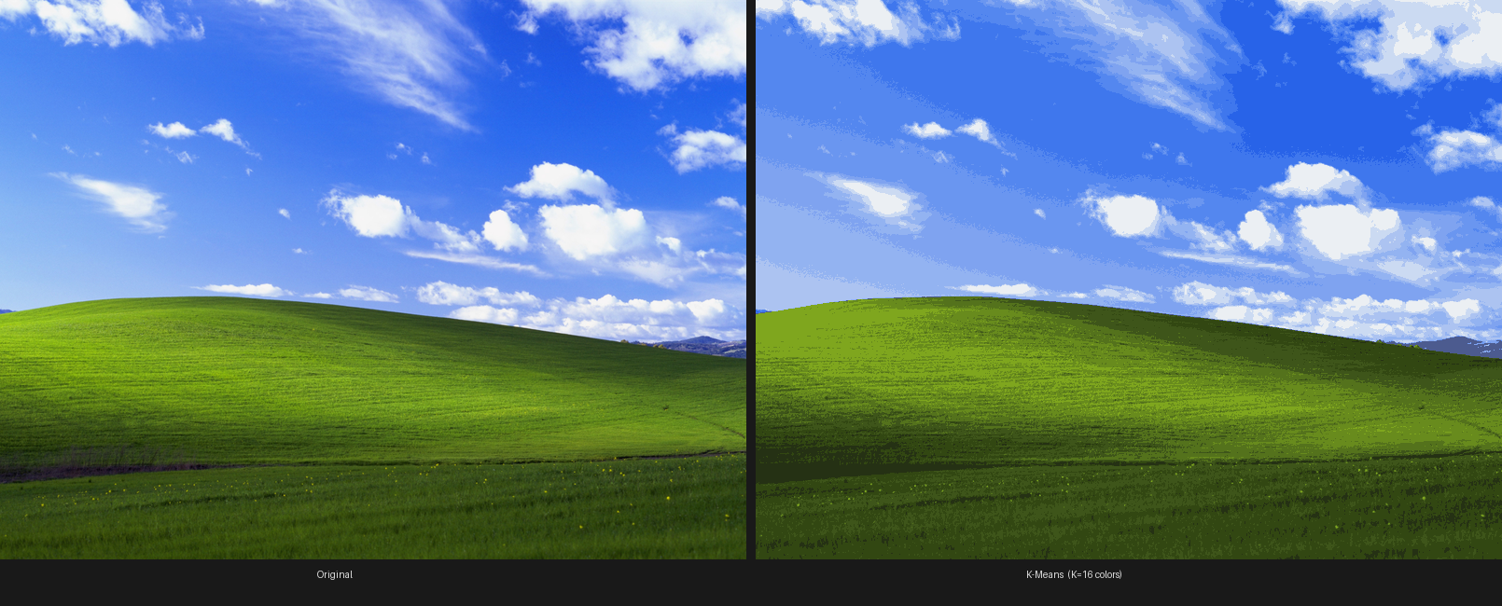
K-Means Image Color Quantization Accelerator
Bao Nguyen | ECE 410/510 | Spring 2026
62×
Roofline — CPU vs PIM Accelerator
System Architecture
projected speedup
What am I doing?
• Custom AI Chiplet: Performs "Image Quantization" to reduce any photo to 16 optimized colors.
• Unsupervised Learning: Accelerates the K-Means clustering algorithm to group similar pixels autonomously.
• Centroid-Based Math: Uses a custom engine to find the closest "color center" (centroid) for every pixel.
How is it done today?
• CPU: scikit-learn + OpenBLAS — ~9 sec/image, <1% utilization
• GPU: NVIDIA cuML / CUDA — fast but general-purpose, not K-Means specific
• FPGA: AMD Artix-7 pipelined designs — rigid, device-specific
• No dedicated near-memory chiplet for K-Means quantization with HBM3 + UCIe
What am I doing differently?
• Memory & Math Side-by-Side: Avoids the "Von Neumann bottleneck" by eliminating data travel time.
• Massive Parallelism: Utilizing HBM3 to feed the Distance Engine, evaluating all 16 centroids simultaneously without memory starvation.
• Shift to Compute-Bound: 16 TB/s bandwidth → ~62x speedup by ensuring the math units never sit idle.
Accomplished so far
•Benchmarked CPU Baseline: Confirmed the 9-second bottleneck where the CPU sits idle waiting for RAM.
•Hardware Logic Verified: Distance engine and AXI4-Lite control interface passing simulation.
•Interconnect: UCIe selected as the high-speed host interface to the computer.
What's next?
• Top-level integration: host driver ↔ UCIe ↔ AXI4-Lite slave ↔ integer distance core
• System-level functional verification with SystemVerilog TB
• Performance benchmarking
• RTL synthesis & timing reports
Bliss.jpg — Original (left) vs K-Means K=16 colors (right)
Notes:
WHAT AM I DOING?
"I'm building a custom chip that takes any photo and compresses it down to just 16 colors — by grouping similar pixels together. Think of the Bliss photo on the right — that's the original, and that's what it looks like with only 16 colors."
HOW IS IT DONE TODAY?
"Right now this runs on a regular CPU and takes about 9 seconds per image — but the CPU is barely doing any work. Less than 1% of its computing power is being used. The bottleneck is memory — the CPU spends almost half its time just waiting for data to load."
WHAT AM I DOING DIFFERENTLY?
"Instead of a CPU, I'm designing a chip where the memory and the math units sit right next to each other — so there's no waiting. You can see that in the roofline plot — on the CPU the kernel sits way down in the memory-bound zone, but on my accelerator it flips to compute-bound. That's where the 62x speedup comes from."
WHAT HAVE I DONE SO FAR?
"I've measured the CPU baseline, confirmed where the bottleneck is, and written all the hardware — the distance engine, the memory interface, and the compute core — all passing simulation."
WHAT'S NEXT?
"I need to connect all the pieces into a full system, verify timing, and then measure actual throughput to prove the speedup is real."
---
TIP: Linger on the Bliss before/after when you first show it — it's your best visual hook.
Total target: ~60 seconds.
---
DEFINITIONS
PIM = Processing-In-Memory. A chip design where the compute units are placed physically next to the memory, instead of the usual CPU→bus→RAM setup. Normally the CPU fetches pixel data across a slow memory bus, does a tiny bit of math, then waits for more data — that's why K-Means is memory-bound on CPU (46% of runtime is just waiting). With a PIM chiplet, the distance math (subtract, square, accumulate) happens right where the pixels already live in HBM3 memory. No bus trip, no waiting. That's where the 16 TB/s bandwidth and the 62× speedup come from. In the diagram it's the pink dashed box — the Compute Engine and On-Chip Memory are co-located on the same chiplet, connected to the CPU via UCIe.

