Slide 1
Appearance and interactivity
Update: 2022.11.14

Slide 2
网址：https://www.chatbot.com/
https://dribbble.com/tags/web 整体页面布局与配色参考
https://www.freepik.com/free-photos-vectors/website-ui 设计demo参考
https://www.toools.design/ui-web-design-inspiration-websites 各种设计网站汇总
https://unblast.com/free-storage-management-dashboard-template-sketch/
https://codemyui.com/neumorphic-button-click-hover-and-clicked-design 组件设计包括css代码

Slide 3



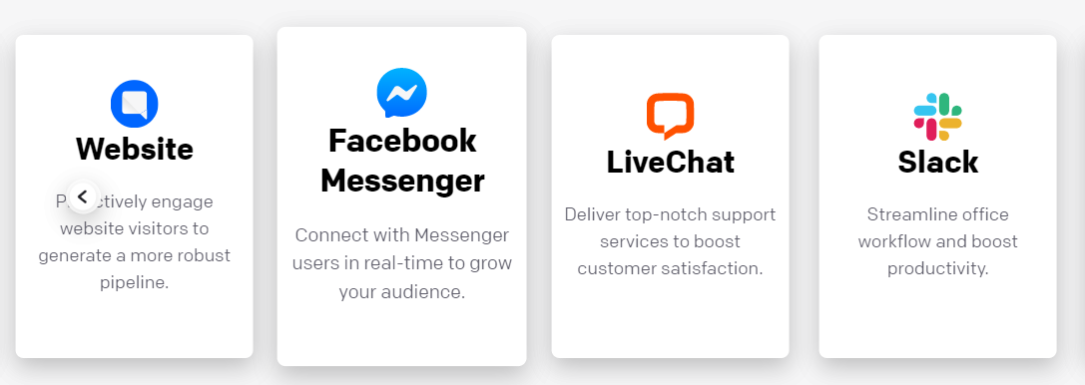
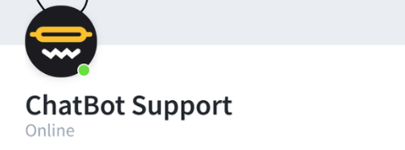

Slide 4
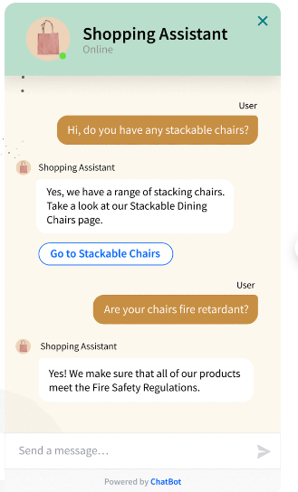
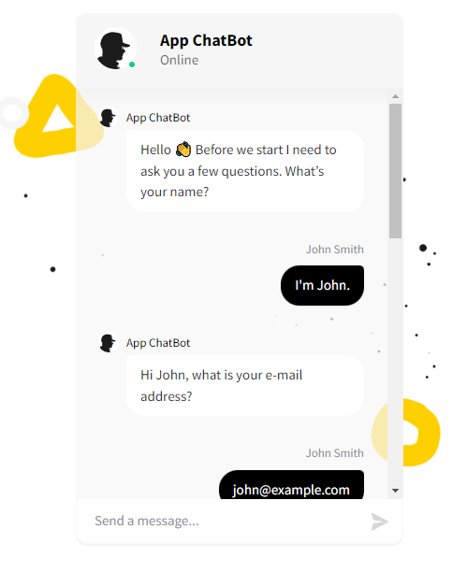



Slide 5
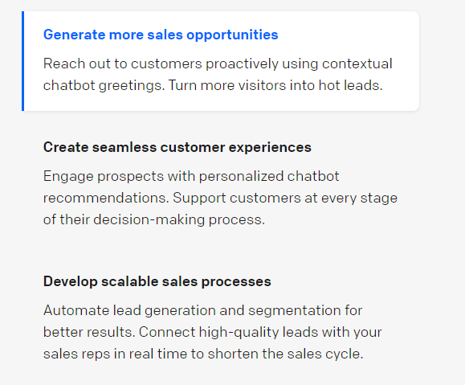
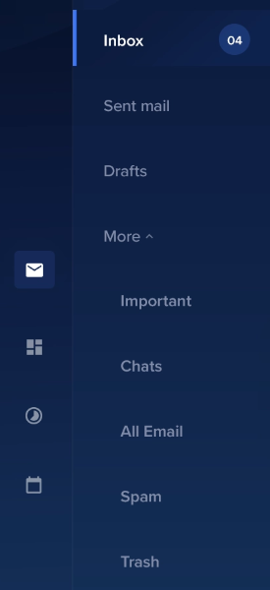
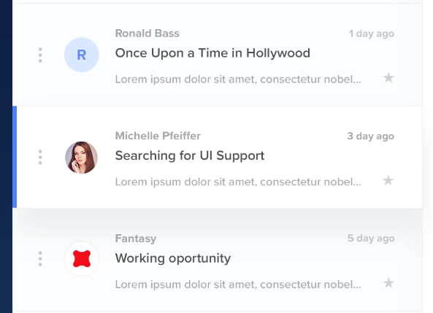

Slide 6
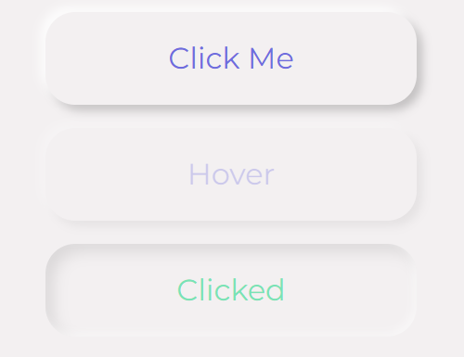
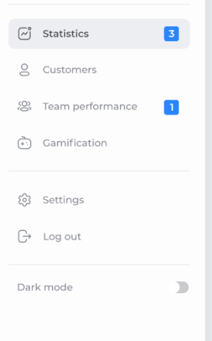
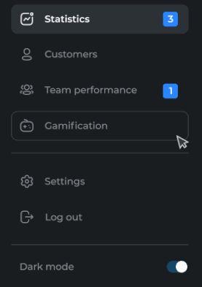
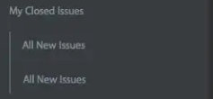
https://codemyui.com/button-to-folding-paper-plane-transition/
特殊的按钮
https://dribbble.com/shots/16050208-Sidebar-Navigation-Exploration
Sidebar sample01

Slide 7



https://dribbble.com/shots/2455265-Day-023-Search

Slide 8
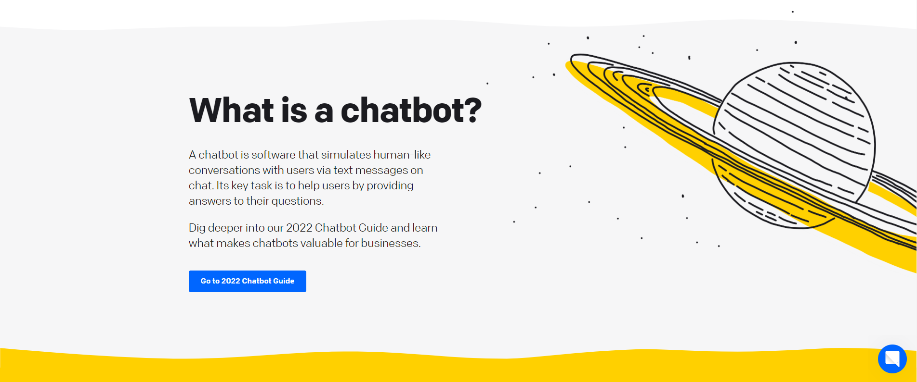

Slide 9
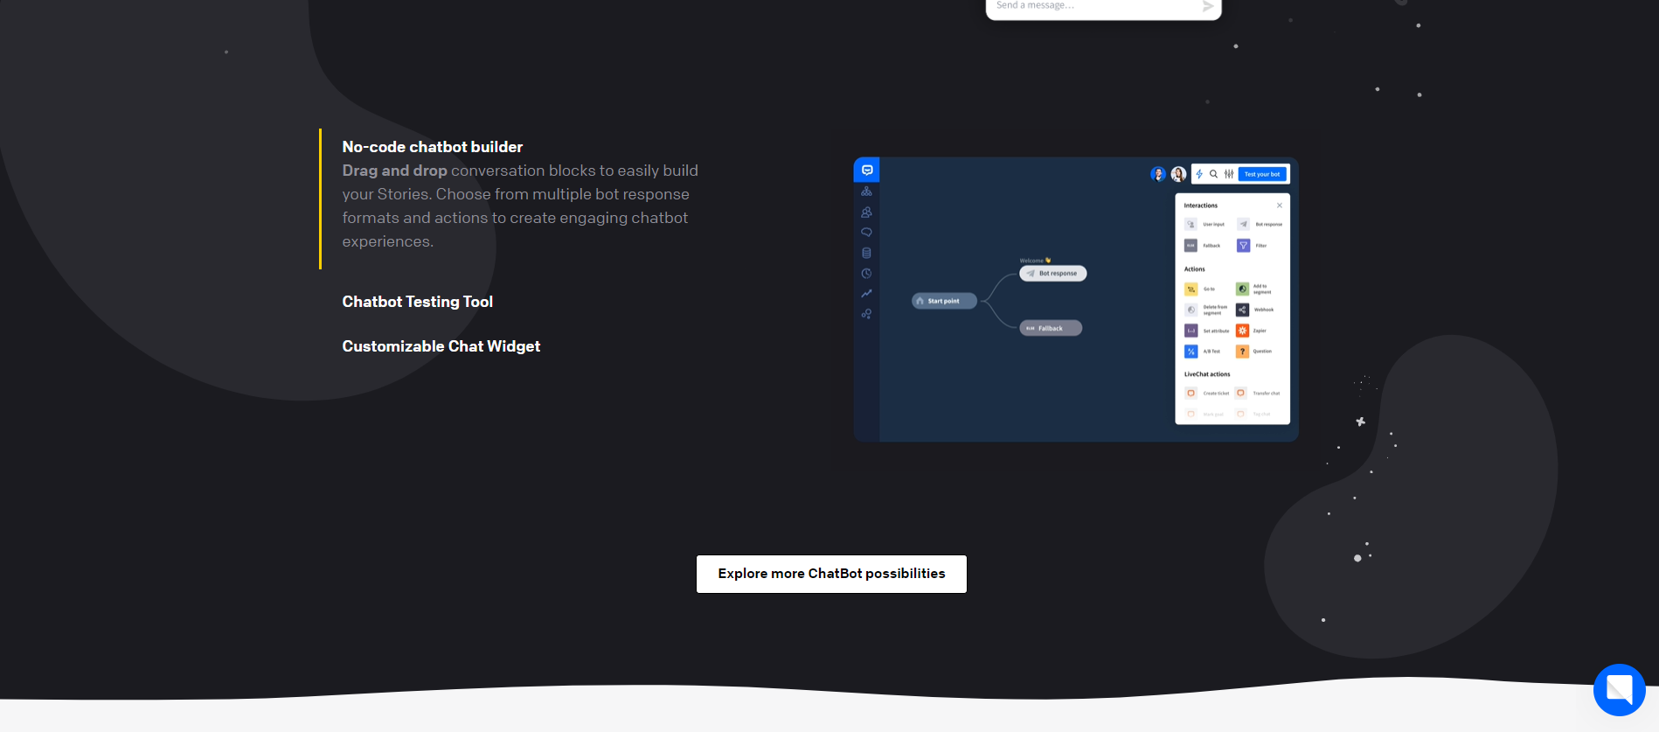

Slide 10


Slide 11
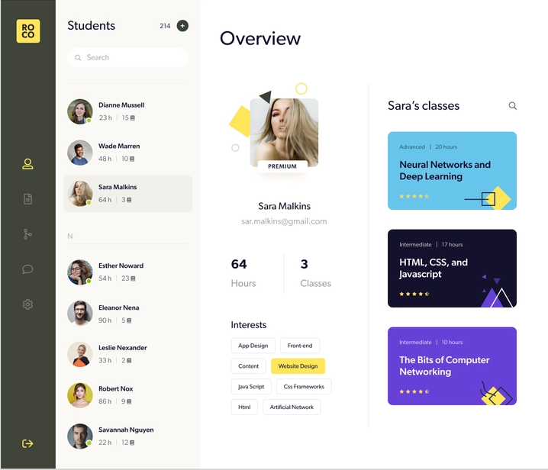
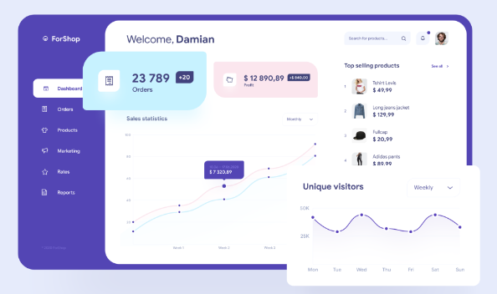
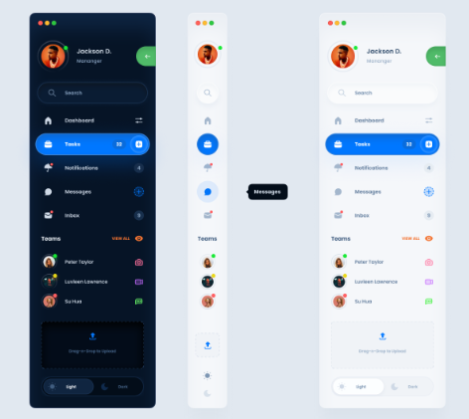

Slide 12
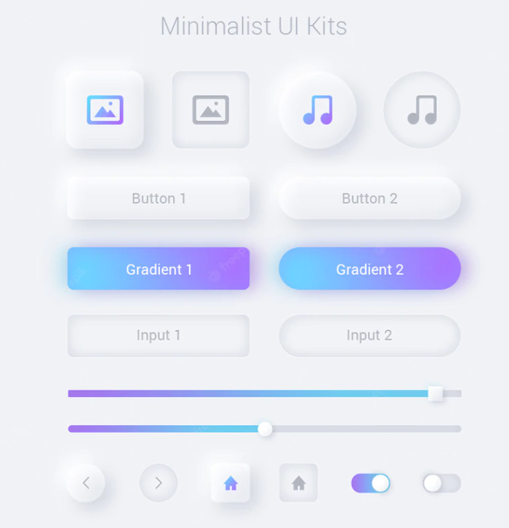
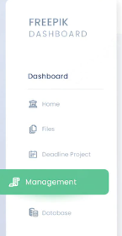
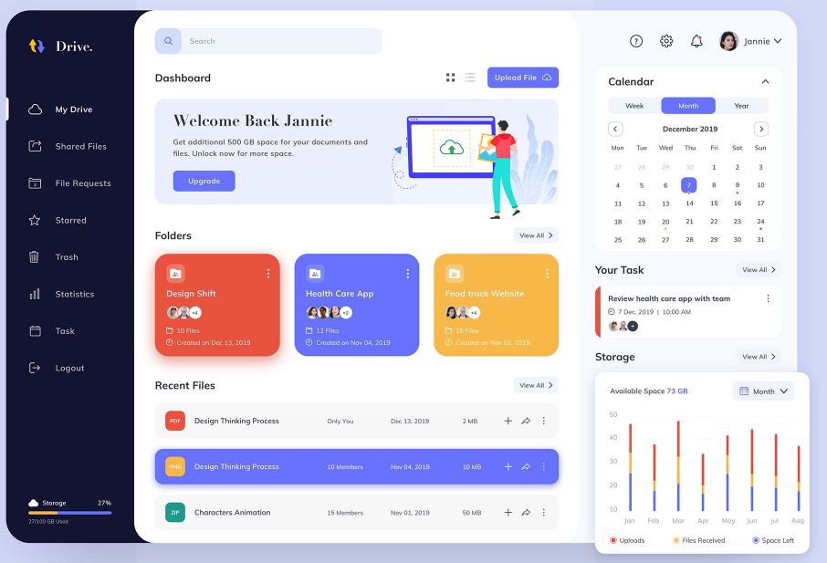

Slide 13
