Slide 1

Portfolio Analysis

Slide 2
Stock Selection
Commonwealth Bank of Australia | BHP Group | CSL Limited | Wesfarmers Ltd | Woolworths Group
Telstra Group Ltd | Santos Limited | Macquarie Group | Goodman Group | APA Group
Why?
Blue Chip
Diversification
Business we can see in some cases.

Slide 3
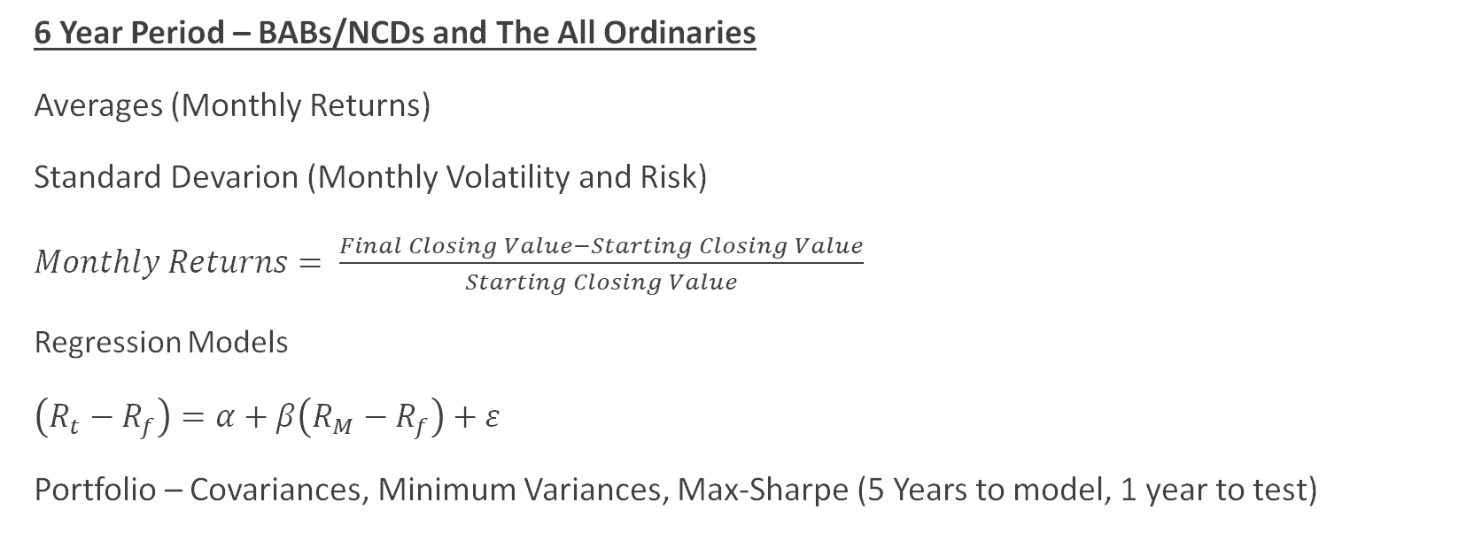
Methodology
6 Year Period – BABs/NCDs and The All Ordinaries
Averages (Monthly Returns)
Standard Devarion (Monthly Volatility and Risk)
$Monthly Returns= \frac{Final Closing Value−Starting Closing Value}{Starting Closing Value}$
Regression Models
$\left(R_{t}−R_{f}\right)=α+β\left(R_{M}−R_{f}\right)+ε$
Portfolio – Covariances, Minimum Variances, Max-Sharpe (5 Years to model, 1 year to test)

Slide 4
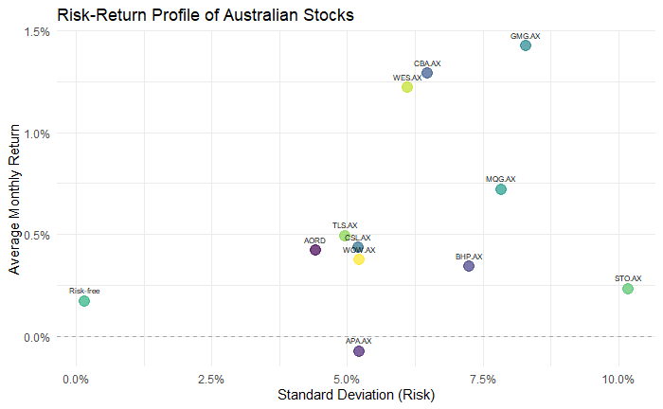
Returns & Risk over 6 years
Figure 2.1 – Average Return and Risk of shares (6-year Period)
# | Stocks | Average Return | Standard Deviation (Risk)
1 | AORD | 0.42% | 4.41%
2 | Risk-free | 0.17% | 0.15%
3 | APA.AX | -0.08% | 5.22%
4 | BHP.AX | 0.34% | 7.25%
5 | CBA.AX | 1.29% | 6.47%
6 | CSL.AX | 0.43% | 5.20%
7 | GMG.AX | 1.43% | 8.29%
8 | MQG.AX | 0.72% | 7.85%
9 | STO.AX | 0.23% | 10.18%
10 | TLS.AX | 0.49% | 4.96%
11 | WES.AX | 1.22% | 6.10%
12 | WOW.AX | 0.37% | 5.22%
Defensive: CSL, TLS, WOW
Growers: CBA, GMG, MQG, WES
Decliners: APA
Borderline: BHP, STO (Risky for our time period)

Slide 5
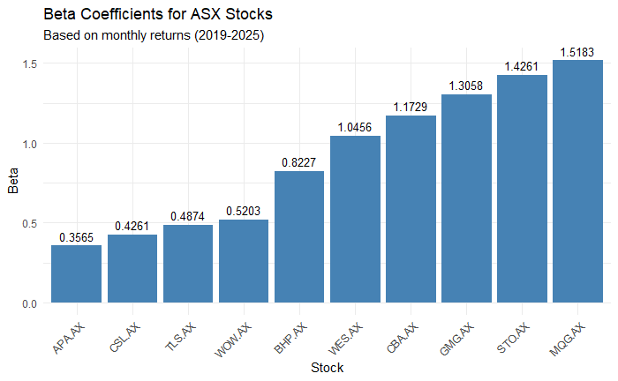
CAPM Regression
Figure 2.3 - CAPM Regression Results for 10 ASX Stocks
Stock | Alpha | Beta | Alpha p-value | Beta p-value | R-squared (%) | H₀: alpha = 0 | H₀: beta = 0
CBA.AX | 0.0083 | 1.1729 | 0.0747 | 0 | 64.18 | Do not reject | Reject
BHP.AX | -0.0004 | 0.8227 | 0.9617 | 0 | 24.97 | Do not reject | Reject
CSL.AX | 0.0016 | 0.4261 | 0.7848 | 0 | 13.01 | Do not reject | Reject
WES.AX | 0.0079 | 1.0456 | 0.0975 | 0 | 57.36 | Do not reject | Reject
WOW.AX | 0.0007 | 0.5203 | 0.8964 | 0 | 19.19 | Do not reject | Reject
TLS.AX | 0.0020 | 0.4874 | 0.7063 | 0 | 18.77 | Do not reject | Reject
STO.AX | -0.0029 | 1.4261 | 0.7575 | 0 | 38.09 | Do not reject | Reject
MQG.AX | 0.0017 | 1.5183 | 0.7231 | 0 | 72.75 | Do not reject | Reject
GMG.AX | 0.0093 | 1.3058 | 0.1910 | 0 | 48.32 | Do not reject | Reject
APA.AX | -0.0034 | 0.3565 | 0.5708 | 0 | 9.04 | Do not reject | Reject

Slide 6
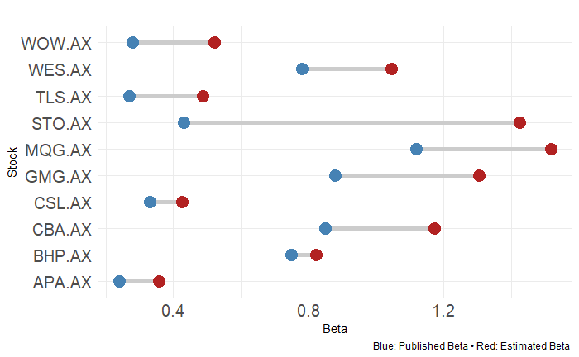
Calculated Beta vs Published Beta
Figure 2.6 – Comparison Beta Values (6-year period)
Stock | Calculate Beta | Published Beta | Difference | Source
APA.AX | 0.36 | 0.24 | 0.12 over | Yahoo Finance – APA.AX
BHP.AX | 0.82 | 0.75 | 0.07 over | Yahoo Finance – BHP.AX
CBA.AX | 1.17 | 0.85 | 0.32 over | Yahoo Finance – CBA.AX
CSL.AX | 0.43 | 0.33 | 0.10 over | Yahoo Finance – CSL.AX
GMG.AX | 1.31 | 0.88 | 0.43 over | Yahoo Finance – GMG.AX
MQG.AX | 1.52 | 1.12 | 0.4 over | Yahoo Finance – MQG.AX
TLS.AX | 0.49 | 0.27 | 0.22 over | Yahoo Finance – TLS.AX
STO.AX | 1.43 | 0.43 | 1 over | Yahoo Finance – STO.AX
WES.AX | 1.05 | 0.78 | 0.27 over | Yahoo Finance – WES.AX
WOW.AX | 0.52 | 0.28 | 0.23 over | Yahoo Finance – WOW.AX

Slide 7
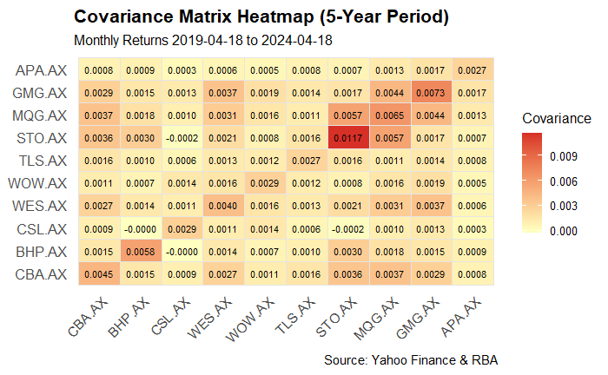
Portfolio Goals
High Return.
Reduce Risk.
Manage Covariance.

Slide 8
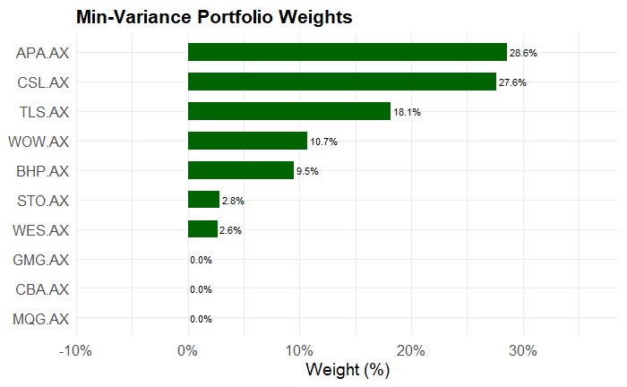
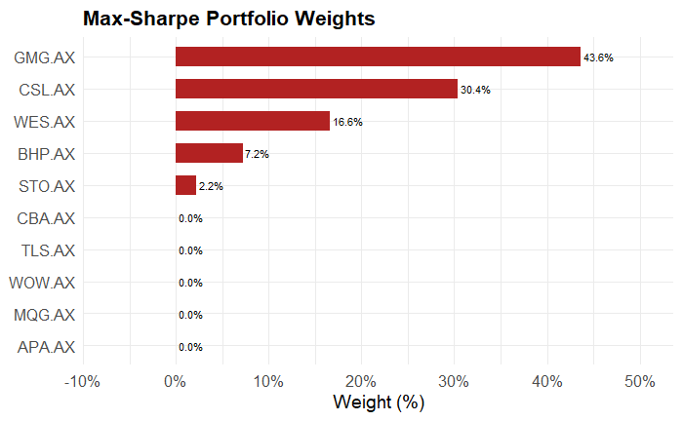
Portfolio Stock Weights
Figure 3.5 – Minimum Variance Portfolio Stock Weights Distribution

Slide 9
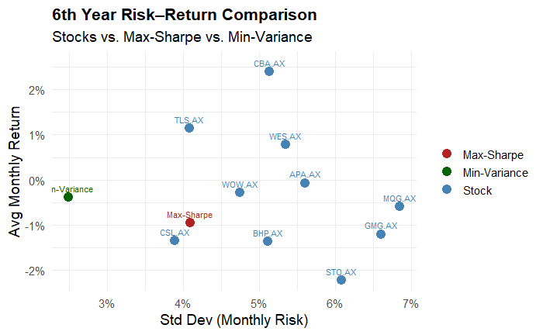
Portfolio Outcomes
Figure 3.3 - Out-of-Sample Returns & Risks (6th Year)
Asset | Avg Monthly Return | Std Dev | Type
Max-Sharpe | -0.0094681 | 0.0408945 | Max-Sharpe
Min-Variance | -0.0038383 | 0.0249292 | Min-Variance
CBA.AX | 0.0239500 | 0.0513026 | Stock
TLS.AX | 0.0114133 | 0.0408449 | Stock
WES.AX | 0.0078693 | 0.0535121 | Stock
APA.AX | -0.0006571 | 0.0560405 | Stock
WOW.AX | -0.0028056 | 0.0474323 | Stock
MQG.AX | -0.0058248 | 0.0685064 | Stock
GMG.AX | -0.0119705 | 0.0659892 | Stock
CSL.AX | -0.0134056 | 0.0389297 | Stock
BHP.AX | -0.0136133 | 0.0511581 | Stock
STO.AX | -0.0221928 | 0.0608527 | Stock

Slide 10

Conclusion and Thank You!

