Slide 1


Understanding Global Happiness Through Data Science
Trung Loi Pham Nguyen, 22317009
Thai Bao Truong, 22305486
Duc Huy Tran, 21886207
Sophie Yau, 19689757
Sarad Devkota, 22048487

Slide 2
Have you ever wondered why some countries consistently rank as the happiest in the world?
Why does Finland consistently rank in the Top 10 happiest countries over multiple years?
Can Happiness arise amidst Corruption?
Is Freedom essential to Happiness?
How important are Societal Factors in shaping Happiness?
Notes:
Presentation Overview i.e. questions we hope are answered by the end of our presentation

Slide 3
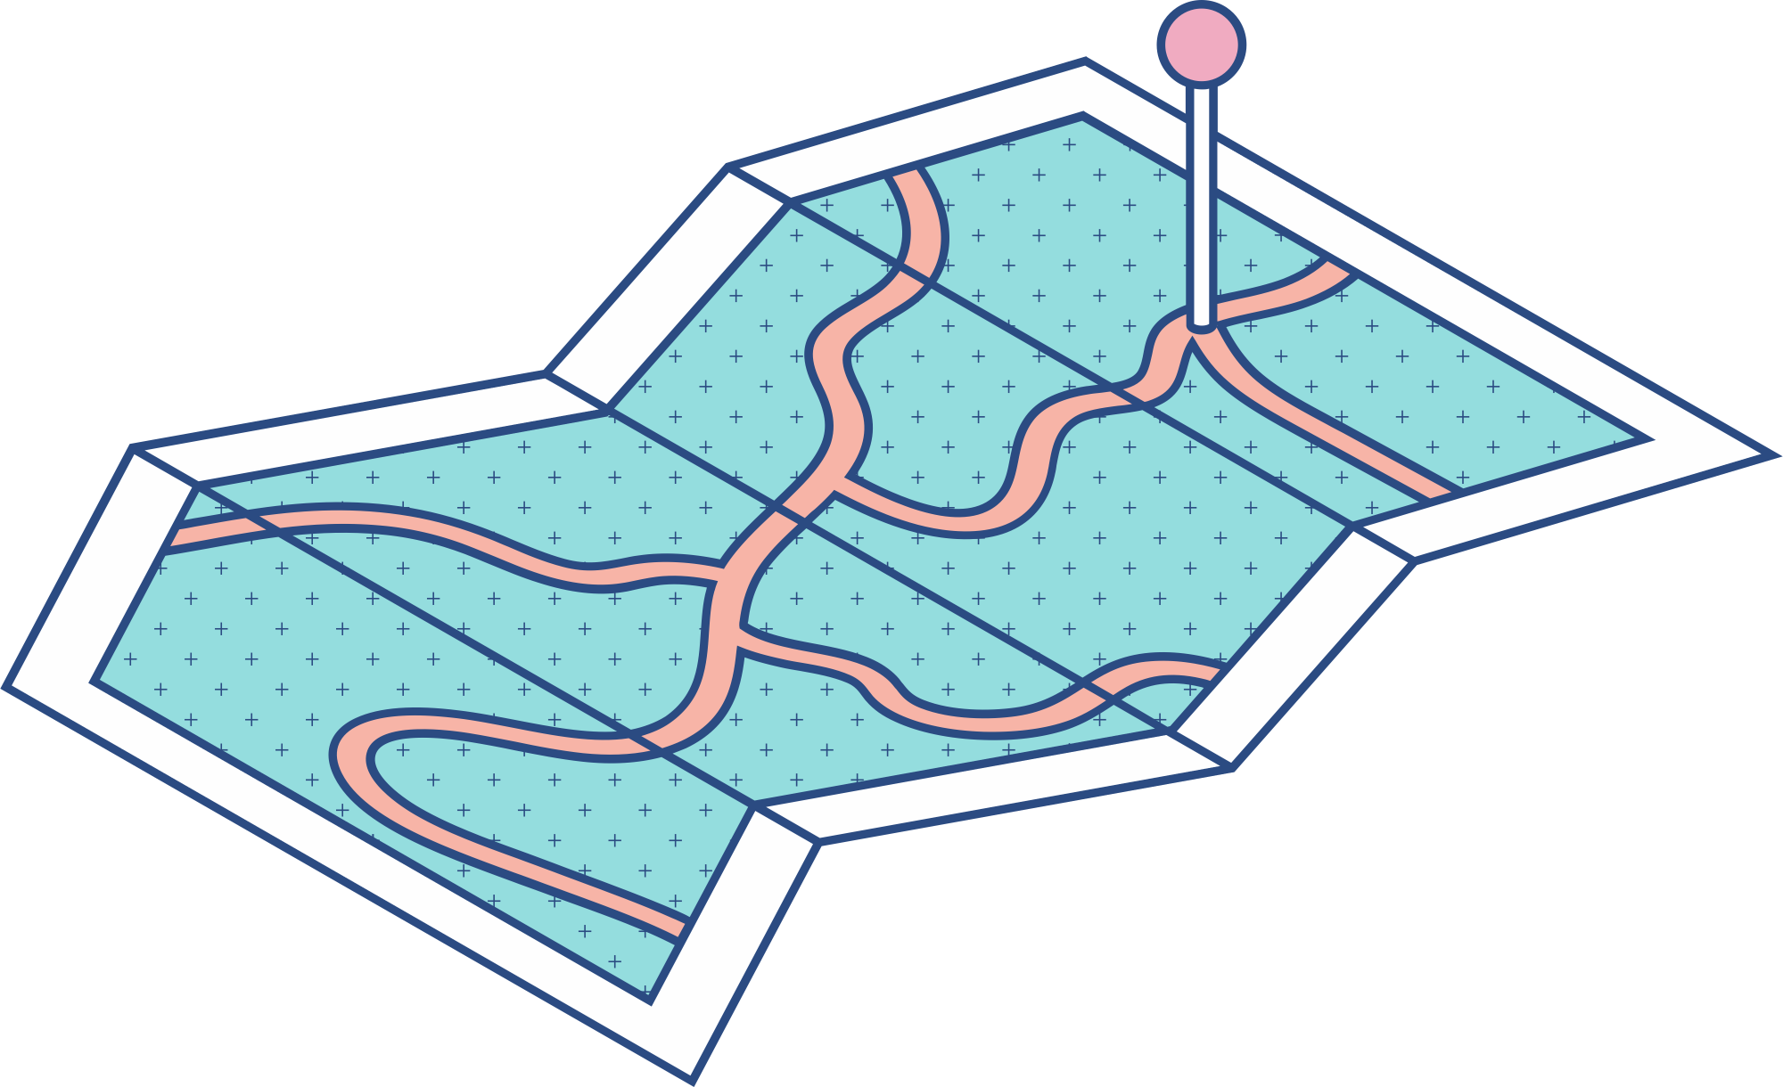

Statement - Data Science Problem:
To develop Supervised Machine Learning models that leverages quantifiable socio-economic and governance indicators to accurately predict a country’s happiness score and identify the most influential drivers behind those predictions (Regression problem)
Happiness is not just a simple concept, we can perceive it on multiple levels from unhappy to very happy. Can we determine the happiness level of a country? (Classification problem)

Slide 4

Exploratory Analysis
Dataset: 1704 data samples - 26 features - 165 countries ranked their happiness and other various factors (social-economic, governance) relating to their country and own wellbeing from 2005 to 2018
Missing Values:
+) Randomness: accounted <5% full dataset (GDP, Social support, Health, Freedom, Affect, Generosity) - removed these observations
+) Not Randomness - Significant: self-report bias (GINI indices, Trust surveys (WVS, Gallup)) - removed these variables
Notes:
Overview of data

Slide 5
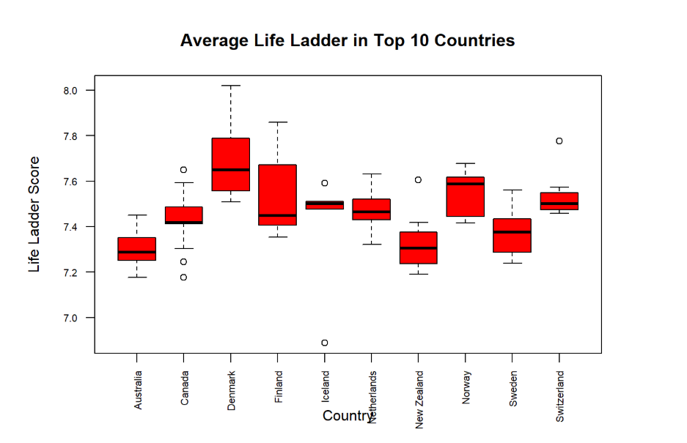
Exploratory Analysis
Most countries cluster around 7.4 - 7.6.
Iceland and Switzerland show tight distribution.
Denmark and Finland show more spread.
8.0 is the ceiling life satisfaction.
Notes:
Overview of data

Slide 6
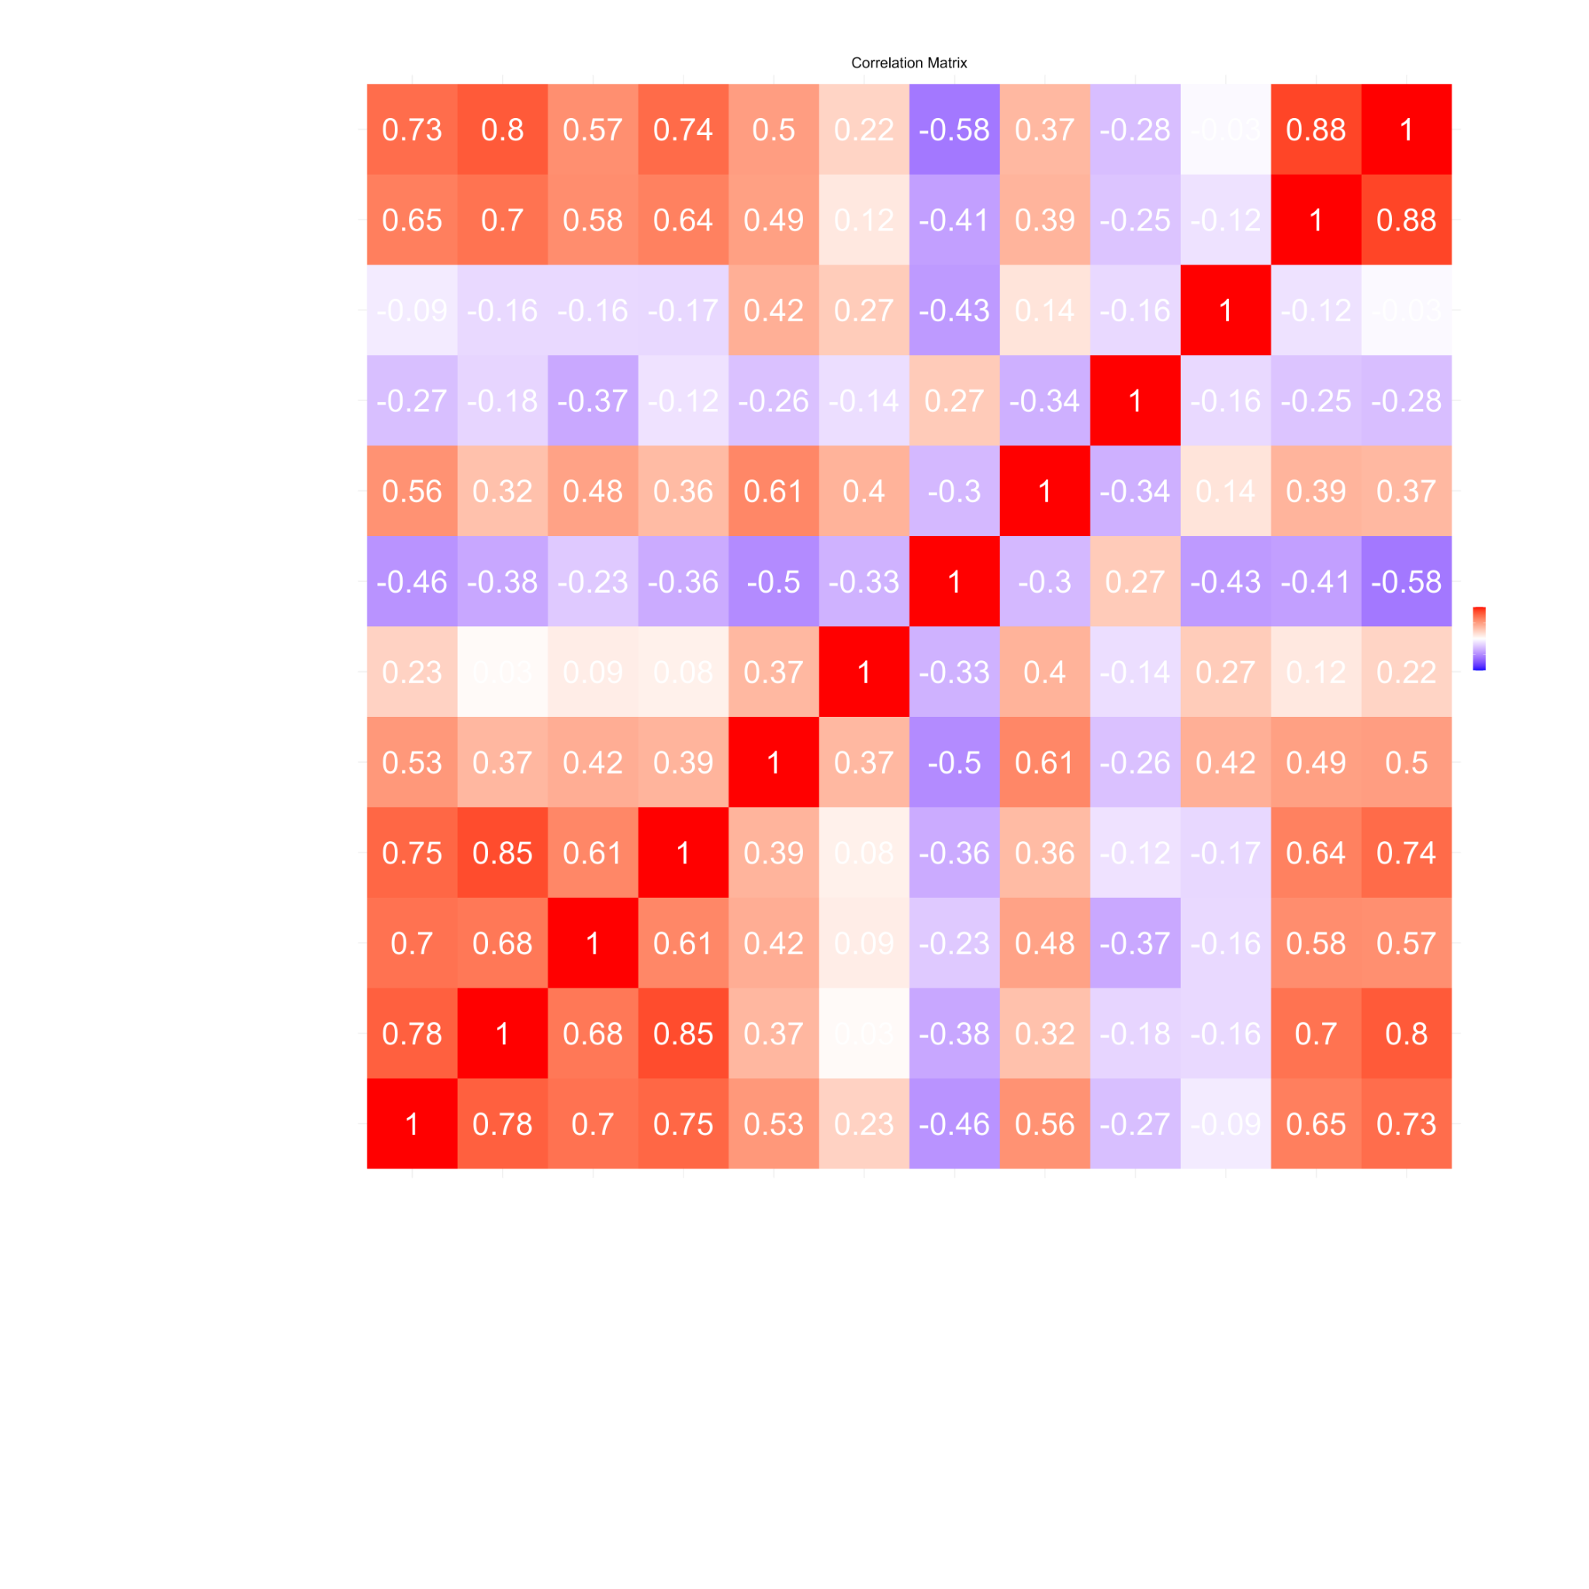
Correlation Matrix

Slide 7
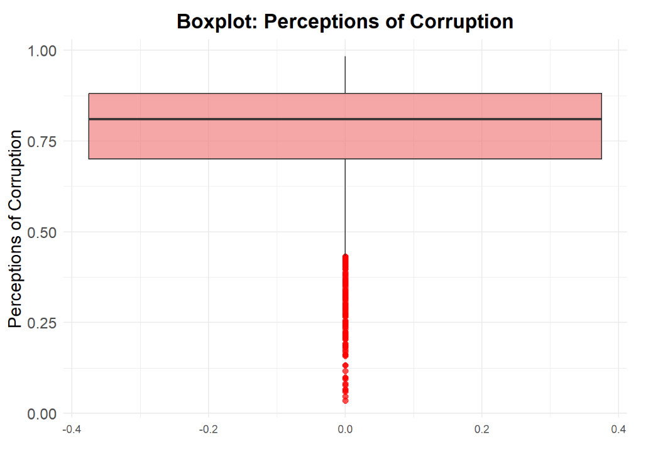
Exploratory Analysis - Outliers
Most of the data is concentrated on the “less corrupt” side, but highly corrupt outliers have a small but large impact on global happiness.
Low corruption observations (near 0) tend to fall into the ‘Low Happiness’ group. This helps the model distinguish between classes better.

Slide 8
Data Processing Steps
1
2
3
4
Removal of Country Name and Year columns
Check % of Null Values
Drop the columns with the Highest % of Null Values
Remove columns with Low Correlation
5
6
7
Check and remove Observations with Missing Values
Detection of Outliers
Addition of new column, Happiness Level
Notes:
Outliers, columns removed, % of missing data, added column for classification

Slide 9
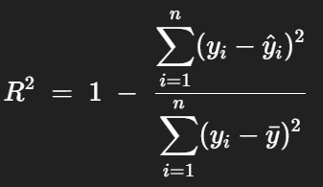
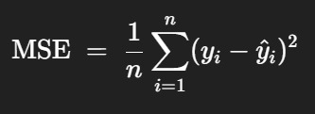
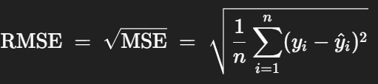
Methods
Model Assumption:
Observations are independent
Constant variance of error
No Multicollinearity
Linearity
Model Choices:
For Regression problem:
Linear Regression
Random Forest
For Classification problem:
KNN
Metrics:
R squared
MSE
RMSE

Slide 10
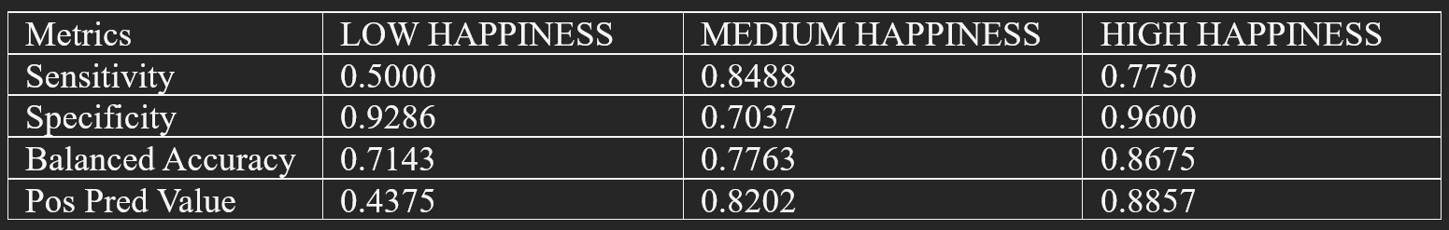
Results
Linear Regression:
MSE: 0.2667571 - RMSE: 0.5164854 - R-squared: 0.7883418
Random Forest:
MSE: 0.1454544 - RMSE: 0.3813848 - R-squared: 0.884546
KNN
Accuracy : 0.7929
Classification accuracy fell from 0.84 to 0.79 and Random Forest R² from 0.89 to 0.88: Demonstrating effective overfitting control.
In regression, Random Forest topped linear models R² from 0.88 vs. 0.78, while KNN classification most accurately identified the “Medium Happiness” group, reflecting its dominance in the class distribution.

Slide 11
Discussion
The survey bias when conducting a self-reported survey
Not random missing value
Other factors impact the happiness score (Education Quality, Work-life Balance, Job Satisfaction…) not examined
Linear regression model transparently interpreted but played a trade-off in variance game , underperformed when non-linear relationship and multicollinearity existed.
The Random Forest not only helped resolve those problems more effectively but also improved the performance in terms of overfitting and accuracy score, despite being less interpretable.

Slide 12
Conclusion
Linear regression models: a simple method to understand the trend and relationship between the features and the target.
Random Forest models: provides high accuracy and an overview of the features and their importance.
KNN Classification model: categorized the Happiness Levels based on the happiness scores.
Summary:
The economy and social factors have a direct affect on the Life Ladder ranking, specifically Log GDP per capita, Social Support and health are vital and influence national happiness.
The prediction results demonstrate the effectiveness of Machine Learning models to resolve real-world problems, especially in social science researches.

Slide 13
Alexander, R., Aragón, O. R., Bookwala, J., Cherbuin, N., Gatt, J. M., Kahrilas, I. J., Kästner, N., Lawrence, A., Lowe, L., Morrison, R. G., Mueller, S. C., Nusslock, R., Papadelis, C., Polnaszek, K. L., Helene Richter, S., Silton, R. L., & Styliadis, C. (2021). The neuroscience of positive emotions and affect: Implications for cultivating happiness and wellbeing. Neuroscience & Biobehavioral Reviews, 121, 220-249. https://doi.org/https://doi.org/10.1016/j.neubiorev.2020.12.002
Helliwell, J., Layard, R., & Sachs, J.(2019). World Happiness Report 2019, New York: Sustainable Development Solutions Network. https://worldhappiness.report/ed/2019/
Kang, H. (2013). The prevention and handling of the missing data. Korean J Anesthesiol, 64(5), 402-406. https://doi.org/10.4097/kjae.2013.64.5.402
Luo, S., & Corne, D. (2008). Feature selection strategies for poorly correlated data: correlation coefficient considered harmful. 226-231.
Pham, T. M., Pandis, N., & White, I. R. (2024). Missing data: Issues, concepts, methods. Seminars in Orthodontics, 30(1), 37-44. https://doi.org/https://doi.org/10.1053/j.sodo.2024.01.007
Veenhoven, R., Ehrhardt, J., Ho, M. S. D., & de Vries, A. (1993). Happiness in nations: Subjective appreciation of life in 56 nations 1946–1992. Erasmus University Rotterdam.
References
APA 7th Ed.

Slide 14





Thank You For Listening

Slide 15

Do you have any questions?

