Slide 1
Mobile-Commerce Development
Lesson
Fragment
Lecturer:
Tran Duy Thanh, Phd
Nguyen Quang Phuc, Msc
Email: thanhtd@uel.edu.vn
Blog: https://tranduythanh.com
Phone: 0987773061

Slide 2
Lesson Objective
- Students understand Fragment and Fragment lifecycle states
- Design UI with Fragment
- Interact actions between Fragment

Slide 3
Outlines
Introduction Fragment
Fragment Life Cycle
Building Fragment
Using Fragment

Slide 4
1. Introduction Fragment
Fragment is an object representing a part of the user interface embedded in an Activity, allowing for interactive reception, has its own lifecycle, and performs information exchange with the Activity and other Fragments.
Some attentions when using Fragments:
Fragments also have their own layout, events and lifecycles ➔ fragments can be added or removed while the Activity is open.
Can combine multiple Fragments in 1 Activity.
A Fragment can be used in many Activities.

Slide 5
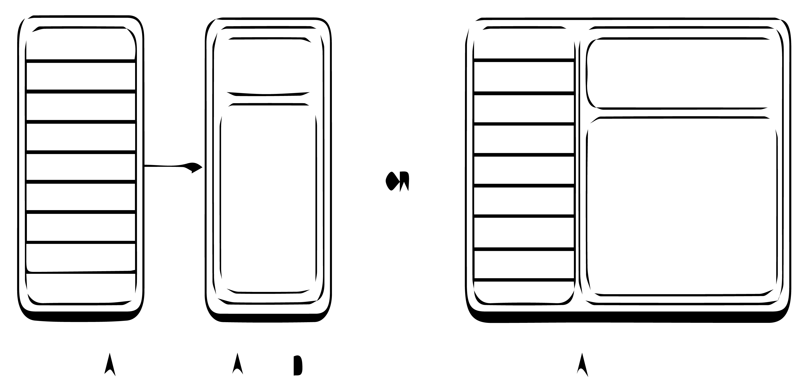
1. Introduction Fragment
Selecting an item
updates Fragment B
Selecting an item
starts Activity B
Activity A contains
Fragment A and Fragment B
Activity A contains
Fragment A
Activity B contains
Fragment B

Slide 6
2. Fragment Life Cycle
onAttach()
onStart()
onDestroyView()
Fragment Callbacks
onCreate()
onResume()
onDestroy()
onCreateView()
onPause()
onDetach()
onActivityCreated()
onStop()
Activity
State
Started
Created
Resumed
Destroyed
Paused
Stopped

Slide 7
2. Fragment Life Cycle
Fragment
onActivityCreate()
Fragment is added
onStart()
onDestroyView()
onResume()
onAttach()
Fragment is actived
onDestroy()
onCreate()
User navigates backward or fragment is removed/replaced
The fragment is added to the back stack, then removed/replaced
onCreateView()
onDetach()
Fragment is destroyed
The fragment returns to the layout from back stack
onPause()
onStop()

Slide 8
3. Building Fragment
Step 1: Create a class that inherits from the Fragment class
Step 2: Override the onCreateView() method to load the interface for the Fragment
public class MyFragment extends Fragment { @Override public View onCreateView(@NonNull LayoutInflater inflater,
@Nullable ViewGroup container,
@Nullable Bundle savedInstanceState) { return inflater.inflate(R.layout.fragment_layout_1, container, false); } }

Slide 9
4. Using Fragment
Method 1: Make a Fragment reference from the Activity's XML interface.
Method 2: Embed Fragment into Activity through FragmentManager object from Java code.

Slide 10
4. Using Fragment
Method 1: Make a Fragment reference from the Activity's XML interface.
<fragment android:id="@+id/fragment1" android:name="com.example.fragmentdemo.MyFragment" android:layout_width="match_parent" android:layout_height="wrap_content" android:layout_marginTop="10dp" tools:layout="@layout/fragment_layout_1" />

Slide 11
4. Using Fragment
Method 2: Embed Fragment into Activity through FragmentManager object from Java Code.
FragmentManager fragmentManager =
getSupportFragmentManager(); FragmentTransaction fragmentTransaction =
fragmentManager.beginTransaction(); Fragment fragment = new MyFragment(); fragmentTransaction.add(R.id.layoutContainer, fragment); fragmentTransaction.commit();
Some important methods of FragmentTransaction:
add()
attach() – detach()
replace()
hide() – show()
remove()
addToBackStack()
setTransition()
Commit()

Slide 12
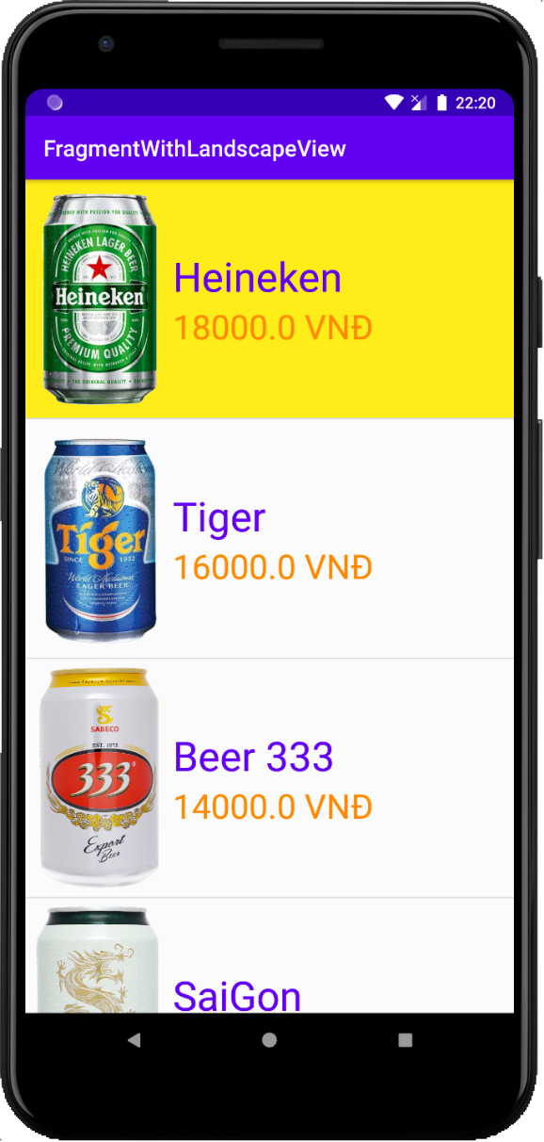
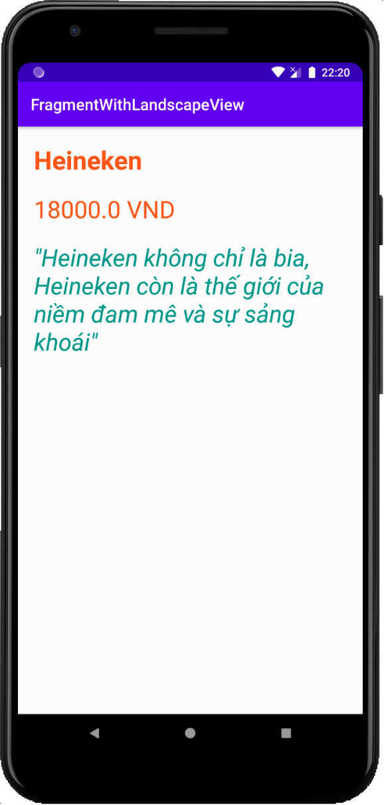
Exercise

Slide 13
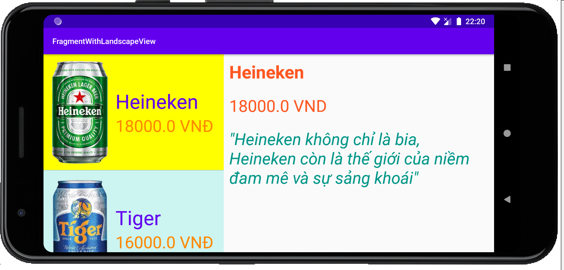
Exercise

Slide 14
Discussions
Q1: Present the advantages of Fragments
Q2: Present Fragment Life Cycle
Q3: Demonstrate how to present Building Fragments
Q4: Demonstrate how to Use Fragment

Slide 15
Next Lesson
Assets
Shared Preferences
SQLite
Content Provider

Slide 16
THANK YOU!

