Slide 1
Mobile-Commerce Development
Lesson
Multi-Threading
Lecturer:
Tran Duy Thanh, Phd
Nguyen Quang Phuc, Msc
Email: thanhtd@uel.edu.vn
Blog: https://tranduythanh.com
Phone: 0987773061

Slide 2
Lesson Objective
Students understand multithreading
Do Handler class as well for updating UI runtime
Do AsyncTask class as well for updating UI runtime
Use Multi-threading for accessing Internet Resources

Slide 3
Outlines
Concepts in multithreaded programming
Multi-process usage context
Multithreaded programming techniques in Android
Handler
AsyncTask

Slide 4
1. Concepts in Multi-Threading
Process, Thread and Multiple Thread
Process provides the necessary resources to execute the program and must have at least 1 Thread to execute.
Thread is an entity in Process, a thread is considered a thread to execute a program. In a process there can be many threads executing simultaneously and each thread has its priority.
➔ Process = Program + State of all Threads executing in Program

Slide 5
1. Concepts in Multi-Threading
Create Thread
Method 1: extends from class Thread
public class MyThread extends Thread { @Override public void run() { super.run(); //TODO } }
new MyThread().start();

Slide 6
1. Concepts in Multi-Threading
Create Thread
Method 2: Implements interface Runnable
public class MyRunnable implements Runnable { @Override public void run() { //TODO } }
new Thread(new MyRunnable()).start();

Slide 7
1. Concepts in Multi-Threading
Main Thread and UI Thread, Worker Thread
In Android, when the application is launched, the system will start an initial Thread along with a Process, this Thread is called Main Thread.
Main Thread is also often called UI Thread because this thread is responsible for handling application interface loading as well as interacting with the Android UI toolkit.
Worker Thread is a thread that the programmer creates for the program to perform a task unrelated to the interface. This thread is also called Background Thread.

Slide 8
1. Concepts in Multi-Threading
Application Not Responding - ANR
When the UI Thread executes many tasks and there is one task that requires a lot of processing time (Internet connection, database query, etc.), then the UI will be blocked, thereby causing the ANR phenomenon. But actually the program is still being executed.
When the UI is blocked for a few seconds (average 5 seconds), the system will display a notification dialog box allowing the user to close the application or wait.

Slide 9
1. Concepts in Multi-Threading
Application Not Responding - ANR
To limit the ANR phenomenon, programmers need to adhere to the following principles:
Do not block UI Thread
Do not connect to the Android UI toolkit from a Thread that is not a UI Thread.

Slide 10
2. Multi-process usage context
Tasks require a lot of processing time → Should use multiple processes. For example: connecting and retrieving data from the Internet, querying the database, etc.
Don't let users wait too long (5 seconds)
when interacting with 1 function on the application.

Slide 11
3. Handler class
Handler is an object used to link and exchange between Threads, usually Main Thread (UI Thread) with Worker Threads (Background Thread).
Common methods when using Handler:
sendMessage(Message)
sendEmptyMessage(int)
sendMessageAtTime(Message, long)
sendMessageDelayed(Message, long)
post(Runnable)
postAtTime(Runnable, long)
postDelayed(Runnable, Object, long)

Slide 12
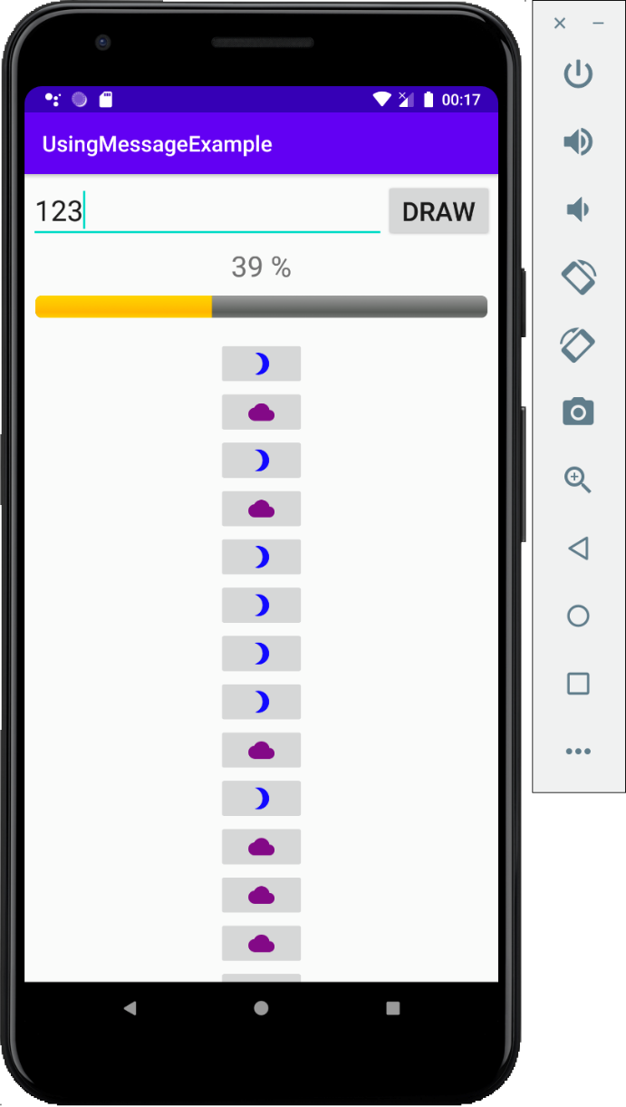
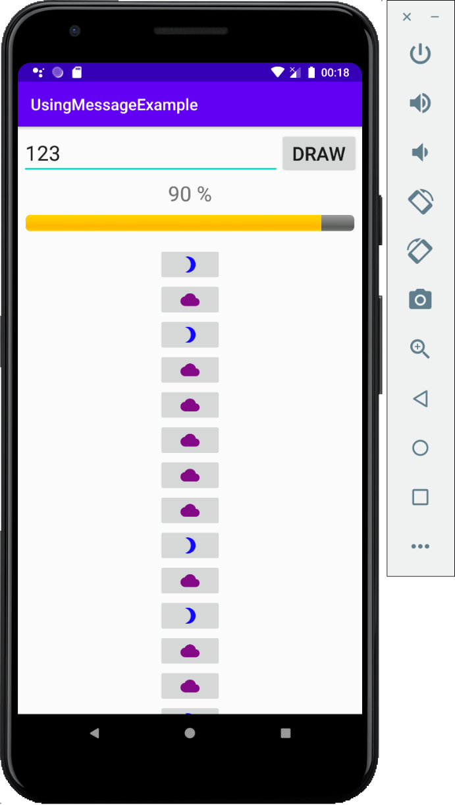
3. Handler class

Slide 13
3. Handler class
Handler - sendMessage(Message) - 1
Main Thread / UI Thread
Handler handler = new Handler(new Handler.Callback() { @Override public boolean handleMessage(Message message) { int percent = message.arg1; if(percent == 100){ Toast.makeText(MainActivity.this, "DONE",
Toast.LENGTH_LONG).show(); }else{ int value = (int) message.obj; //UPDATE UI … } txtPercent.setText(percent + " %"); pbPercent.setProgress(percent); return true; } });

Slide 14
3. Handler class
Handler - sendMessage(Message) - 1
Worker Thread / Brackground Thread
Thread thread = new Thread(new Runnable() { @Override public void run() { for(int i=1; i<=numb; i++){ Message message = handler.obtainMessage(); message.arg1 = i*100/numb; //Percent message.obj = random.nextInt(100); handler.sendMessage(message); SystemClock.sleep(100); } } }); thread.start();

Slide 15
3. Handler class
Handler - sendMessage(Message) - 2
Main Thread / UI Thread
Handler handler = new Handler(Looper.getMainLooper()){ @Override public void handleMessage(Message msg) { switch (msg.what){ case MSG_UPDATE_UI: int value = (int) msg.obj; //UPDATE UI … txtPercent.setText(msg.arg1 + " %"); //percent pbPercent.setProgress(msg.arg1); break; case MSG_UPDATE_UI_DONE: //DONE break; default: break; } } };

Slide 16
3. Handler class
Handler - sendMessage(Message) - 2
Worker Thread / Brackground Thread
Thread thread = new Thread(new Runnable() { @Override public void run() { for(int i=1; i<=numb; i++){ Message message = new Message(); message.what = MSG_UPDATE_UI; message.arg1 = i*100/numb; //Percent message.obj = random.nextInt(100); handler.sendMessage(message); SystemClock.sleep(100); }
handler.sendEmptyMessage(MSG_UPDATE_UI_DONE); } }); thread.start();

Slide 17
3. Handler class
Handler - post(Runnable)
Main Thread / UI Thread
int numb = 0, percent, value;
Handler handler = new Handler(); Runnable foregroundThread = new Runnable() { @Override public void run() { txtPercent.setText(percent + " %"); pbPercent.setProgress(percent); //UPDATE UI … } };

Slide 18
3. Handler class
Handler - post(Runnable)
Worker Thread / Brackground Thread
Thread backgroundThread = new Thread(new Runnable() { @Override public void run() { for(int i=1; i<=numb; i++){ percent = i*100/numb; //Percent value = random.nextInt(100); handler.post(foregroundThread); SystemClock.sleep(100); } } }); backgroundThread.start();

Slide 19
4. AsyncTask class
AsyncTask is an abstract class that allows declaring implicit processing and automatic interface updates.
The task processing stages in AsyncTask are performed through the following methods in the correct order:
onPreExcute: preprocessing process
doInBackground: background processing
onProgessUpdate: update processing progress
onPostExcute: UI update process → completed

Slide 20
4. AsyncTask class
public class MainActivity extends
AppCompatActivity { @Override protected void onCreate(Bundle
savedInstanceState) { super.onCreate(savedInstanceState); setContentView(R.layout.activity_main); new MyTask().execute("string parameter"); } }
private class MyTask extends
AsyncTask<String, Integer, String>{ @Override protected void onPreExecute() { super.onPreExecute(); } @Override protected String doInBackground(String... strings) { String myString = strings[0]; int i = 0; publishProgress(i); return "result string"; } @Override protected void onProgressUpdate(Integer... values) { super.onProgressUpdate(values); } @Override protected void onPostExecute(String s) { super.onPostExecute(s); } }

Slide 21
4. AsyncTask class

Slide 22
4. AsyncTask class
private void drawUI() { int numb = Integer.parseInt(edtNumberOfControls.getText().toString()); MyAsyncTask myAsyncTask = new MyAsyncTask(); myAsyncTask.execute(numb); }
class MyAsyncTask extends
AsyncTask<Integer, Integer, Void>{ @Override protected void onPreExecute() { super.onPreExecute(); } @Override protected Void doInBackground(Integer... integers)
{ return null; } …..
@Override protected void onProgressUpdate(Integer... values)
{ super.onProgressUpdate(values); } @Override protected void onPostExecute(Void aVoid) { super.onPostExecute(aVoid); } }

Slide 23
4. AsyncTask class
@Override protected void onPreExecute() { super.onPreExecute(); txtPercent.setText("0 %"); layoutControls.removeAllViews(); } @Override protected Void doInBackground(Integer... integers) { int n = integers[0], percent, value; for(int i=1; i<=n; i++){ percent = i*100/n; value = random.nextInt(100); publishProgress(percent, value); SystemClock.sleep(100); } return null; }

Slide 24
4. AsyncTask class
@Override protected void onProgressUpdate(Integer... values) { super.onProgressUpdate(values); int percent = values[0]; int value = values[1]; txtPercent.setText(percent + " %"); pbPercent.setProgress(percent); //UPDATE UI … }
@Override protected void onPostExecute(Void aVoid) { super.onPostExecute(aVoid); txtPercent.setText("DONE"); }

Slide 25
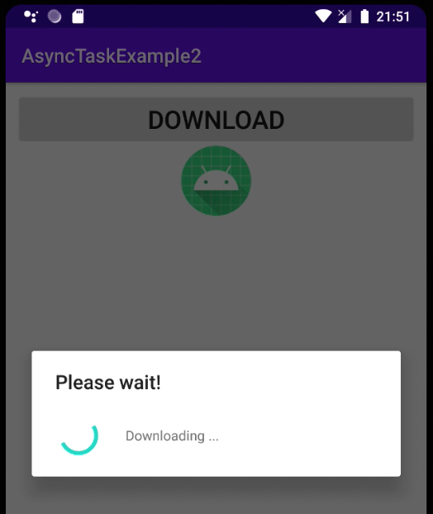
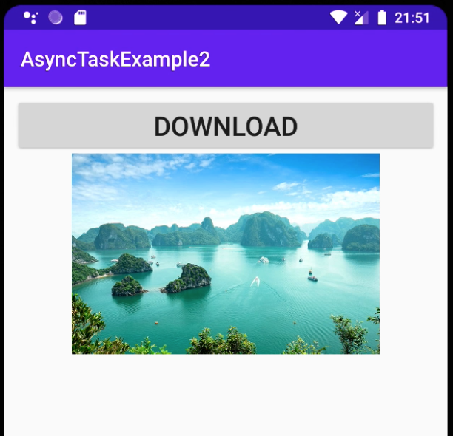
4. AsyncTask class
More Example: using AsyncTask to load image from Internet

Slide 26
4. AsyncTask class
More Example: using AsyncTask to load image from Internet
btnDownLoad.setOnClickListener(new View.OnClickListener() { @Override public void onClick(View view) { MyAsyncTask myAsyncTask = new MyAsyncTask();
myAsyncTask.
execute("https://media.worldnomads.com/explore/vietnam/halong-bay-vietnam-from-above-gettyimages.jpg "); } });

Slide 27
4. AsyncTask class
private class MyAsyncTask extends AsyncTask<String, Void, Bitmap>{ @Override protected void onPreExecute() { super.onPreExecute(); } @Override protected Bitmap doInBackground(String... strings) { Bitmap bitmap = null; …. return bitmap; } @Override protected void onProgressUpdate(Void... values) { super.onProgressUpdate(values); } @Override protected void onPostExecute(Bitmap bitmap) { super.onPostExecute(bitmap); } }

Slide 28
4. AsyncTask class
@Override protected void onPreExecute() { super.onPreExecute(); progressDialog.show(); }
@Override protected Bitmap doInBackground(String... strings) { Bitmap bitmap = null; try{ URL url = new URL(strings[0]); HttpURLConnection connection = (HttpURLConnection)url.openConnection(); bitmap = BitmapFactory.decodeStream(connection.getInputStream()); }catch (Exception e){ Log.e("Error: ", e.toString()); } return bitmap; }

Slide 29
4. AsyncTask class
@Override protected void onProgressUpdate(Void... values) { super.onProgressUpdate(values); } @Override protected void onPostExecute(Bitmap bitmap) { super.onPostExecute(bitmap); progressDialog.dismiss(); imvPhoto.setImageBitmap(bitmap); }

Slide 30
Discussions
Q1: What are advantages of Multi-Threading?
Q2: How to do Handle class with sendMessage method?
Q3: How to do Handle class with post method?
Q4: How to do AsyncTask class?
Q5: How to get image from Internet?

Slide 31
Next Lesson
Web Services

Slide 32
THANK YOU!

