Slide 1


EME v 3.1.1 and ArcGIS 10
Working with FGDC metadata in ArcGIS 10

Slide 2
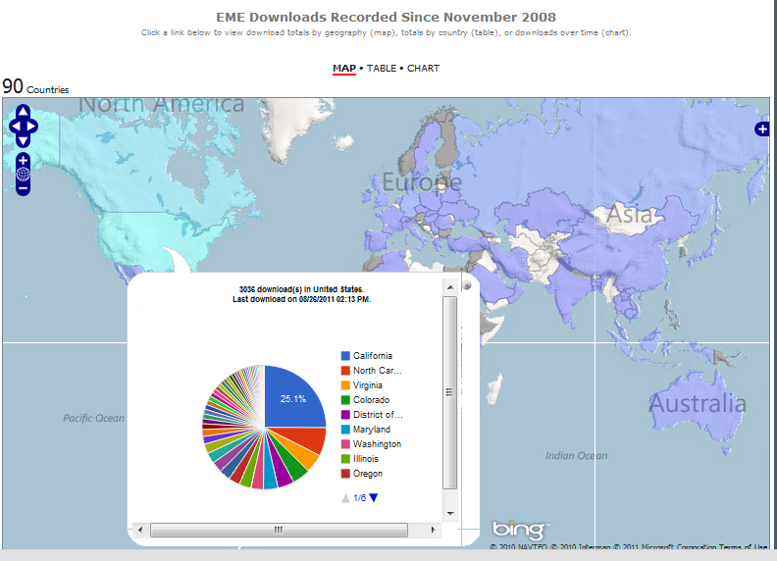
Welcome
Second 2011 EME/ArcGIS 10 Training
First training held April 2011
Basic Updates on AGIS 10
Overview of EME in ArcGIS 10
This training includes:
AGIS 10 Metadata
Basic Changes
Recent patches/updates
FAQs
Update on EME 3.1.1 (July 2011)
Plans for EME 3.2 (November 2011)
EME Overview/Refresher

Slide 3
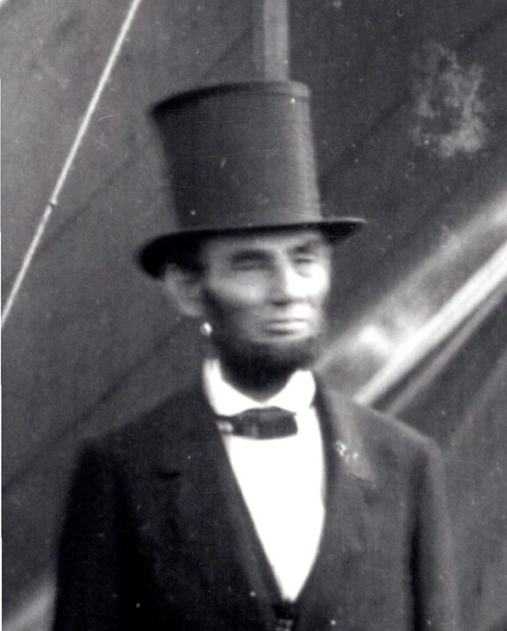
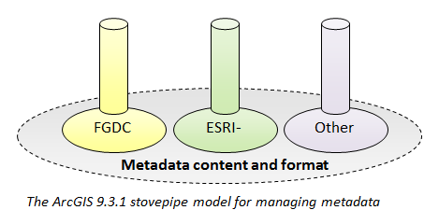
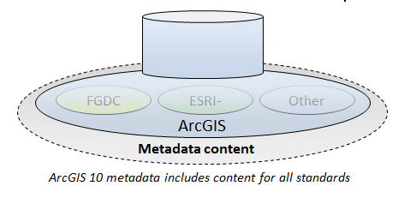
ArcGIS 10 Changes
New approach to metadata storage
‘Unified’ approach (as opposed to old “stovepipe” approach)
Idea was to make it easier to support multiple standards
Originally moving away from FGDC CSDGM
Stovepipes are out.

Slide 4
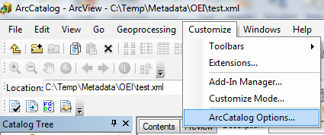
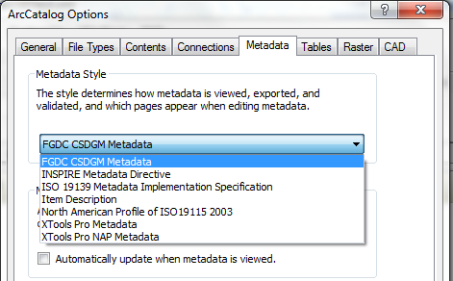
ArcGIS 10 Changes
Metadata styles and standards
Style: View/create metadata based on standard you choose
Default is Item Description
Customize->ArcCatalog Options
Esri software synchronizes between “Description” style and common standards
Be Careful! Synchronizing between Esri style and FGDC CSDGM has a few bugs
Should be addressed with forthcoming patch
In the meantime, it may be best to not edit description elements
FGDC Style Patch
BUG: If you enter information the AGIS Summary and Description fields, FGDC abstract/purpose fields are updated with AGIS Summary and description information, and the old info that used to exist in FGDC abstract/purpose fields is removed.

Slide 5
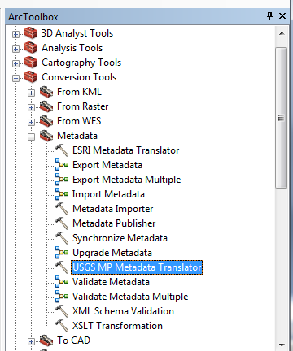
ArcGIS 10
Look and feel changes
Metadata tools moved to ArcToolbox
Conversion Tools->Metadata
Old 9.3 tools have changed a bit
‘Metadata Import/Export’
Concept of “upgrading” metadata
Common Question:
“Error with metadata configuration file”
Users must remove the "&" or "<“ in their records
http://forums.arcgis.com/threads/9523-ArcCatalog-Metadada-quot-There-is-an-error-in-the-metadata-editor-configuration-file-quot-
Recent Updates
Esri FGDC Editor: http://blogs.esri.com/Dev/blogs/arcgisdesktop/archive/2010/06/25/FGDC-Metadata-Editor-for-ArcGIS-10.aspx
FGDC Style Patch: http://resources.arcgis.com/content/patches-and-service-packs?fa=viewPatch&PID=160&MetaID=1637
Coming Soon: New Esri patch to address many issues
Timing and processes to be confirmed

Slide 6

ArcGIS 10 Changes
Removing Unwanted Tags
Validation “warnings”
Esri tags and ISO tags
Step 1: Use the Remove Esri Tags function in EME to remove Esri Elements
Step 2: Use the USGS MP Metadata Translator tool in Toolbox to remove ISO Elements

Slide 7
Enter EME v3.1.1
Same simple geospatial metadata editor (3 tabs)
Maintains ArcGIS 9.X metadata business processes in ArcGIS 10
Works as a standalone tool
Download from https://edg.epa.gov/EME/

Slide 8
EME v3.1.1
Newest Features
Bug Fixes:
Addresses synchronization issue when exporting or copy/pasting feature classes
Allows ‘Save as’ without requiring that the user first edit the record,
When user selects multiple processing steps for deletion, EME no longer only deletes the first step upon save,
Enhancements
Keyboard shortcuts for Copy ,Cut and Paste
Metadata Export & Import tools from the EME Toolbar,
Provides direct access to EME Help from the EME Toolbar
Provides a number of small edits to the EME database
Provides EME source code from EME website.

Slide 9
EME v3.2
What’s Planned for a November Update
Include additional fields
Source citation information
Spatial data organization
Standard order process
Stylesheet for EPA FGDC metadata
Highlight FGDC Fields
Avoid Translation Errors
Validation Updates
Batch results summary
Ordering results details

Slide 10


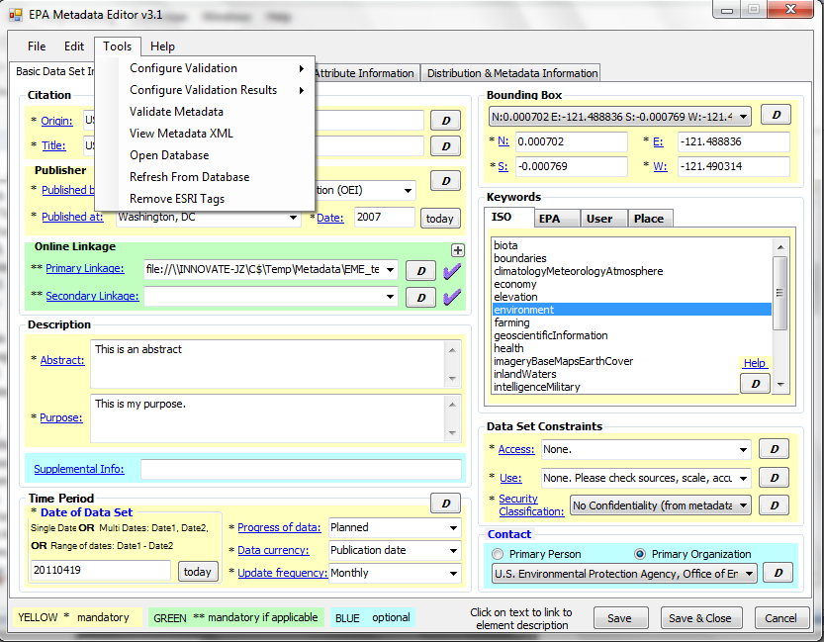
EME for AGIS 10
On the face of it – not much has changed But….
Compatible with ArcGIS 10
Runs as a standalone application
ArcGIS 10 extension calls standalone tool
Synchronizes FGDC metadata in ArcGIS 10
Same configurable EPA Synchronizer
Allows user to retain published doc ID if removing ESRI tags
Clear all & import buttons in toolbar
One or more records
Many functions moved to menu bar

Slide 11
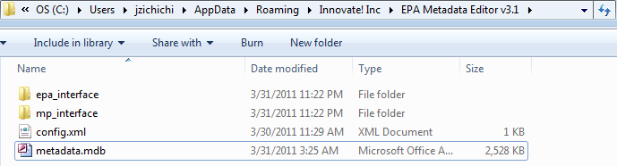
New in EME v 3.1.1 (cont’d.)
EME database moved to new location
Makes an operational copy of EME database in user directory (e.g., C:\Users\jzichichi\AppData\Roaming\Innovate! Inc)
Still allows user to point to alternative db location in config.xml
Allows users to include more than two online linkages in metadata
Fixes bugs from previous version of EME

Slide 12
New in EME v 3.1.1 (cont’d.)
Version 3.1.1 released in July, 2011
Metadata Import and Export tool
Keyboard shortcuts for copy/cut/paste in the EME user interface
Access to EME help files directly from EME Toolbar
Bug fixes

Slide 13
Using the EME
Installing v. 3.1.1
EME 3.0 must be uninstalled prior to uninstalling ArcGIS 9.X.
EPA has developed a patch to help address this issue (Included in EME v3.1.1 download package)
EME v3.1.1 Installation Reqts:
.Net Framework 3.5 required
ArcGIS 10 (for ArcGIS extension)
FGDC Style Patch (for ArcGIS extension)
Uninstall EME 3.0
Uninstall ArcGIS 9.x

Slide 14
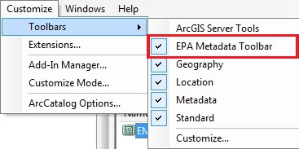
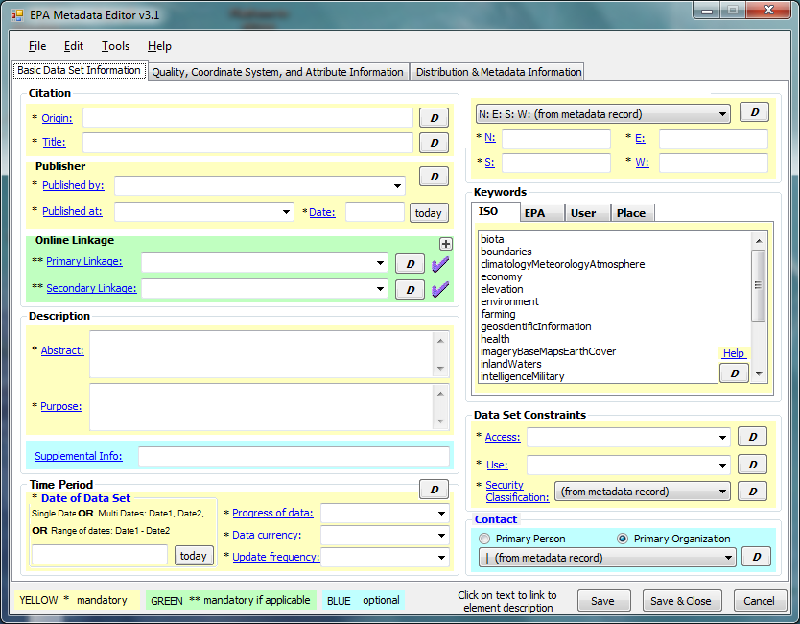
Using the EME
Access EME as an Extension from ArcCatalog
Access EME as a standalone application
Start → EPA Metadata Editor

Slide 15
Using the EME
User interface
Specify information that corresponds to all EPA required elements in Sections 1, 2, 4, 6, and 7 of the FGDC CSDGM.
Specify some information for Section 5 (Attributes) of the FGDC CSDGM.
Fields are color-coded
Yellow = 'mandatory',
Green = 'mandatory if applicable‘
Blue = considered ‘optional’.
Mandatory
Mandatory if applicable
Optional

Slide 16
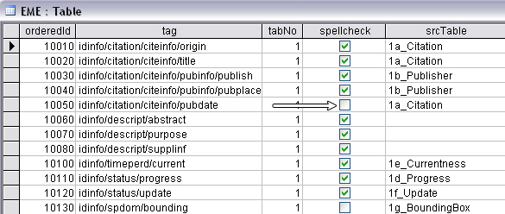
Using the EME
EME Database
EME uses a Microsoft Access database to supply default information within the user interface
Database is structured to align closely with the flow of the user interface
Modify the database from the EME user interface
Change the location of the database as needed

Slide 17


Using the EME
Synchronization
Automatically insert data properties into metadata
Save time and ensures consistency with data
Particularly useful for coordinate system and spatial extent
Non-compliant

Slide 18
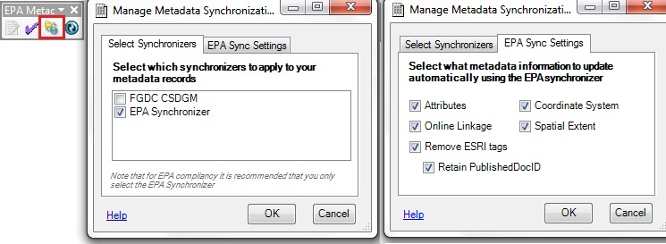
Using the EME
The EPA Synchronizer
Lets users control which data properties are synchronized
Retain information for important elements
Avoid inserting unnecessary information
Access from EME Toolbar

Slide 19
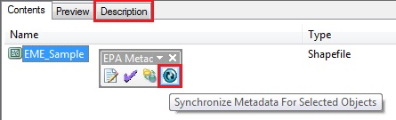
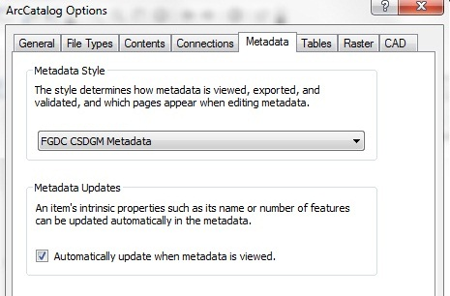
Using the EME
Set EPA Synchronizer as default
Select which attributes to synchronize
Apply synchronization

Slide 20
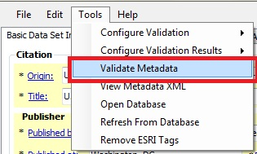
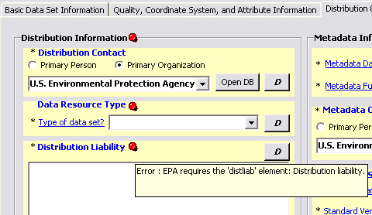
Using the EME
The EME Validator
Tests metadata records for compliancy with both FGDC and EPA requirements.
Validate records one at a time or with batch processing
Results of validation available in:
EME user interface
Web browser

Slide 21
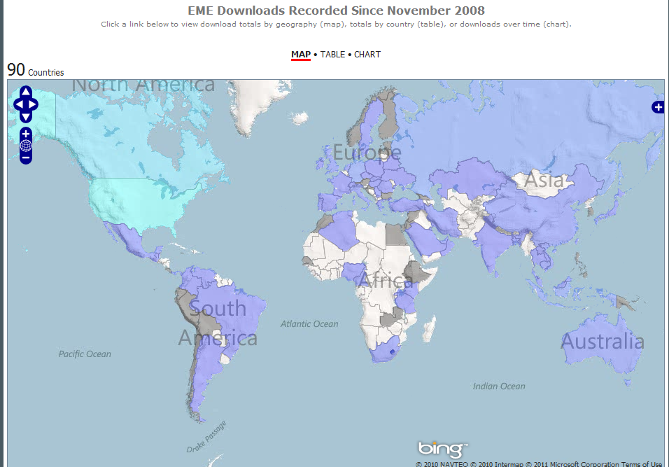
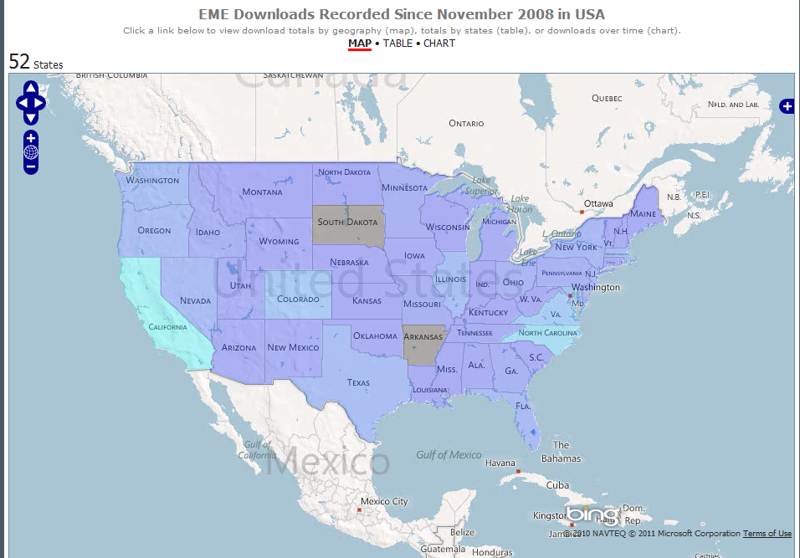
EME Usage
Over 4,000 downloads from 90 countries since 2008
https://edg.epa.gov/EME/Home.htm

Slide 22
Additional Resources
EME Website
https://edg.epa.gov/EME/
ESRI FGDC Style Patch
http://blogs.esri.com/Dev/blogs/arcgisdesktop/archive/2010/08/25/FGDC-Metadata-Style-Patch.aspx
ArcGIS 10 Desktop Metadata Help
http://help.arcgis.com/en/arcgisdesktop/10.0/help/index.html#//00qp0000001p000000.htm
ArcGIS Metadata Blog Posts
http://blogs.esri.com/Dev/blogs/arcgisdesktop/archive/2011/01/03/A-new-approach-for-Metadata-with-ArcGIS-10.aspx
FGDC Metadata Website
http://www.fgdc.gov/metadata

Slide 23

Questions?

Slide 24
Contact Us
Jessica Zichichi
jzichichi@innovateteam.com
Alexandra Walrath
awalrath@innovateteam.com

