Slide 1
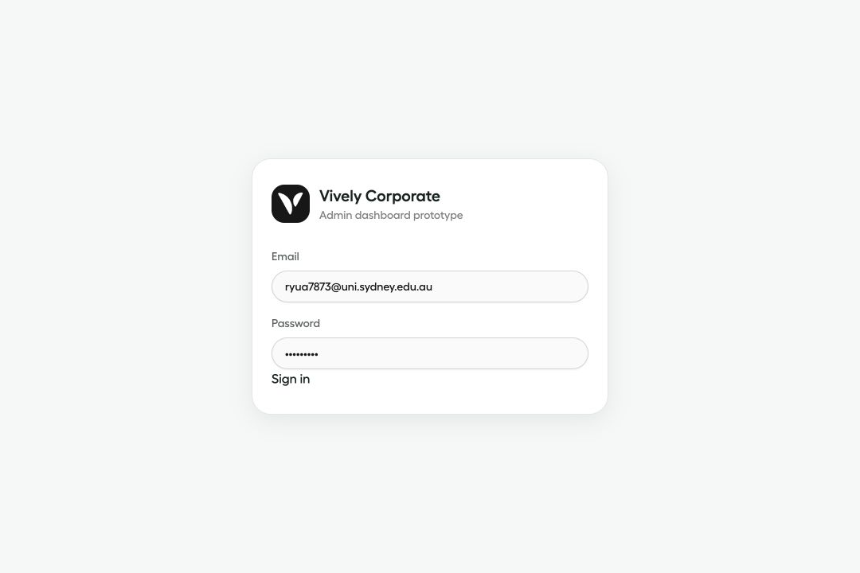
Vively Corporate Dashboard MVP
Week 3 client meeting prototype update
Today’s purpose
Show the working frontend foundation, confirm the workflow direction, and identify the next decisions needed from Vively.
7 July 2026
Week 3 client meeting · 1

Slide 2
VIVELY CORPORATE DASHBOARD MVP
We focused on the frontend workflow first
The prototype is designed to move now, while real Vively routes can be added later.
Build the corporate admin experience before waiting for production APIs.
Privacy boundary
Use mock API functions instead of hardcoding data inside pages.
The dashboard only shows workflow status and aggregate metrics. No individual health records are displayed.
Keep Vively as the source of truth for users, memberships and health data.
Week 3 client meeting · 2

Slide 3
VIVELY CORPORATE DASHBOARD MVP
The prototype now covers the main admin journey
Six core routes are available and connected to mock data.
/login
Admin entry point
/dashboard
Corporate overview
/employees
Invite and track employees
/activation
Onboarding funnel
/health-metrics
Aggregate health reporting
/billing
Mock plan and billing history
Week 3 client meeting · 3

Slide 4
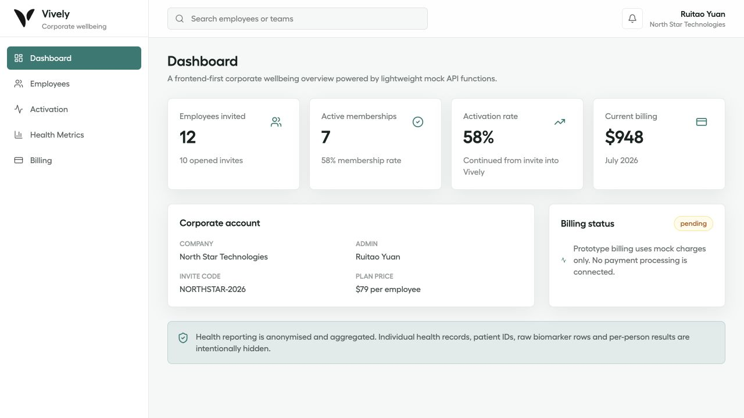
VIVELY CORPORATE DASHBOARD MVP
The dashboard gives admins a quick corporate snapshot
The overview page pulls account, activation and billing signals into one place.
What it communicates
How many employees have been invited and activated.
Current corporate account and plan information.
A clear privacy reminder before health reporting.
Week 3 client meeting · 4

Slide 5
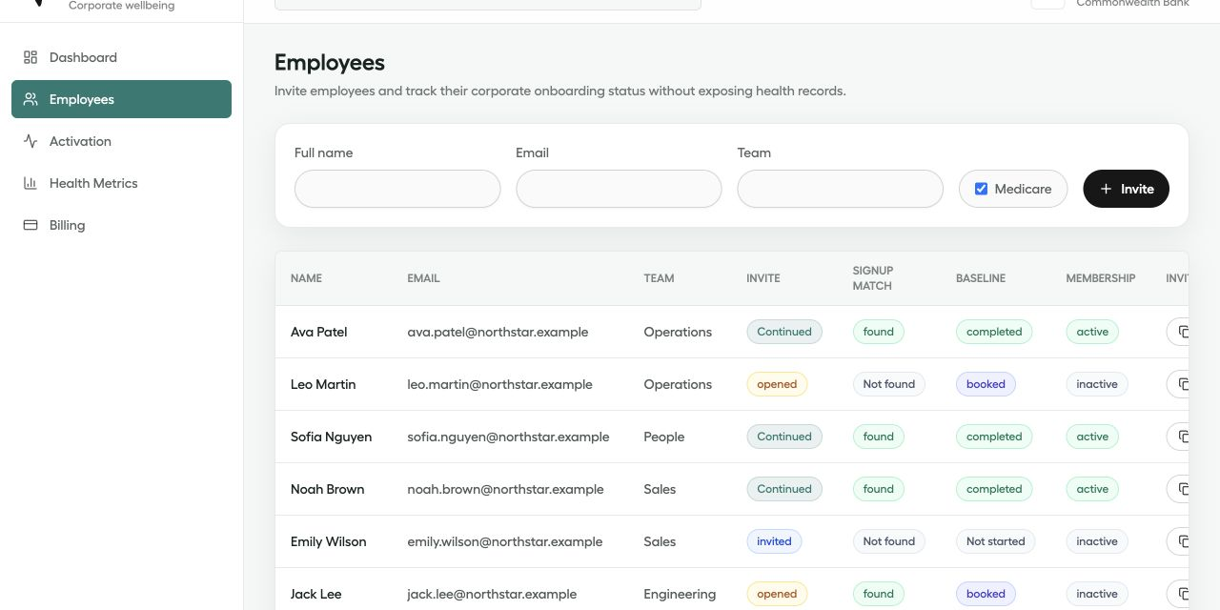
VIVELY CORPORATE DASHBOARD MVP
Employee invites are the first working workflow
Admins can create invites and view onboarding states in one place.
What works now
Create a new invite with name, email, team and Medicare status.
Simulate Vively email matching through a mock resolver.
Generate copyable invite links using /join/{invite_token}.
Week 3 client meeting · 5

Slide 6
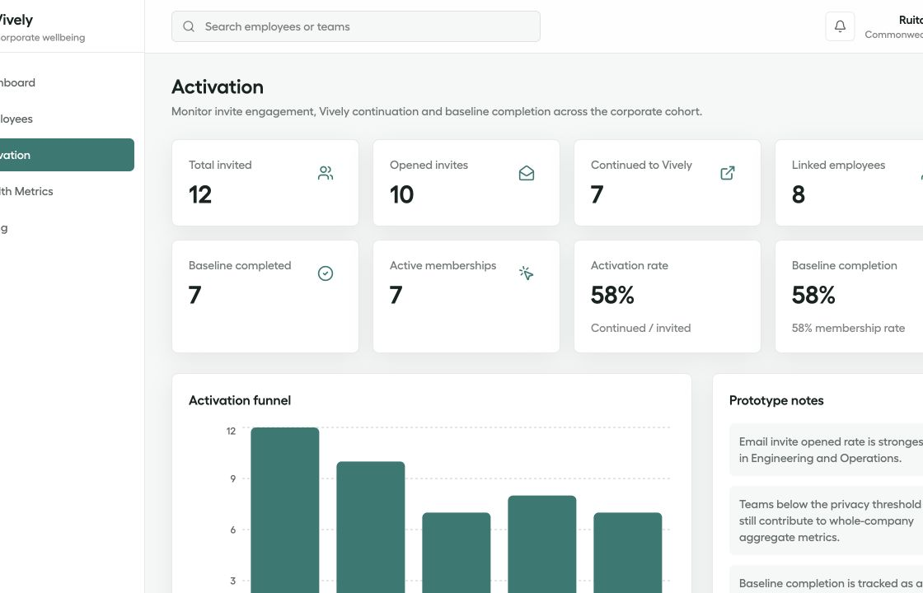
VIVELY CORPORATE DASHBOARD MVP
Activation reporting turns workflow data into progress metrics
The page translates employee invite states into a funnel view.
12
9
7
Total invited
Opened invites
Continued
The funnel uses the same employee records as the table, so it gives us a realistic way to validate whether these stages match Vively’s onboarding process.
Week 3 client meeting · 6

Slide 7
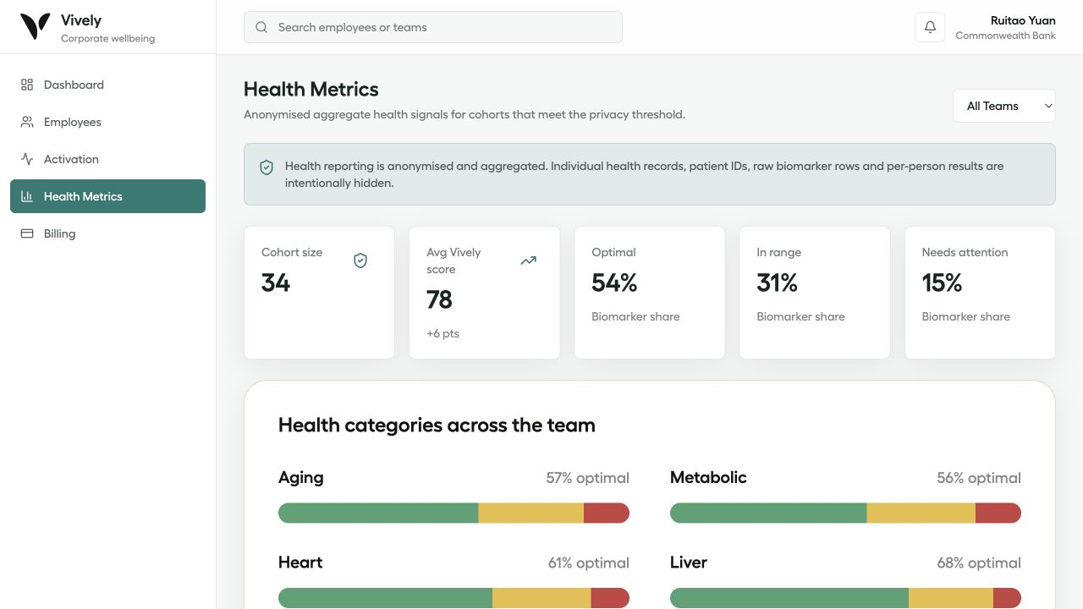
VIVELY CORPORATE DASHBOARD MVP
Health metrics are aggregate-only by design
The page shows team-level trends while suppressing small cohorts.
Privacy threshold
Teams below 10 people show Insufficient Data.
What is hidden
No patient IDs, individual biomarker rows, raw blood tests or individual health records.
Week 3 client meeting · 7

Slide 8
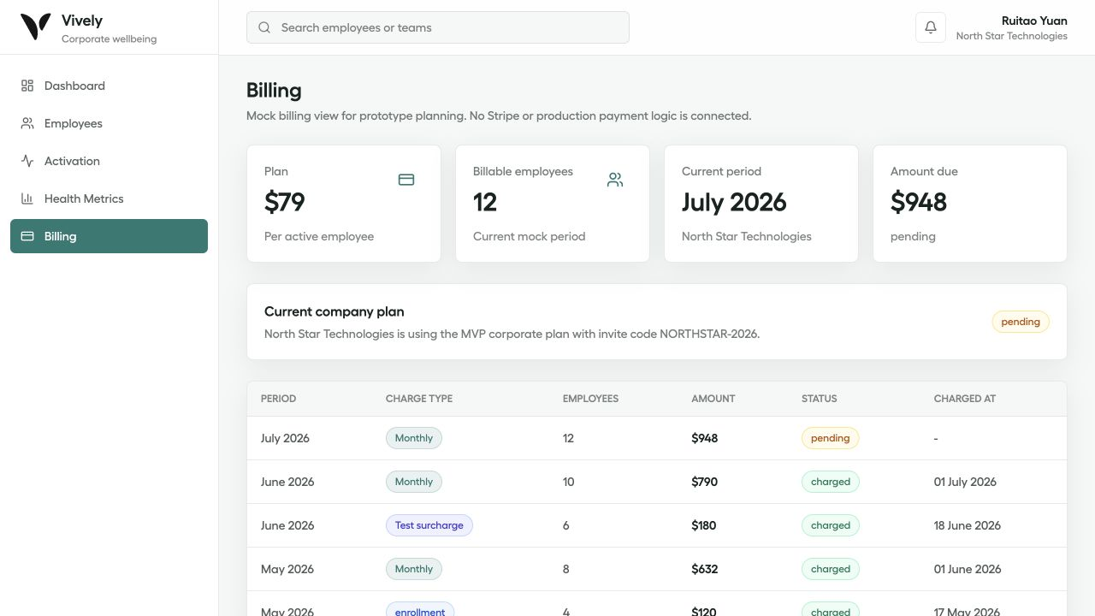
VIVELY CORPORATE DASHBOARD MVP
Billing is represented as a safe mock workflow
The page shows plan and billing history without real payment processing.
What is included
Current plan price and billable employee count.
Current billing period, amount due and status.
Mock billing history only: no Stripe or real payments.
Week 3 client meeting · 8

Slide 9
VIVELY CORPORATE DASHBOARD MVP
We need Vively’s feedback before deepening the build
The foundation is in place; the next step is validating the product assumptions.
Feedback needed
Are the employee invite fields correct for the corporate workflow?
Next build priorities
1. Add the /join invite page
2. Improve employee search and filtering
3. Continue aligning selected Vively UI components
4. Keep the mock API layer ready for real routes
Do the activation stages match Vively’s real onboarding process?
Is 10 the right minimum cohort size for health reporting?
Week 3 client meeting · 9

