Slide 1
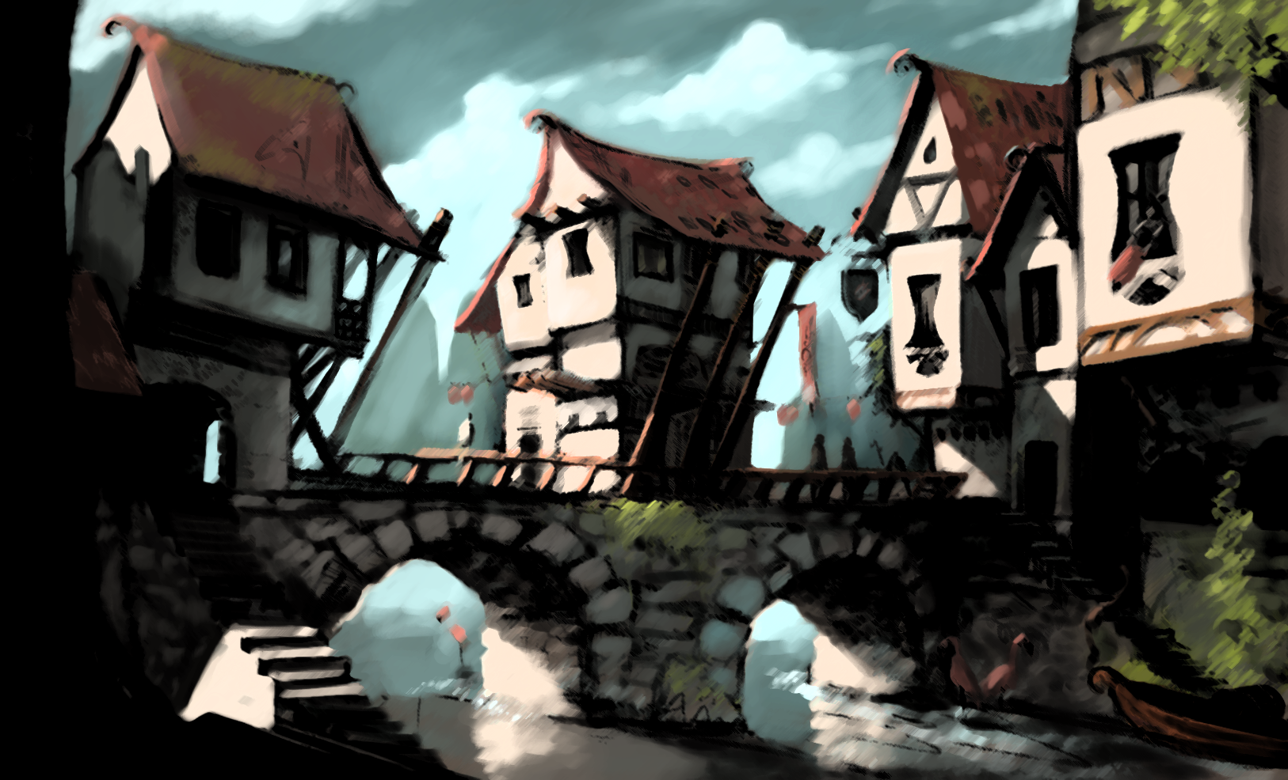
Dominion Web Game CMP http://www.dominioncmp.5gbfree.com/#
Carlos Perez
Brent Parker

Slide 2
Features:
Table view
Cards that grow with mouseover
Ability to play action and coin cards from hand
Feedback when clicking cards in supply
Ability to buy a card from supply deck.
Functional end turn button.

