Slide 1
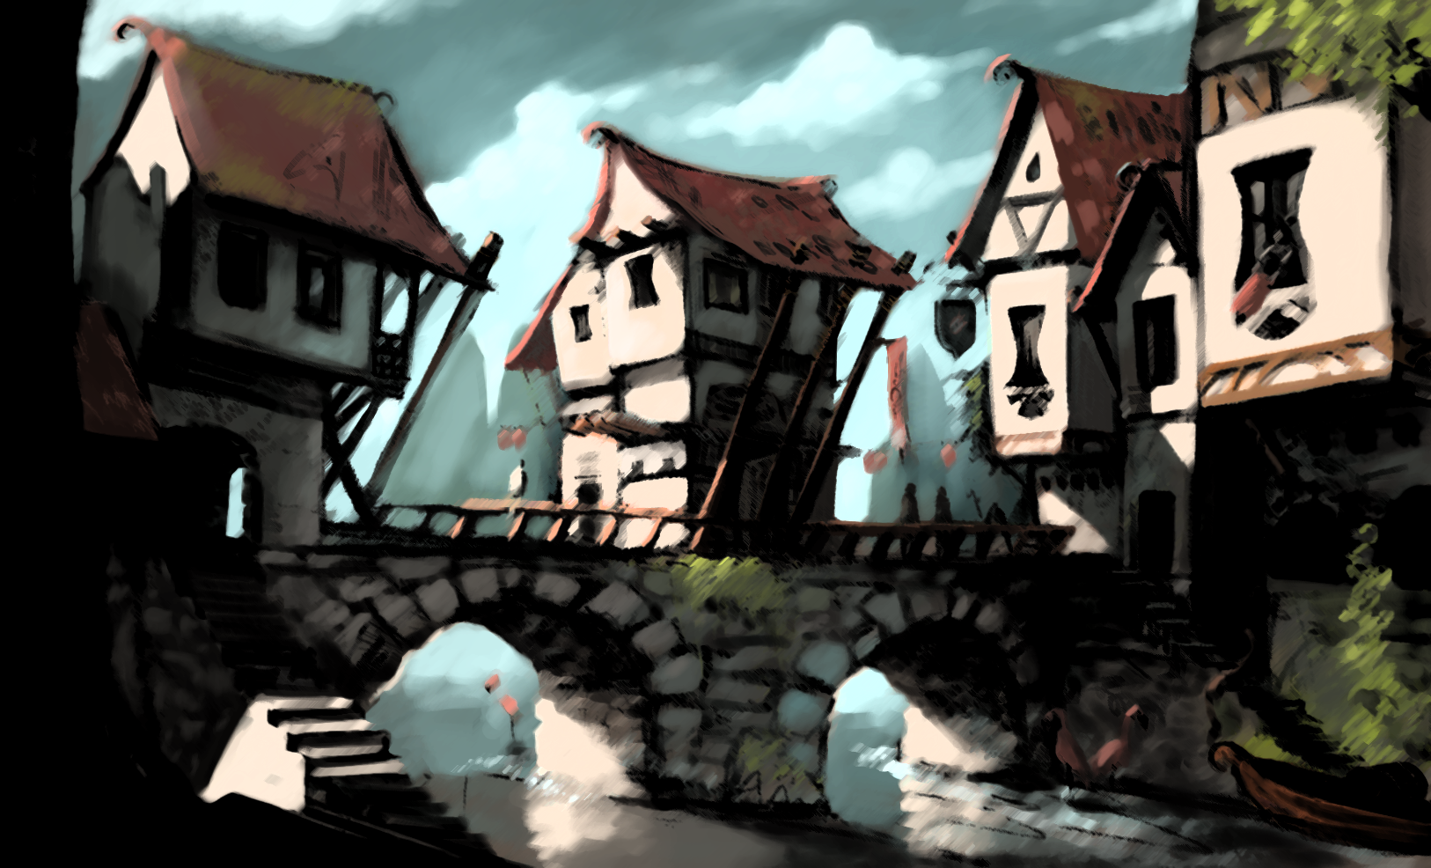
Dominion Web Game CMP
Matthew Griffin
Carlos Perez
Brent Parker

Slide 2
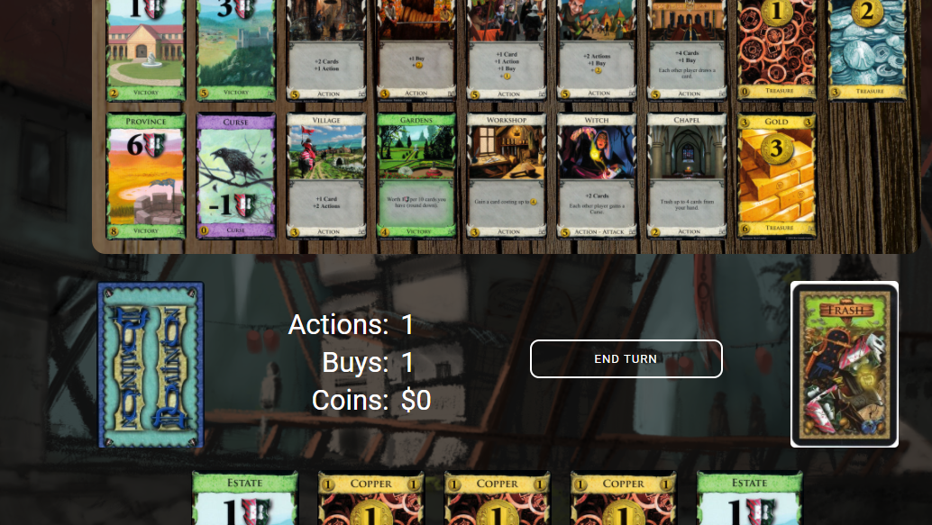
What is it?
The Dominion web game is an electronic version of the card game Dominion.
There’s no need to set up the game, or clean up the mess when the game ends, the computer does it all for you.

Slide 3
Who is This For?
This program is geared more for people that are familiar with the Game Dominion, and have probably played the card game before.
People who just want to play a quick game of Dominion without setting everything up will love this program.
People who want to play the game, but don’t have people to play with, will love the ability to play against A.I.

Slide 4
Features:
Table View
Cards that Grow with Mouseover
Ability to Play a Card from Hand
Feedback when Clicking Cards in Supply

Slide 5
System Requirements:
Color display 1024 X 768
1.5ghz CPU
Integrated graphics
2GB of RAM
500MBs free hard drive space
Mouse and keyboard
56kbps Internet connection
Chrome, Firefox, or Edge browser

Slide 6
Planned Features:
Ability to buy a card from supply deck.
Ability to start a new game with the new game button.
Functional end turn button.
Ability to choose the number of A.I players.
Functional trash card pile.

