Slide 1
DC Crime analysis
Brandon Pennington
GEOG498G - Fall 2020

Slide 2
Overall updates
Performed exploratory geospatial analysis of the DC area on the distribution of crime for 2 years (2017-2018). Mainly, added transportation figures
Was able to perform the multi-variable OLS regression analysis, GWR/MGWR, Moran’s I, and Local Moran’s I (may still need some final tweaking though)
Interactive visualizations with Folium may be scrapped for time being. More prudent to concentrate on the final report and having good figures, maps, and reports

Slide 3
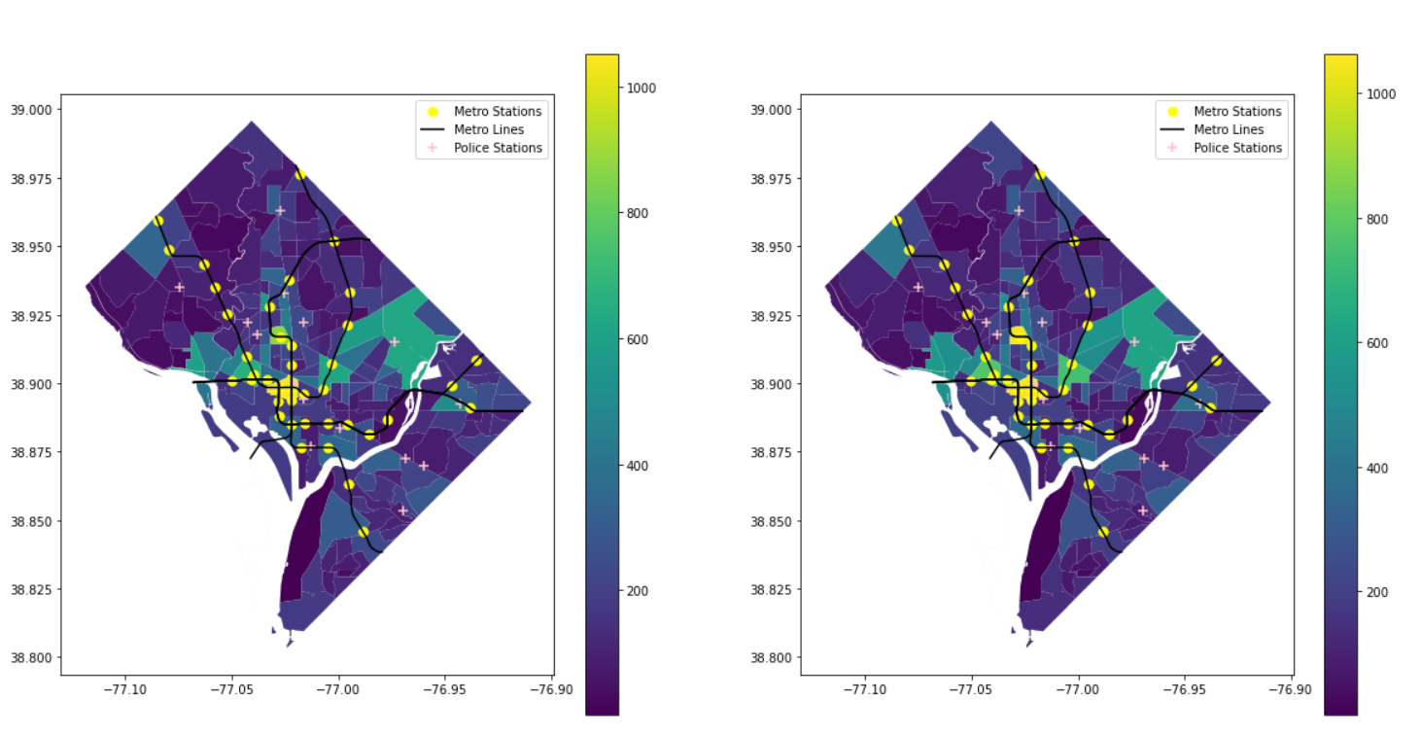
Crimes by census tract + transportation
Crime Density by census tract
2017
2018

Slide 4
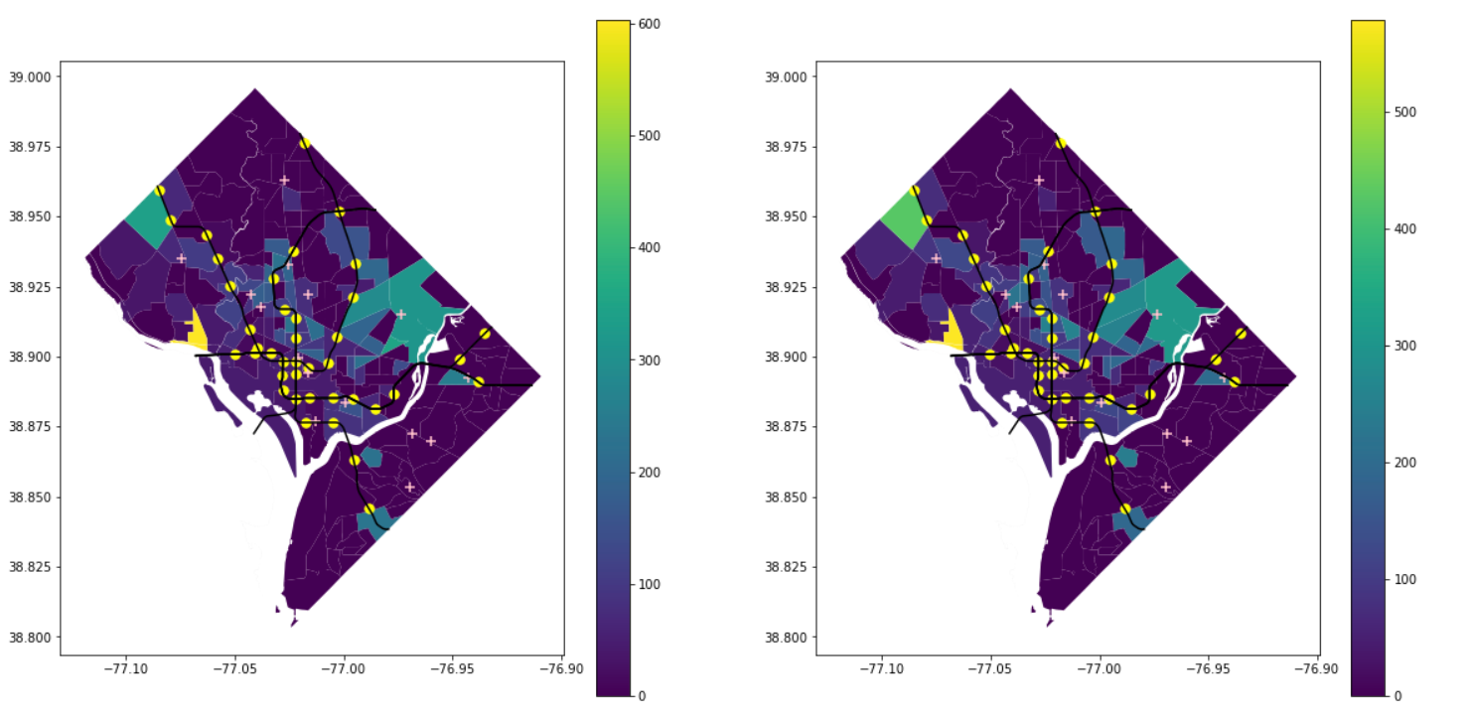
Crimes by census tract + transportation
Bus stop to crime ratio
2017
2018

Slide 5
Local hot/cold spots
The results for 2017 seemed to be a bit more dispersed/sporadic overall.
The hot and cold spot analysis seemed to make a bit more sense in 2018 with larger concentration of hotspots centered around where the National Mall and the touristy museums are dispersed (even though the actual crime choropleth maps looked pretty similar for both years)

Slide 6
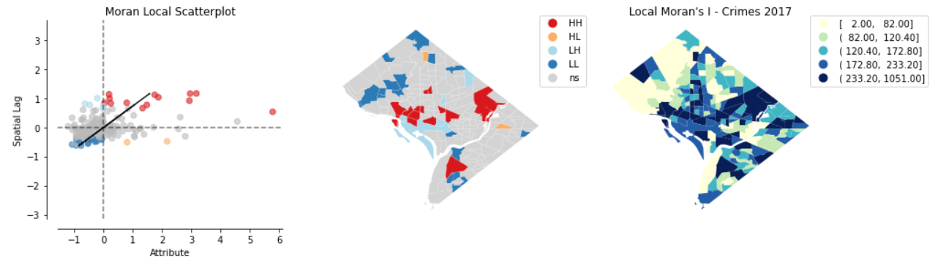
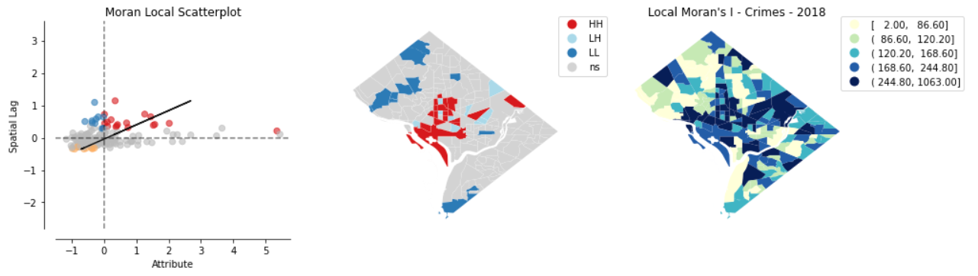
Autocorrelation Plots

Slide 7
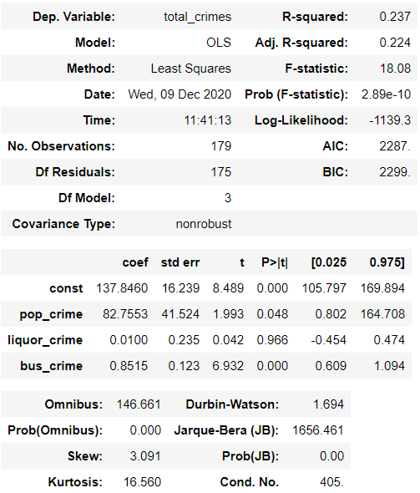
Ordinary least squares regression model
Population_crimes ~ total_liquor + total_bus + total_atms
I started getting warnings/errors with the atm data that including it into the model would result in strong multicollinearity problems, so I withdrew it
Low R-squared values
High skew

Slide 8
Gwr & mgwr
Issue: there are only so many census tracts in Washington DC (less than 400), so there may be a bit of a collinearity problem (GWR and MGWR are best performed on larger datasets)

Slide 9
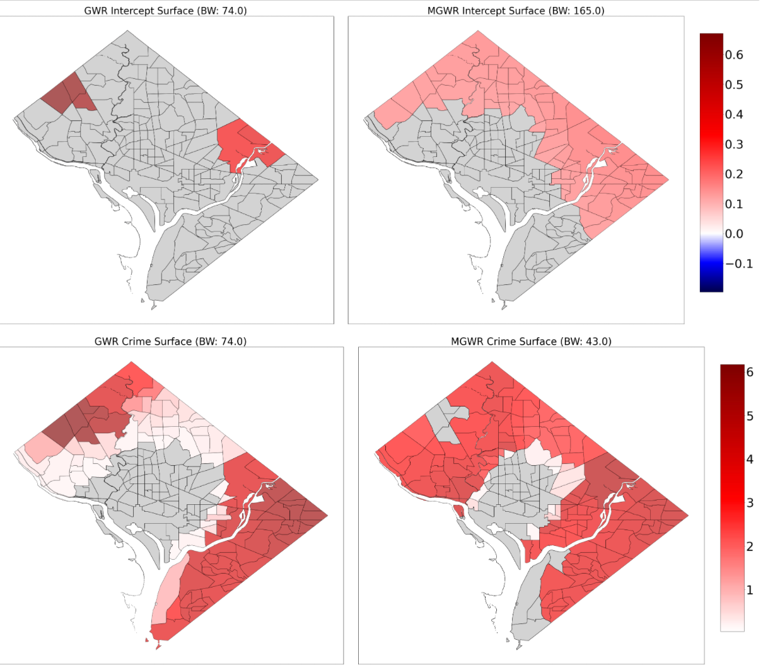
GWR/MGWr
2017

Slide 10
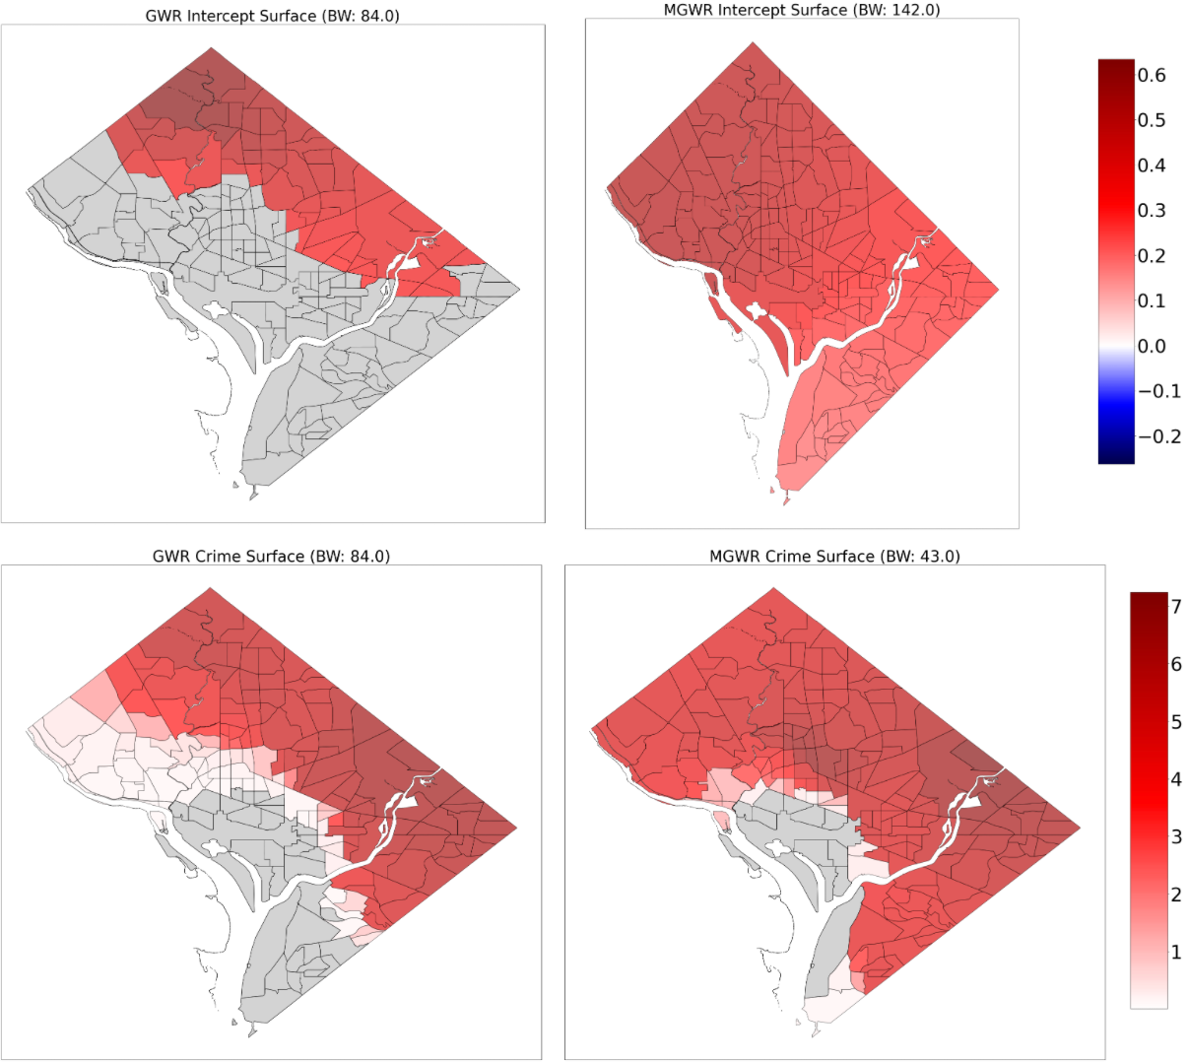
GWR/MGWr
2018

Slide 11
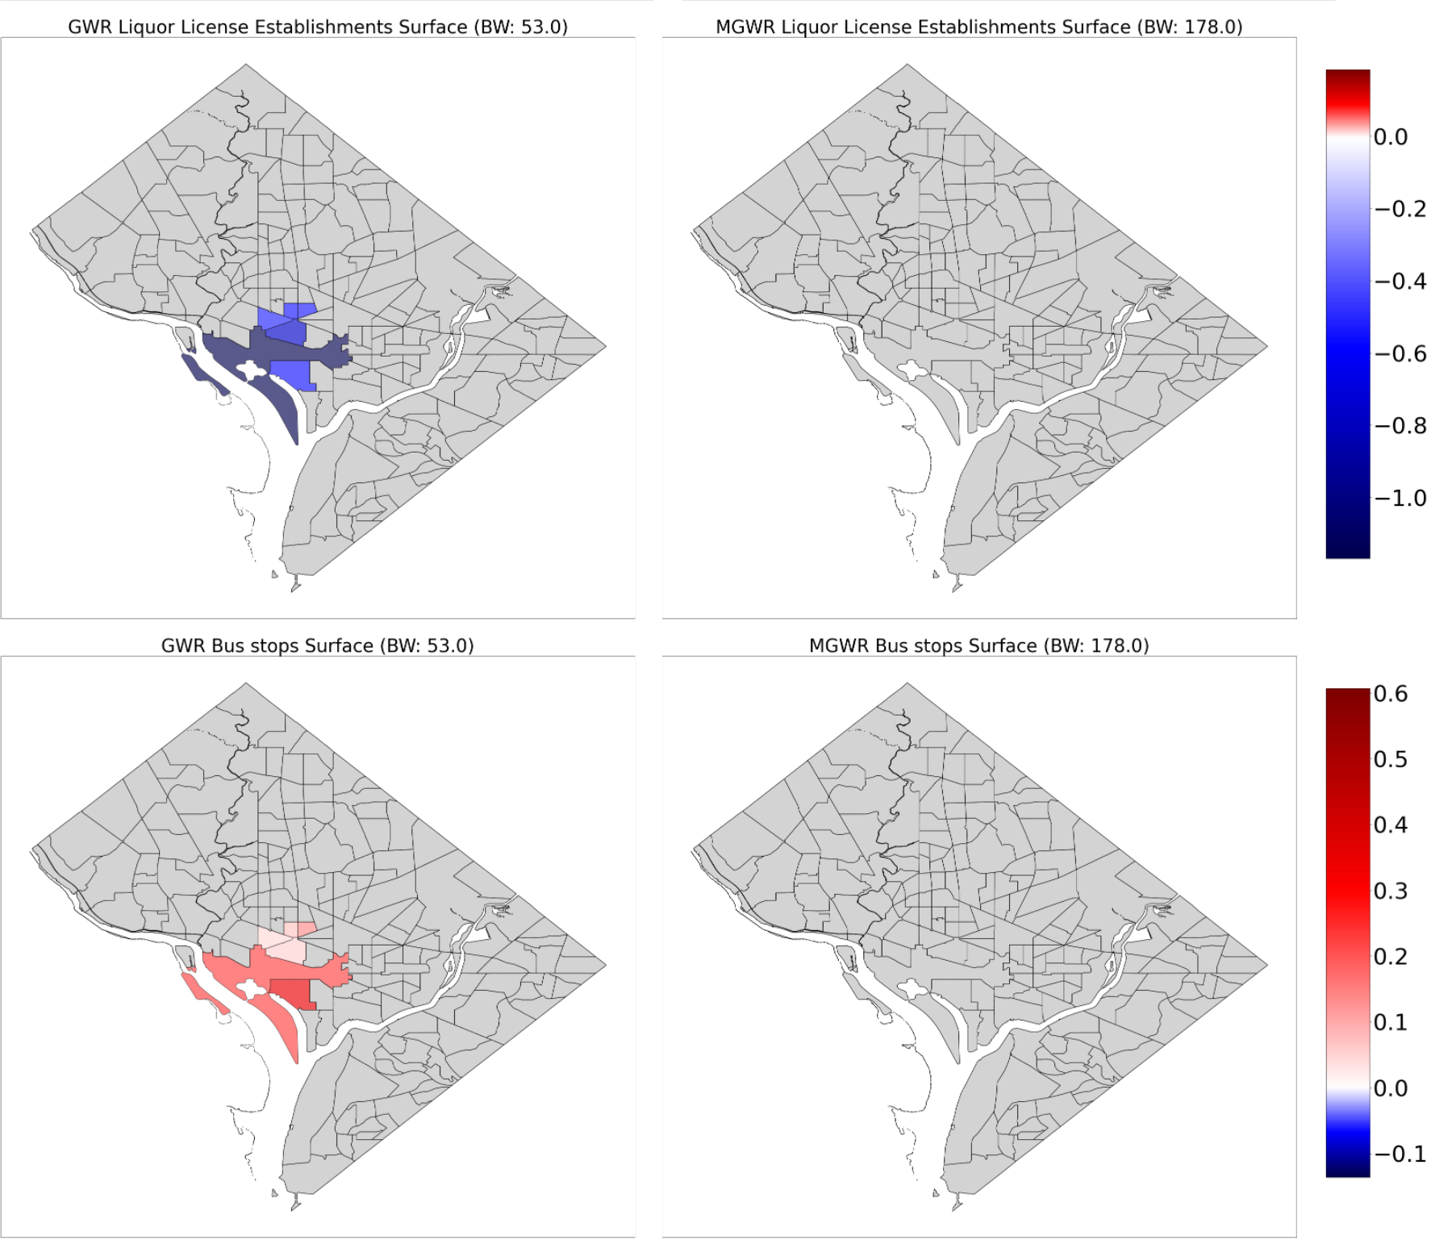
GWR/MGWr
2018 cont.

Slide 12
Difficulties/concerns
Need to more fully interpret some of the other findings in the GWR/MGWR plots. Some of the statistics are still over my head from lack of experience
Wasn’t able to come up with a good way to factor in metro stops into the spatial models, which is why I ended up taking in the metro bus stops as a substitute (more points, more distribution, etc.)
Shout outs to Matthew Tralka for bringing to my attention an interesting new way that crime is being uniformly reported on for trend analysis – NIBRS
  https://www.fbi.gov/services/cjis/ucr/nibrs
It would be interesting in the next iteration to split up the data into types of crimes

Slide 13

Questions?
Suggestions?

