Slide 1
Project update 1
Brandon Pennington
GEOG498G - Fall 2020

Slide 2
objectives
Perform exploratory geospatial analysis of the DC area on the distribution of crime
Discover how various points of interest that affect the immediate areas likelihood of crime occurrences for better or for worse, and measure how severe it modifies it.
Analysis to be done utilizing Local Moran’s I, GWR/MGWR, possibly others
Visualize the results in a meaningful and preferably browser-based way

Slide 3
Data cleaning, gathering, progress
Finalized datasets from opendcdata.gov
  Crime data (just taking 2020 data for now for ease of computation)
  ATMs
  Police Stations and Sectors
  Metro System (entrances)
  Establishments that have a liquor license
Probably abandoning cenpy in favor of pulling ACS data from dcopendata.gov.
Finalize decision on what spatial metric to use (census blocks, police districts)

Slide 4
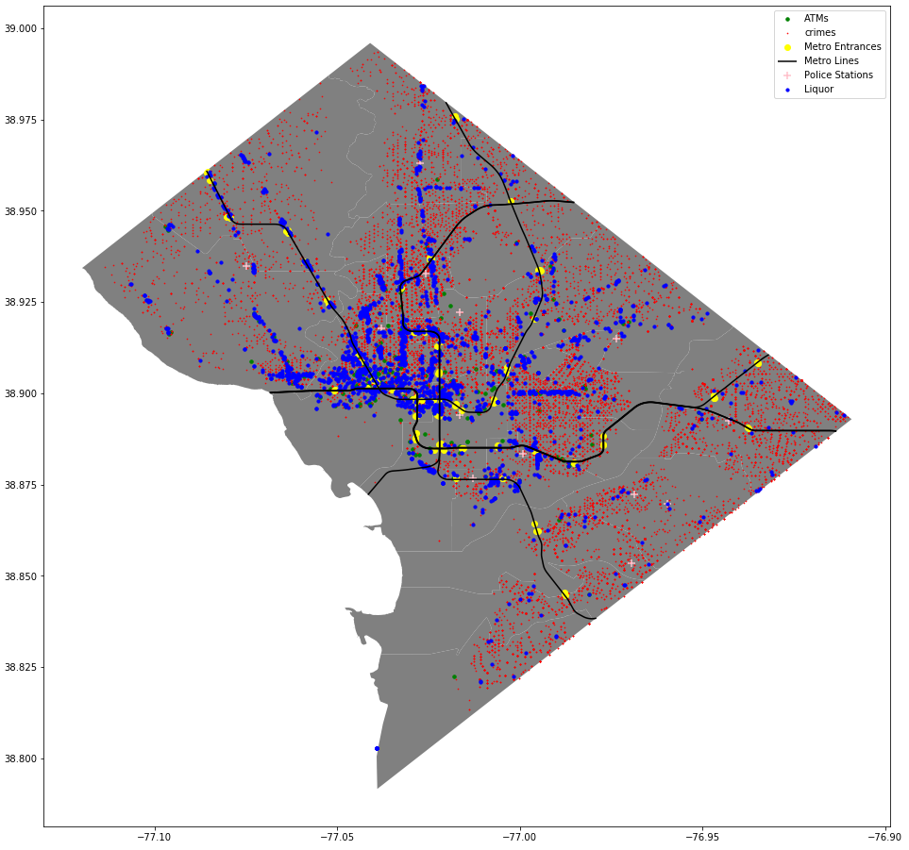
Original Matplotlib data plot

Slide 5
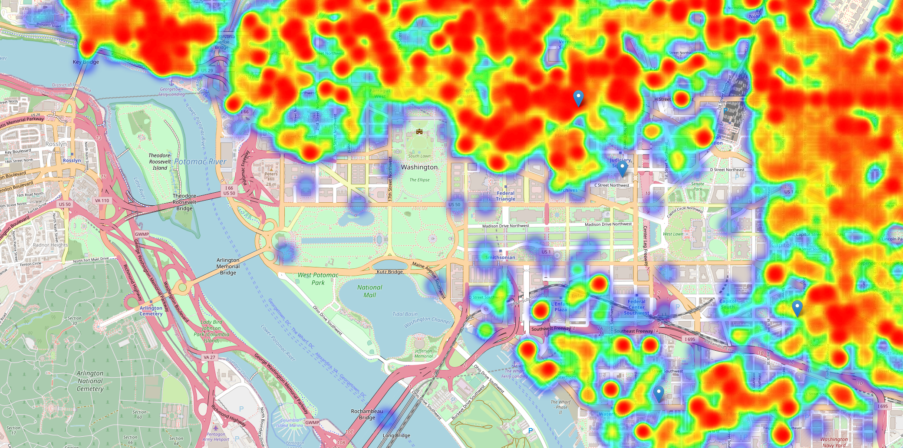

Slide 6
Current Challenges
Multiple restarts. Not making much headway on the actual geostatistics
Technology problems – built new computer, data migration complications were had. Development being done entirely in Docker for the time being
Pulling relevant census data is still a pretty big challenge for me so far.
Original scope might be a bit much for me to accomplish

Slide 7
Moving Forward
Pull relevant Cenpy data
Normalize crime density for the population
Get working MGWR model up and running – correlate to POI’s
Refine the Folium map (toggleable layers by year, clickable markers, layers for future analysis, etc.)

Slide 8
Questions?

