Slide 1
Project update 2
Brandon Pennington
GEOG498G - Fall 2020

Slide 2
objectives
Perform exploratory geospatial analysis of the DC area on the distribution of crime
Discover how various points of interest that affect the immediate areas likelihood of crime occurrences for better or for worse, and measure how severe it modifies it.
Analysis to be done utilizing Moran’s I, Local Moran’s I, GWR/MGWR
Visualize the results in a meaningful with preferably browser-based delivery

Slide 3
Data cleaning progress
Analysis done with census tracts as spatial unit
Plotted per census tract counts/distributions of data
For one year (so far) I was able to:
  Merged population tract data to crime and number of liquor establishments in each tract
  Performed LISA statistical tests (Global and Local Moran’s I)
  Performed initial GWR and MGWR analysis

Slide 4
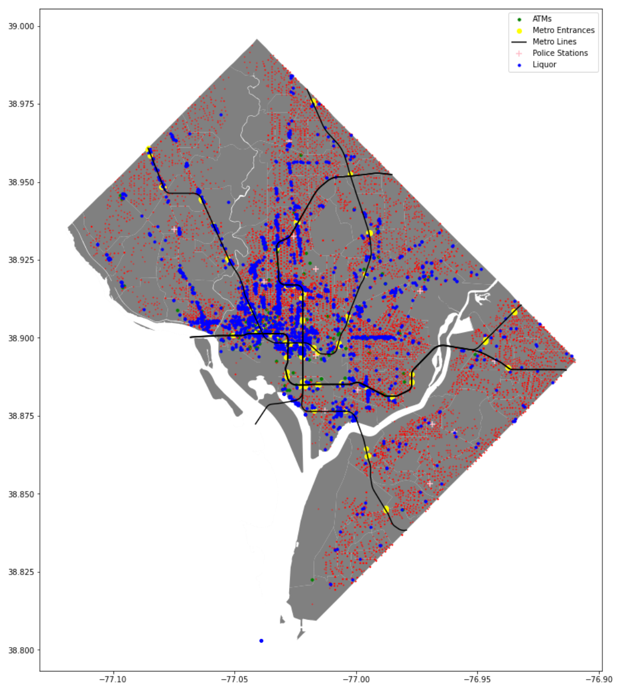
Original Matplotlib data plot

Slide 5
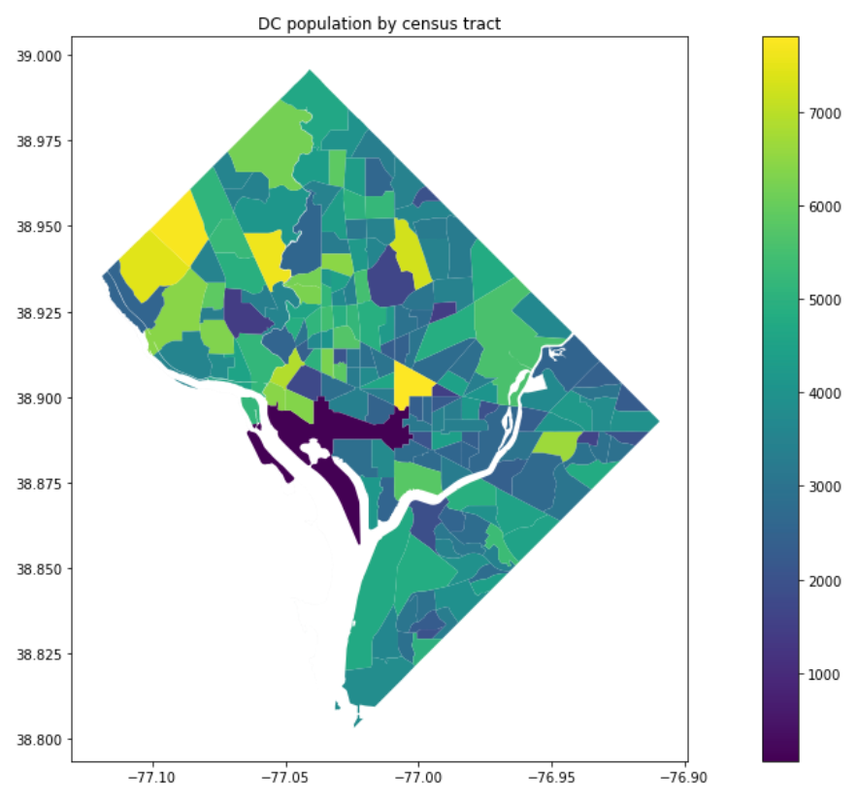
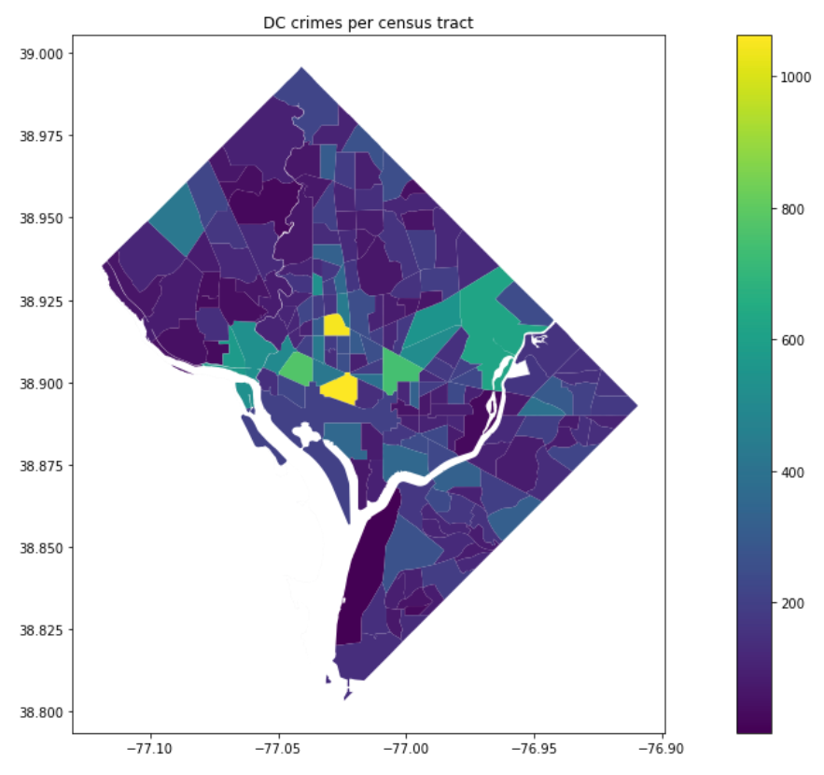
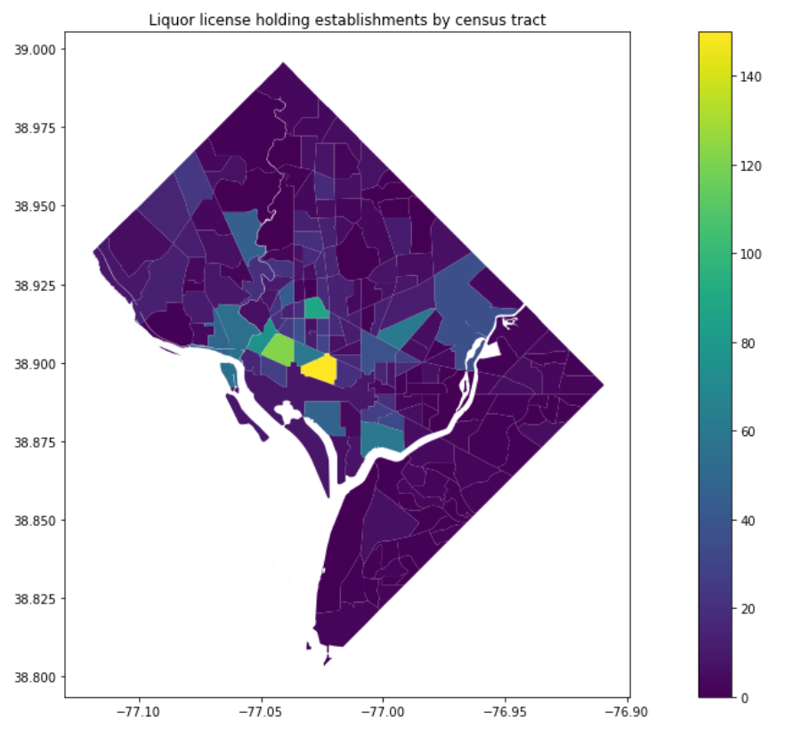
Initial plots

Slide 6
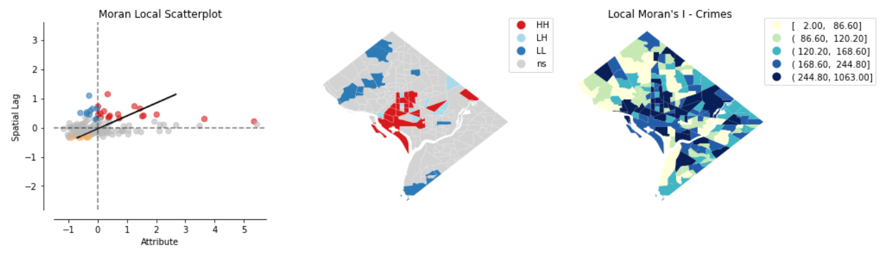
Local indicators of spatial association

Slide 7
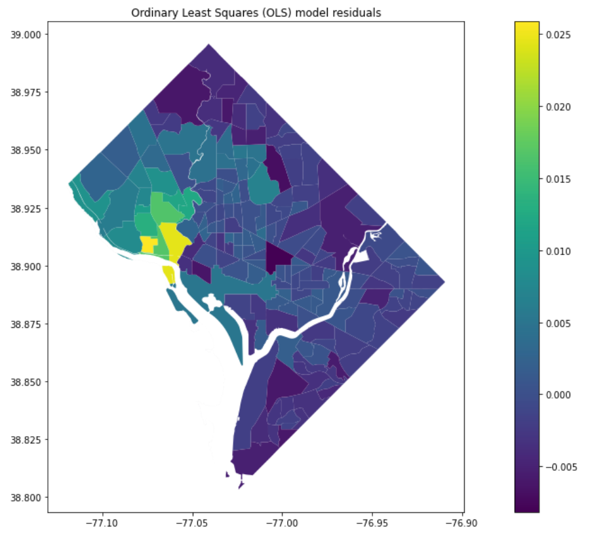
Regression: crimes to population

Slide 8
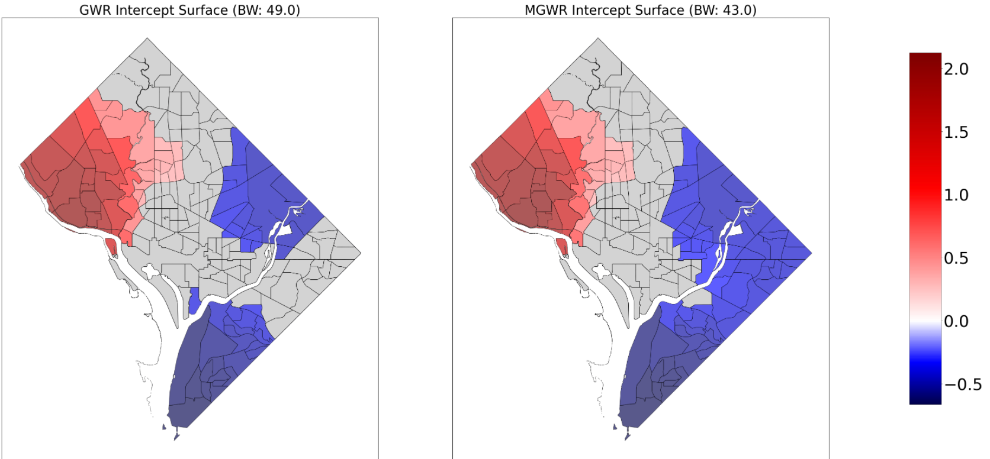
GWR/MGWR initial surface comparison

Slide 9
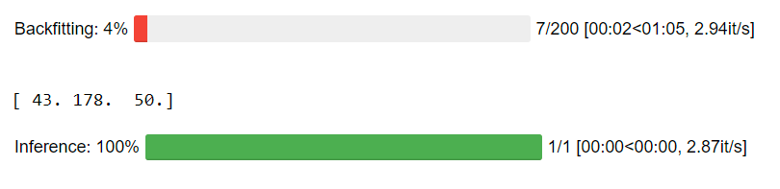
Moving Forward
I need to finalize how I’d like to normalize for population given some tracts report obscenely low population (one tract reported 60 people in the tract for 2018)
Binarize whether there is a metro stop in each census tract and add that to the model
Add ATM’s to the model
Work on setting up my interactive Folium map to be able to visualize the results in a meaningful way (being able to flip through timeline layers, etc)
Perform the analysis on other years (2020 preliminary data has been released)
Revisit explanations of some of the statistical methods used so I can ensure I’m explaining my results accurately
Bug with the population and liquor license GWR/MGWR analysis

Slide 10

Questions?

