Slide 1
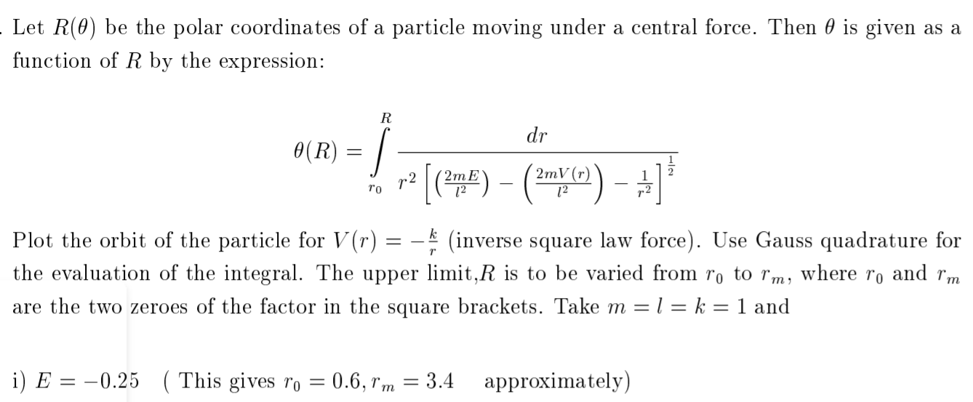
Numerical Integration - 1

Slide 2
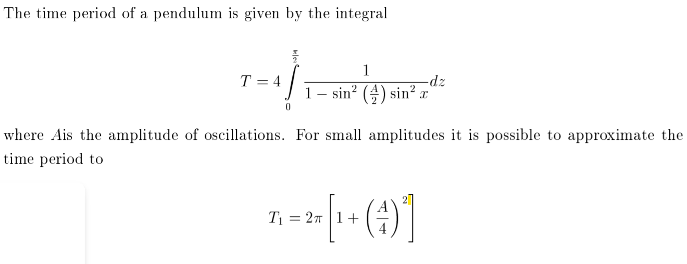
Numerical Integration - 2

Slide 3
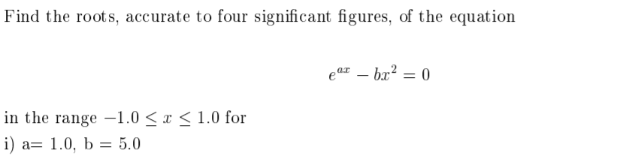
Root finding – 1 (Newton3)

Slide 4
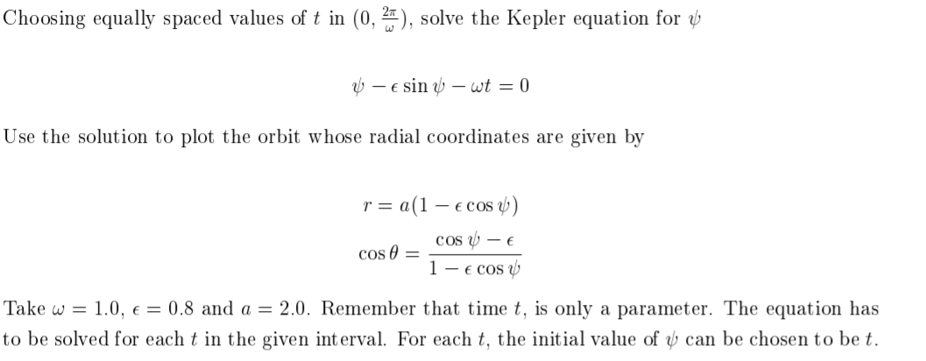
Root Finding -2 (Newton2)

Slide 5
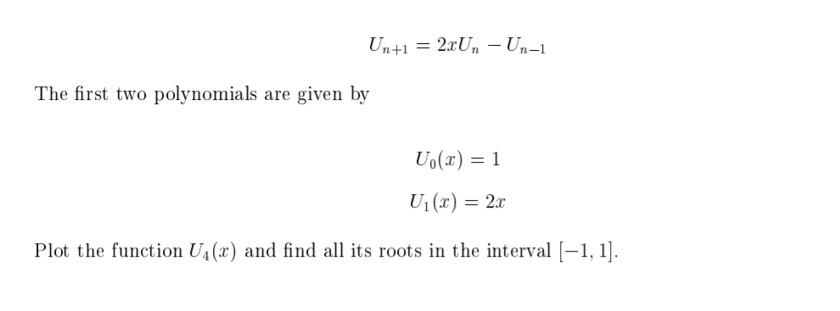
Root Finding – 3 (Bisec2)

Slide 6
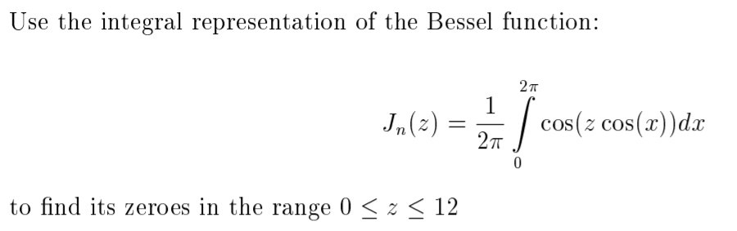
Roots of integral

Slide 7
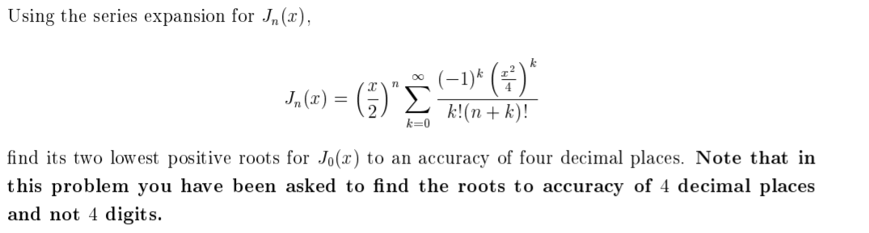
Root Finding – 4 (Bisec3)

