Slide 1
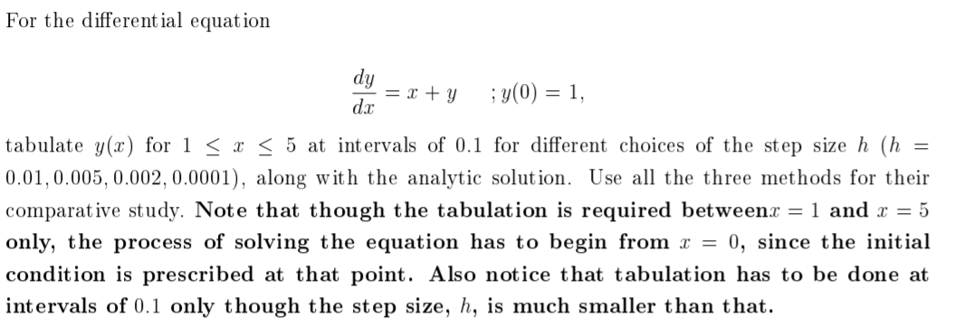
Intro to solving ODEs

Slide 2

Pendulum

Slide 3
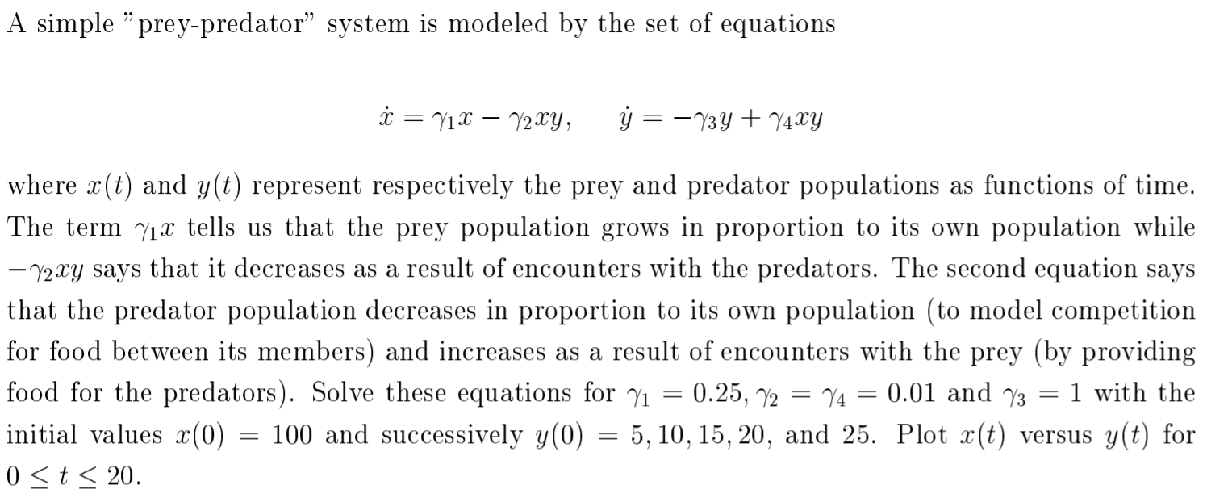
Prey-predator

Slide 4
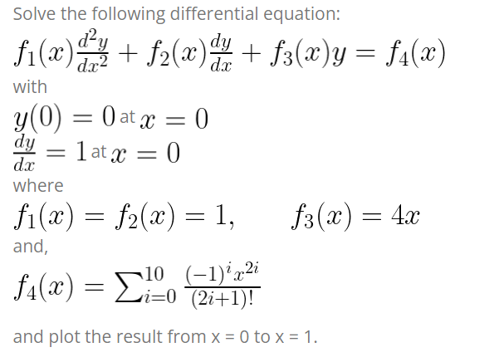
Problem 4

Slide 5
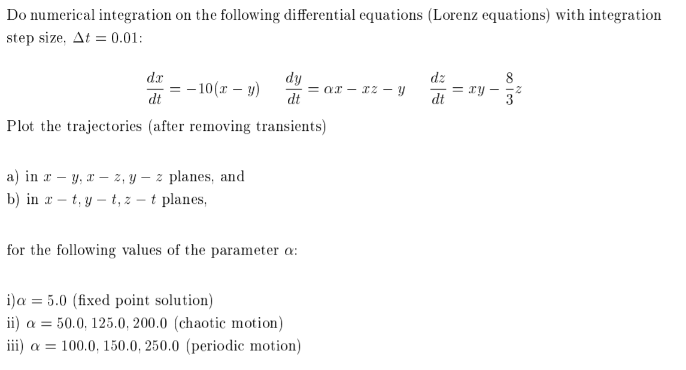
Lorenz Attractor

Slide 6

Logistic Map

