Slide 1
Web Development
Assignment
BAPPADITYA BISWAS
Roll no. : 227058
1st Sem. B.Tech. (CST)
HTML, CSS
Hosted in Github using git

Slide 2
INDEX
Introduction
Objective
Feasibility Study
Application of Software tools
Conclusion
References

Slide 3
INTRODUCTION
There are three HTML files, the first one (pizza.html) for the front page, and the second (menu.html) for the menu Page , and the third (best deal.html) for the best deal page.
Content of the repository -
Pizza .html
Menu.html
Best deal.html
style.css
images

Slide 4
Objective
To design a website that people can order delicious pizza’s and other snack’s and have a good day.
User will choose there favourite items and order it from online .
User can see the menu , there are three types of snack’s.
1st PIZZA’s
2nd WRAP’s
3rd COFFEE’s
User can see the best deal’s , there will be a good discount for all snack’s.

Slide 5
Feasibility Study
Technical Feasibility
The Project only involves Front End development with
all the backend work happening on the Brave server.

Slide 6
Application of Software tools
Tools used :-
VS CODE : Visual Studio Code, also commonly referred to as VS Code, is a source-code editor made by Microsoft with the Electron Framework, for Windows, Linux and macOS.
SUBLIME : it , is a source-code editor made by Microsoft with the Electron Framework, for Windows, Linux and macOS.
OS : Window 11

Slide 7
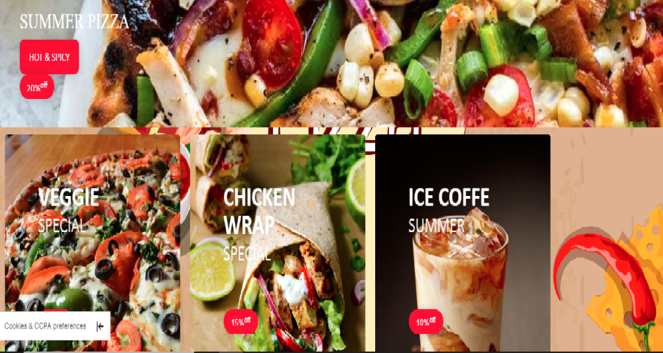
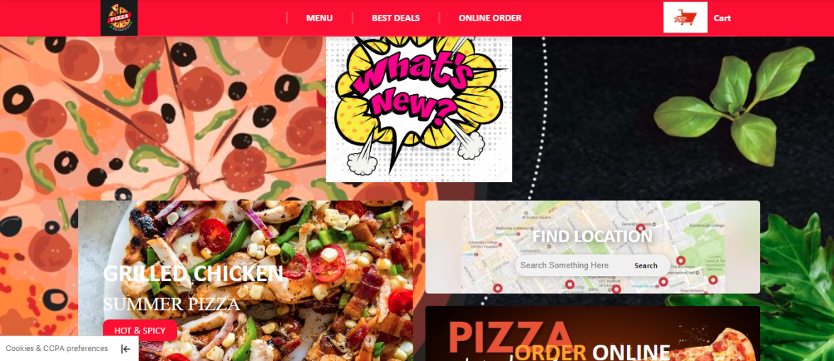
Conclusion
Simple images to show how the website works

Slide 8
References
Thank You
BAPPADITYA BISWAS
Roll no. :- 226023
St. Andrews Institute of Technology and Management
1st Semester B.Tech. CST

