Slide 1
Terraform

Slide 2
Terraform Course Outline

Slide 3
IAC Tools
Terraform
Cloudformation
Azure ARM Template
Google Deployment Manager
Heat
Ansible
Puppet
Chef
Salt-stack

Slide 4
Configuration Management & Provisioning Tools
Ansible, Puppet , Chef & Salt-Stack are CM tools, primarily designed to install and manage software on existing servers
Terraform/CFT/ARM Template/Deployment Manager are provisioning tools, they can provision servers and infrastructure for the applications
CM tool also can perform provision tasks but provisioning tools are better in provisioning and better fit

Slide 5
Criteria while Selecting IAC tools
Is your infrastructure going to be vendor specific in longer term?
Are you planning to have multi-cloud/hybrid cloud based infrastructure
How well does it integrate with CM tools
Price & Support

Slide 6
Terraform
Support multiple platforms, has hundreds of providers
Simple Configuration language and faster learning curve
Easy integration with CM tools like ansible
Easily extensible with the help of plugin
Free!!!
https://www.terraform.io/docs/providers/
https://d1.awsstatic.com/whitepapers/compliance/AWS_CIS_Foundations_Benchmark.pdf

Slide 7
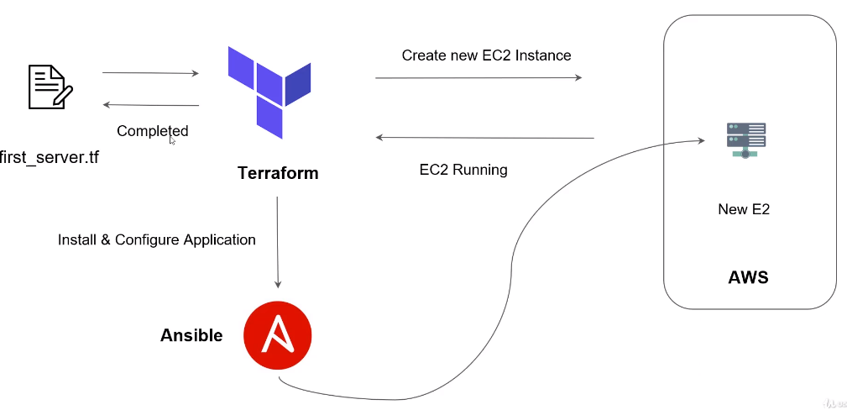
What is Terraform?
Infrastructure as a Code
Automation of Infrastructure
Keep your Infrastructure in certain state (Compliant)
E.G. 2 Web Instances with 2 Volumes and 1 load Balancer
Make your Infrastructure auditable
You can keep your infrastructure change history in version control system like GIT

Slide 8
What is Terraform?
Infrastructure as a Code
Automation of Infrastructure
Keep your Infrastructure in certain state (Compliant)
E.G. 2 Web Instances with 2 Volumes and 1 load Balancer
Make your Infrastructure auditable
You can keep your infrastructure change history in version control system like GIT

Slide 9
Terraform
Ansible, Chef, Puppet, Saltstack have focus on automating installation and configuration of software
Keeping the machine in compliance, in a certain state
Terraform can automate provisioning of the infrastructure itself
E.g. Using AWS/Azure/Google Cloud/DigitalOcean
Works well with automation software like ansible to install software after the infrastructure is provisioned

Slide 10
Installing Terraform
https://www.terraform.io/downloads.html
https://releases.hashicorp.com/terraform/0.12.9/terraform_0.12.9_linux_amd64.zip
yum update -y
yum install wget -y
wget -q https://releases.hashicorp.com/terraform/0.12.9/terraform_0.12.9_linux_amd64.zip
yum install unzip -y
unzip -o terraform_0.12.9_linux_amd64.zip -d /usr/local/bin
rm terraform_0.12.9_linux_amd64.zip

Slide 11
Spin AWS Instance using Terraform
https://www.terraform.io/downloads.html
https://releases.hashicorp.com/terraform/0.12.9/terraform_0.12.9_linux_amd64.zip
yum update -y
yum install wget -y
wget -q https://releases.hashicorp.com/terraform/0.12.9/terraform_0.12.9_linux_amd64.zip
yum install unzip -y
unzip -o terraform_0.12.9_linux_amd64.zip -d /usr/local/bin
rm terraform_0.12.9_linux_amd64.zip

Slide 12
Spin AWS Instance using Terraform
Open AWS Account
Create IAM admin user
Create Terraform file to spin up t2.micro instance
Run terraform apply

Slide 13
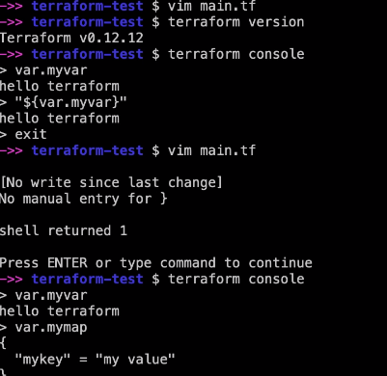
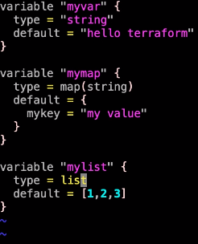
Terraform HCL
HCL – Hashocorp Configuration Language
“${var.mymap[“mykey”]}” ,
element(var.mylist, 1)
Slice(var.mylist, 0, 2)

Slide 14
Variables
Terraform variables completed reworked in 0.12 release
You can now have more control over variables and have for and for-each loops which is not possible in earlier version
You do not have to specify types in variables but it is recommended
Terraform’s Simple Variable Type
String
Number
Bool

Slide 15
Variables
Terraform’s Complex Variable Type
List(type)
Set(type)
Map(type)
Object({<ATTR_NAME>=<TYPE>,…}
Tuple([<TYPE>,…])
List: [0,1,5,2]
Map: {“key” = “value”}
A list is always ordered it always returned 0,1,5,2 not 5,1,2,0
A “set” is like list but doesn’t keep the order you put in and can only contain unique values
In set it become [1,2,5]

Slide 16
Variables
Object is like a map but each element can have different type
For example
{
firstname = “John”,
Housenumber = 10
}
A tuple is like list but each element can have different type
[0, “string”, false]
The most common types are List and Map the other ones are only used sporadically
The one you most remember is string, number, bool and the list & map

Slide 17
Variables
Everything in one file is not great
Use variable to hide secrets
You don’t’ have to store aws creds in git repo
Use Variable that might change
AMIs are different per region
Use Variable to make yourself easier to reuse terraform files

Slide 18
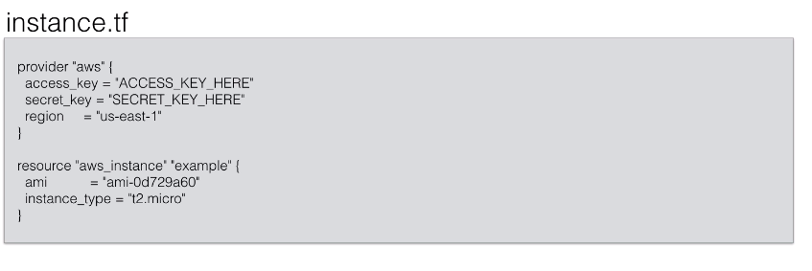
Variables

Slide 19
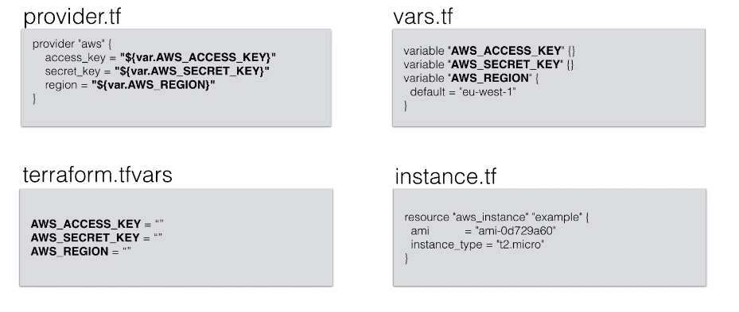
Variables

Slide 20
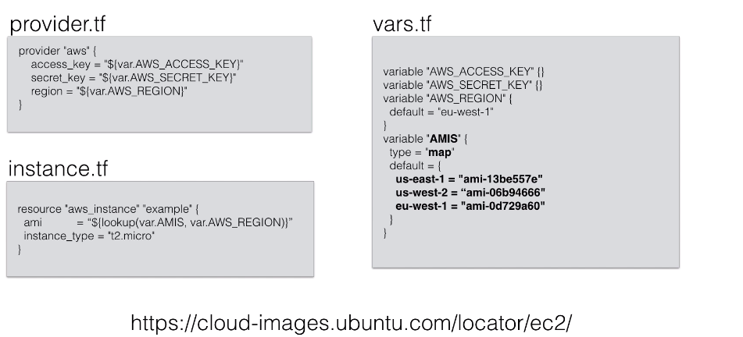
Variables

Slide 21
Software Provisioning
Open AWS Account
Create IAM admin user
Create Terraform file to spin up t2.micro instance
Run terraform apply

Slide 22
Outputting Attributes
Terraform keeps attribute of all the resources you create
E.g. the aws_instance resource has the attribute public_ip
Those attribute can be queried and outputted
This can be useful just to output valuable information or to feed information to external software

Slide 23
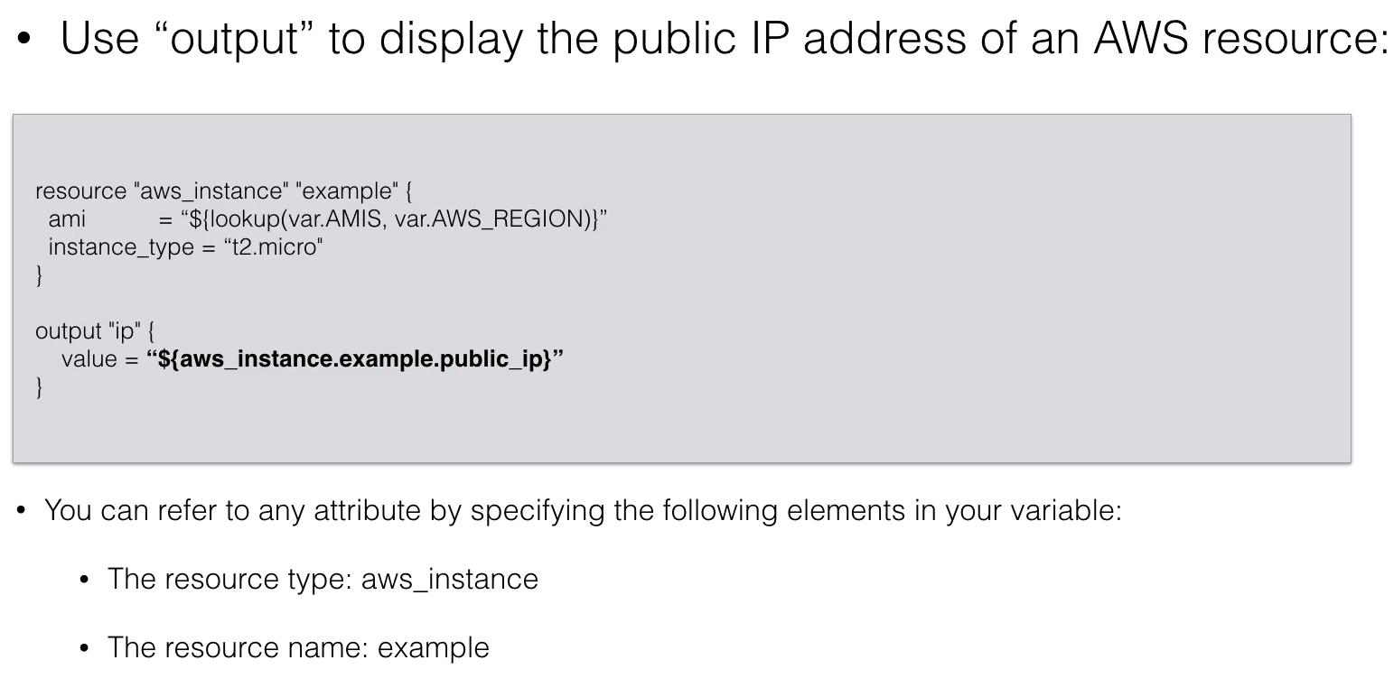
Outputting Attributes

Slide 24
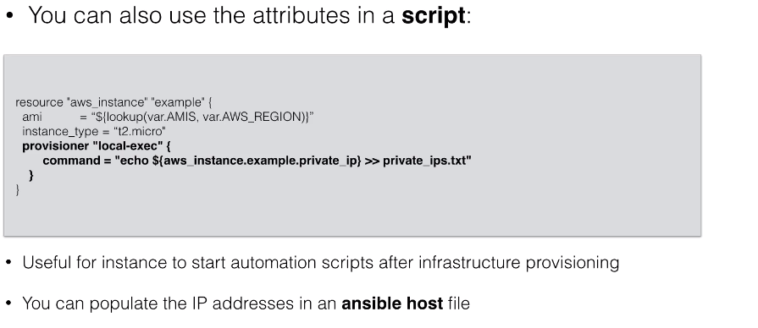
Outputting Attributes

Slide 25
Outputting Attributes

Slide 26
Datasources
For certain providers (like AWS), terraform provides data sources
Data sources provides you with dynamic information
A lot of data is available by AWS in structured format using their API
Terraform also exposes this information using data sources
Examples:
List of AMIs
List of Availability Zones

Slide 27
Datasources
Another Example is the data source that gives you all IP address in use by AWS
This is useful if you want to filter traffic based on an AWS region
We could manage security groups as well

Slide 28
Template Provider
Template provider can help creating customized configuration files
You can build templates based on variables from terraform resource attributes (e.g. a public IP address)
The result is a string that can be used as a variable in terraform
The string contains a template
E.g. a configuration file
Can be used to create generic templates or cloud init configs
If we want to pass user-data that depends on other information in terraform (e.g. IP address) you can use the provider template

Slide 29
Template Provider
First you create a template file
#! /bin/bash
echo "database-ip = ${myip} >> /etc/myapp.config
Then we will create template file resource that will read the template file and replace ${myip} with the IP address of an AWS instance created by terraform
data "template_file" "my-template"{
template = "${file("templates/init.tpl")}"
vars {
myip = "${aws.instance_database1.private_ip}"
}
}

Slide 30
Template Provider
Then you can use the my template resource when creating a new instance
#Create a Web server
resource "aws_instance" "web"{
user_data = "${data.template_file.my-template.rendered}"
}
When terraform runs it will see that it needs to spin up the database1 instance then generate the template and only then generate the web instance
The web instance will have template injected in user_data and when it launches the user_data will create a file /etc/myapp.config with the ip address of the database

Slide 31
Other Provider
Terraform is a tool to create and manage infrastructure resources
Terraform has many provider to choose from
AWS the most popular one
Potentially any company that opens API can be used as a terraform provider
Some of the popular Cloud Provider
Google Cloud
Azure
Heroku
Digital Ocean
An on premise/Private Cloud:
Vmware Cloud/vsphere/OpenStack
https://www.terraform.io/docs/providers/

Slide 32
Terraform Command Overview
Terraform is very much focused on the resource definition
It has limited toolset available to modify, import, create these resource definition
Still every new release there are new features coming out to make it easier to handle your resource

Slide 33
Terraform Command Overview
Command | Description
terraform apply | Applies State
destroy | Destroys all terraform managed state
fmt | Rewrite terraform config files to canonical format and style
get | Download and update modules
graph | Create visual representation of configuration or execution plan
Import [options] ADDRESSID | Import will try and find the infrastructure resource identified with ID and import the state into terraform.tfstate with resource id ADDRESS
output [options] [name] | Output any of your resource. Using NAME will only output a specific resource.
plan | Shows changes to be made to the infrastructure
refresh | Refresh remote state. Can identify differences between state file and remote state

Slide 34
Interpolation
Terraform

Slide 35
Functions
You can use build in functions in your terraform resources
These functions are called with syntax name(arg1, arg2, …) and wrapped with ${…}
For example ${file(“mykey.pub”)} would read the contents of the public key file. Here file is a function.
Ref: https://www.terraform.io/docs/configuration-0-11/interpolation.html

Slide 36
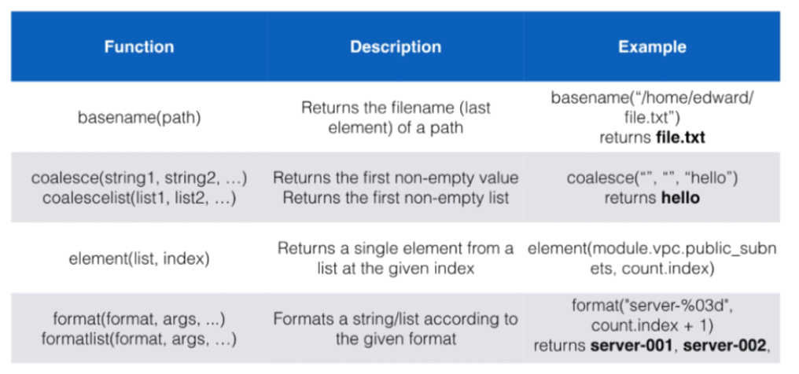
Terraform Functions
Terraform

Slide 37
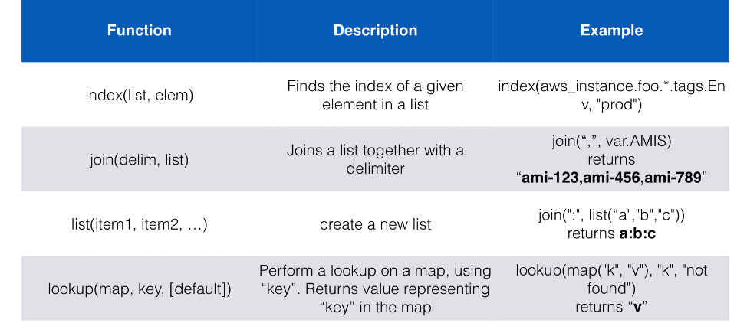
Terraform Functions
Terraform

Slide 38
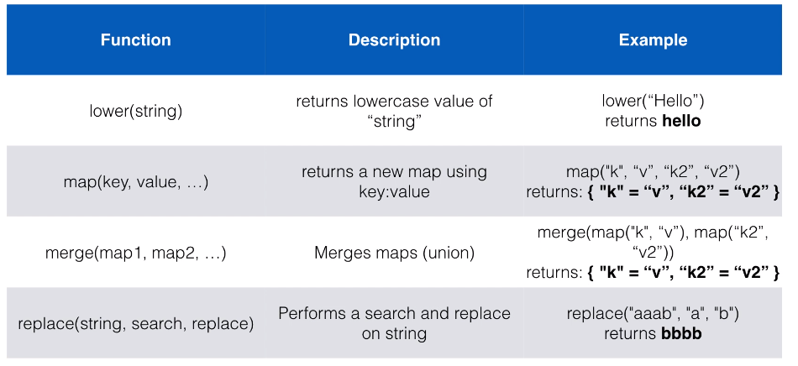
Terraform Functions
Terraform

Slide 39
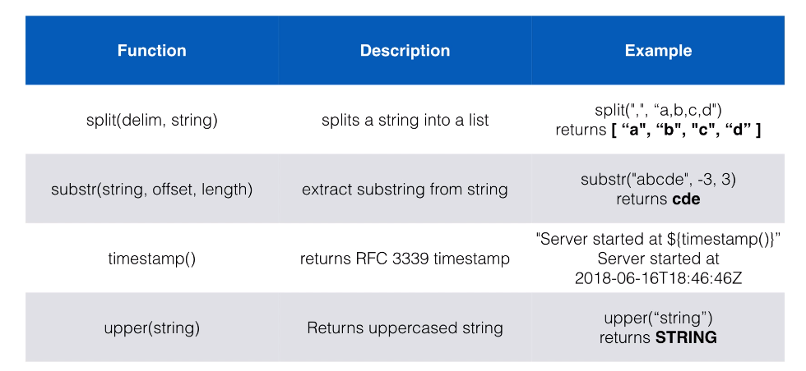
Terraform Functions
Terraform

Slide 40
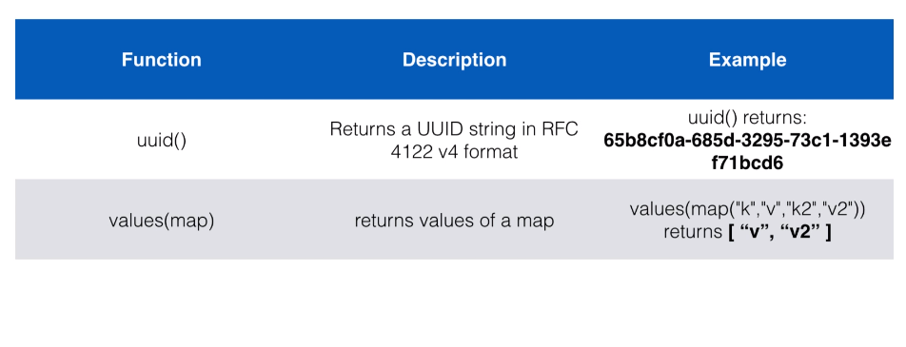
Terraform Functions
Terraform

Slide 41
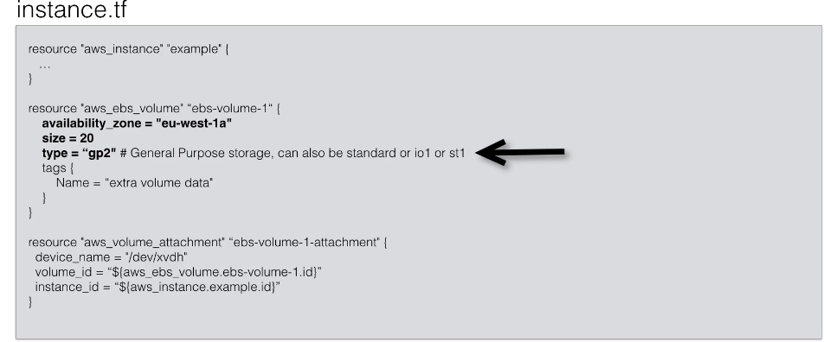
Terraform With AWS

Slide 42
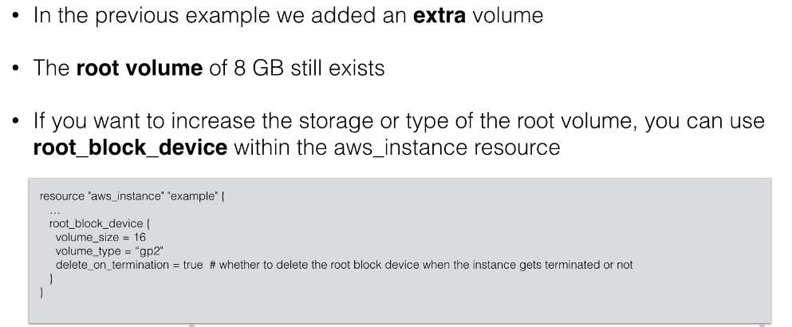
Terraform With AWS

Slide 43
Terraform With Loops
Starting terraform 0.12 we can use for and for_each loop
The for-loop feature scan help you to loop over variables , teranform it and output it in a different format
For example:
[for s in [“this is a”, “list”] : upper(s)]
You can loop over list [1,2,3,4] or map like {“key” = “value”}
We can transform them by doing calculation or a string operation
Then you can output them as list or map

Slide 44
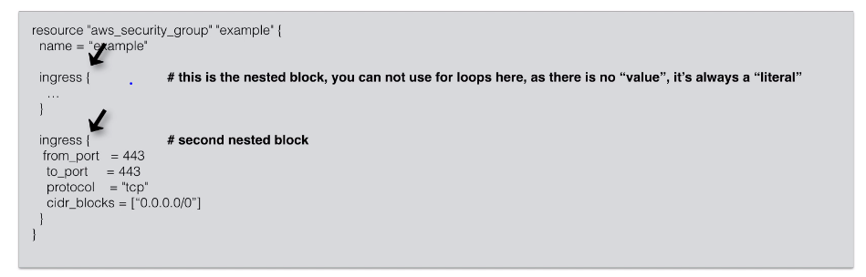
Terraform With Loops
For loops are typically used when assigning a value to an argument
For example:
security_groups = [“sg-12345”, sg-567”]
This could be replaced by for loop if you need to transform the input data
Tags = { Name = “resource name” }
This map can be “hardcoded” or which can be output of a for loop
For_each loops are not used when assigning a value to an argument but rather to repeat nested blocks

Slide 45
Terraform With AWS

Slide 46
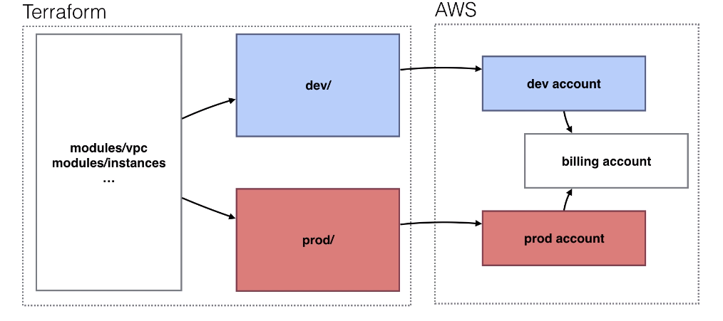
Project Structure
Terraform

Slide 47
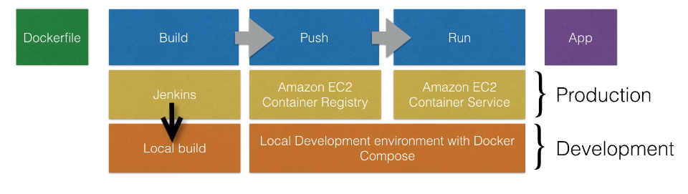
Docker on AWS
Terraform

Slide 48
ECS
Running dockerized app on ECS cluster
Need to Dockerize app
Now that we have dockerized app and uploaded on ECR we can start ECS cluster
ECS – EC2 Container services will manage your docker containers
You just need to start an autoscaling group with custom AMI
The custom AMI contains the ECS agent
Once ECS cluster is online, tasks and services can be started on the cluster
ECS cluster is group of EC2 instances with ecs agent on. ECS service will manage them.
Ref : https://docs.aws.amazon.com/AmazonECS/latest/developerguide/ecs-optimized_AMI.html

Slide 49
ECS Task Defination
Before Docker app can be launched a tasks definition needs to be provided
Task definition describes what docker container to be run on cluster:
Specifies docker image (the docker image in ECR)
Max CPU usage, Max memory usage
Whether containers to be linked (e.g. link app container with db container)
Environment Variables (e.g. credentials)
And any other container specific definitions

Slide 50
ECS Service Definition
A service definition going to run specific amount of containers based on the task definition
A service is always running if the container stops, it will be restarted
A service can be scaled you can run 1 instance of container or multiple
You can put an ELB in front of service
You typically run multiple containers spread over Availability zones
If one containers fails, your load balancer stops sending traffic to it
Running multiple instances with ELB/ALB allows you have HA

Slide 51
ECS Task Definition
A service definition going to run specific amount of containers based on the task definition
A service is always running if the container stops, it will be restarted
A service can be scaled you can run 1 instance of container or multiple
You can put an ELB in front of service
You typically run multiple containers spread over Availability zones
If one containers fails, your load balancer stops sending traffic to it
Running multiple instances with ELB/ALB allows you have HA

Slide 52
Terraform Modules
Terraform modules are powerful way to reuse code.
You can either use external module or write module yourself
External module can help you setting up infra without much effort
When modules are managed by community you will get updates and fixes
Writing modules gives you full flexibility
It you maintain module in git repo you can even reuse the module over multiple projects

Slide 53
AWS EKS
Amazon Elastic Container Service for Kubernetes is a highly available, scalable and secure kubernetes service
It is general available in Jun 2018
Kubernetes is an alternative to ECS
ECS is AWS specific, where as kubernetes can run on any public cloud providers or on-prem as well
Both are container orchestration solution

Slide 54
AWS EKS
AWS EKS provides managed Kubernetes master nodes
There is no master node to manage
The master node are multi A-Z to provide redundancy
The master node will scale automatically when necessary
In case of own kubernetes cluster we need to manage master node if the worker nodes increased
Secure By Default: EKS integrates with IAM

Slide 55
Terraform Provisioners
Till now we are working on construction and destruction of infrastructure scenario
Suppose we created Ec2 Instance and now we want to install software on this?
What if we want E2E solution using Terraform (provision + Configure)
To Solves such problems Provisioners helps us

Slide 56
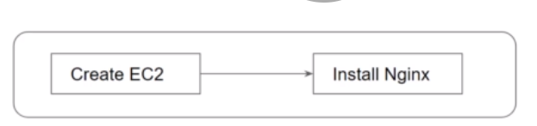
Terraform Provisioners
Provisioners are used to execute scripts on local or remote machine as part of resource creation or destruction

Slide 57
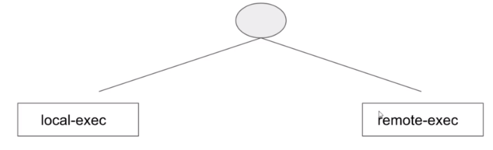
Provisioners Type
We can use Terraform Provisioner capability at both time of resource creation and resource destruction
There are 2 types of provisioners

Slide 58
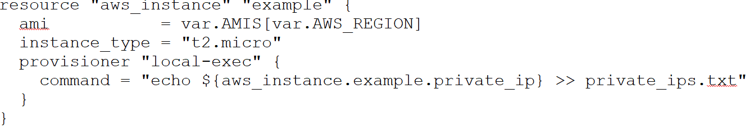
Local Exec Provisioner
Local exec provisioner allow us to invoke local executable after resource is created
It can be used to execute ansible as well

Slide 59
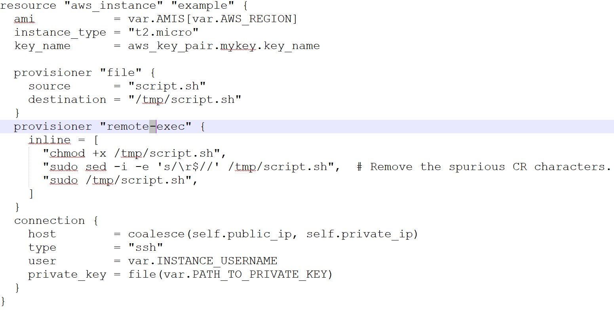
Remote Exec Provisioner
Remote exec provisioner allow to invoke scripts directly on the remote server

Slide 60
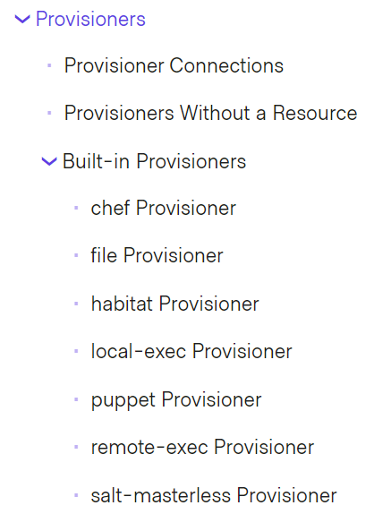
Others Provisioner
https://www.terraform.io/docs/provisioners/

Slide 61
Modules
DRY Principle – Don’t repeat yourself is a principle if s/w development aimed at reducing repetition of s/w pattern
Like variables we can define the single source and refer it in rest of the places in project
Similarly we can avoid repetition of resource creation
Terraform introduces Modules for the same.

Slide 62
Modules
Modules are nothing but a centralized source where code/resources are defined. These files reused in various projects.
You can use modules to make your terraform more organized
Use third party modules
Modules from github
Reuse parts of your code
E.g. to setup network in AWS – the Virtual Private Network (VPC)

Slide 63
Modules
Use a module from git
module “module-example” {
source = “github.com/maheshkharwadkar/terraform-module-example”
}
Use a module from a local folder
module “module-example” {
source= “./module-example”
}
Pass Argument to module
module “module-example” {
source = “./module-example”
region = “us-east-1”
ip-range = “10.0.0.0/8”
cluster-size = 3
}

Slide 64
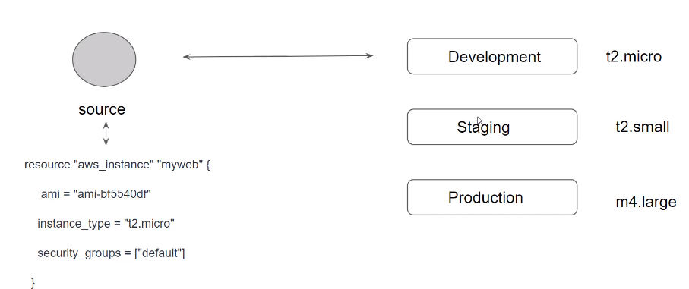
Terraform Variables & Modules
One if the challenge in Infrastructure management is to build environment like staging/production with similar setup but keeping environment variable different

Slide 65
Terraform Registry
It is repository of modules written by Terraform Community
https://registry.terraform.io/
Within Terraform Registry you can find verified modules that are maintained by various third party vendors
Verified modules are reviewed by Hashi corp and actively maintained by contributor

Slide 66
Using Registry Module in Terraform
To Use Terraform Registry module within the code, we can make use of source argument that contains module path
module “ec2-instance” {
source = “terraform-aws-modules/ec2-instance/aws”,
version = “2.13.0”
#Insert the required variable here
}
Example - https://registry.terraform.io/modules/terraform-aws-modules/ec2-instance/aws/2.15.0

Slide 67
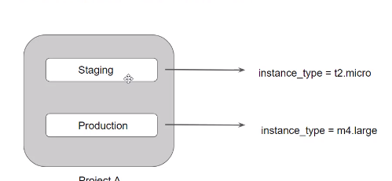
Terraform Workspace
Terraform allows us to have multiple workspace with each of the workspace we can have different set of environment variables associated

Slide 68
Remote State
Terraform keeps remote state of the infrastructure
It is stored in file called terraform.tfstate
There is also backup of previous state in terraform.tfstate.backup
When we execute terraform apply, a new terraform.tfstate and backup is written
This is how terraform keeps track of remote state
If remote state changes and you hit terraform apply again terraform will make changes to meet the correct remote state again
E.g. if you terminate an instance that managed by terraform after terraform apply it will be started again

Slide 69
Remote State Management
Team Collaboration (Managing tfstate in scm)
Local changes are not always good (managing tfstate file)
Commit code to Github
To collaborate with team member
There are security challenges while push the code to the scm (github/bitbucket etc)
Terrform.tfstate can contain sensitive information hence it is not good practice to store state in scm tools

Slide 70
Remote State
You can keep the terraform.tfstate in version control
E.g. git
It gives you a history of your terraform.tfstate file (which is just a big json file)
It allows you to collaborate with other team members
Unfortunately you can get conflicts when 2 people work at the same time
Local state works well in the beginning, but when your project becomes bigger, you might want to store your state remote

Slide 71
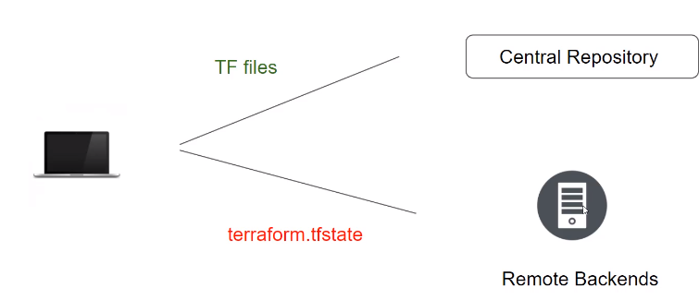
Remote State – Remote Backend
The terraform state can be saved remote, using the backend functionality in terraform
The default is a local backend (the local terraform state file)
Other backend includes
s3(with locking mechanism using
DynamoDB)
Consul(with locking)
terraform enterprise (the commercial
solution)
2 Types of Remote Backend
Standard Backend Type - State storage + locking
Enhanced Backend Type - All features of Standard + Remote management

Slide 72
Remote State
Using backend functionality has definitely beinifits:
Working in a team: it allows for collaboration, the remote state will always be available for the whole team
The state file is store locally. Possible sensitive information is now only stored in the remote state
Some backends will enable remote operations. The terraform apply will then run completely remote. These are called enhanced backend.
https://www.terraform.io/docs/backends/types/index.html

Slide 73
Remote State
There are 2 steps to configure a remote state:
Add the backend code to a .tf file
Run the initialization process
To configure a consul remote state, you can add a file backend.tf with the following contents:
terraform {
backend “consul” {
address=“default.consul.io” #hostname of consul cluster
path = “terraform/myproject”
}
}

Slide 74
Remote State
You an also store state in S3
terraform {
backend “s3” {
bucket = “mybucket”
key = “terraform/myproject” #directory in bucket
region = “us-east-2”
}
}
When using S3 remote state. It’s best to configure the AWS credentials:
aws configure
Next step, terraform init:

Slide 75
Remote State
Using a remote store for the terraform state will ensure that you always have the latest version of the state
It avoids to commit and push the terraform.tfstate to version control
Terraform remote state don’t always support locking
Documentation always mentions if locking is available for remote store.
S3 and consul both support remote store

Slide 76
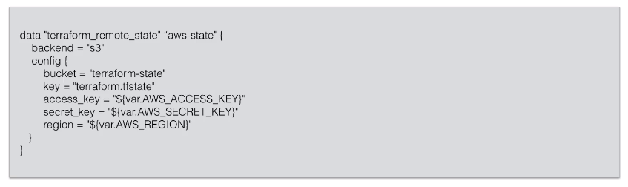
Remote State
You can also specify a (read-only) remote store ditrectly in the .tf file
This is only useful as read only feed from your remote file
Actually it’s a data source
Useful to generate outputs

Slide 77
Demo: Remote State
Create s3 bucket
aws configure
As in case of backed we can not use access key as variables
dnf install python3-pip
pip3 install awscli --upgrade –user
vi ~/.bash_profile
export PATH=~/.local/bin:$PATH
source ~/.bash_profile
aws --version
aws configure

Slide 78
State Locking
Whenever we ae performing write operation, terraform would lock the state file
If users are doing terraform apply operations in parallel it would corrupt the state.
Example
PersonA – terminating RDS resource associated with rds.tfstate file
PersonB- has now tried resizing the same RDS resource at same time
Demo of State Locking with Dynamodb

Slide 79
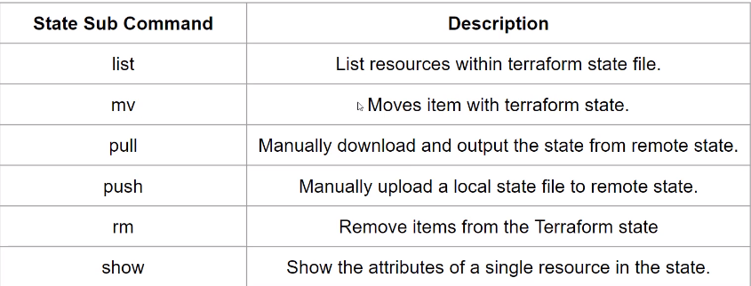
Terraform State Management
As our Terraform usage more advanced, there are some cases where you may need to modify the Terraform state
We should never modify the terraform state file instead make use of Terraform state command
terrform state mv aws_instance.ec2 aws_instance.myec2

Slide 80
Terraform Import
It might happen that there is resource which is already created manually
In such case, any change you want to make to that resource, must be done manually
Terraform import feature helps us to convert manually created resource into terraform format
It will not write resource file(*.tf) it will just create tfstate file
We have to write resource file manually
Demo
terraform import aws_instance.ec2 <instance_id>

Slide 81
Handling Sensitive Data

Slide 82
Handling Sensitive Data
Install aws cli
Aws configure
No need to use access_key_id & secret_key_id
Resources in multiple region
Managing Multiple Accounts

Slide 83
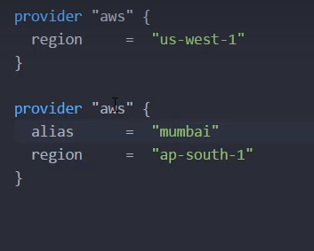
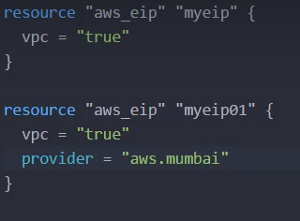
Handling Sensitive Data
Provider Configuration (Resources in Multiple Region)
Till now we are hardcoding aws-region parameter within provider.tf

Slide 84
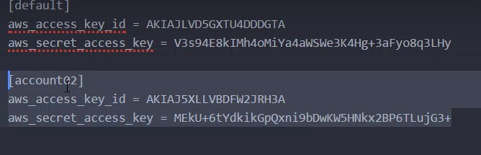
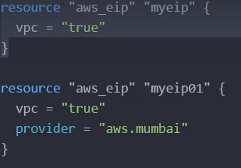
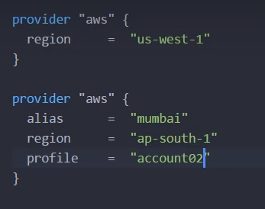
Handling Sensitive Data
Handling Multiple Accounts

Slide 85
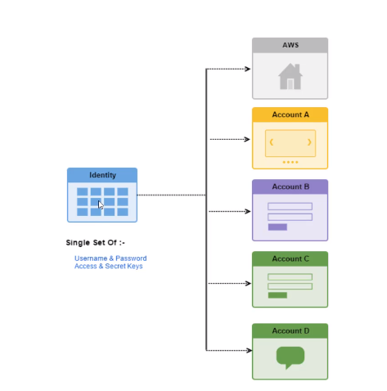

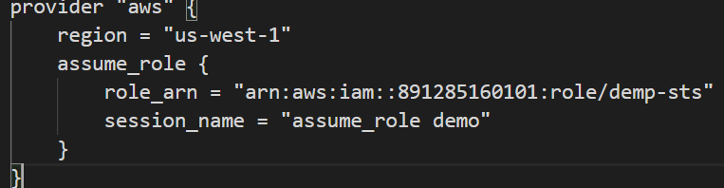
Handling Sensitive Data
Handling Multiple Accounts via Assume Role

Slide 86
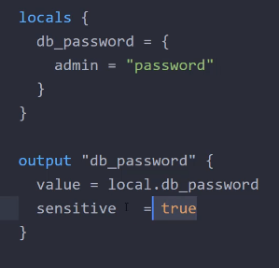
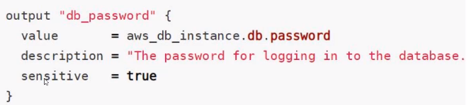
Handling Sensitive Data
Sensitive Parameter
If we are working on db password or any sensitive info terraform provides a way to set the attribute as “sensitive” to true
This will prevent the showing value on cLI bit in state file it can show the value.

Slide 87
Terraform Cloud

Slide 88
Terraform With Packer
Packer is command line tool used to built AWS AMIs based on templates
Instead of installing software after booting up an instance, you can create an AMI with all the necessary software on
This can speed up boot times of instances
It’s a common approach when you run horizontally scaled app layer or a cluster or something

Slide 89
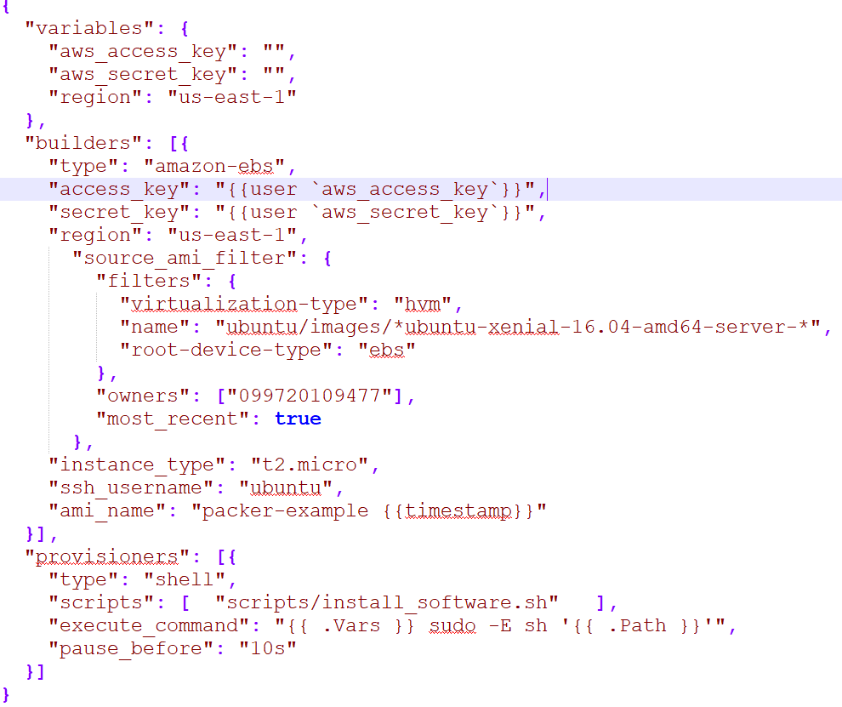
Packer Template

Slide 90
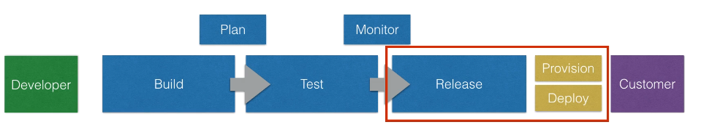
Devops With Terraform
Release (Provision & Deploy) can be done using
Git + Jenkins + Terraform + Packer
Git + Jenkins + Terraform + Docker

Slide 91
Packer With Terraform
Github
Jenkins
AWS
git clone
app repo
AMI Containing node + app
App Repository
Terraform Files
packer build
App instance launched from AMI created by AMI
git clone
terraform repo
S3 Bucket with terraform files
terraform apply
aws_instance:app-demo

Slide 92
Terraform With Azure

Slide 93
Azure Stream Analytics
Stream Analytics Job
Real-time data and filter messages (temperature > 25)
Write output to blob storage
Input generated by Raspberry Pi Simulator

